Slide 1
Student Demographics for undergraduates in HE economics in England
Data from HEFCE http://www.hefce.ac.uk/analysis/supplydemand/ug/

Slide 2
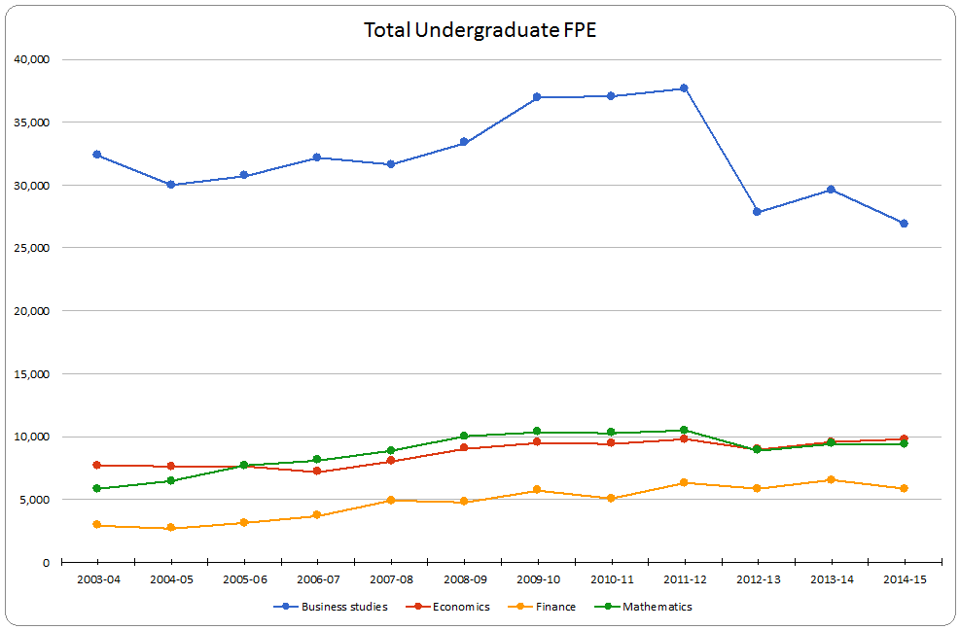

Slide 3
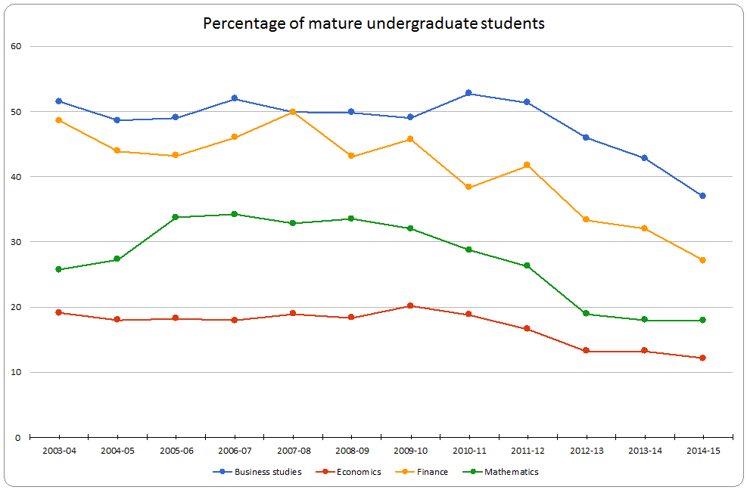

Slide 4
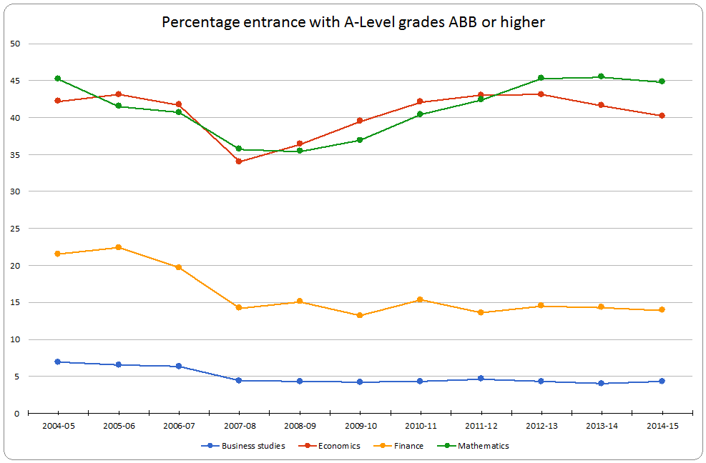

Slide 5
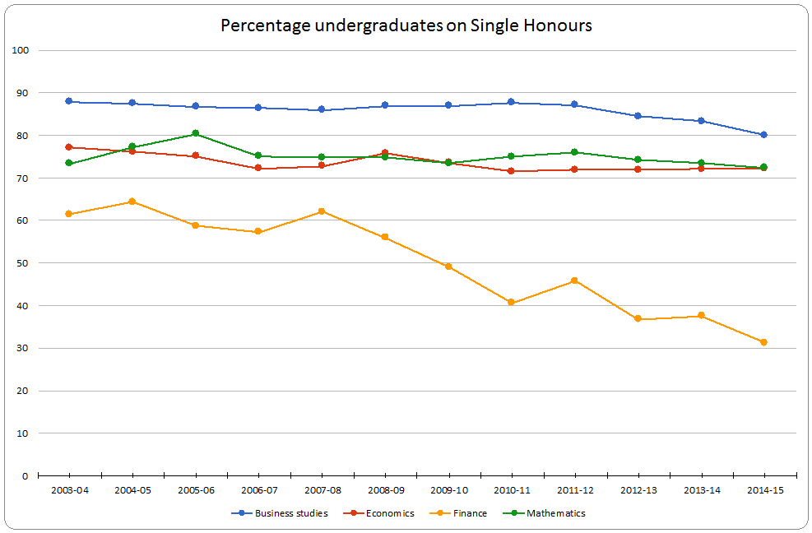

Slide 6
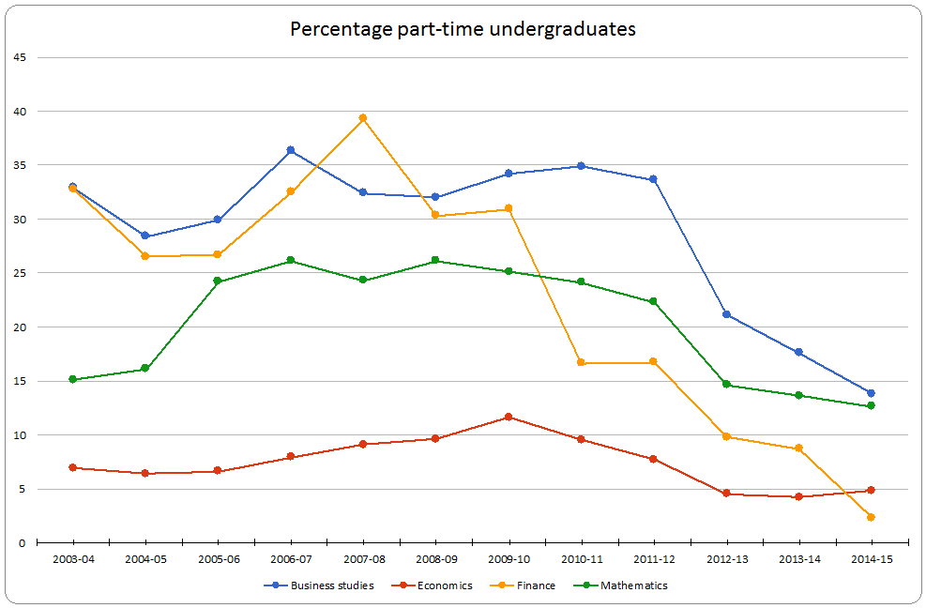

Slide 7
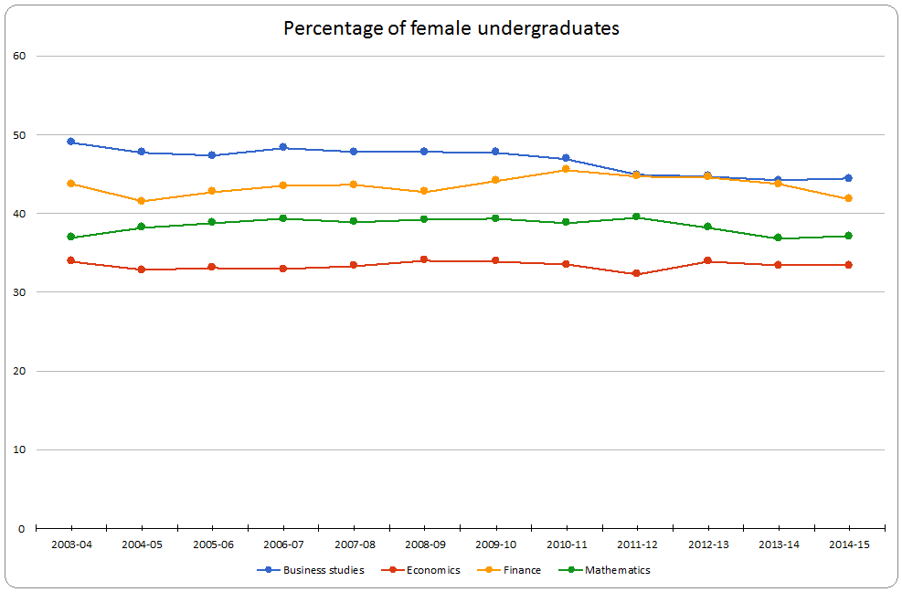

Slide 8
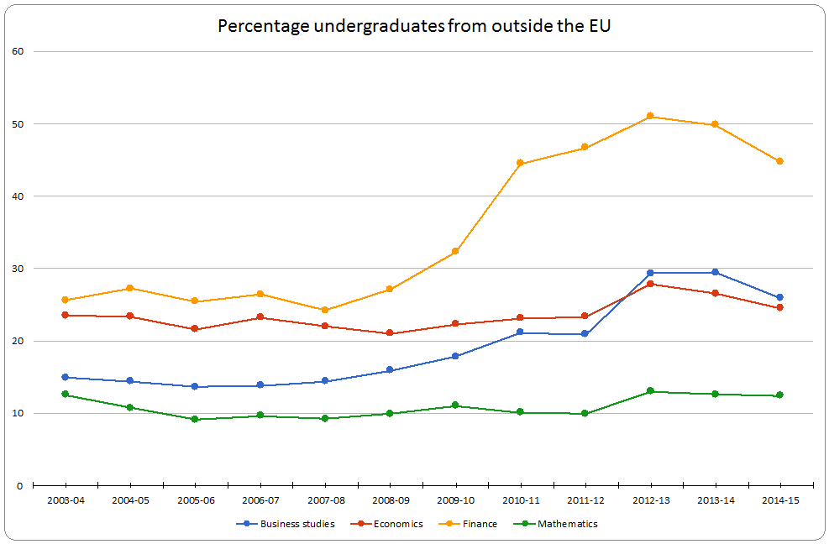

Slide 9
