Slide 1
The Blackboard Wiki for Learning
Conclusions from the Classroom
Dr Mike Reynolds, Teaching Fellow in Economics
M.M.Reynolds@leeds.ac.uk

Slide 2
The Problem
History of Economic Thought module
The Challenge
Limited background
Inspiration
DEE 2013

Slide 3
Aims
Specific
Improve historical knowledge
Show how key economic ideas developed over time
General
Give access to appropriate content
Introduce ‘research’
Further develop ‘self-learning’
Teamwork

Slide 4
Wiki $≠$ Wikipedia
A Wiki is… “a web application which allows people to add, modify, or delete content in collaboration with others” (Wikipedia, 2014)
Editable pages on the internet
Wikipedia is just one example
An encyclopedia that people can access and edit

Slide 5
Collaboration
Key things
Create
Share
Modify
Facilitates Group Work
Important for Employability
(Caruso & Woolley, 2008; Mannix & Neale, 2005)

Slide 6
Team Learning
Not just Employability
Evidence that team based learning helps students
e.g. Sweet and Michaelsen (2011)
Wiki advantages
Remote collaboration
Instructor has overview
Monitor who is engaging

Slide 7
Graduate Capabilities
Employment focus
Team work
IT Skills
Wikis increasingly used
Module Assessment
Group Presentation
Group Report
Embeds employment skills
Key part of ‘graduateness’

Slide 8
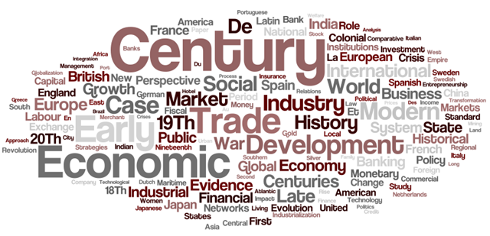
The Module
Development of Economic Ideas
1st year Economics
40 Students
History content
Evolution of economics
Ancient Greece to modern day
Historical context
Four key topics
Lots of information
General Knowledge
Links to other modules and topics

Slide 9
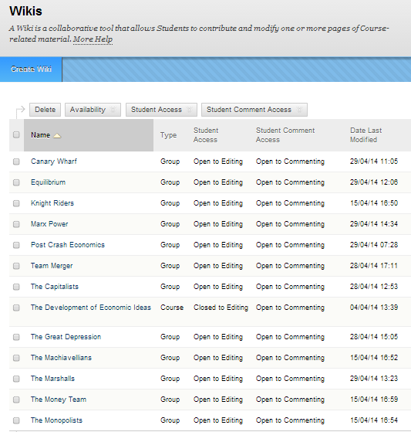
Module Setup
Two main Wikis
Course Wiki
On Blackboard from start
All course and lecture material
Team Wiki
Every team
On Blackboard
Separate to Course Wiki
Each student can create and edit pages

Slide 10
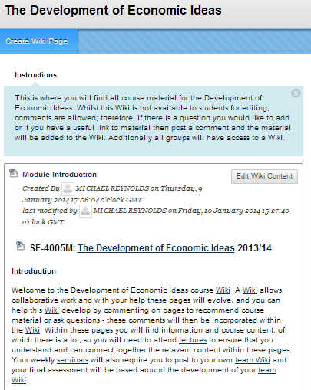
Lecture Material
No lecture handouts
Lectures are a guide through the Wiki
Internal Links
Other Blackboard Wiki pages
External Links
Encyclopaedia Britannica
To the library catalogue
Can upload or embed other files
No editing rights

Slide 11
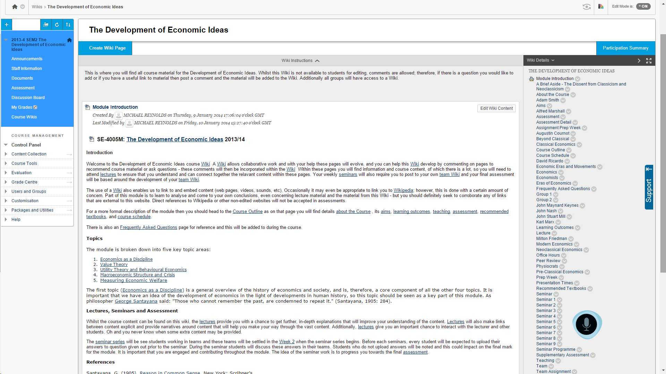

Slide 12
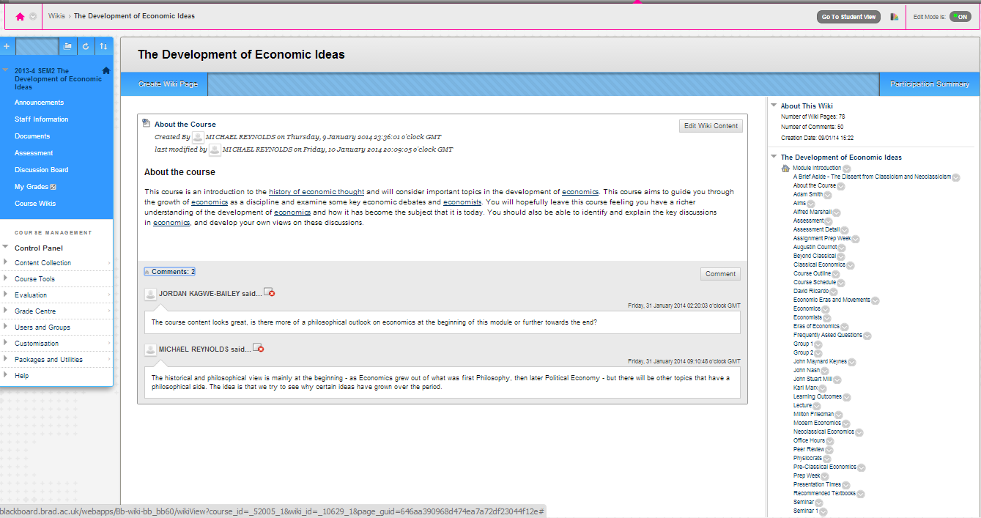
The Blackboard Wiki
Advantages
One log in

Slide 15
A‘Sandbox’
The ‘Wiki’ is a research sandbox
Limited scope
Easier to navigate that the WWW
Links to outside

Slide 16
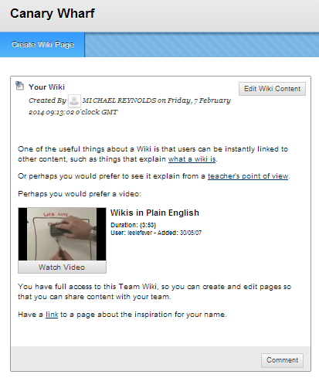
Team Wiki
Every team has a ‘wiki’
Separate to the ‘Course Wiki’
Total editing rights
Create, modify and delete pages
Version control
Instructors and students
Can always get back deleted content
Monitor who is creating content
See the number of words each student writes

Slide 17
Seminar Work
Tasks placed on Wiki
Embed the Wiki
Seminar 1 Task:
“Every student should visit this course wiki and make a 'useful' comment on one of the pages, whether it is a relevant link, a correction to the page, or a relevant question”
I then made changes to the relevant pages
All tasks involve a Wiki element
Often writing on the Team Wiki
Course Wiki scavenger hunt
Strict deadline
Final report
Completed on Wiki
Tasks lead up to this

Slide 18
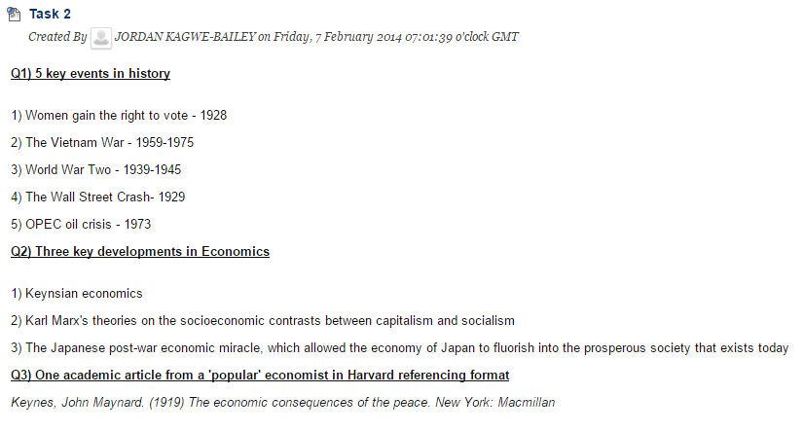
A Task
Task 2
Key historical events
Key economic events
Uploaded prior to seminar
Photo of Whiteboard then uploaded

Slide 19
Blackboard Wiki
Advantages
One log in
All students registered
Familiar and safe environment
Disadvantages
‘Clunky’ format
Lacks notifications
Can’t see updates or new comments
Rollover Issues

Slide 20
Conclusions (1)
Positive Experience
Added layer of interaction
Ability to mix media
Positive reaction from students
Module Evaluation (on strengths):
“The thorough teaching and how the seminars got the students involved.”
“The lectures and seminars were interesting, enjoyable, fun and quite entertaining.”
“The wiki and unique presentation of the material in lectures. The group presentation also helped”
Engagement
Good seminar attendance
Impressive grades

Slide 21
Conclusions (2)
Work hard to embed
Carefully designed seminars
Monitoring of Team Wikis
Occasionally challenging to implement
Improvements
Better integration between seminar tasks
Assessed ‘Team Wiki’
Open up the ‘Module Wiki’
A page of ‘live’ links
The future
Try to integrate into other appropriate modules
What to know more?
Good guide on University of Southampton website: www.southampton.ac.uk/isolutions/computing/elearn/wikis

Slide 22
References
Caruso, H.M., & Wooley, A.W. (2008). Harnessing the power of emergent interdependence to promote diverse team collaboration. Diversity and Groups. 11, 245-266.
Encyclopaedia Britannica (2014), Encyclopaedia Britannica Website [online], [Accessed 4th July 2014] Available from: http://www.britannica.com/EBchecked/topic/1192819/wiki
Mannix, E., & Neale, M.A. (2005). What differences make a difference? The promise and reality of diverse teams in organizations. Psychological Science in the Public Interest, 6(2), 31-55.
Sweet, M. and Michaelsen, L.K. (2011). Team-Based Learning in the Social Sciences and Humanities: Group Work That Works to Generate Critical Thinking and Engagement, 1st Edition. Stylus Publishing

Slide 23
Questions
Comments
Any experiences to share

Slide 24
Just One More Thing…
Presentation template was found using Pinterest
A website that allows the sharing of ideas and creations

