Slide 1
Can multiple small feedback activities improve students’ opinion of feedback and their performance? Evidence from compulsory final year
Business School
Economics division
Antonio Rodriguez Gil
Leeds University Business School
Developments in Economic Education (DEE) 2017. UCL, September 2017
Notes:
Good morning everyone and thanks for attending this session. My name is ARG, and I’m a teaching fellow at Leeds University. What I want to do in this presentation is to share my experience of introducing up-to three small pieces of formative assessment in my final year macroeconomics module. In particular, whether it has improved students performance of feedback and whether their performance has been enhanced.

Slide 2
Outline
Motivation
Intervention
Existing literature
How to evaluate it? (methodology & data)
Results
Students opinion on feedback
Students performance
Summary

Slide 3
Motivation
Students, were (and still are) dissatisfied with feedback that they received… Including in my module
What to do?

Slide 4
Intervention
Module: Advanced Macroeconomics: Year 3 compulsory Module
2013/14 | 2014/15 | 2015/16 | 2016/17
Current affairs essay x2
Two essays Max 500words
Discuss FT.com articles using theory/empirics
Deadline: Any time before end-of-term
Feedback within 7days
(+ve, -ve, Forward)
Seminar Questions x1
Seminar 2 or 4
Seminar 4
Max 600words
Deadline: Before seminar
Feedback within 7 days (+ve, -ve, Forward)
Notes:
So why essays, why several, why small…

Slide 5
Existing literature
Grounded on “Seven principles of good feedback” by Nicol and Macfarlane‐Dick (2006) that encompasses Sadler (1989), Black and William (1998). (For econ: Miller et al., 2002 and Guest and Taylor, 2013).
According to these authors, good feedback must, …
Clarify meaning of good performance (-ve, +ve. Essay as in exam)
Transmit high-quality information
Timely: (within 7 days-tested)
Guide forward (Forward: Where to go next, square-one? how to use in exam?)
Towards higher learning (how to apply? analyse? evaluate?)
Encourage interactive dialogue (essays, multiples activities)
Provide opportunities to close the gap (several pieces)
Facilitate self-regulation (open deadline)
Foster motivation and self-esteem (opportunity to improve)
Improves teaching (open deadline=scatters submission, S2&4)

Slide 6
How to evaluate intervention?
Students satisfaction (2013.14-2016-17):
Module evaluation (School’s survey)
Ad-hoc Feedback survey
Student performance (only 2016-17) (applying for funding to go back to 2013.14):
Intervention amounts to a quasi-experiment: Students opt-into the activity(-ies), cannot randomly select who participates and who does not.
“Self-selection problem”: Only “good students” might be participating
Use Year2 macroeconomics grades to separate:
40-49 | No, participation
 | Yes, participation
50-59 | No, participation
 | Yes, participation
60-69 | No, participation
 | Yes, participation
70-79 | No, participation
 | Yes, participation
+80 | No, participation
 | Yes, participation

Slide 7
DATA
Module: Advanced Macroeconomics: Year 3 compulsory Module
About 1/3 of students
Current affairs are generally more popular, but both activities well participated

Slide 8
Results: Improvement in students opinion?
Source: Module evaluation (School’s survey)

Slide 9
Results: What they (dis-)like?
More detail…
Source: Ad-hoc Feedback survey (Antonio’s survey)

Slide 10
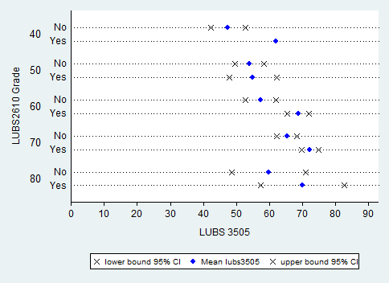
Results: Students performance (2016.17)?
n=12
n=1
No or little impact, obs?
n=38
n=10
Year 2 Macro
n=45
n=11
+ve impact
n=25
n=12
n=3
n=4
+ve
Year 3 Macro
Caveat: More data needed (2013.14-2015.16, 400obs approx.)
Source: Matching performance Y2 & Y3 against participation in feedback

Slide 11
Summary
Multiple small feedback activities improve students satisfaction substantially (Nearly double)!
Students’ performance also improves, but only for 2:1 and above students!
Next steps involve…
More data needed (2013.14-2015.16)
If initial results are confirmed: How to make sure all students benefit from feedback?

Slide 12
 | MCQ | 1-minute paper | Mock Exam | Current Affairs essay | Seminar Question essay
Clarifies meaning good performance
High-quality information:
Timely
Forward | x | x
Direct to higher learning | x | x
Encourages interactive dialogue | x | x
Opportunity to close gap |  |  | x
Facilitates self-regulation & assessment |  |  | x
Fosters motivation and self-esteem |  |  | x
Improves teaching |  |  | x

