Slide 1
The Forgotten Research Academics: The Academic Career Structures of Research Academics within Business Schools in Teaching Focused Institutions in the UK
Denise Hawkes and Laura Muncey
Anglia Ruskin University

Slide 2
The key research questions are:
(1) How do research academics navigate the Business School environment in terms of their research?

Slide 3
(2) How do research active academics maintain their research within teaching focused local, civic universities?

Slide 4
(3) What impact do the Business School priorities, such as REF UoA 17, Triple Crown, ABS journal ranking and Small Business Charter, have on individual research academics research interests?

Slide 5
(4) How do research academic navigate the university promotion processes within a Business School context?

Slide 6
(5) Are female and BAME research academics equally successfully in these institutions as white, male economists?

Slide 7
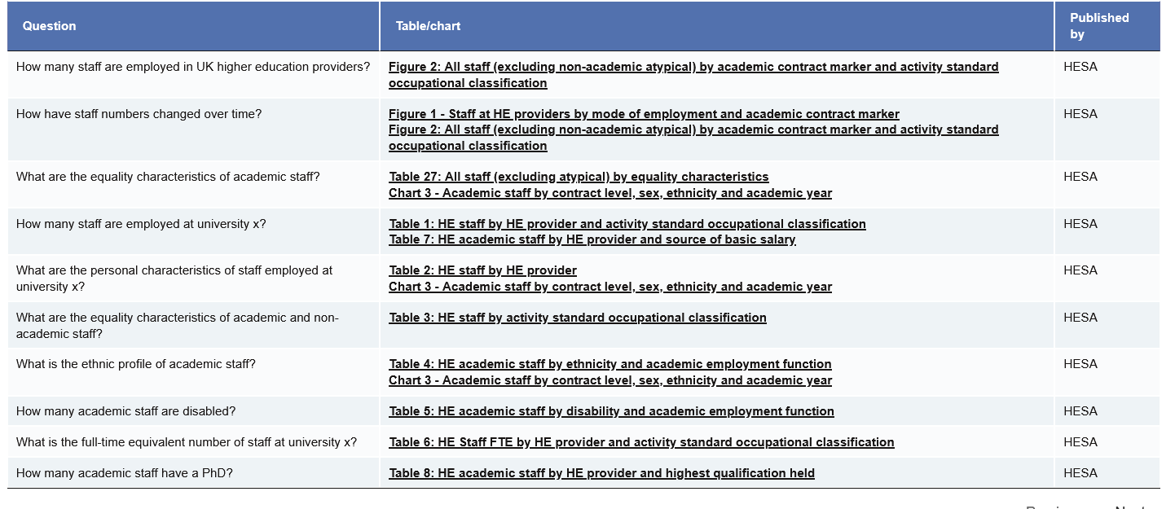
What is out there?
HES provide data on student and staff
Statistical analysis – mean, SD

Slide 8
What is a systematic review?
Focused research question
Criteria determined on the outset
Multiple reviewers
Clear processing of selecting papers
Comprehensive search and explicit search methodology
(LibrarySkills@UCL)

Slide 9
Purpose
Forcing accounts of other people's living experience
There is still a questionable gap between men and women in this discipline within the HE sector.
Looking into systematic literature to see what already exists in the niche research area. Can women and men achieve the same position within the same time frame? Is having a career break the end to achieving such a position within the same time frame?

Slide 10
Answerable Question: PICO
Identify the main concepts
P = a description of populations
I = An identification intervention
C = An explicit comparison
O = relevant outcomes
Often it is not necessary or desirable to include all PICO components in search, example population and intervention may be sufficient (LibrarySkills@UCL)

Slide 11
Literature Review?
Underlying assumption that research focused academics are based within Research Intensive Universities
Within UK Higher Education, increasing numbers of research focused academics are found within Teaching-Focused Universities

Slide 12
In practice
Identify key journals – 20
  Economics of Education Review; Journal of Higher Education
Key words (with alternatives)
  woman or women or female or females or lady or womenhood or womenlike
  economics or finance or money matters or financial side
  HE or higher education or Academia or university or academe
Time period
  2010-2023 – more specific from 2012 due to change in tuition fees
Total of 803 – 184 duplicates

Slide 13
Coding
Move to specific group of resources that can be reviewed
Subject Area
  Business management
  Economics
  Social science (including education)
  Other – Exclude
Country
  UK
  USA
  Australia
  Other

Slide 14
Coding
Gender
  Women
  BAME
  Other
Career stage
  Masters
  PhD
  ECR
  Profs
  All
Institution Type
  Post 92
  Russell group
  Other

Slide 15


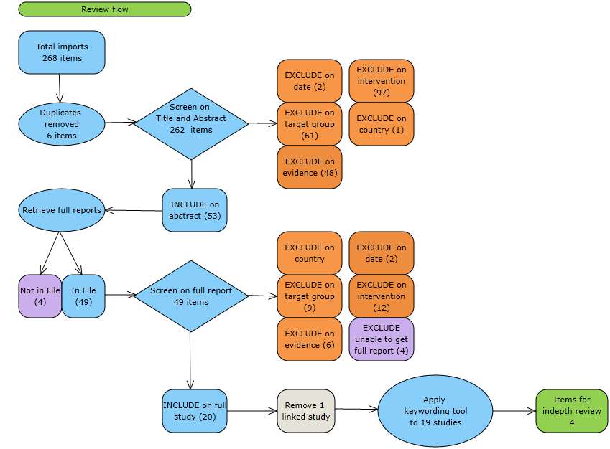
Diagram Report – Example

Slide 16
Indication
Inductive results but have not completed the thematic analysis
From the coding this provides an indication of what the likely outcome would be for early findings: show that men seem to excel at a fast rate than women,
but a more in-depth analysis needs to be completed

Slide 17
ChatGPT
Can it do it for you?
  Provide straight forward answers
  Does not read the abstracts in full
  Does not gain the insight from individual perspective
“The future of UKHE and the diversity of leadership and scholarship is currently under threat. I argue that the values of diversity, accessibility and inclusivity, especially that of class diversity that universities are quick to espouse be placed at the centre of higher education policy and practice, especially so at the postgraduate level” (Rowell, 2022).

