Slide 1
Using Excel conditional formulae to provide individual exam feedback in large groups.
Dr. Antonio Rodriguez-Gil* Dr. Ali Raza

Slide 2
Background
Module: Advanced Macroeconomics (compulsory, final year); >200 students.
Delivery: On-campus lectures/seminars; video solutions to selected questions.
Assessment: Final examination (100% weight).
      Section A: 3 short mathematical questions.
      Section B: 2 involved mathematical/essay type questions.
Feedback:
      Informal: Lecture polling; practice questions; seminars; office-hours.
      Formal: General cohort feedback → Excel spreadsheet → Detailed individual feedback upon request.
  Intervention: 21/22 (240 students) and 22/23 (227 students) cohorts, respectively.

Slide 3
Excel Spreadsheet
 | A | B | C | D | E | F | G | H
1 |  | GRADE | GRADE | GRADE | GRADE | FEEDBACK | FEEDBACK | FEEDBACK
2 | SID | Q1 hypoth. | Q1 Diag | Q1 Pol | Q1 Total | Q1 hypoth. | Q1 Diag | Q1 Pol
3 |  |  |  |  |  | =IF(B3>6,"",IF(B3>4,"Lacks details in explaining the hysteresis hypothesis, see L7",IF(B3>0,"Very superficial or no explanation of hysteresis hypothesis, see L7",""))) | =IF(C3>7,"",IF(C3>5,"Lacks details explaining diagram and/or small diagram issues, see L7",IF(C3>0,"Incomplete or incorrect diagram, see L7",""))) | =IF(D3>6,"",IF(D1>4,"Lacks details in explaining policy implications, see L7",IF(D3>0,"Very superficial or no explanation of policy implications, see L7","")))
Figure 1: Excel Spreadsheet

Slide 4
Example Feedback
Figure 2: Feedback sheet

Slide 5
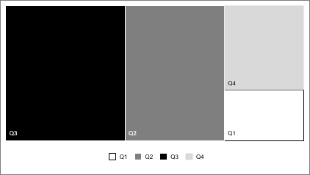
Requests: Percentages and Concentration
(a) Across years
(b) Across questions in 21/22
Figure 3: Students’ requests

Slide 6
Requests vis-à-vis Cohort Size and Ave. Grades
Figure 4: Cohort size and average grade

Slide 7

Summary
Excel spreadsheet based feedback using conditional formulae is time-effective.
It reduces the demand for detailed individual feedback.
For students, there are no costs but clear benefits in terms of understanding grades. For staff, the benefits of time-reduction exceed initial set-up costs.
Feedback is focused on grade reflection rather than grade justification.
Next step: offer to current cohort of 300+ students.
Read more at: https://doi.org/10.53593/n3593a

