Slide 1
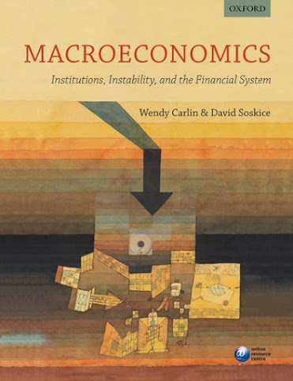
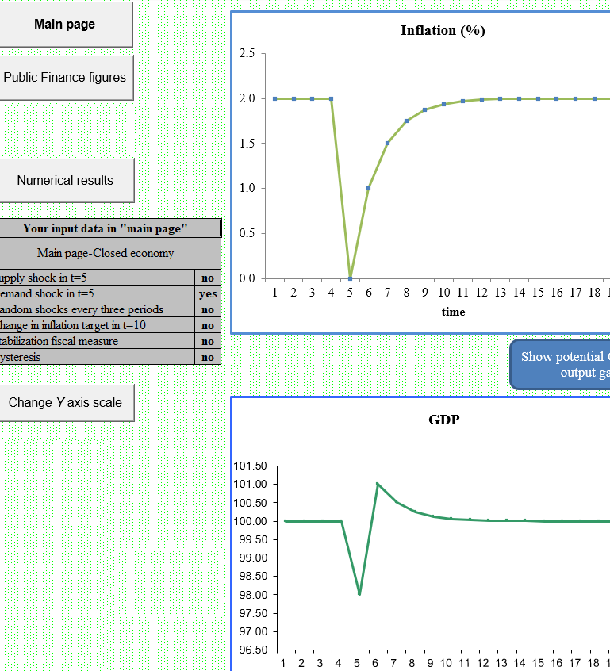
Using an Excel simulator in teaching macroeconomics
Wendy Carlin, UCL and CORE
June 2020

Slide 2
Why use a simulator in teaching macro?
Modern macro teaches a purposeful policy maker(s) with objectives and constraints facing an economy subject to temporary and permanent supply and demand shocks
Which courses?
In the first year – using CORE’s The Economy, for example
In the second year ‘Intermediate macro’ – using Carlin and Soskice or Blanchard, for example
In the third year ‘Topics in macroeconomic policy’ – using Carlin and Soskice and papers / blogs such as Bank Underground and www.voxeu.org

Slide 3
Why use a simulator in teaching macro?
The usual tools: equations, diagrams, data charts, historical and contemporary episodes of shocks and policy responses
What students find hard:
  understanding the model dynamics
  how do the different models relate to each other?
    e.g. inflation-targeting monetary policy-maker with
    debt dynamics with
    exchange rate dynamics
  relating the models to the world
The macro simulator is invaluable for addressing (1) – (3).

Slide 4
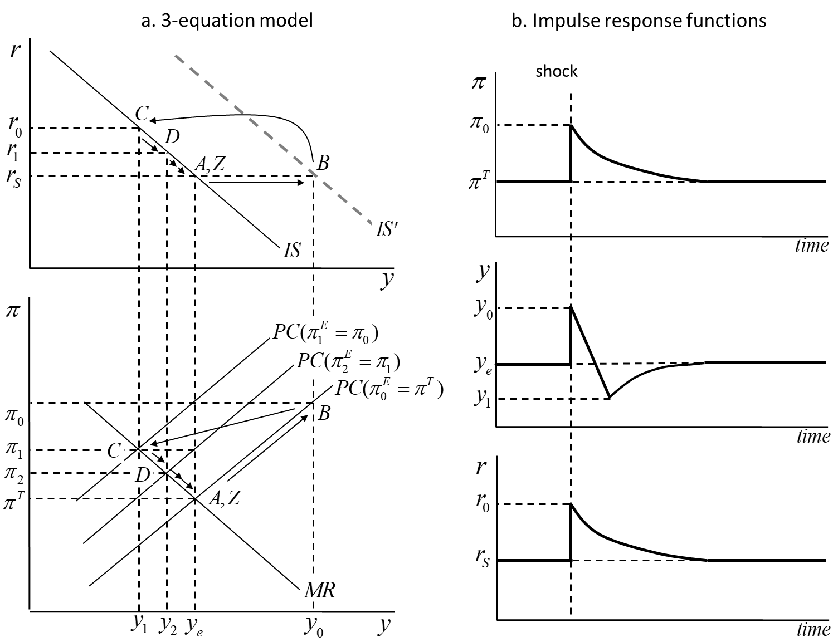
What students find hard:
(1) understanding model dynamics
Temporary positive AD shock

Slide 5
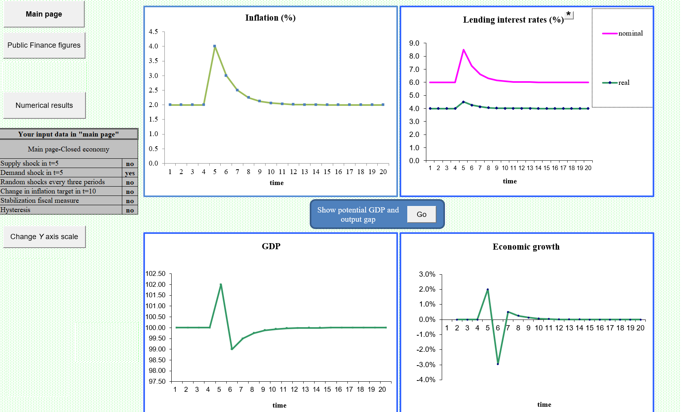

Slide 6
What students find hard:
(2) how do the different models relate to each other?
inflation-targeting monetary policy-maker with
debt dynamics with
exchange rate dynamics
Small open economy with inflation-targeting CB; a negative permanent AD shock
  what is the new medium-run equilibrium?
  how does the economy adjust … what does the CB do?
  what role in adjustment is played by the forward-looking forex market?
  what are the implications for public sector finances?
Students have studied each model separately – even good students would like to check their analytical treatment

Slide 7
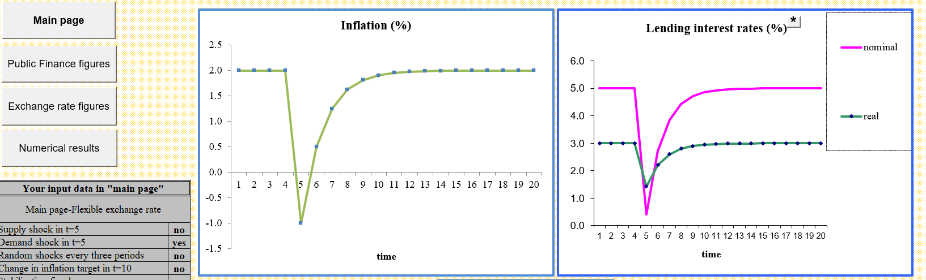
Small open economy with inflation-targeting CB; a negative permanent AD shock

Slide 8
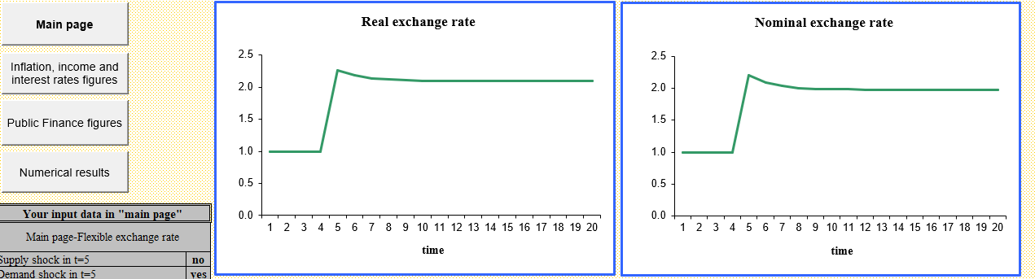
Small open economy with inflation-targeting CB; a negative permanent AD shock

Slide 9
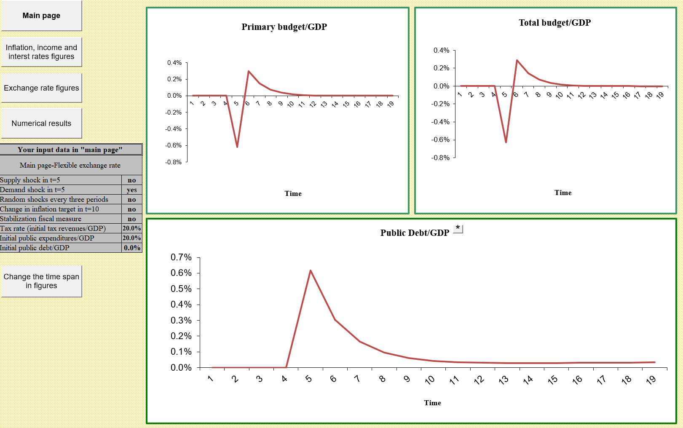
Small open economy with inflation-targeting CB; a negative permanent AD shock

Slide 10
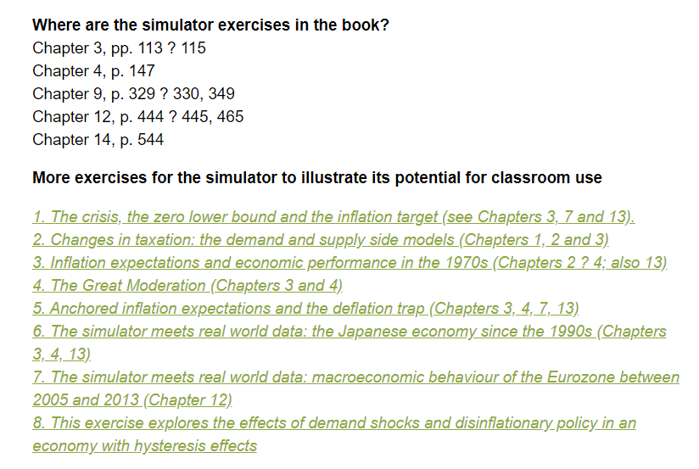
What students find hard:
(3) relating the models to the world

Slide 11
How would this work in an online teaching environment?
Very well – perfect for individual or group online learning.
You can ask them to compare analytical and simulation results and explain the dynamics
They can plot the numerical results and compare to data
You can add random shocks and ask them to collect the data and analyze it
Get them to play the game (3 levels) where they are the macro policy maker faced by unpredictable shocks, which they have to diagnose and use policy tools to respond to
Get them to write up their results – very good for the difficult-to-teach dynamics of a deflation trap and hyperinflation

Slide 12
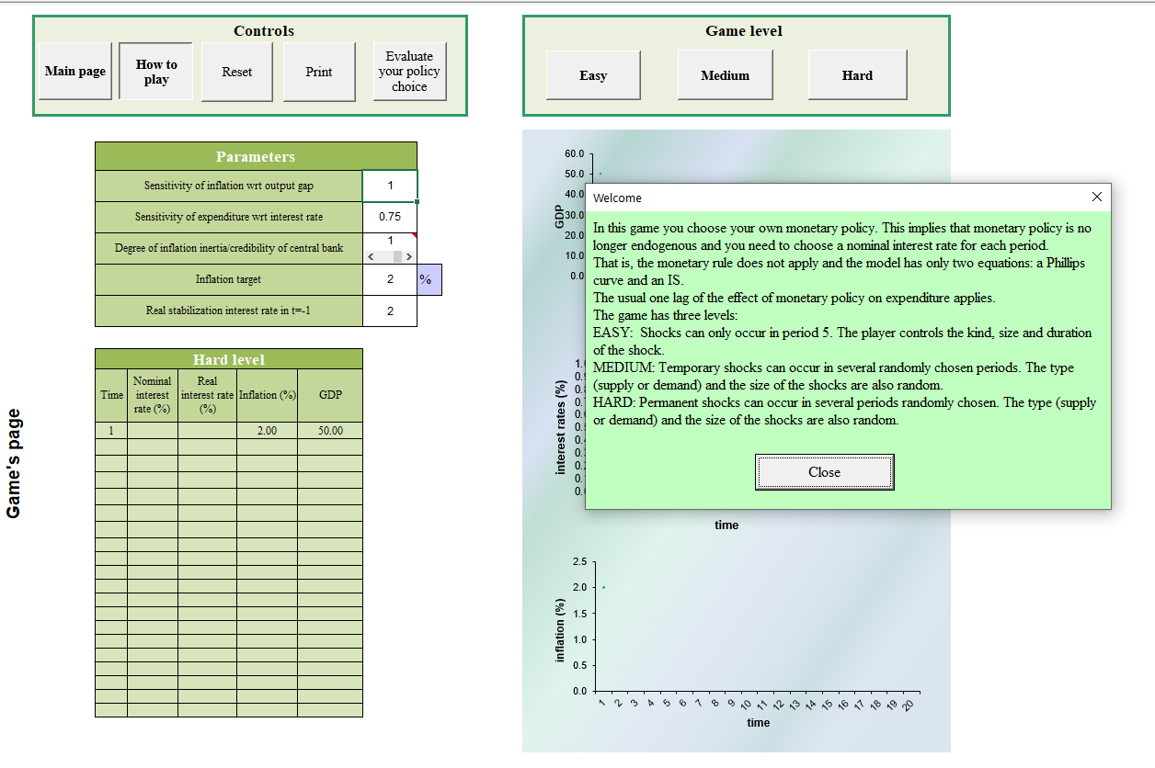
A game

Slide 13
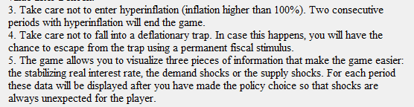

Slide 14
How would this work for research-based learning; for assessment?
Opportunities for linking to research using
  theory
  data
  policy episodes
Advanced students e.g. for dissertations can be set the challenge of creating a new simulator exercise related to a policy episode
Assessment: for online open book assessment, simulator output can be required for validation of analytical solutions
----------------------------------

Slide 15
Mainstream macro model
(Textbook: Carlin and Soskice, 2015)
For the model, see textbook or https://discovery.ucl.ac.uk/id/eprint/16060/1/16060.pdf
3-equation model (IS/PC/MR) where the PC has backward-looking expectations; in the simulator, anchored expectations can be experimented with
Open economy – small open economy with inflation-targeting CB
Open economy – small open economy with fixed exchange rate (two versions in the simulator – with and without an endogenous fiscal policy rule to stabilize inflation at the ‘world’ inflation rate)

Slide 16
The structure of the 3-equation closed economy model
CB minimizes its loss function, which expresses its objectives
subject to the constraint from the supply side, in the Phillips curve
which produces the monetary rule function that pins down the optimal output gap
which, is implemented in closed economy through choice of r using the IS equation (best-response Taylor Rule)

Slide 17
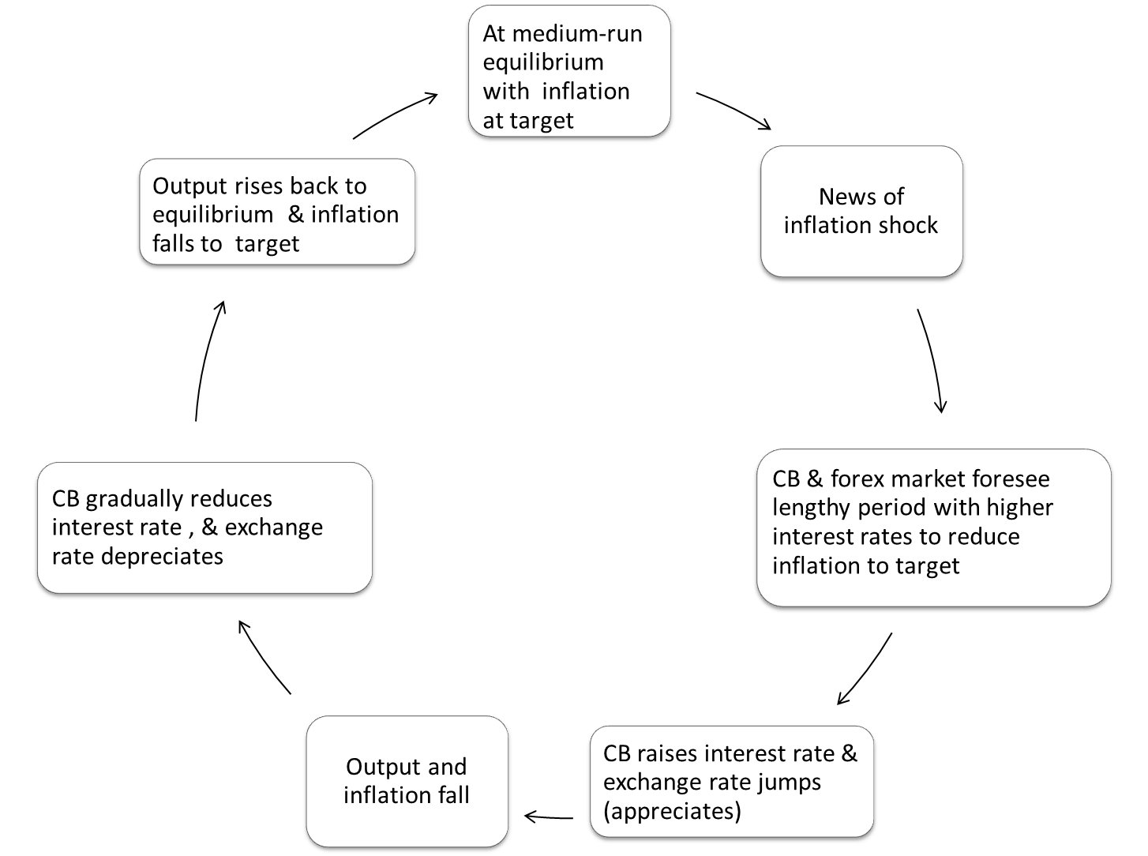
3-equation open economy model: forward-looking CB and forex market (inflation shock)

Slide 18

Open economy with inflation targeting CB
The CB’s optimization problem:
The forex market knows all of this too
$$\text{Min} L={\left(y_{t}−y_{e}\right)}^{2}+β{\left(π_{t}−π^{T}\right)}^{2} \\ \text{subject} \text{to} π_{t}=π_{t−1}+α\left(y_{t}−y_{e}\right) \\ → \left(y_{t}−y_{e}\right)=−αβ\left(π_{t}−π^{T}\right).$$
In order to produce the desired output level, $y_{t} ,$the
$$\text{CB} \text{chooses} r_{t−1} \text{knowing} \text{the} \text{equations}\text{:}$$
$$y_{t}=A−ar_{t−1}+bq_{t−1} \\ \text{and} r_{t}−r^{∗}=q_{t+1}^{E}−q_{t}$$

Slide 19
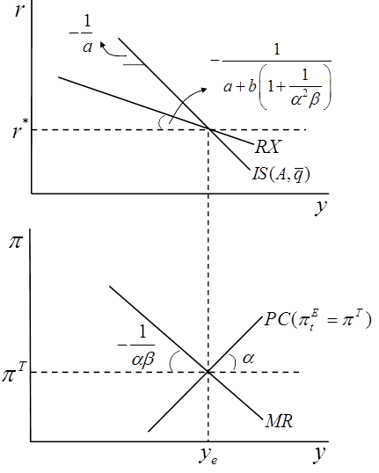
Showing all the parameters of the open economy model in a diagram

Slide 20
Comparing an inflation shock in closed & open economies

Slide 21
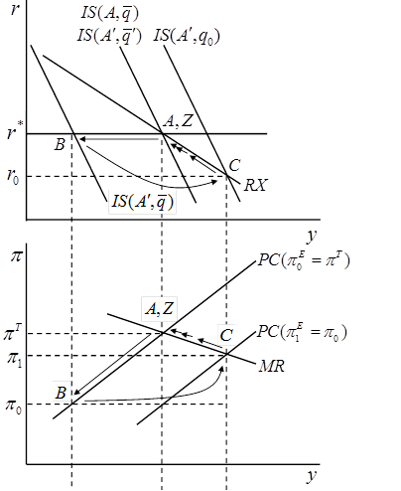

Central bank reaction to a permanent negative demand shock
Find new MRE at Z
Output falls to B on new IS
Inflation falls to B on PC
CB & forex market calculate CB’s optimal output gap on MR curve at C
RX shows how much r must be cut below r* : C on RX
IS shifts by equilibrium depreciation
plus extra depreciation to take IS to C
CB gradually raises r back to r* along RX (as expected)
Since from C to Z, q appreciates as expected and IS moves to the left

Slide 22
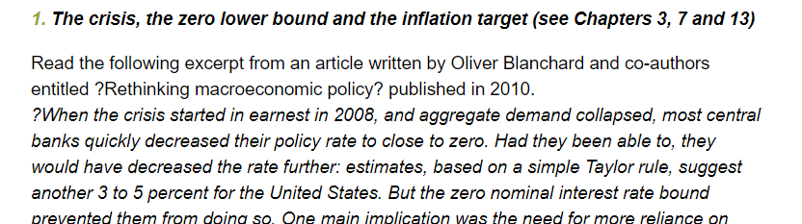
Simulator free online here https://global.oup.com/uk/orc/busecon/economics/carlin_soskice/student/excelsimulator/
Instructions on the website
Examples on the website
Try Question 1
https://global.oup.com/uk/orc/busecon/economics/carlin_soskice/student/excelsimulator/#Exercise1

Slide 23
