Slide 1
Survey on AI and Assessment in Higher Education: Some Results
Carlos Cortinhas c.cortinhas@exeter.ac.uk

Slide 2
Do you know what your university policy is on the use of Generative AI for assessment?

Slide 4
Please provide further details…
“Generally allowed to use for research but not allowed to use to create an output.”
“Default is 'does not allow the use of generative AI in their assessments' but unit directors have the flexibility to change this”
“Students have to admit the use AI and be ready to explain the scope of it”
“AI use can be regulated in the assessment brief. It all depends on what the lecturer wants them to do. ”
“The use of AI is considered commissioning, so it is considered to be a serious academic offence.”
“Specific use has to be mentioned/cited, not allowed for writing an essay/paragraph, etc., but allowed for editing and retrieving information”
“My students can only engage with AI after discussing their possible use with me and after approval. ”

Slide 6
Please provide further details…
“…plan to move one online quiz to in-class closed book with blocking software”
“…will include output from (eg.) ChatGPT and ask for their opinion on how correct it is, what they would change etc.”
“I incorporated the use of AI into tutorials and into a major summative assessment for the course (worth 40%). ”
“Mostly made the assessments (all are open-book, some are timed) more specific to the module readings, specific things mentioned in lectures etc”
“I have a mix of in person exam and coursework. (…) I have as a formative exercise invited students to prompt ChatGPT to write an essay on a theme and critique it.”
“We switched back to in-person exams for 1st and second-year students.”
“Assessments that are take home are now required to use specific citations and materials from class.”

Slide 7
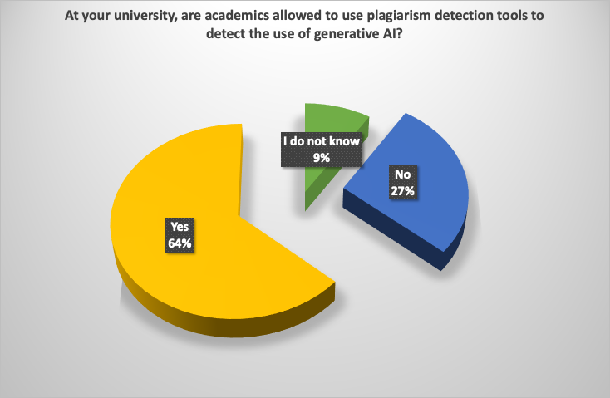

Slide 8
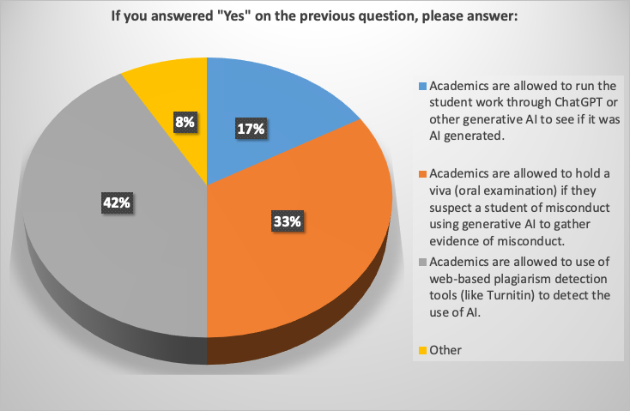

Slide 9
Thank you

