Slide 1
One Bank Research Agenda
Andrew G Haldane
Chief Economist, Bank of England
Sujit Kapadia
Head of Research, Bank of England

Slide 2
Motivation (1)
Monetary, macroprudential and microprudential policy at the BoE
World-class policymaking requires frontier research
Research agenda emphasises new challenges and new directions
  though familiar questions facing central banks are still important
Emphasis on interdisciplinary and alternative approaches

Slide 3
Motivation (2)
Opening up research agenda to expand external research connections, increase collaboration and crowd-source solutions to key policy questions
  need input from wider community of academics, policymakers and experts
Opening up datasets
Two new competitions – research and data visualisation

Slide 4
One Bank Research Agenda Themes
Central bank policy frameworks and the interactions between monetary policy, macroprudential policy and microprudential policy, domestically and internationally.
Evaluating regulation, resolution and market structures in light of the financial crisis and in the face of the changing nature of financial intermediation.
Operationalising central banking: evaluating and enhancing policy implementation, supervision and communication.
Using new data, methodologies and approaches to understand household and corporate behaviour, the domestic and international macroeconomy, and risks to the financial system.
Central bank response to fundamental technological, institutional, societal and environmental change.

Slide 5
Policy frameworks and interactions

Slide 6
Macroprudential policy framework
Target
Banking system stress tests
What scenario?
What model?
How do we interpret the results?
Macroprudential policy
(FPC)
Financial stability/Systemic risk
No quantified target
What Instruments?
What’s the impact?
Is the relationship stable?
Indicators, eg
credit/GDP gap
credit growth

Slide 7
Evaluating regulation, resolution and market structures

Slide 8
Extensive regulatory reform since the crisis
Tougher capital requirements; new liquidity and leverage standards
Measures to address TBTF
Resolution regimes
Strengthening derivative markets: greater central clearing and trade reporting

Slide 9
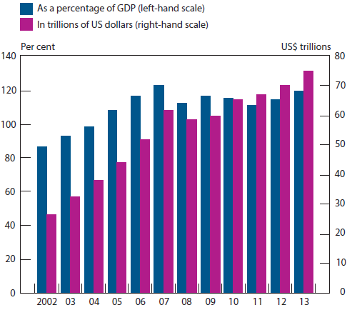
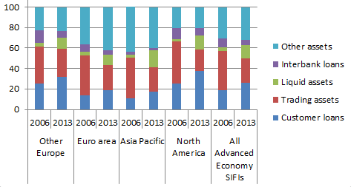
Changes in bank balance sheets and intermediation
Bank balance sheets before the crisis and now
Assets of NBFIs
Source: Financial Stability Board (2014), Global shadow banking monitoring report.

Slide 10
Key questions
How should we evaluate the overall effects of regulatory change?
What are the implications of regulatory reform for competition and the links between competition and financial stability?
How do financial institutions (including non-banks) benefit from TBTF? How can we measure TBTF subsidies for banks and other institutions?
What is the impact of the development of resolution regimes for financial institutions on regulatory and supervisory arrangements for these institutions?

Slide 11
Risks from NBFIs and possible policy responses
What are the risks from NBFIs and how can they be monitored?
The role of collateral and asset encumbrance
Developing diverse and resilient sources of market-based finance
Building transparency and trust

Slide 12
Complexity and the design of regulation
Institutional structure and ring-fencing
The network of interconnections
Complexity of system
Regulatory response

Slide 13
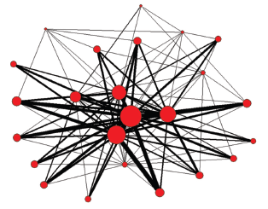
Network of large exposures^{(a)} between UK banks^{(b)(c)}
Source: FSA regulatory returns
(a) A large exposure is one that exceeds 10% of a lending bank’s eligible capital during a period. Eligible capital is defined as Tier 1 plus Tier 2 capital, minus regulatory deductions.
(b) Each node represents a bank in the United Kingdom. The size of each node is scaled in proportion to the sum of (1) the total value of exposures to a bank, and (2) the total value of exposures of the bank to others in the network. The thickness of a line is proportionate to the value of a single bilateral exposure.
(c) Based on 2006 Q4 data.

Slide 14
Epidemiology: ‘Tipping Points’ and ‘Super-spreaders’
When will a disease spread through a population?
Suppose everyone spreads the disease to 1 in 10 of their friends:
  If everyone has exactly 9 friends, the disease will die out
  But if everyone has exactly 11 friends, it will go viral

Slide 15
Epidemiology: ‘Tipping Points’ and ‘Super-spreaders’
In reality, some are better connected than others.
  People with more friends spread the disease more widely.
  But they are also more likely to catch it in the first place, since they have many friends to catch it from.
Connectivity enters twice. A person with 10 friends is 10x10 = 100 times as important in spreading the disease than someone with 1 friend.
Highly connected ‘super-spreaders’ are key to the propagation of contagion.
Policy: target super-spreaders (eg vaccines, education programmes)

Slide 16
Policy operationalisation and communication

Slide 17
Judgment-based supervision
Contributions of research
Rules versus ‘discretion’
Cognitive biases
Future challenges
Harnessing heuristics
Interdisciplinary lessons

Slide 18
Example: fast and frugal tree for treatment allocation
ST segment changes in electroocardiogram?
no
yes
Coronary
Care
Unit
chief complaint of chest pain?
yes
no
regular
nursing
bed
any one other factor? (NTG, MI,ST⬄,ST,T)
no
yes
regular
nursing
bed
Coronary
Care
Unit
regular
nursing
bed
Coronary
Care
Unit
Green and Mehr, 1997

Slide 19
Emergency Room Decisions: Admit to the Coronary Care Unit?
1
.9
.8
.7
Sensitivity
Proportion correctly assigned
.6
.5
Heart Disease
Predictive Instrument
.4
Fast and Frugal Tree
.3
.2
.1
.0
.0
.1
.2
.3
.4
.5
.6
.7
.8
.9
1
False positive rate
Proportion of patients incorrectly assigned

Slide 20
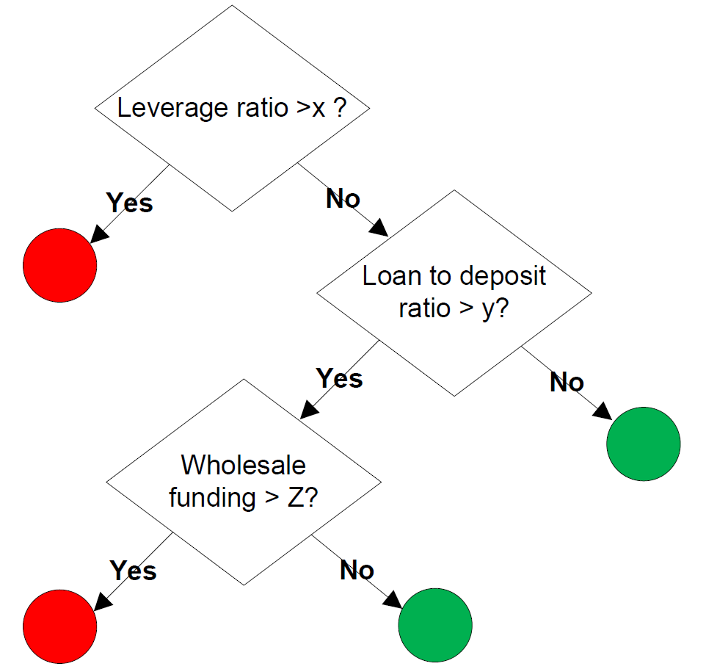
Judgment-based supervision
Contributions of research
Rules versus ‘discretion’
Cognitive biases
Future challenges
Harnessing heuristics
Interdisciplinary lessons
Source: Neth, Meder, Kothiyal and Gigerenzer (2014), ‘Homo heuristicus in the financial world: from risk management to managing uncertainty’, Journal of Risk Management in Financial Institutions, 7(2).

Slide 21
Response to Fundamental Change

Slide 22
Key Challenges
Technical innovations in the financial sector
  Digital currencies → payments and credit systems may have to adjust
  Peer-to-peer lending, crowd-funding → competition for bank credit
Demographics/aging → adjustments in insurance, asset prices, interest rates
Increased income inequality → lower interest rates, greater financial fragility
Climate change
  Structural transformation → “stranded assets”, credit risk in “old” industries
  Catastrophes → lower world growth, insurance industry losses

Slide 23
New data, methodologies and approaches

Slide 24
Coverage of this Theme
Potential coming from new, more varied data sets
Understanding household and corporate behaviour
Learning from relevant historical experiences
Understanding the interactions between different sectors of the economy
Understanding the interactions between different economies
Notes:
A very broad theme but only 5 minutes
So will touch on a few lessons we have learnt from the crisis…
Questions we now face…
And links between the themes

Slide 25


Is Correlation the New Causality?
Karl Popper
(Source: http://en.wikipedia.org/wiki/Karl_Popper)
Hal Varian
(Source: http://en.wikipedia.org/wiki/Hal_Varian)

Slide 26
The Productivity Puzzle
Source: Hills, Thomas and Dimsdale (2015) “Three Centuries of Data - Version 2.1”, available here.

Slide 27
The Productivity Puzzle?
Source: Hills, Thomas and Dimsdale (2015) “Three Centuries of Data - Version 2.1”, available here. Illustrative estimates prior to 1850 are based on data on the growth rate of technology between 1AD and 1750AD in “A farewell to Alms” by Gregory Clark.

Slide 28
The Labour Market
Source: ONS.

Slide 29
Googling the Labour Market
Source: ONS; Google. Notes: The Google indices are mean and variance adjusted to put on the same scale as the unemployment rate and wage growth. The Google index is drawn from searches containing the term “salaries”.

Slide 30
Googling the Labour Market
Source: ONS; Google. Notes: The Google indices are mean and variance adjusted to put on the same scale as the unemployment rate and wage growth. The Google indices are drawn from searches containing the terms “salaries” and “job seekers allowance”. See Mclaren and Shanbhogue (2011) for further details.

Slide 31
Phillips Curve Flattening?
Source: Data to 2012 are available here. Details of the methodology used are provided in Relleen, Copple, Corder and Fawcett (2013).

Slide 32
Impact of Monetary Policy
Impact of a one percentage point rise in interest rates on income and spending
Source: NMG Survey. See Anderson, Bunn, Pugh and Uluc (2014) for further details. Data are available here.

Slide 33
Impact of Monetary Policy
Proportion of mortgagors that would need to
respond to a rise in mortgage rates
Source: NMG Survey. See Anderson, Bunn, Pugh and Uluc (2014) for further details. Data are available here.

Slide 34
Rising Household Debt
Distribution of mortgage debt to income ratios
Source: NMG Survey; Living Costs and Food Survey (LCFS) prior to 2012. See Anderson, Bunn, Pugh and Uluc (2014) for further details.

Slide 35
Loan-to-income multiple ≥ 4.5
Source: Data are based on the Bank of England’s internal Product Sales Database collected by the FCA.

Slide 36
Loan-to-income multiple ≥ 4.5

Slide 37
Loan-to-income multiple ≥ 4.5

Slide 38
Loan-to-income multiple ≥ 4.5

Slide 39
Loan-to-income multiple ≥ 4.5

Slide 40
Loan-to-income multiple ≥ 4.5

Slide 41
Loan-to-income multiple ≥ 4.5

Slide 42
Loan-to-income multiple ≥ 4.5

Slide 43
Loan-to-income multiple ≥ 4.5

Slide 44
Loan-to-income multiple ≥ 4.5

Slide 45
Loan-to-income multiple ≥ 4.5

Slide 46
Loan-to-income multiple ≥ 4.5

Slide 47
Loan-to-income multiple ≥ 4.5

Slide 48
Loan-to-income multiple ≥ 4.5

Slide 49
Loan-to-income multiple ≥ 4.5

Slide 50
Loan-to-income multiple ≥ 4.5

Slide 51
Loan-to-income multiple ≥ 4.5

Slide 52
Loan-to-income multiple ≥ 4.5

Slide 53
Loan-to-income multiple ≥ 4.5

Slide 54
Loan-to-income multiple ≥ 4.5

Slide 55
Loan-to-income multiple ≥ 4.5

Slide 56
Loan-to-income multiple ≥ 4.5

Slide 57
Financial Market Sentiment
Score
Anxiety
Excitement
Source: Rickard Nyman, David Gregory, Sujit Kapadia, Robert Smith, David Tuckett and Paul Ormerod (forthcoming). Notes: Bank Reports are the relative sentiment score (balance between excitement and anxiety) of the Bank’s market commentary summarising market moods. VIX is an index of the implied volatility of S&P 500 index options over the upcoming 30-day period, and is mean-variance adjusted to fit on the same scale.
47

Slide 58
MPC Sentiment
‘Banking’ in MPC Minutes
Notes: This chart shows the estimated allocation of each month’s MPC minutes to a topic which we label "banking". The words used most frequently in the topic are bank(s)/banking/banker(s), credit(s), financial/finance, market(s), asset(s), condition(s), money and lend(s)/lending/lender. See Hansen, S, McMahon, S, and Prat, A (2014) and Haldane (2014) for further details.
48

Slide 59

Monetary Policy Correlations?
Strength of common factor in UK, US and German spot yields at different maturities
Key:
Proportion of variation explained
by common factor
Source: Bloomberg and Bank calculations. Notes: Each cell shows the proportion of the variation of weekly changes in UK, US and German interest rates over the past two years explained by the first principal component over those two years. See Haldane (2014) for further details.
49

