Slide 1
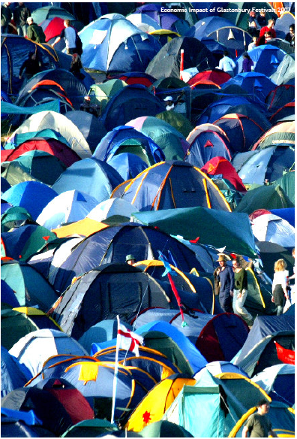
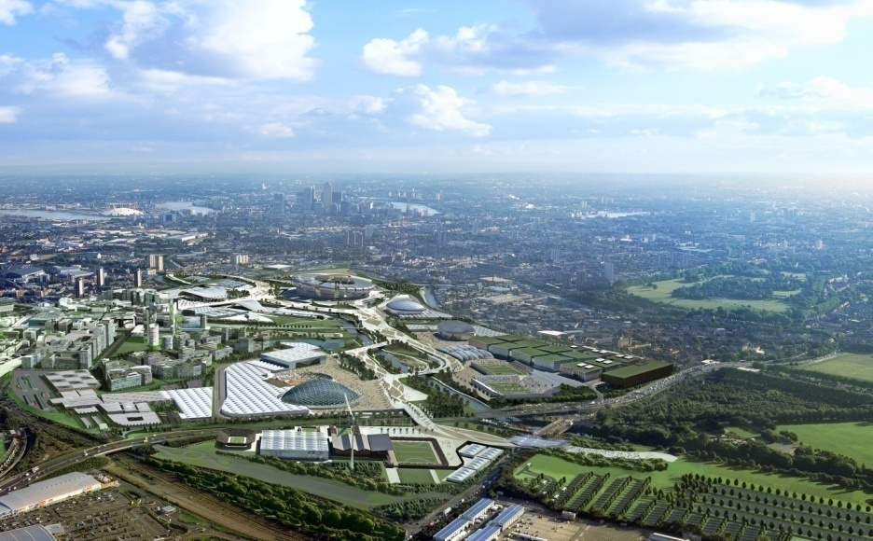
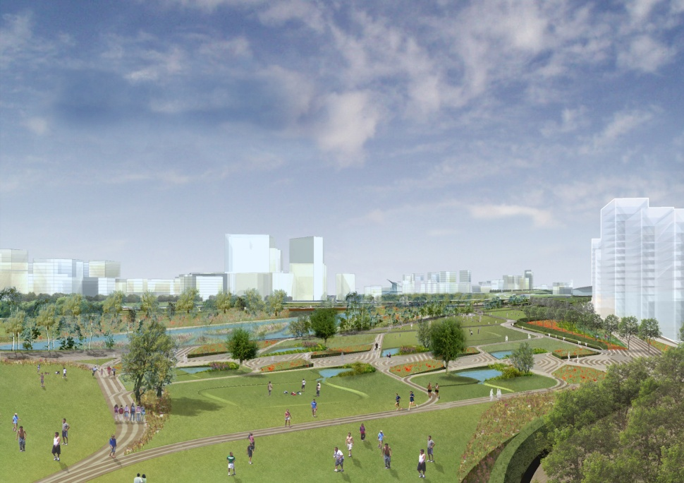
Lecture 10a Event-based regeneration and economic boosters

Slide 2
Event-based regeneration and economic boosters
Aims
To examine the concept that major sporting and cultural events act as a stimulus to economic regeneration.
To review some of the available literature on the short and long-term economic impact of major events
Outcomes
Have an awareness of the physical economic legacy provided by major events.
Be aware that the short-term economic booster effects may be negative as well as positive
Have an awareness of why countries and cities put so much effort into bidding or acquiring such events

Slide 3
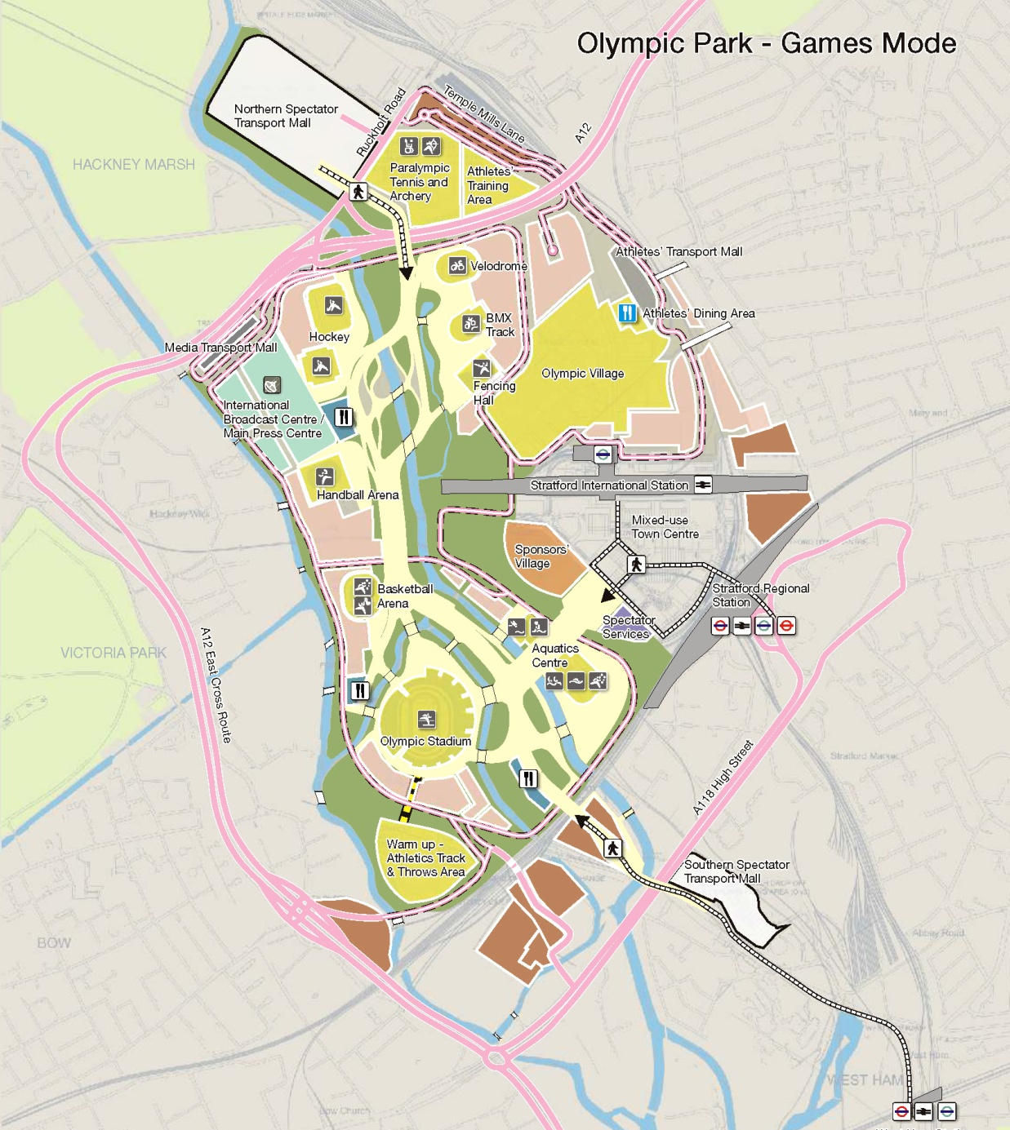
Definitions
Olympic games and other mega events - “hallmark” events -“transitory” - short-term international participation - long-term legacy.
Staging the Olympics can only be justified on the grounds that it is “seen as leading to a major programme of regeneration and improvement”.
Proactive & entrepreneurial – spectacle as part of urban renewal – marketing attracts inward investment – direct effects: tourism; construction; stadia operation. Essex & Chalkley
“The Olympic Park will become a hub for east London, bringing communities together and acting as a catalyst for profound social and economic change. It will become a model of social inclusion, opening up opportunities for education, cultural and skills development and jobs for people across the UK and London, but especially in the Lea Valley and surrounding areas.”
http://www.london2012.org/en/news/publications/Candidatefile/Candidatefile.htm

Slide 4
The employment and skills legacy - The Economic Development, Culture, Sport and Tourism Committee of the London Assembly
An important part of that legacy is economic regeneration to provide lasting skills and employment opportunities in the five host boroughs around the Olympic park. These boroughs include some of London’s poorest and most disadvantaged people. A quarter of the working population in this area has no qualifications, and many have never had a job.
LDA estimate up to 12,000 new jobs in the Olympic Park; up to 50,000 in the Lower Lea Valley as a whole; and a reduction of 70,000 in the number of workless people in London, of which 55,000 will be as a result of increased job opportunities and 15,000 will result from changes in recruitment practices. IPPR suggests this may be overoptimistic based on their analysis of Sydney.
The London Development Agency sees the key to a sustainable legacy as a combination of effective engagement and a “pipeline” of opportunities with local firms, instead of a mass of menial low paid jobs, to create the potential for career progression that will encourage people to stay.
The committee were highly sceptical and asked what lessons the agency (LDA) had learned from the gentrification of Canary Wharf, where one group of residents was simply replaced with another, wealthier, set.

Slide 5
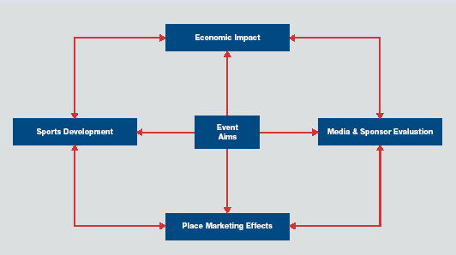

The balanced scorecard approach to
evaluating events
Source Measuring Success 2 from
Notes:
According to Sport UK:
Apart from an event’s economic impact, additional aims and benefits might arise in the form of media value linked to coverage at home or internationally.
Moreover, linked to such coverage may be place marketing benefits for key aspects of the host city or area, which could ultimately impact upon tourism by increasing the number of visitors to the area in future as a result of media coverage afforded to an event.
Public perceptions of places can also improve as a result of people’s experiences at major sports events, which in turn might lead to repeat visits as evidenced by qualitative feedback from spectators at some of the events.
Furthermore, an immediate benefit of staging an event might involve some form of sports development impact which could encourage more people to take up a sport being showcased.
The long term effect of any increase in participation could be tracked, although it may be difficult to prove causality.

Slide 6
4 Categories of sporting event
Gratton et al
Type A | Irregular, one off, major international spectator events, these generate significant economic activity and media interest e.g. Olympics, Football World Cup etc.
Type B | Major spectator events, significant economic activity & media interest part of the annual domestic cycle e.g. Test matches, 6 Nations Rugby, Open golf, Cup final etc.
Type C | Irregular, one-off major international spectator/ competitor events generating limited economic activity e.g. European boxing and swimming championships
Type D | Major competitor events generating limited economic activity and part of an annual cycle e.g. National championships
Gratton et al

Slide 7
Olympic games, evidence of legacy inflation
Low impact locations where little additional facilities were provided (Low) | Athens 1896, Paris 1900, St Louis 1904, London 1948, Mexico City 1968, Los Angeles 1984
Games focusing on mainly sporting facilities (Medium) | London 1908, Stockholm 1912, Paris 1924, Los Angeles 1932, Berlin 1936, Helsinki 1952, Melbourne 1956, Atlanta 1996
Games stimulating transformations of the built environment (High) | Rome 1960, Tokyo 1964, Munich 1972, Montreal 1976, Moscow 1980, Seoul 1988, Barcelona 1992, Sydney 2000, Athens 2004, Beijing 2008 and London 2012

Slide 8
Distributional effects of Olympic Games controversial
Does public investment represent a subsidy to affluent consumers and visitors at the expense of consumption for the local underprivileged?
Part of wider debate about property led regeneration – is this at the expense of education and training, affordable housing and quality of social services?
Equity issue about awarding games - capital accumulation in prosperous western cities but should poorer nations be the beneficiaries. Or should there be one purpose built venue to overcome threats such as terrorism.
The Games accelerates change but does not initiate it
Not to the same scale
Infrastructure plans may be devised but not implemented
Pressure exerted to complete urban development and renewal by focus of world media
Notes:
Essex and Chalkley

Slide 9
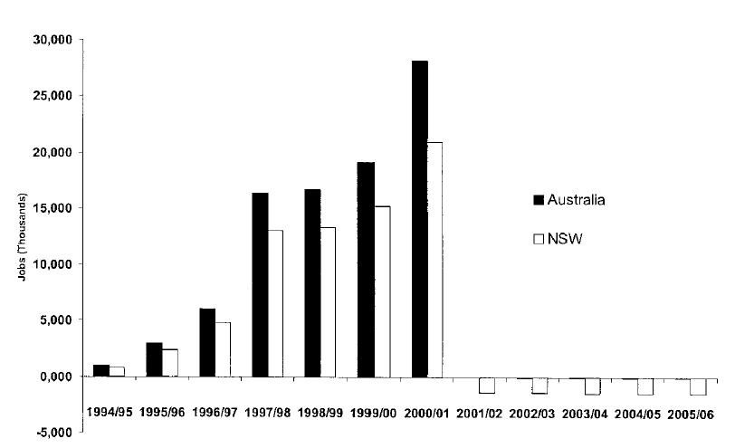
Madden analysis of Sydney Olympics prior to the games
Study for Arthur Andersen CGE Model
4 expenditure phases
Total direct impact $8.4billion
Main impacts:
  Capital stock
  Real investment
  Jobs
  Real GDP
  Consumption
Very sensitive, induced tourism
See also Yaxiong Zhang and Kun Zhao on the expected impact of the Beijing Olympics

Slide 10
The Barcelona Olympics, Sunahuja
Expensive to stage Infrastructure $7.5billion Olympic Committee’s budget $1.5 main legacy impacts on tourism and status
Legacy benefits of the Barcelona Olympic Games
1990
2001
Hotel capacity (beds)
18, 567
34, 303
Number of tourists
1, 732, 902
3, 378, 636
Number overnights
3, 795, 522
7, 969, 496
Average room occupancy (%)
71
84
Average stay
2.84
3.17
Tourist by origin %
Spain
51.2
31.3
Europe
32
39.5
Others (US, Japan, Latin America)
16.8
29.2
Sanuhuja 2002

Slide 11
Baade & Matheson Olympics and World Cup
Sydney Olympics
  Substitution and displacement effects
  Resources drawn from other potential uses
  Tourism displacement from other cities
  Were potential visitors “put off”? – is net or gross being measured – are multiplier effects as large as estimated
World Cup America 1994
  Modelling the effects of the world cup on many of the main host cities suggests that the anticipated impact may not be achieved.
  Although they point out that the private owners of stadia benefit greatly from public subsidy associated with the tournament.

Slide 12
But the anticipated benefit don’t always come off

Slide 13
Jones – The Millennium Stadium in Cardiff
Findings
  Expenditure impacts significant - but the proportion of economic value staying in the region is questionable
  Urban renewal significant – but based on industry with low pay, low-value employment, with substantial public subsidy
  Extensive media exposure – but little concrete evidence that this encourages tourists or investment
Potential economic outcomes can be:
  Return to the status quo post event
  Increased level of employment but no impact on growth
  Step change in rates of growth over a long period.

Slide 14
Gratton - a wider range of sporting events
Although Euro 96 football championships, used existing stadia, the impact on host cities was significant.
Attracted 280,000 overseas visitors, spending around £120m as well as £75m from UK residents living outside the 8 venue cities.
3% boost to net earning from travel and tourism and a 0.25% boost to exports pushing the balance of trade into surplus.
Government revenues were also boosted by around £64m from VAT on tickets and increased betting and corporation tax.

Slide 15
Gratton et al 2
Majority of sports events in any year are of Types C and D.
Type A and B events will generate the largest economic benefits but there is fierce competition between cities to host them.
The majority of Type B events either do not move venues or, cities are not able to bid to host them. Britain is unusual in having a very high number of Type B events. Type B events are a low-risk investment for the host city.
Major sports events are now a significant part of Britain’s tourism industry.
Britain has, partly by historical accident rather than by design, become the global market leader

Slide 16
Gratton et al study (2005)
Year
Event
Host city
Event days
Impact
(£ million)
Impact per
event day
(£ million)
97
World Badminton
Glasgow
14
2.22
0.16
97
European Junior Boxing
Birm’ham
9
0.51
0.06
97
1st Ashes Test Cricket England v Australia
Birm’ham
5
5.06
1.01
97
IAAF Grand Prix 1 Athletics
Sheffield
1
0.18
0.18
97
European Junior Swimming
Glasgow
4
0.26
0.06
97
Women’s British Open Golf
Sunn’dale
4
2.07
0.52
98
European Short Course Swimming
Sheffield
3
0.31
0.10
99
European Show Jumping
Hickstead
5
2.20
0.44
99
World Judo
Birm’ham
4
1.94
0.49
99
World Indoor Climbing
Birm’ham
3
0.40
0.13
00
Flora London Marathon
London
1
25.46
25.46
00
Spar Europa Cup, Athletics
Gateshead
2
0.97
0.48
01
World Amateur Boxing
Belfast
8
1.49
0.19
01
World Half Marathon
Bristol
1
0.58
0.58
03
World Cup Triathlon
Manchester
1
1.67
1.67
03
World Indoor Athletics
Birm’ham
3
3.16
1.05

Slide 17
Arts and Cultural Festivals
Often perceived as economic and place promotional activities. Quinn suggests cities could suffer from “serial reproduction”.
Glasgow oft quoted European Capital of Culture (1990) ☺ tourism numbers rose from 700k in 1983 to 4m+ in 2002 Estimated 125,000 visitors to 8 separate festivals with a combined economic impact of £6m p.a.
Edinburgh Festival £135million £75m from fringe 2.5m visitors to the summer festival 70% from outside Edinburgh. Responsible for 2,500 jobs £11.6m in publicity value
It is suggested that over seven million people attend nearly 600 festivals and cultural events throughout Ireland (2007). Festivals and cultural events were estimated to generate in excess of €200 million to the economy. Galway Arts Festival generates a spend of over €20m in Galway every July.
Study by Sussex Arts Marketing (2004) - Brighton Festival 3 weeks duration, - 430,000 people attend (69% local) - spending £20m (£1m on tickets)
See also The Impact of Festivals on Cultural Tourism, Razaq Raj

Slide 18
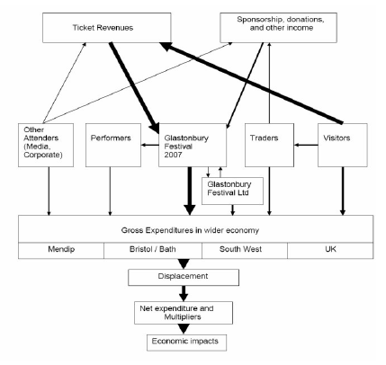
Economic Impact of Glastonbury 2007
New study just released by Baker Associates.
More than 177,000 visitors with average stay of 4-5 days spending around £300 each
Based on surveys of visitors, traders and local business as well as Glastonbury Festivals accounts.
Gross direct impact calculated at £73m, of which 70% is visitor spend
Net impact £35m for Mendip Council area after accounting for deadweight, displacement and multipliers
Non-tangible economic benefits – place marketing – tourist repeat visits – local charities – greening business – enterprise culture
Source: Baker Associates

Slide 19
Cultural regeneration (Evans)
Culture led regeneration Cultural activity the catalyst – high public profile cultural flagship – design and construction or reclamation of open space – claim uniqueness that other regeneration projects do not share - often misused – example Salford.
Cultural regeneration cultural activity more integrated into an area strategy alongside employment and development planning often several rounds of development activity - example Birmingham
Culture and regeneration model by default not integrated into the strategy may lack a champion – often small public art, heritage interpretation or small local museum – example Fareham
Notes:
Point one: examples include Salford the Lowry, Guggenhime Bilbbao, Baltic/ Sage in Gateshead – Money and originality of design are not enough . . . You need many ingredients for big, emblematic projects to work, and one of the keys is the active support of local communities.
Point two: where, at an early stage of the city’s ‘renaissance’ (BCC, 2003), ‘culture’ was incorporated with mainstream policy, planning and resourcing through the council’s joint Arts, Employment and Economic Development Committee, and in the ‘exemplar’ cultural city Barcelona which early on took an urban design, cultural planning and creative quarter approach, which is still recreating itself through the further expansion from the old city out to the former Olympic village site – but the risk is a divided “event city” with locals largely excluded.
Point three: Although introduced at a later stage, cultural interventions can make an impact on the regeneration process, enhancing the facilities and services that were initially planned. It is important to note that the lack of discernible cultural activity or provision within a regeneration scheme does not necessarily mean that cultural activity is absent, only that it is not being promoted (or recognised) as part of the process.

Slide 20
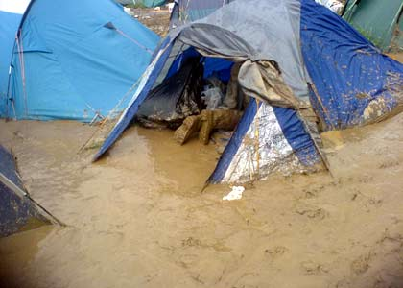
Conclusions
Significant opportunity to bring forward economic regeneration.
Justified by economic regenerative effect.
Physical legacy but is the economic booster effect long-lasting?
Predictions are usually over optimistic.
Substitution and displacement effects quality of resultant employment is poor.
Does media exposure guarantee additional tourism or inward investment?
Smaller spectator/ competitor events may be the most realistic opportunity but the economic outcomes from these are far less certain.
Festival and culture have increasing roles but regenerative effects are not always obvious.

