Slide 1
Trans-national regional policy:
The EU becomes a major player.
Aims
Examine what problems regional economic integration creates & look at the arguments for and against an EU-wide regional policy
Review the main principles and funding streams underpinning current EU regional policy
Evaluate EU regional policy and the future shape of policy after 2007
Outcomes
Be able to argue the rationale for and against a trans-national regional policy
Have a working knowledge of the priority areas that have received funding, the reasons for this and the likely direction of policy in the future.

Slide 2
The EU is an Economic Union
but what does this mean?
Common Market – customs unions free movement of capital and labour internally, common external trade policies
EMU - fiscal and monetary policy by a central authority may also be common currency.
Three processes taking place -
Dismantling of NTBs, Enlargement, Monetary union
Benefits -
Lower prices for goods and services as a result of a larger market
No exchange rate costs; Lower inflation; More jobs;
Improved balance of payments; Lower member state public sector deficits
Notes:
Three groups of non-trade barriers:
Cost increasing barriers such as red tape, delays at customs posts and different safety and technical standards;
Market entry barriers inability to entering or competing freely in a domestic market, opening up public procurement;
Market distorting practices for example price controls or differential taxes and subsidies on goods, Vat rates for instance or excise duties.
Benefits: Lower prices mainly as a result of competition and to some extent firms have economies of scale the larger protected “home” market also means that firms have a competitive advantage in international trade.
Lower prices feed through into lower inflation and with and free movement of capital and labour, the supply side is likely to be more competitive thus also keeping down inflationary pressures.
Improved balance of payments mainly through fiscal discipline involved in monetary union – with most countries tied to the Euro they are unable to devalue their way out of a balance of payments problems but instead will have to trade themselves out of it or cut back on excessive public sector deficits.

Slide 3
Outcomes of closer regional integration
Two main forces at work - Allocation and Accumulation effects
Allocation
Trade creation - (specialisation through competitive advantage)
Trade diversion - protection (via tariff walls)
+ other allocation effects;
Accumulation
Additional investment; via expanding market, higher rates of return, less risk.
Benefits not spread evenly - central or core regions benefited most from closer integration whilst peripheral regions lag.
Problem will increase with eastern enlargement
EU is caught on the horns of a classic dilemma
Notes:
Other allocation effects
The elimination of trade rents customs duties these are no longer collected.
Integration also leads to other longer-term allocation effects amongst these are economies of scale which results from selling into a far larger market said to benefit core regions – such as France Germany, Benelux and UK.
Lower costs as a result of increased competition within the Union.
Another of these is the benefit consumers capture through a wider range of choice because customers in one country are able to buy product from firms in other member states.

Slide 4
Arguments for and against
an EU-wide regional policy
Arguments for
Ensure policy spending matches the severity of the problems faced
The EU can greatly improve the co-ordination of regional policy
Offers a means by which any one member can legitimately assist other member states.
Further integration is preconditioned on stabilising the periphery
Against
Uniform approaches do not work because problems differ
Over centralisation stifles innovation
Centralisation discourages local participation
Notes:
Point 1. In individual nations. It is often argued that individual nations do not have the money or the expertise to tackle their regional problems
Point 2. Not only can it use tried and tested methods but it can divert resources sufficient to tackle the problems faced.
Point 3. One country would not be allowed to interfere in the affairs of another country (both recipient and donor constituents may well object). But having the resources through VAT and seemingly “independent” the EU or similar body does have a role – honest broker. Thus indirectly the donor countries such as UK and Germany help less developed countries such as Greece. The payback is that as the Greek market develops there will be more opportunities for UK and German firms to trade into Greece as its citizens become more affluent.

Slide 5
Principles & Objectives of EU regional policy
EU regional policy or “Structural Funds” are the 2nd largest expenditure item in the EU Budget. The size of the fund has more than doubled since end of 1980’s.
6 main principles underpin the policy
  Concentration of Assistance; Co-ordination
  Partnership; Subsidiarity
  Programming; Additionality
There were three main objectives
  Objective 1: Eligible areas are those that have less than 75% of EU average GDP.
  Objective 2: Aims to support the economic and social conversion of areas facing structural difficulties.
  Objective 3: This Objective involves only the European Social Fund.
Notes:
Objective 1: It is the highest level of regional funding available from the EU. It is aimed at promoting the development and structural adjustment of the EU regions most lagging behind in development. In the UK areas that qualify are Merseyside, South Yorkshire, Cornwall and the Scilly Isles, and West Wales and the Valleys. In addition to these areas, the UK also has two transitional Objective 1 areas, the Highlands and Islands and Northern Ireland which also qualifies for a unique PEACE programme. In total the UK will receive over £3.9 billion of Objective 1 money between 2000 - 2006.
Objective 2: It is the second highest level of funding available from the EU. Areas qualify for Objective 2, under four strands - industrial, rural, urban and fisheries. This objective covers nearly 14 million people in the UK. In addition, areas that had Objective 2 or 5b status in the previous programming period are eligible for transitional funding until 2005. Including transition, Objective 2 covers well over 19 million people in the UK. In total, the UK will receive over £3.1 billion for UK Objective 2 and transitional Objective 2 areas for the period 2000 - 2006.
Objective 3: It aims to develop labour markets and human resources and in addition, will help firms and workers adapt to new working conditions and so compete more effectively in global labour markets. It is directed at the long-term unemployed and those facing particular barriers to finding fulfilling employment because of their disability, racial origin, or sex. The UK will benefit from just under £3 billion of Objective 3 money for 2000-06.

Slide 6
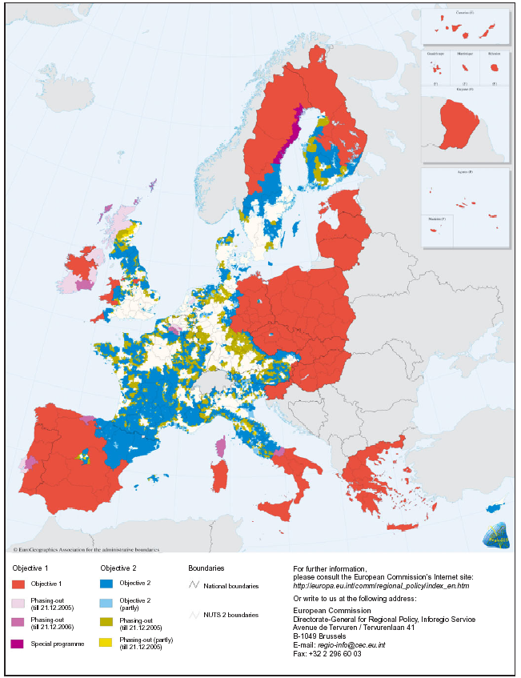
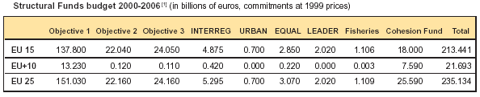
Funds that underpin
EU regional policy
The European Regional Development Fund (ERDF)
European Social Fund (ESF)
European Agricultural Guidance and Guarantee Fund (EAGGF)
Financial Instrument for Fisheries Guidance (FIFG)
Notes:
The European Regional Development Fund (ERDF); Aims to improve economic prosperity and social inclusion by investing in projects to promote development and encourage the diversification of industry into other sectors in areas lagging behind. This fund is available in Objective 1 and 2 areas.
The European Social Fund (ESF); Funds training, human resources and equal opportunities schemes to promote employability of people in both Objective 1 and 3 areas. In Objective 2 areas ESF may be used to complement the ERDF activities.
The guidance section of the European Agricultural Guidance and Guarantee Fund (EAGGF); Is available in rural Objective 1 areas to encourage the restructuring and diversification of rural areas, to promote economic prosperity and social inclusion, whilst protecting and maintaining the environment and our rural heritage.
The Financial Instrument for Fisheries Guidance (FIFG); Funds projects to modernise the structure of the fisheries sector and related industries and to encourage diversification of the workforce and fisheries industry into other sectors. It also funds complementary actions taken under the Common Fisheries Policy.
Community Initiatives
INTERREG: cross-border, transnational and interregional co-operation to encourage balanced development and spatial planning.
URBAN: urban regeneration (funding: ERDF)
LEADER: rural development (funding: EAGGF-Guidance)
EQUAL: transnational co-operation on new ways to combat discrimination and inequality in the labour market (funding: ESF)

Slide 7
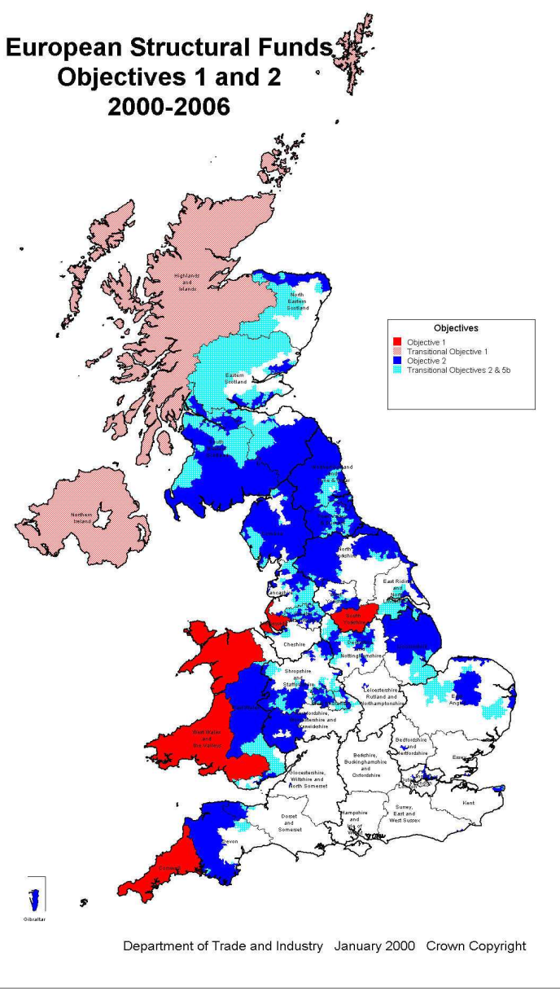
Which areas in the UK qualify?

Slide 8
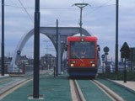
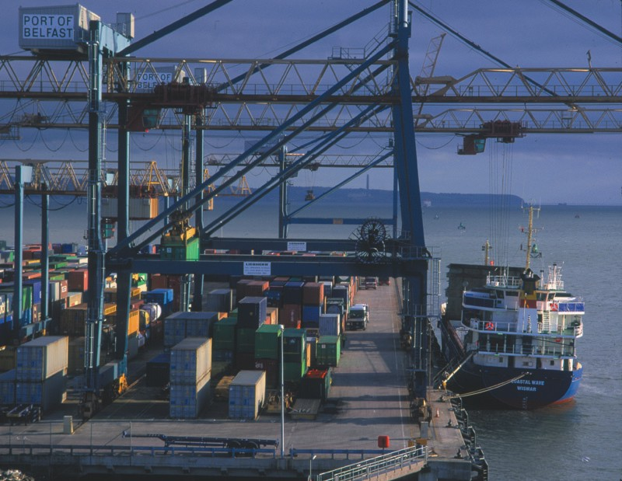


What sort of schemes qualified in the UK?
Urban Pilot Project
Belfast ERDF
Wolverhampton tramway ERDF
Wind Generation
Blyth
Northumberland
Tourism Canterbury

Slide 9
How policy changed after 2000
Thread running through EU regional policy changed after 2000 - Concentration, Simplification, Decentralisation and Improving efficiency.
Themes
Reform of the EU's financing system
EU enlargement strategy
Reform of the Common Agricultural Policy
Reform of the Structural Funds
Achieved by
Channelling resources  Simplified management
Improve transparency  Limit role of EU
Set performance reserve
Notes:
Agenda 2000 Reform of the structural funds (The Theory)
The "Agenda 2000" programme presented by the European Commission in July 1997 considered how to promote growth, competitiveness and employment in Europe, and developed a strategy for modernising the main EU policy areas with a view to future eastern enlargement of the Union. The general theme running through the proposals was for more: Concentration, Simplification, Decentralisation and Improving efficiency.
This is to be achieved by:
• Channelling resources more towards poorer regions.
• Simplified management with further decentralisation and clearer remits.
• Improved transparency and reduce red tape.
• Limit the role of the EU to setting development priorities; approving programmes; independent evaluation and control. Programmes delegated to member governments or the regions.
• Set up a performance reserve - 10% of funds would be retained and only allocated after a positive assessment of the programming.

Slide 10
Impact of policy in Objective 1 regions
Rodriguez-Pose et al, Between Development and social policies, Regional Studies, February 2004
Number of regions eligible has risen steadily from 44 in 1989 to 67 now representing about 30% of the EU budget.
Spending in 4 priority areas; agriculture & rural (8%); business and tourism (23%); investment in human capital (13%) & investment in transport, infrastructure and environment (49%)
No observable regional convergence (GDP per capita terms) overall in the EU and only slow convergence in the sub-set of Objective 1 regions.
No real positive association between structural funds and regional growth up to 6 years following the initial investment.
Impact of expenditure in agriculture positive in the short-run but tails off; infrastructure and business support have little short/medium-term benefit and weak in the longer-run; by contrast human capital development has a positive effect on regional growth.
Notes:
Agriculture impact short-term and acts as income support rather than sustainable development more like CAP that regional economic development.
In the case of business support Rodriguez suggests that SMEs [in Objective 1 Regions] lack capacity and know-how to compete in open markets and larger firms tend to have weak competitive advantage – lame ducks.
Infrastructure development takes time to come through, also whilst improvements benefit local inhabitants they may not be enough to generate economic dynamism or attract in firms. May also make peripheral regions more exposed to stronger core economies.

Slide 11
How successful was cohesion policy in the past?
Unemployment | 1996 | 2002
Cohesion countries | 17% | 9.6%
Greece | 9.7 | 10
Ireland | 11.9 | 4.3
Spain | 22.3 | 11.4
Portugal | 7.4 | 5.1
Rest of EU | 9.5 | 7.5
Proportion of EU transfers to main beneficiaries spent
on imports purchased from other Member States
Greece
42,6 %
Portugal
35,2 %
Ireland
26,7 %
New Länder
18,9 %
Mezzogiorno
17,4 %
Spain
14,7 %
0
10
20
30
40
50
Notes:
Taken from the Third Cohesion Report 2004

Slide 12
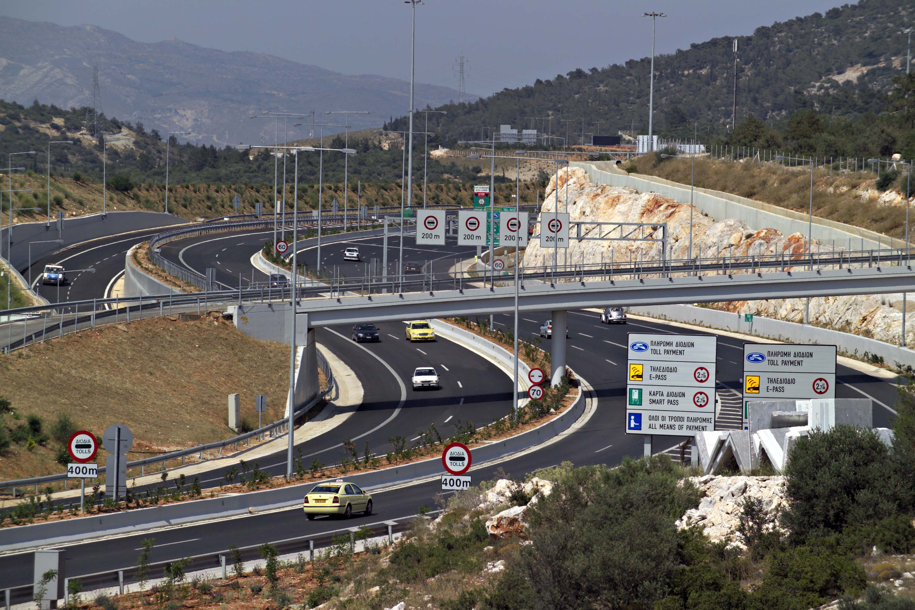
Example of the 2004 Olympic games
The EU objective was to boost the modernisation of Greece, in particular of its capital. The EU used its Solidarity instruments, SF and the CF. European funds were aimed at financing the accessibility to sports facilities.
ATHENS METRO Estimated cost €1,600m EU funding €900m
ATTIKI HIGHWAY Estimated cost: €950 m EU funding: €475m
ATHENS TRAMWAY Estimated cost: €350m EU funding: €175m
ATHENS SUBURBAN RAILWAY Estimated cost €640m EU funding €320m
INTEGRATION OF ATHENS CULTURAL SITES EU contribution: 75%
Notes:
SF = Structural Fund; CF = Cohesion Fund

Slide 13
Shape of EU regional policy from 2007
Agreement was reached at the Lisbon Conference in March 2005 on the future direction of EU policy: There were to be four political priorities.
Sustainable development; competitiveness, cohesion
Conservation & management of natural resources
Citizenship, freedom, security, justice
The EU – a global trade partner
Finance
Total budget has an annual ceiling of €146.4 billion; €48 billion for structural actions (was €37 in previous period);
50% in new 50%, in old member states;
75% in lagging regions
Accounts for 34% of total EU budget
Notes:
Sustainable development – competitiveness, cohesion (for growth and employment)
Conservation and management of natural resources
Citizenship, freedom, security and justice
The EU – a global partner

Slide 14
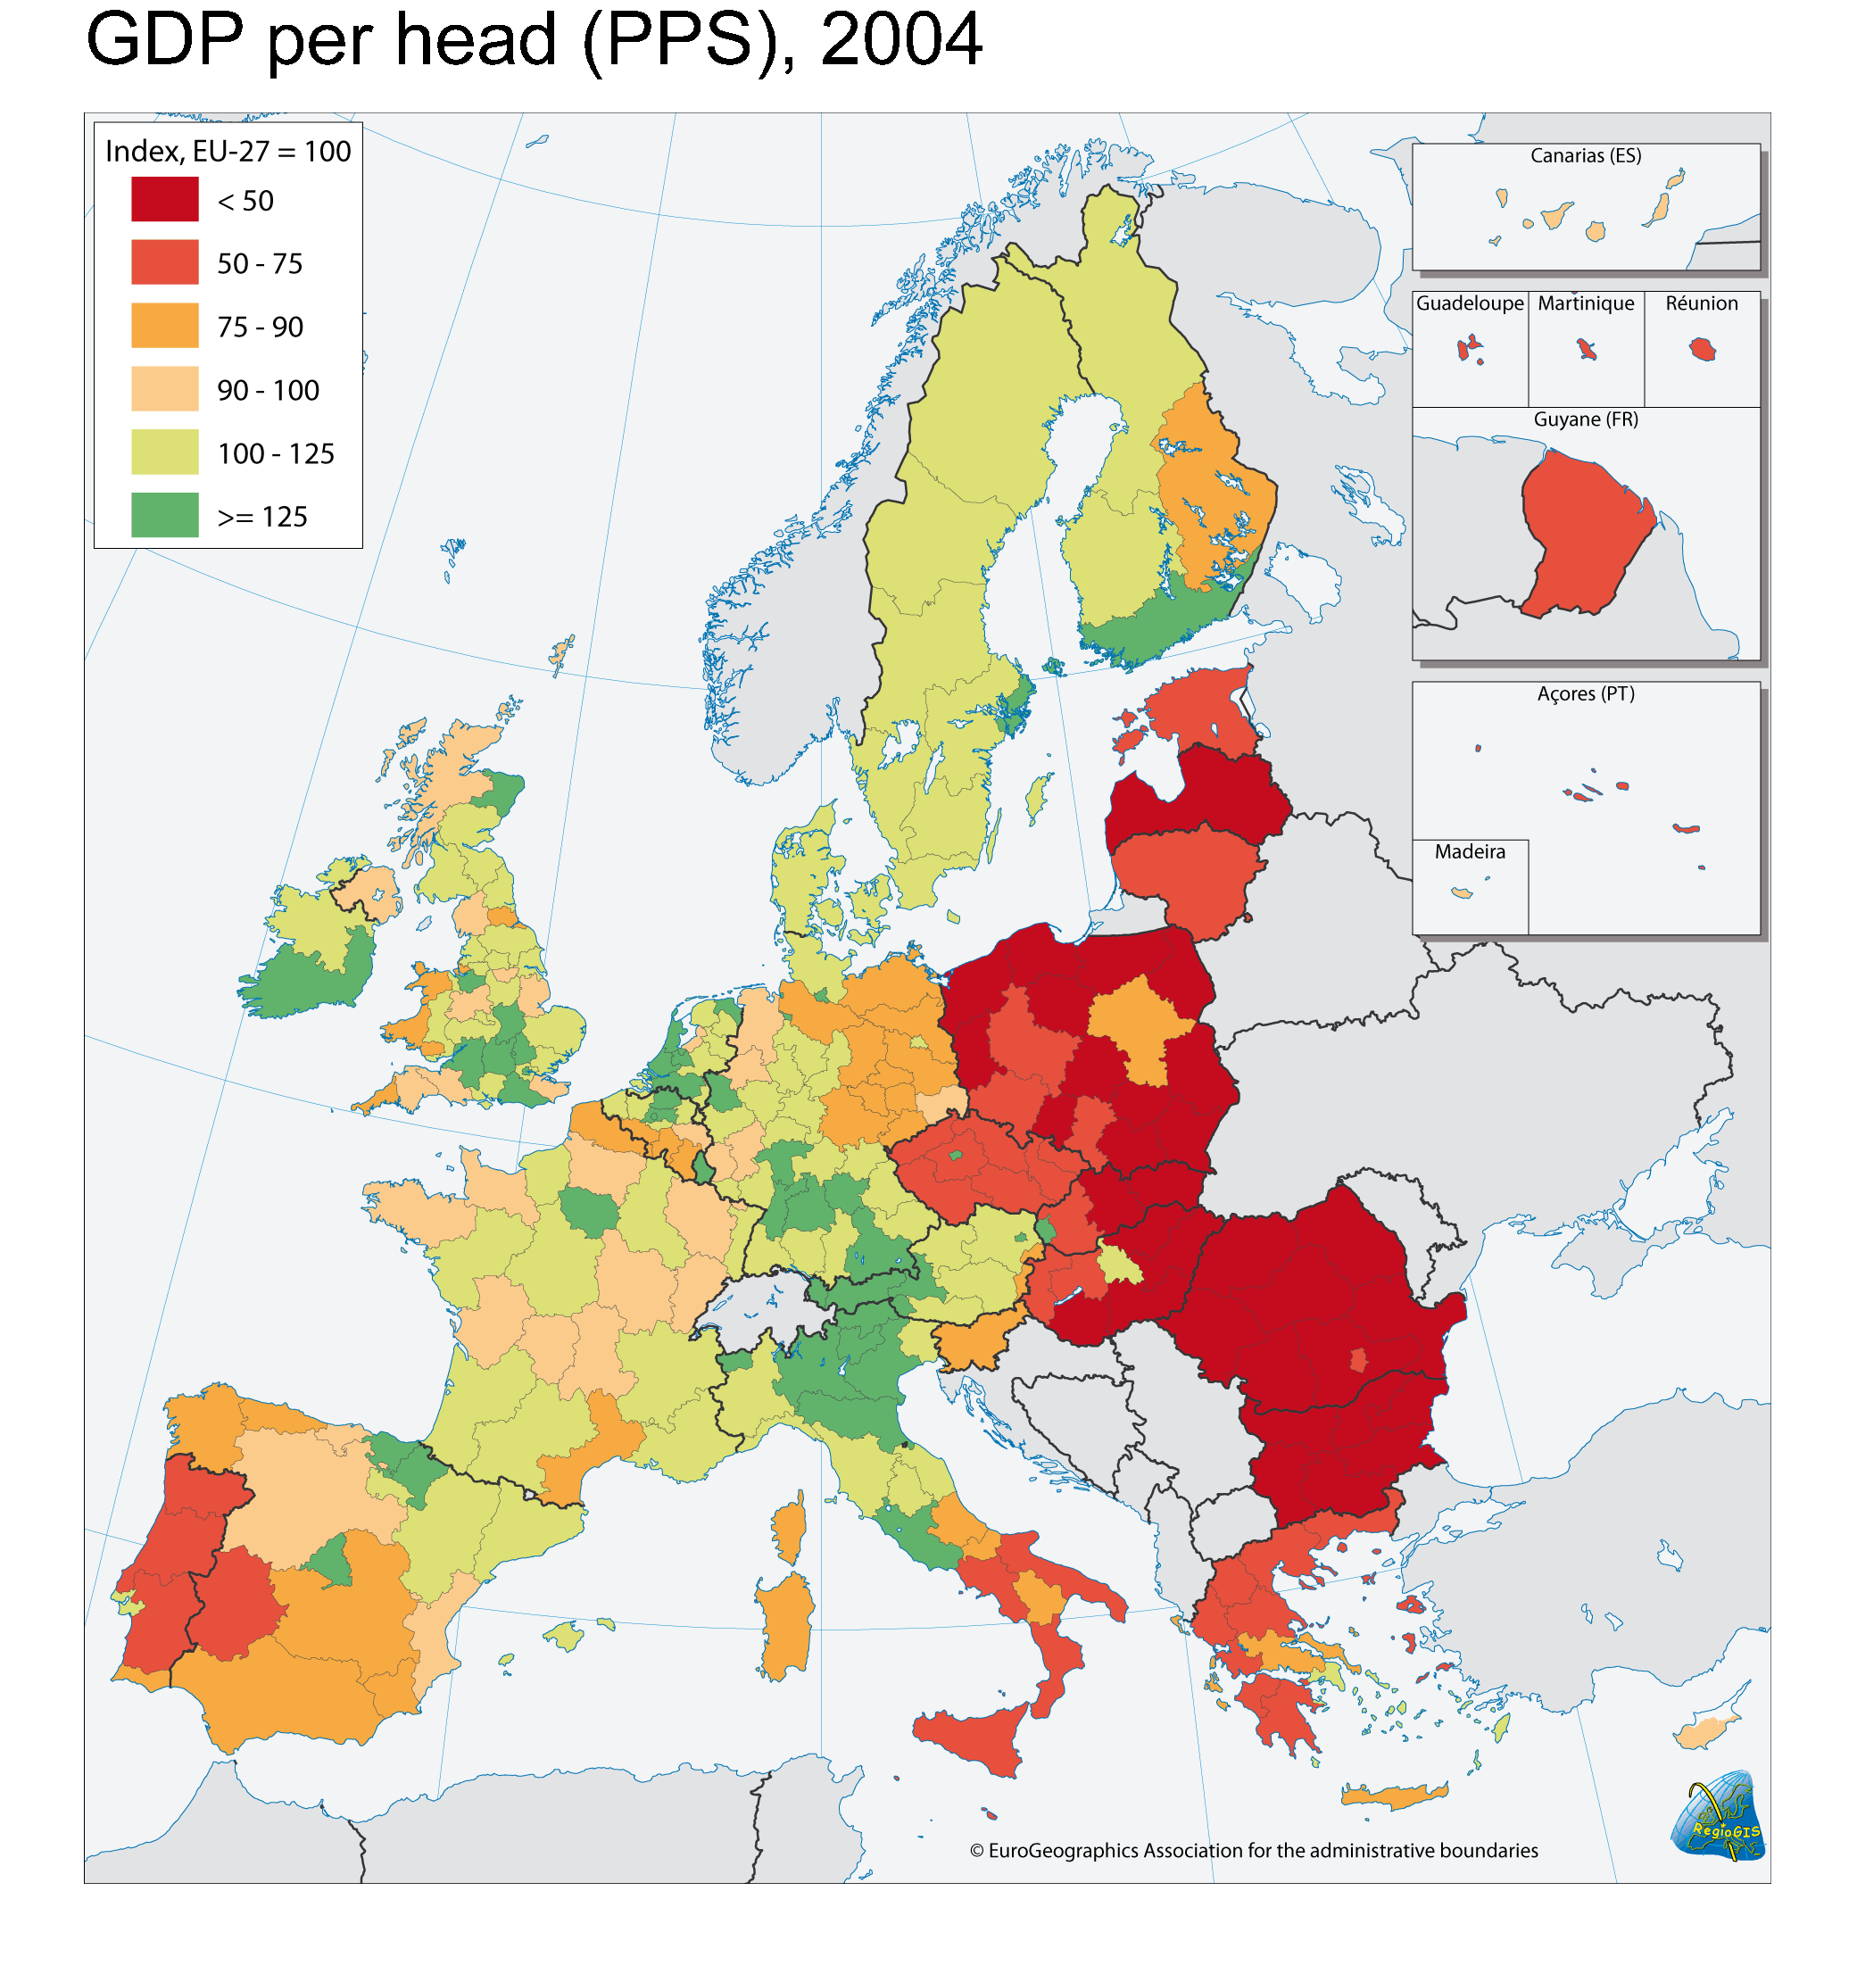
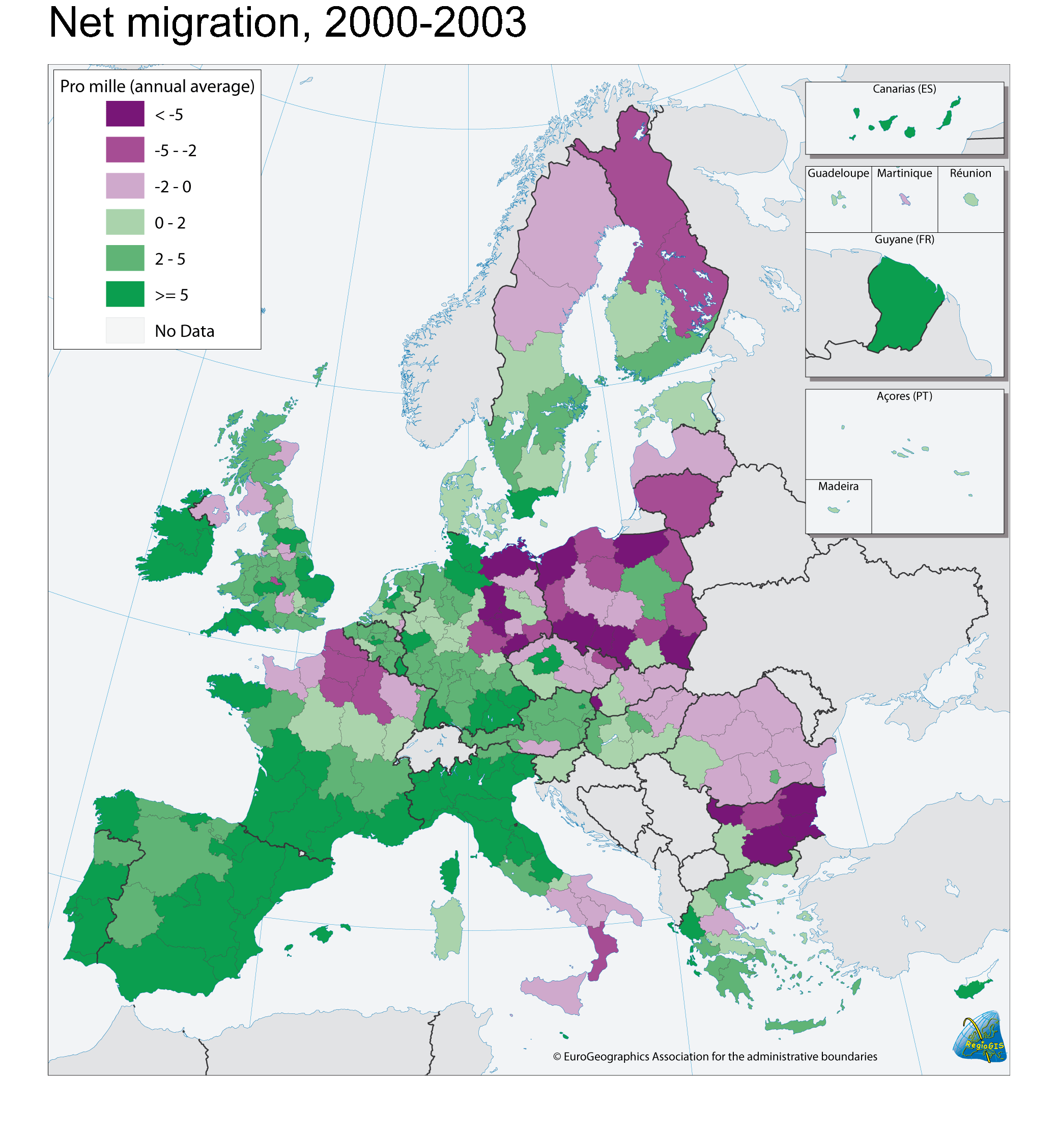
The scale of the challenge

Slide 15
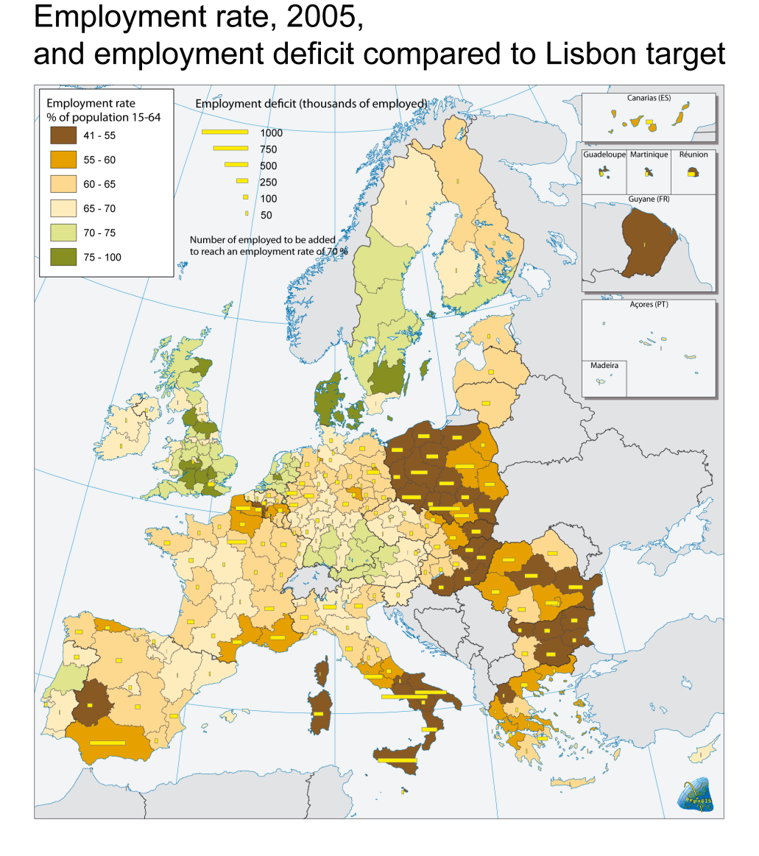
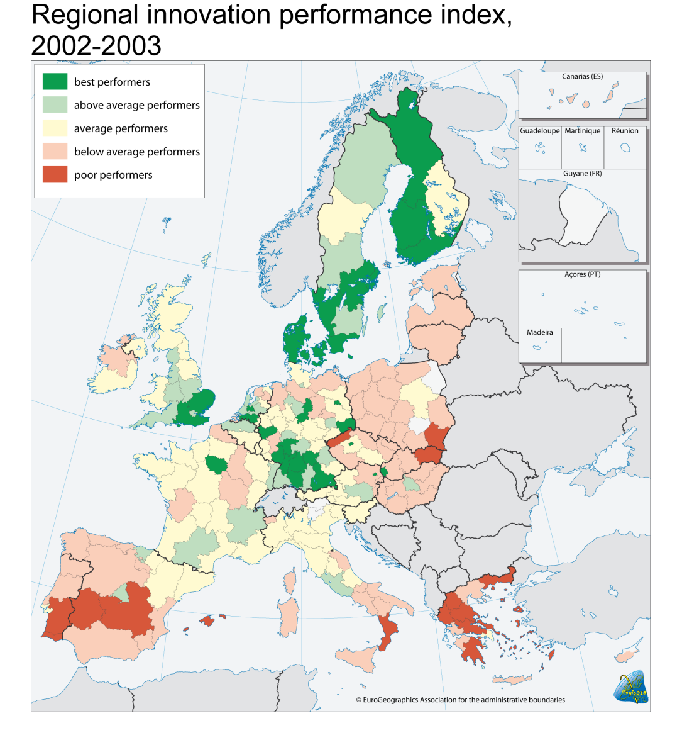

Slide 16
% of GNI

Slide 17
More focused than before
Simplification:
Reduction in number of financial instruments: to 3 from 6 the only additions single fund programmes.
Clearer division of responsibilities with the sustainable development policy.
Reducing the stages of programming (policy document from each Member State, operational programmes).
Simplification of financial management (priority axes).
Controls: introduction of proportionality, contracts.

Slide 18
Main themes from 2007
Convergence and competitiveness Regions less than 75% of EU 25 average GDP/head: accounts for 78% of total regional expenditure: States with less than 90% of EU 25 average GNI/head have access to Cohesion Fund). Phasing out support available for those losing eligibility.
Competitiveness & employment all regions eligible: 18% of total: 2 elements Regional competitiveness & Employment. Aimed at innovation, knowledge society and entrepreneurship
European territorial cooperation Boarder regions including sea: 4% of total: Based on INTEREG: Promote harmony through annual interregional programmes.
Notes:
Competitiveness and employment has two main strands
first element: regional competitiveness innovation and the knowledge society
accessibility and services of general interest
environment and risk prevention
would include responsibility for cities delegated to the regions (URBAN+),
no community initiative.
second element: employment - based on European Employment Strategy
adaptability of the workforce,
job creation,
accessibility to the labour market for vulnerable persons

Slide 19
Where will the money be spent?
Objectives
Structural funds and instruments
Convergence €251.3bn
ERDF
ESF
Cohesion
Fund
Regional Competitiveness
and Employment €48.8bn
ERDF
ESF
European territorial
Cooperation €7.5bn
ERDF
infrastructure,
innovation,
investments
etc.
vocational
training,
employment
aids etc.
environmental and
transport infra-
structure,
renewable energy
all Member States and regions
MemberStates with a
GNI/head below 90%
Notes:
European Regional Development Fund
European Social Fund
Cohesion Fund

Slide 20

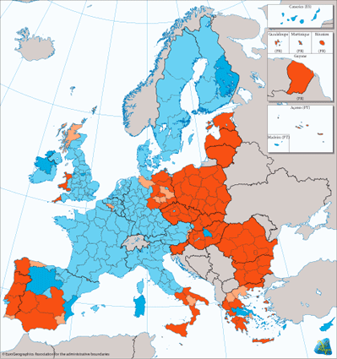
Where is the money going?

Slide 21
What next?
Regions 2002 published November 2008 is an attempt to highlight the issues that the EU will need to address over the next 10 years.
The transformation to a knowledge economy and managing social change
Aging society giving rise to questions about economic efficiency, and inter-generational equity.
Mitigating against climate change and adapting to it
Secure, sustainable and competitive energy requirements
The gap between rich and poor regions estimated at 8:1
The policy response is yet to follow
Regional and Local Economics (RELOCE)
Lecture slides – Lecture 8b

Slide 22
Conclusions
A common market and an economic and monetary union are advanced versions of the integration process
Currently 3 processes occurring simultaneously - NTBs, enlargement and MU
Forces at work tend to favour the centre over the periphery in the short-run
Arguments for an against EU-wide policy
4 major sources of funding ERDF, ESF, EAGGF, FIFG
Six main principles concentration, co-ordination, partnership, subsidiarity, programming, additionality
Agenda 2000 reforms channelling resources, simplified management, brought transparency, limit EU role, performance reserve
Policy after 2007 - less objectives, areas of eligibility changed, funding switch, UK share will reduce
But will it begin to bridge the gap?

