Slide 1
Using Total Enterprise Simulation Within Management Development
Simulation Experience – Over 20 Years
Some Customers (Past and Present) :-
Insurance: Zurich Financial Services, Norwich Union, Eagle Star, Prudential
Banking: Nationwide
Brokerage: Jardines
Retail: Tesco
FMCG: Mars
Telecommunications: Vodafone
IT: IBM
Education: School of Management, Southampton University (implementation plus research)
Consultancy: Accenture
Some Customer Needs :-
Finance (understanding company accounts, financial analysis, ratio analysis)
Strategic planning, marketing management, market research, interpreting management information
Business dynamics (the inter-dependencies of business)
Application of business skills
Project management
Teamwork and leadership
Key account management
Assessment: succession planning, business acumen
Student Employability
Author contact details: Dr Andrew Stainton
Email:a.stainton@soton.ac.uk

Slide 2









Topic Areas
Using Total Enterprise Simulation Within Management Development
Strategic Management
Team Work
Negotiation
Marketing Management
Leadership
Communication
Financial Analysis and Control
Project Management
Discussion
Team Work
Strategy Management
Negotiation
Communication
Marketing
Leadership
Financial Analysis and Control
Project Management
Discussion

Slide 3
Using Total Enterprise Simulation Within Management Development
Simulation Design Considerations
- Realistic (verisimilitude)
- Complex (challenging)
- Broad (stimulating)
- Meaningful (motivating)
- Multi-faceted (versatile usage)
- Content (developmental)
- Performance related (accountability)
- Cognitive (management principles)
- Behavioural (“learning by doing”)
- Affective (enjoyable, rewarding)
- Experiential (reflective learning)
- Strategic (competitive)
- Dynamic (problem solving)
- Depth (impact)
Comprehensive

Representation of real-world business environment
Learning Effectiveness
Simplistic
Abstract
Relevant
Relevance of marketplace to target audience

Slide 4
Using Total Enterprise Simulation Within Management Development
The Learning Process
Experience
Reflection
Deduction
Theory

Slide 5
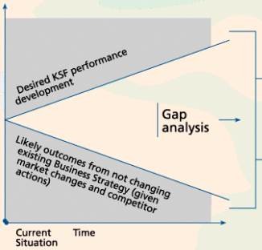
Using Total Enterprise Simulation Within Management Development
Plan
Implement
Where do we want to be?
Strategic Marketing
Closing the gaps
Seasonality
Fads
Environment
Competition
Where are we now?
Demography
Sales
Price competitiveness
Technology
Warehouse capacity
Market share
Financial Accounting
Retailer sales price
Production capacity
Stocks
Contribution margins
Benchmarks/controls
Product
Price
Variable + fixed costs
Information
Orders
Product attributes
Volume discounts
Manufacturer sales price
Leadership
Market potential
Management Accounting
Customer Needs
Preferred retailers
Co-operation
Retailer/ Manufacturer relationships
Teamwork
Motivation
Customer
Retailer size
Market Research
Target markets
Communication
People
Place
Shelf space
Key Ratios
Competence
Staffing
Manufacturer reliability
Roles
Retailer service
Goals
Pay
Loyalty schemes
Campaign response
Promotion
Brand image
Control
Product promotions
Monitor

Slide 6

Using Total Enterprise Simulation Within Management Development
Retailer Team A
Retailer Team B
Retailer Team C
Retailer Team D
Control Centre
Manufacturer Team A
Manufacturer Team B
Manufacturer Team C
Manufacturer Team D
Month 2
Month 3
Month 1
Team A
Team A
Team A
Team A
Decisions
Results
Decisions
Results
Decisions
Results
Processing
Processing
Processing
Control Centre
Control Centre
Control Centre
Control Centre
Team B
Team B
Team B
Team B
Decisions
Results
Decisions
Results
Decisions
Results

Slide 7
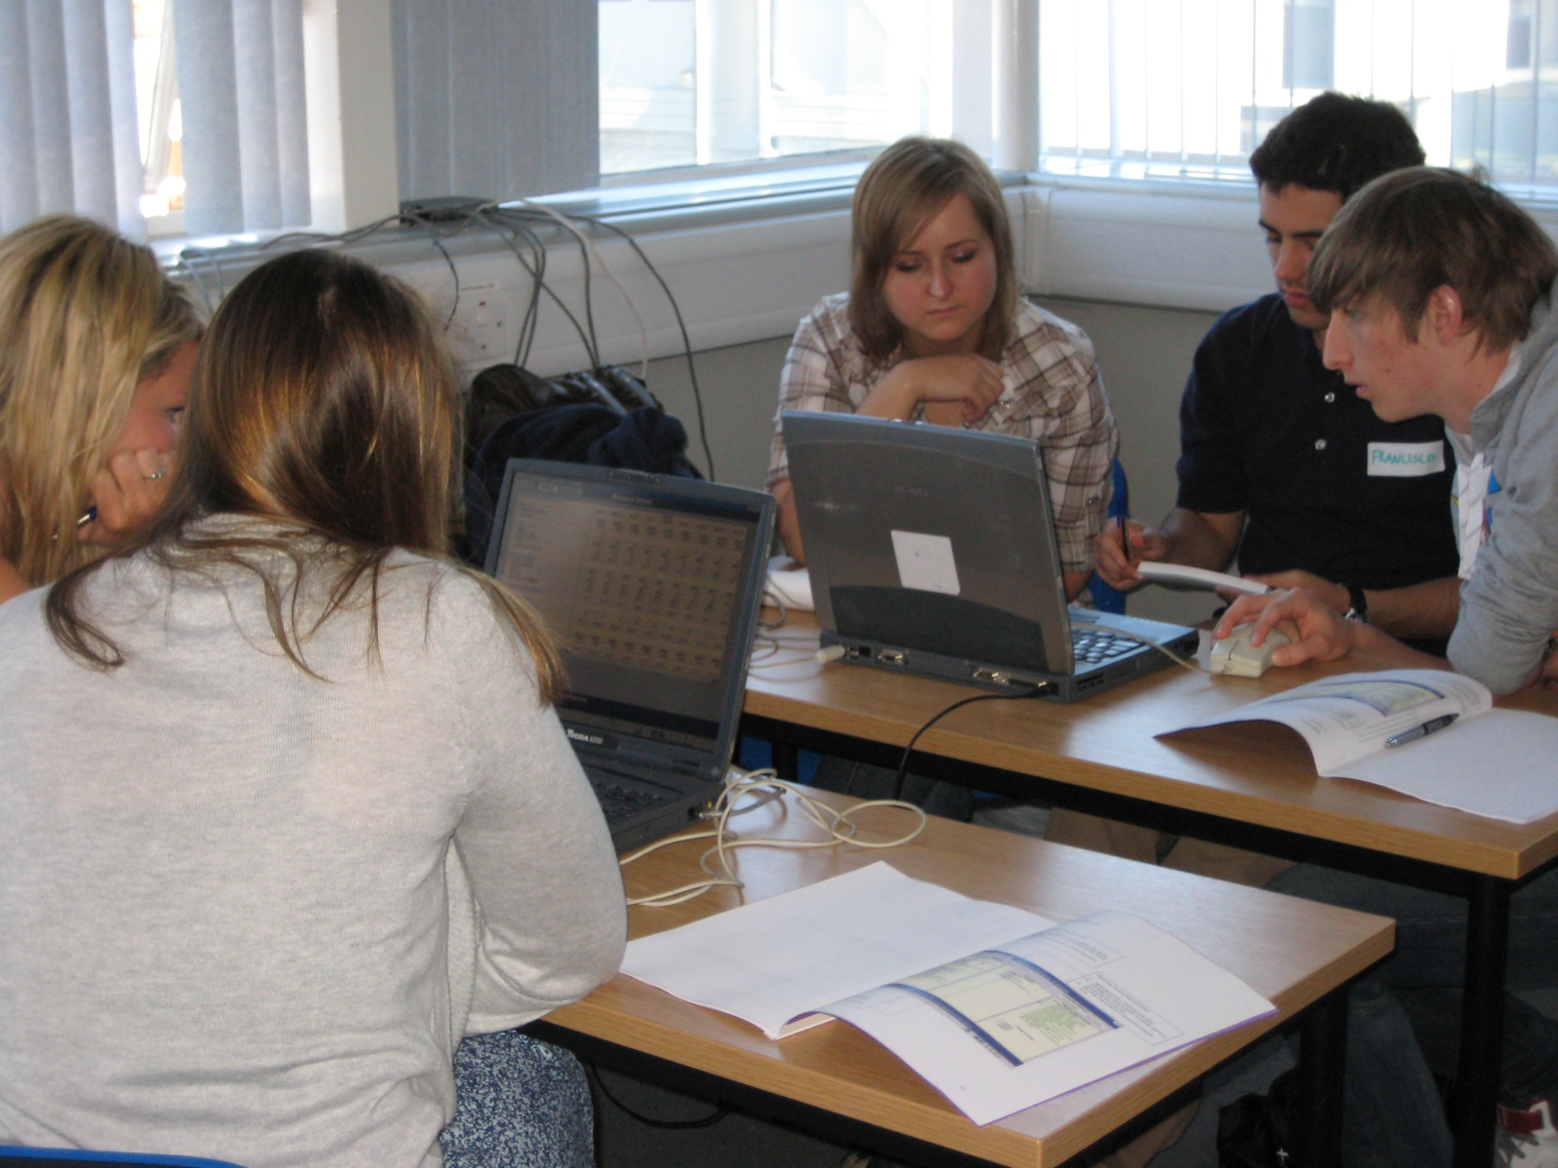
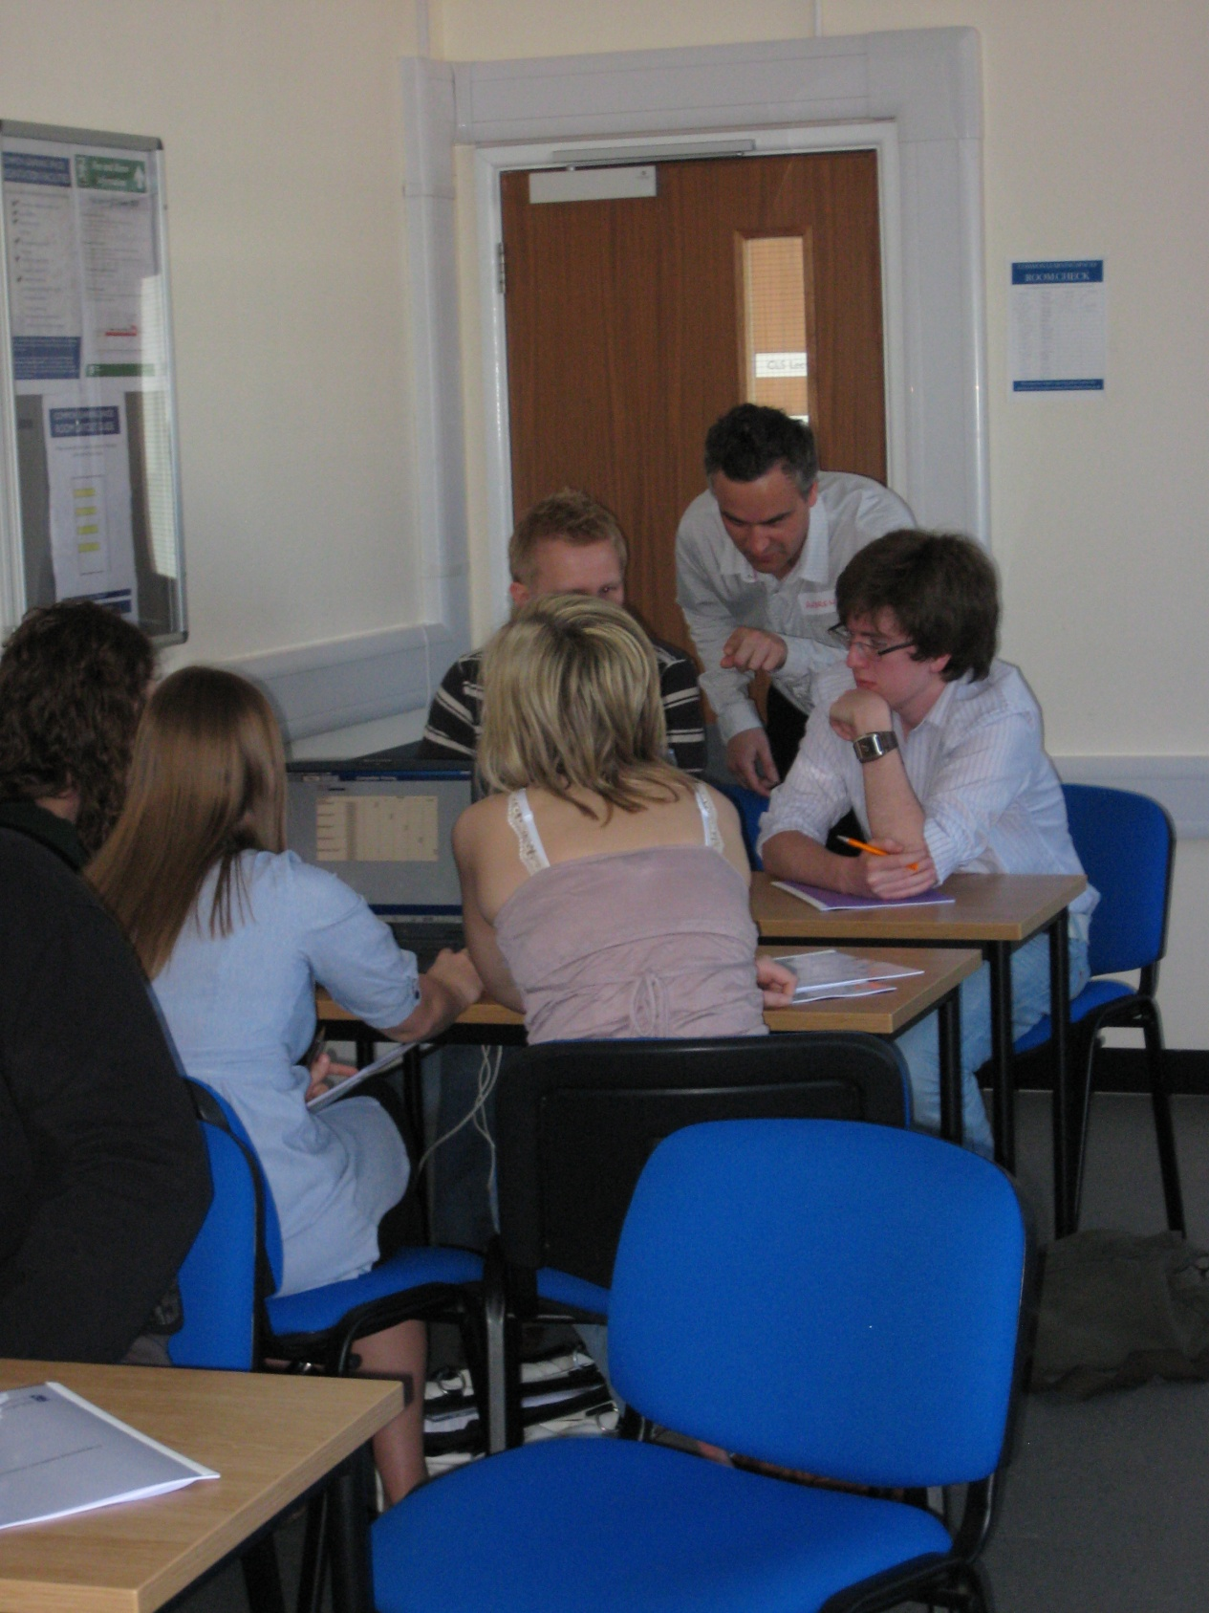
Employability Training Days For Law Students
Using Total Enterprise Simulation Within Management Development
9am Registration
9am – 10am Business management issues within a firm of solicitors
Business simulation – management in practice
(decision making – analysis – reflection)
10am-12am Applying business skills - quarter 1
12am-1pm Buffet lunch and talk by Blake Lapthorn
1pm-4pm Applying business skills - quarters 2/3/4
4pm-5pm Group presentations – reflection and discussion
5pm Work Placement Awards
Throughout the course facilitators assist participants to reflect upon their experiences and highlight learning points.

Slide 8
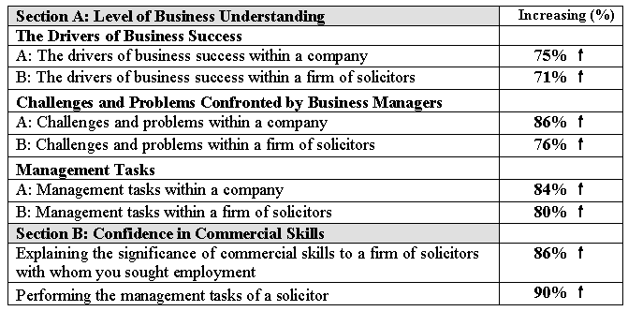
Evaluation Feedback
Using Total Enterprise Simulation Within Management Development

Slide 9
Using Total Enterprise Simulation Within Management Development
Attribute | Total Enterprise Simulation | Behavioural Simulation | Business Management Development Simulation
Description: | Mathematical model of a holistic business environment. Often delivered through computer medium. | Participants act out or role play a situation based upon a pre-determined story line. Can be computer controlled. | Comprehensive, mathematical computer model providing a holistic representation of a real-world business environment. Role play around management responsibilities is intrinsic and developing story lines are an outcome.
Proposed Learning Objective: | - Decision making - Business skills - Behavioural skills | - Decision making - Business skills - Behavioural skills | - Decision making - Business skills - Behavioural skills
Decisions: | Span across all business functions | Multiple choice relative to story line | Detailed business decisions across all business functions concerning key business drivers
Results: | - Financial statements - Operations reports | - Next stage of story line | Management reports to assist business thinking processes - Extensive market research reports - Performance analysis through financial statements and management accounting reports - Interactive tutor within computer interface of simulation to assist business thinking
Business Environment: | Can be a game based on luck and rules or a simulated representation of a business environment | Can be a game based on luck and rules or a simulated representation of a business environment | Focuses upon representing the real-life business environment.
Algorithm: | Mathematical model of a business | Decision tree relative to story line | Dynamic mathematical model of the competitive consumer market place, the supply chain, and the organisational infrastructure within a real-life business environment.
Level of social interaction during exercise: | Often low | Can be very high | Very high
Source: PhD Thesis by Dr Andrew Stainton

