Slide 2
The Economics of Pandemics
Rajiv Sethi and the CORE Team
Current Version: March 27, 2020

Slide 3
Overview
COVID-19 - another hockey stick?
Externalities: testing and distancing
Social preferences and the choice to self-quarantine
Disruption of global supply chains
Individual markets: masks, sanitizers, cruises, and flights
Income, employment, and aggregate demand
Asset prices: stock market indexes and Zoom Video Communications
Composition effects and scale effects

Slide 4
Additional Readings
Thomas Pueyo, Coronavirus: Why You Must Act Now and Coronavirus: The Hammer and the Dance (Medium)
Noreen Qualls et al., Community Mitigation Guidelines to Prevent Pandemic Influenza (Centers for Disease Control and Prevention)
Safra Center for Ethics at Harvard University, COVID-19 Response White Papers
CORE COVID-19 Collection

Slide 5
COVID-19 Hockey Sticks?

Slide 6
COVID-19 Growth Rates
Suppose daily growth rate of confirmed cases is g
With n cases today, $n{\left(1+g\right)}^{t}$ cases after t days
If g is $\sqrt{2}−1$ or about 41.42%, ${\left(1+g\right)}^{2}=2$
At this growth rate cases double every two days
100 cases grows to 1,131 in a week, over 46,000 in a month
Eventually growth slows because more recover or succumb
Assuming recovery comes with immunity
So, not another hockey stick
See more by comparing paths with linear and ratio (log) scales
Notes:
Relevant resource on CORE COVID-19 Collection:
Killing COVID-19 – a video lecture by Stephen Wright, Birkbeck College, University of London, that goes through some of the key mathematics and economics concepts relating to COVID-19, together with lecture slides and the Excel spreadsheet with the model simulations. https://www.core-econ.org/project/core-covid-19-collection/
Relevant section of The Economy.
Sections 1.2 and 1.3 on ‘History’s hockey stick’ comparison using linear and ratio scales. https://core-econ.org/the-economy/book/text/01.html#subheadline; https://core-econ.org/the-economy/book/text/01.html#13-historys-hockey-stick-growth-in-income

Slide 7
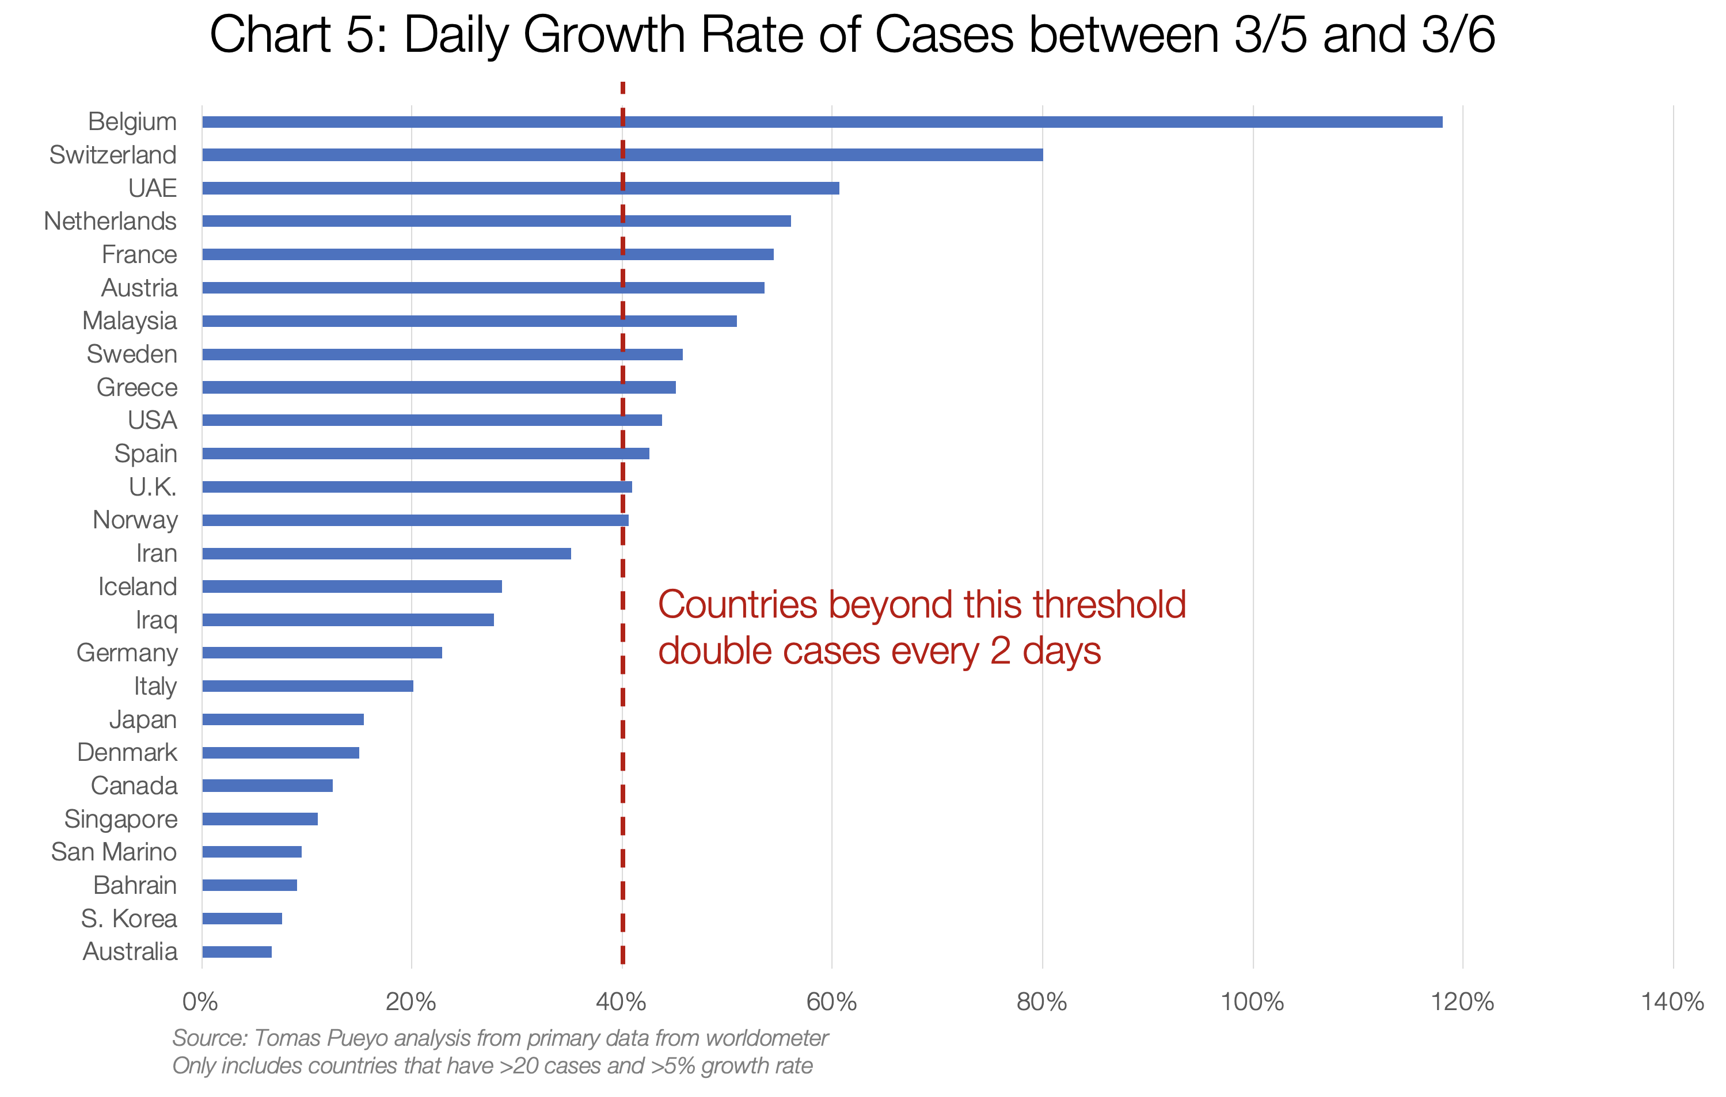
Number of days for confirmed cases to double from OWiD

Slide 8
Data
Valuable Data Source: Our World in Data
Search for COVID
Examine Total Confirmed COVID-19 cases (select your own countries)
Examine Total COVID-19 tests performed per capita (select your own countries)
Compare tests in total and per capita (per million people)

Slide 9
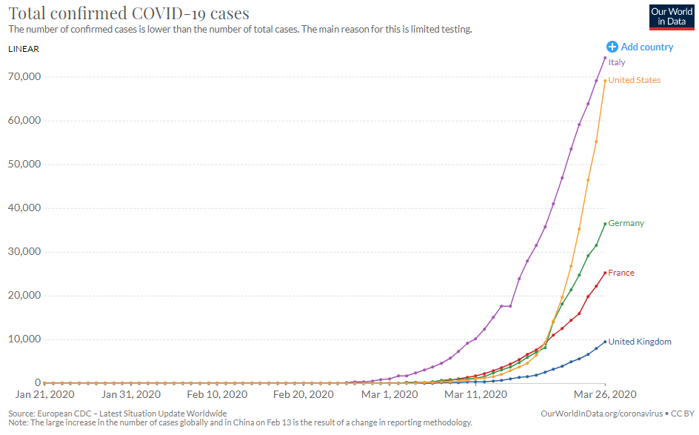
OWiD chart - select your own countries
Notes:
Relevant section of The Economy.
Sections 1.2 and 1.3 on ‘History’s hockey stick’ comparison using linear and ratio scales. https://core-econ.org/the-economy/book/text/01.html#subheadline; https://core-econ.org/the-economy/book/text/01.html#13-historys-hockey-stick-growth-in-income

Slide 10
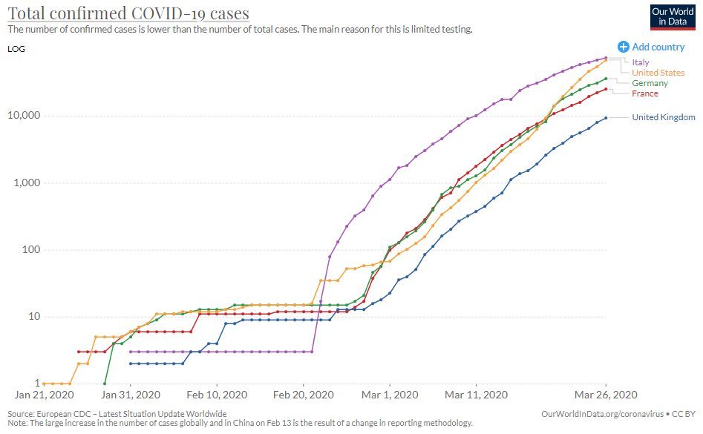
OWiD chart - select your own countries

Slide 11
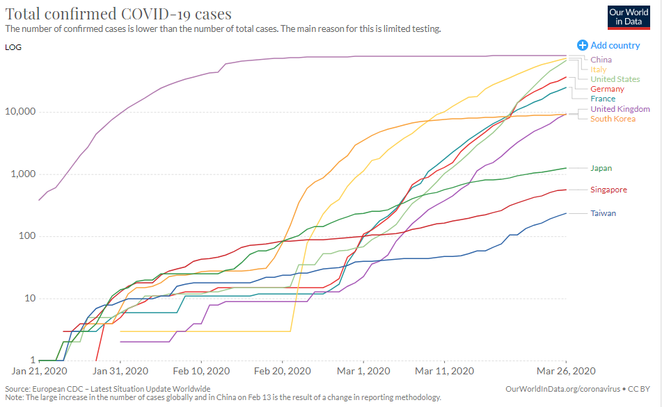
OWiD chart - select your own countries

Slide 12
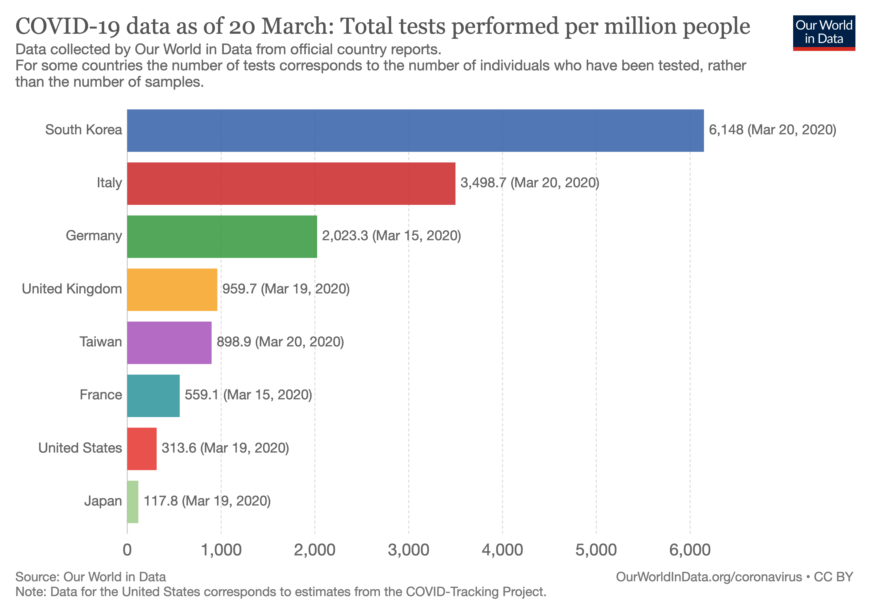
OWiD chart select your countries

Slide 13
COVID-19 Total Cases
Data on total cases doesn’t account for population
Also doesn’t account for extent of testing
High growth can arise from greater testing or spread of virus
Differences across countries can also arise from reliability of reporting
Still, cross-country comparisons can be informative

Slide 14
Flattening the Curve

Slide 15
Flattening the Curve
If growth is rapid, peak number of cases will be high
Possibly exceeding capacity of health care system
How can growth be slowed?
Those exposed or infected must self-quarantine (or be isolated)
Those not exposed must take precautions
Washing hands, avoid touching face, and social distancing
Closing of schools, cancellation of events and travel, distance learning

Slide 16
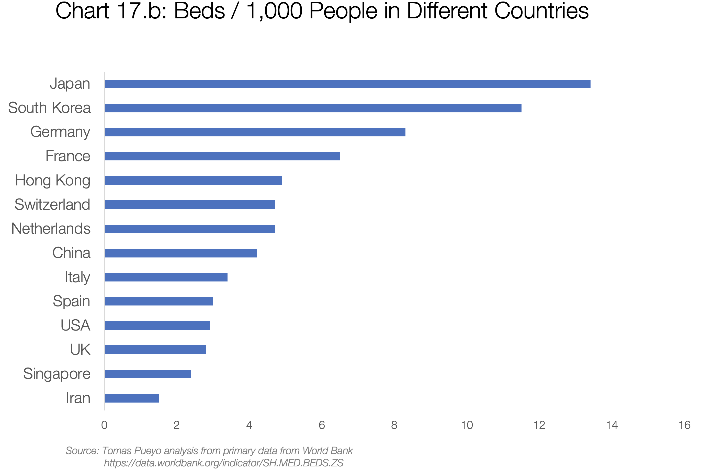
OWiD data - select your countries

Slide 17
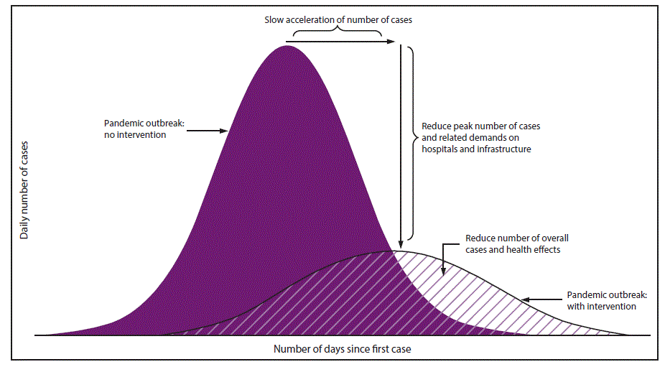

Slide 18
External Effects
Social distancing has private costs and social benefits
Similar to contributions to a public good
If people only equate private benefits and costs, insufficient distancing
Policy response: closings, cancellations, restrictions on mobility
Testing also has private costs and social benefits
If people only equate private benefits and costs, insufficient testing
Policy response: subsidization of testing, mandatory testing
Vaccine development also not profitable (before or after pandemic)
Policy response: subsidies and grants for vaccine development
Notes:
Relevant sections in The Economy:
Discussion of public goods in The Economy: https://core-econ.org/the-economy/book/text/04.html#46-public-goods-free-riding-and-repeated-interaction
External effects in The Economy (Unit 12): https://core-econ.org/the-economy/book/text/12.html
Vaccine development - link to innovation and patents (The Economy, Unit 21): https://core-econ.org/the-economy/book/text/21.html
Government as an economic actor: The Economy (Unit 22) https://core-econ.org/the-economy/book/text/22.html#221-the-government-as-an-economic-actor
Relevant sections in Economy, Society, and Public Policy:
Discussion of public goods in ESPP: https://www.core-econ.org/espp/book/text/02.html#27-free-riding-and-the-provision-of-public-goods
External effects in ESPP (Unit 11.7): https://www.core-econ.org/espp/book/text/11.html#117-market-failure-external-effects-of-pollution
Government as an economic actor: ESPP (Unit 12) https://www.core-econ.org/espp/book/text/12.html#123-the-government-as-an-economic-actor

Slide 19
Social Preferences
Those with exposure or symptoms should self-quarantine
But this also has private costs and social benefits
In fact private benefits are few (too late to prevent infection)
Benefits may even be negative: loss of wages
So why do many people self-quarantine?
Social preferences: concern for others and civic responsibility
Policy response: acknowledge and encourage civic responsibility
But not all are responsive to such initiatives, or can afford to stay home
Policy response: screening and isolation, paid sick leave
Notes:
Relevant sections in The Economy:
Social preferences (The Economy Unit 4.4): https://core-econ.org/the-economy/book/text/04.html#44-social-preferences-altruism
Relevant sections in ESPP:
Social preferences (ESPP Unit 2.10): https://www.core-econ.org/espp/book/text/02.html#210-how-three-kinds-of-social-preferences-address-social-dilemmas

Slide 20
Demand and Supply

Slide 21
Demand Shifts
Significant contraction in demand for some goods and services
Examples: restaurants, hotels, flights, cruises
Supply and demand model suggests lower price and quantity
With lower profits and significant debt: increased incidence of bankruptcy
Reduced hiring, increased layoffs
But some goods/services see higher demand
Healthcare, sanitizers, masks, cleaning supplies
Incentives for panic buying, hoarding and profiteering
Notes:
Relevant sections in The Economy
Elasticity of demand, price-setting, market power (The Economy Unit 7.8): https://core-econ.org/the-economy/book/text/07.html#78-the-elasticity-of-demand
Gains from trade (The Economy Unit 8.5): https://core-econ.org/the-economy/book/text/08.html#85-competitive-equilibrium-gains-from-trade-allocation-and-distribution
Rent-seeking and market equilibration (The Economy Unit 11.1): https://core-econ.org/the-economy/book/text/11.html#111-how-people-changing-prices-to-gain-rents-can-lead-to-a-market-equilibrium
Price-scalping, rationing, non-clearing markets (he Economy Unit 11.9): https://core-econ.org/the-economy/book/text/11.html#119-non-clearing-markets-rationing-queuing-and-secondary-markets
Relevant sections in ESPP
Elasticity of demand, price-setting, market power (ESPP Unit 7.7): https://www.core-econ.org/espp/book/text/07.html#77-price-setting-market-power-and-public-policy
Gains from trade (ESPP Unit 7.6): https://www.core-econ.org/espp/book/text/07.html#76-gains-from-trade

Slide 22
Supply Shifts
Disruption of global supply chains
With inability to source components quickly elsewhere, supply falls
Greater employee absence also lowers supply
Supply and demand model suggests higher price and lower quantity
Opposite effects on profits, but negative on balance
Again resulting in reduced hiring, increased layoffs, more bankruptcy
Notes:
Relevant sections from The Economy
Globalization (The Economy Unit 18) https://core-econ.org/the-economy/book/text/18.html

Slide 23
Asset Prices

Slide 24
Asset Prices
Prices of shares reflect expectations of future profitability
Demand contraction lowers expected profits and stock prices
Somewhat mitigated by wage effects of higher unemployment
So stock market indexes (Dow Jones, S&P 500) fall
Stocks of airline, cruise lines fall especially far
But some assets rise in price: Zoom Video Communications (ZM)
Notes:
Relevant section in The Economy: Asset prices (The Economy 11.5): https://core-econ.org/the-economy/book/text/11.html#115-the-value-of-an-asset-basics
Relevant section in ESPP: Unit 10.8: https://www.core-econ.org/espp/book/text/10.html#108-the-value-of-an-asset-expected-return-and-risk

Slide 25
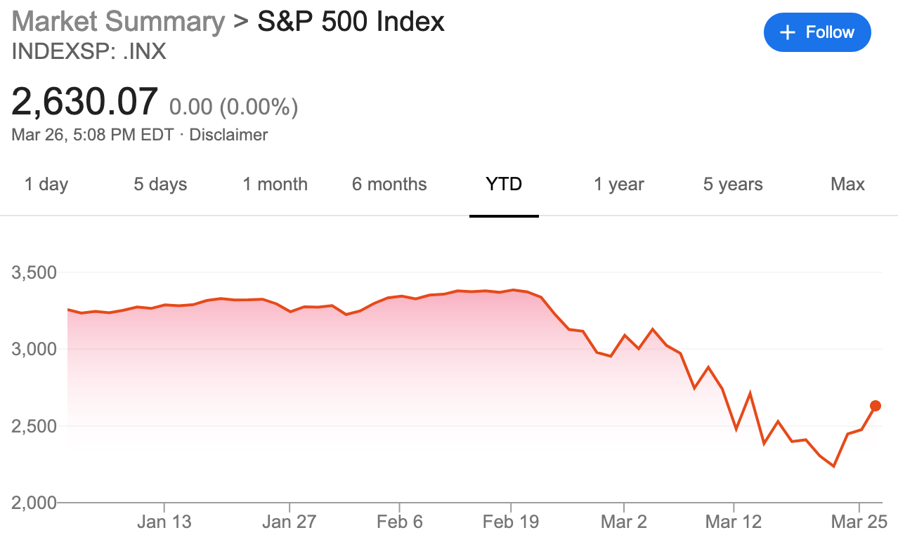

Slide 26
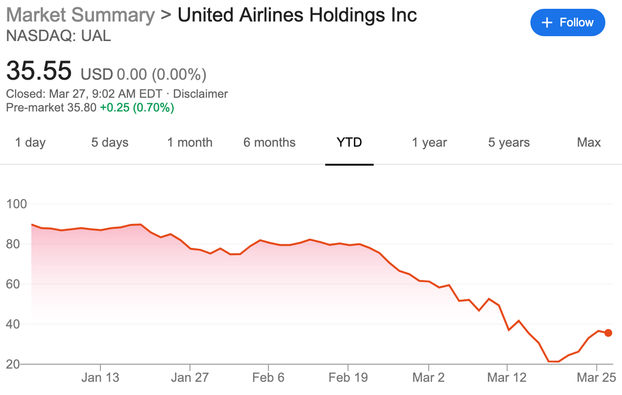

Slide 27
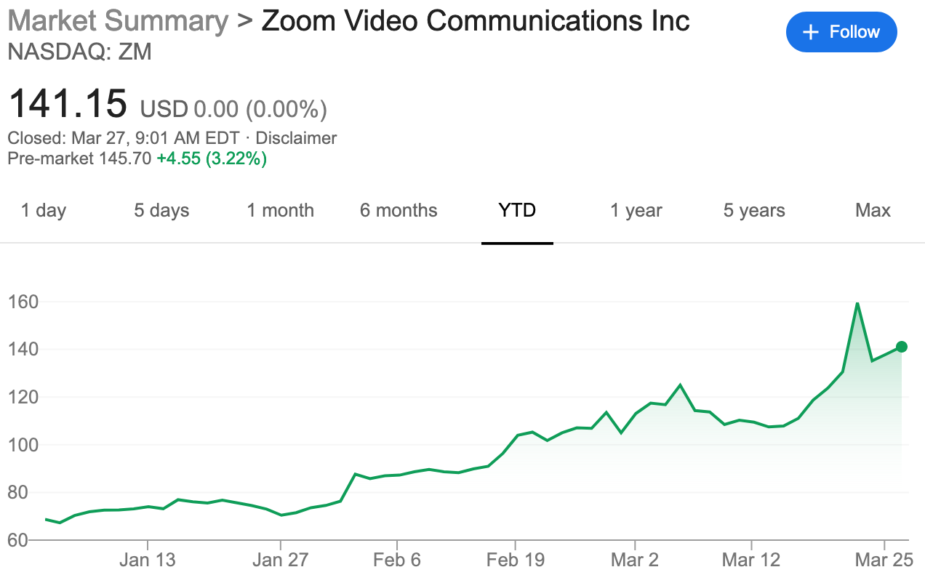

Slide 28
Composition and Scale Effects

Slide 29
Composition and Scale
Economic effects of COVID-19 can be partitioned into two categories
Composition effects refer to collapse in demand for some goods/services
Even as there is surging demand for others
Collapsing demand: travel, lodging, meals, entertainment, durables
Surging demand: health services, masks, ventilators, sanitizers, software
Scale effects refer to the collapse in aggregate output and employment.
Predicted contraction in second quarter: 14% (JPM) and 24% (GS)
Treasury Secretary: unemployment rate of 20% possible
Different types of effects call for different policies
Notes:
Relevant section of The Economy:
How changes in demand for goods and services affect unemployment The Economy (Unit 9.7): https://core-econ.org/the-economy/book/text/09.html#97-how-changes-in-demand-for-goods-and-services-affect-unemployment
Great Depression The Economy (Unit 17.2) https://core-econ.org/the-economy/book/text/17.html#172-the-great-depression-positive-feedbacks-and-aggregate-demand

Slide 30
Composition Effects
For goods/ services in high demand, incentives needed for more supply
Market will respond to some extent
AMZN hired 100,000 more workers, raised pay
Some distilleries converting operations to produce disinfectants
But market solutions not adequate on both efficiency and equity grounds
Ventilator production relies on disrupted global supply chains
Role for government mandated or subsidized production (as in wartime)
Should affluent individuals be allowed to buy and store ventilators?
Should hoarding and profiteering be monitored and punished?
Notes:
Relevant Unit in The Economy:
Global supply chains (The Economy Unit 18): https://core-econ.org/the-economy/book/text/18.html
Inequality in impact of pandemics https://core-econ.org/the-economy/book/text/10.html, https://core-econ.org/the-economy/book/text/19.html
Einstein on Gini and unemployment https://core-econ.org/the-economy/book/text/09.html#einstein-the-lorenz-curve-and-the-gini-coefficient-in-an-economy-with-unemployed-employed-and-employers-owners
Relevant Unit in ESPP
Pareto efficiency 5.2 https://core-econ.org/the-economy/book/text/05.html#52-evaluating-institutions-and-outcomes-the-pareto-criterion, for ESPP 3.4 https://www.core-econ.org/espp/book/text/03.html#34-evaluating-an-outcome-is-it-efficient

Slide 31
Local Governments
State and local governments face hard budget constraints
Face possibility of bankruptcy (unlike federal government)
Sharp fall in revenues just as expenditure needs rise substantially
Cannot simply borrow to finance shortfall
Role for Federal Reserve in buying municipal bonds

Slide 32
Scale Effects
As layoffs and bankruptcies rise, aggregate demand falls further
Multiplier effect amplifies decline, lead to recession
Mitigated by automatic stabilizers: lower taxes, higher expenditure
Policy response: Expansionary fiscal and monetary policy
Federal Reserve: lower interest rates, asset purchases
Treasury: tax cuts, delayed filing, increased benefits, cash payments
Other policies: suspension of loan repayments and evictions
Discussion: should we have a flexible universal basic income?
Discussion: should we allow individual accounts at the Fed?
Notes:
Relevant sections in The Economy:
Multiplier effect (The Economy Unit 14.1): https://core-econ.org/the-economy/book/text/14.html#141-the-transmission-of-shocks-the-multiplier-process
Fiscal policy (The Economy Unit 14): https://core-econ.org/the-economy/book/text/14.html
Monetary policy (The Economy Unit 15): https://core-econ.org/the-economy/book/text/15.html
Historical comparisons with Great Depression and global financial crisis (The Economy Unit 17): https://core-econ.org/the-economy/book/text/17.html

Slide 33
Glossary
aggregate demand
asset
automatic stabilizers
cooperation
demand side
employment rate
external effect
fairness
fiscal multiplier
fiscal policy
fiscal stimulus
income
monetary policy
Pareto efficient
private benefit
private cost
prudential policy
public bad
public good
social interactions
social preferences
stock exchange
supply side

