Slide 1
Logistic Regression I
SIT095
The Collection and Analysis of Quantitative Data II
Week 7
Luke Sloan

Slide 2
About Me
Name: Dr Luke Sloan
Office: 0.56 Glamorgan
Email: SloanLS@cardiff.ac.uk
To see me: please email first
Note: Monday and Tuesdays only

Slide 3
Introduction
Multiple (Linear) Regression – Recap
Intro To Logistic Regression
Assumptions
Choosing Model Variables
Multicolinearity
Coding and Dummy Variables
Summary

Slide 4
Multiple (Linear) Regression - Recap
Used to model the relationship between categorical or continuous independent variables and a continuous dependent variable
Assumes that this relationship is linear
Tells us what effect a one-unit increase in x will have on y using the coefficient (‘B’)
What if we have a categorical dependent?...

Slide 5
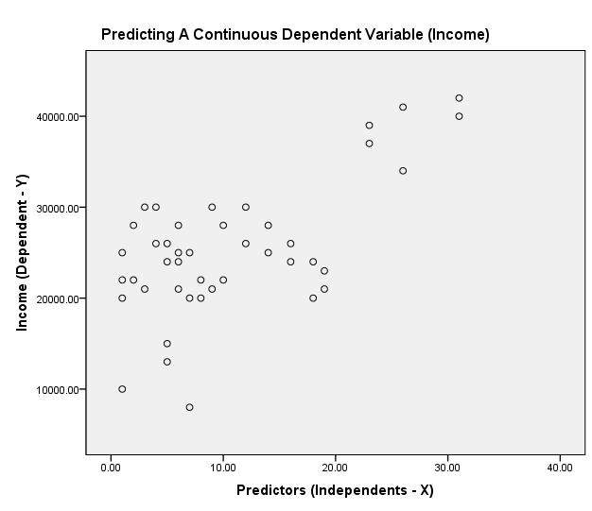
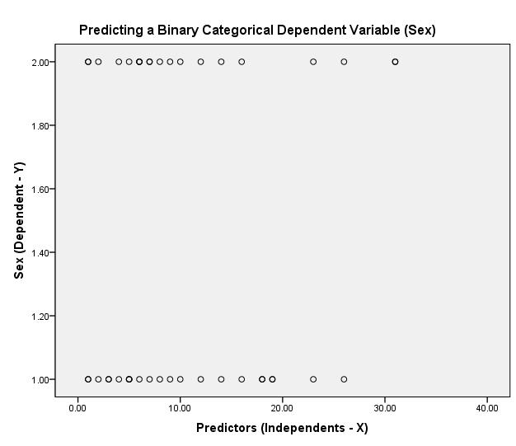
Multiple (Linear) Regression – Recap II
Linear regression uses the mean value – this is useless for categorical data!
With a continuous dependent variable we can observe whether linearity exists
With a categorical dependent variable linearity cannot exist

Slide 6
Intro To Logistic Regression I
Logistic regression allows us to predict the probability of y having a given value based on information from categorical and continuous independent variables
Binary logistic model – when categorical dependent has only two response categories (e.g. male/female)
Multinomial logistic model – when categorical dependent has more than two response categories (e.g. Lab/Con/LD/Green…)
Allows us to calculate how a change in x affects the odds of y
e.g. respondents who played games consoles were more likely to be male than female (odds increase of 4)… or… the odds playing a games console were 4 times higher for males than for females
This is not the same as ‘likelihood’!

Slide 7
Intro To Logistic Regression II
Examples of Applied Logistic Regression
Model Type:
Dependent:
Predictors:
Binary Logistic
Sex:
Male/Female
Height, games console ownership, favourite colour etc…
Cancer:
Malignant/Not Malignant
Chemical presence, size, aggression, drug resistance etc…
Ethnicity:
White/Non-White
Income, highest qualification, occupation, religion etc…
Multinomial Logistic
Party Affiliation:
Lab/Con/LD/Green
Occupation, income, social class, house-ownership etc…
Ethnicity:
White/Black/Asian/Other
Income, highest qualification, occupation, religion etc…

Slide 8
Intro To Logistic Regression III
y = a + b x
‘y’ represents the dependent variable (what we are trying to predict) e.g. income or sex
‘a’ represents the intercept (where the regression line crosses the vertical ‘y’ axis) aka the constant
‘b’ represents the slope of the line (the association between ‘y’ & ‘x’) e.g. how income or sex changes in relation to education or console ownership
‘x’ represents the independent variable (what we are using to predict ‘y’) e.g. years in education or console ownership
P(y) = 1/(1 + e^{- (a + bx)})
Logarithmic Transformation
Probability

Slide 9
Intro To Logistic Regression IV
Probability is the mathematical likelihood of a given event occurring i.e. probability of being male or female based on predictor variables
Resulting value of the logistic regression equation (in this form) gives a value between 0 and 1
A value close to 0 means that y is very unlikely to have occurred
A value close to 1 means that y is very likely to have occurred
In our example, the outcome might be that the respondent is male
Just as in multiple linear regression, the independent variables are given coefficients
These coefficients are interpreted as odds rather than unit increases

Slide 10
Intro To Logistic Regression V
The logarithmic transformation allows us to express a non-linear relationship in a linear way
Thus the logistic regression equation expresses the linear regression equation using a logarithmic term (referred to as logit)
This overcomes the problem of linearity and avoids violating this assumption
Residuals can now be normally distributed (requires dependent to take more and two values!)

Slide 11
Intro To Logistics Regression VI
Linear Probability Model:
Logistic Probability Model:
PROB(Male) = a + b ‘Income’
PROB(Male) = 1/(1 + e^{- (a + b} ^{‘Income’)})
Prob (Male)
Prob (Male)
1
1
0.5
0.5
0
Income
0
Income
Probability can exceed 1 or be less than 0 (i.e.unbounded)
Logarithmic transformation bounds probability between 0 - 1

Slide 12
Intro To Logistic Regression VII
To transform this logistic curve into a straight line (so we have linearity):
PROB(Male) = 1/(1 + e^{- (a + b} ^{‘Income’)})
LOGIT(Male) = a + b ‘Income’
This is the equation for the curve!
This is the equation for a straight line!
But both of these are complicated to interpret (mental gymnastics required!) so we talk about interpreting the effect of the independent variables in terms of ‘odds’
ODDS(Male) = exp(a + b ‘Income’)
or…
ODDS(Male) = exp(a) exp (b ‘Income’)
or…
ODDS(Male) = exp(a) exp(b)^{’Income’}
Because the constant (‘a’) does not change, ‘exp(b)’ tells us the effect of the independent variable on the odds ratio (‘ODDS(Male)’)

Slide 13
Intro To Logistic Regression VIII
EXAMPLE: There are 20 rainy days in March (out of 31 possible days)
Probability:
The chance or likelihood of a specific event of outcome
Probability of rain tomorrow:
20/31 or 2/3
Odds:
The ratio of the probability that a particular event will occur to the probability that it will not occur
Odds of rain tomorrow:
(Prob. of rain) / (Prob. no rain)
or (2/3) / (1/3) or 0.6 / 0.3
or 2:1 or 2
Logit:
The natural log of the odds
Logit of rain tomorrow:
LN(ODDS(rain)) or LN(2) or 0.69

Slide 14
Intro To Logistic Regression IX
Now we know what the technique is, how it can be useful and what it can tell us
Running the model in SPSS and interpreting coefficients next week
Multinomial logistic regression is very similar
Don’t worry if you haven’t followed the equations!
Rest of today – model design and assumptions

Slide 15
Assumptions
Assumption | Issue | Recommendation
Sample Size | Sample should be large enough to populate categorical predictors. Limited cases in each category may result in failure to converge | Use crosstabs at variable selection stage to identify low populated cells, may result in recoding
Outliers | Cases that are strongly incorrectly predicted may have been poorly explained by the model and misclassified | Identify cases through classification table and residuals – use probability threshold scores
Independence of Errors | Cases of data should not be related i.e. one respondent per dataset, not repeated measures - overdispersion | Easy to avoid if the data collection has been conducted properly
Multicollinearity | Independent variables are highly inter-correlated (continuous) or strongly related to each other (categorical) | Use collinearity diagnostics in linear regression model and test high tolerance values using chi-square or correlation
Does not assume normal distribution of predictor variables – very useful!

Slide 16
Choosing Model Variables I
Choosing the variables for your model is not guess work!
You need to form hypotheses about which independents might be related to the dependent and why
Perform hypothesis tests (chi-square, t-tests etc) to ensure that there is a relationship
Understand that p-values of around 0.05 may be accepted – there is no hard and fast rule
Cell counts for crosstabs must not drop below 5 as this may result in model computation problems (e.g. if independent perfectly explains dependent)
Use this opportunity to check for outliers and to identify categorical variables that may need recoding (collapsing to increase cell counts) – start with frequencies
These problems are much easier to deal with before running a model

Slide 17
Choosing Model Variables II
Logistic Regression will exclude any cases where one or more of the independent variable values is missing
When choosing variables you must look carefully at the amount of missing data – 50% missing data from one independent variable will exclude 50% of sample from analysis
This effect can accumulate to unacceptable levels
EXAMPLE: In my PhD thesis I designed a multinomial logistic regression model with 22 original variables which excluded 90.56% of cases due to missing data. After excluding 7 of the worst offenders the percentage of included cases rose to 75.01%. This is a big deal!

Slide 18
Multicollinearity I
Multicollinearity is particularly problematic for logistic regression models
It occurs when one or more independent variables are related to each other (i.e. not independent!)
It tends to reduce or negate the influential effect of either predictor and can also have cumulating effects on the rest of the model
It must be prevented at all costs and is more common than you might think – income, education, social class, age, house ownership, political party affiliation…

Slide 19
Multicollinearity II
To test for multicollinearity you need to use the ‘collinearity diagnostics’ available under ‘Linear’ regression in SPSS
Eigenvalues – smaller values mean that the model is likely to be less affected by changes to the measured variables
Condition Index – the square root of the ration of the largest Eigenvalue to the Eigenvalue of interest, disproportionately large values are indicative of collinearity
Variance Proportions – show % of variance of regression coefficient associated with relevant (small) Eigenvalue, more than two high values on the same dimension may be indicative of collinearity (I use =>0.30)
As Eigenvalues shrink towards the bottom of the table collineairty tends to appear around the bottom, but similar Eigenvalues will prevent this
Use as a diagnostic test – investigate further with chi-square, t-tests or correlation

Slide 20
Multicollinearity III
Collinearity Diagnosticsª
Model | Dimension | Eigenvalue | Condition Index | Variance Proportions
 |  |  |  | (Constant) | ethnicity, 2cat (derived) | Highest educational qualification | Previously stood as a Parliamentary candidate | professional association | charitable organisation | local party | in a local pressure group | Trade unions | Local pressure group | Community Groups | Personal Friends | Business Associates | Employers | Party Members | Party Agents | More people seeking selection than seats? | Did you apply for more than one seat in 2006 ? | STAND3 | PAPER3 | LikelyC | Reputation | local public body
1 | 1 | 12.915 | 1.000 | .00 | .00 | .00 | .00 | .00 | .00 | .00 | .00 | .00 | .00 | .00 | .00 | .00 | .00 | .00 | .00 | .00 | .00 | .00 | .00 | .00 | .00 | .00
 | 2 | 1.427 | 3.008 | .00 | .00 | .00 | .02 | .03 | .01 | .00 | .03 | .00 | .00 | .00 | .00 | .00 | .00 | .00 | .00 | .07 | .00 | .01 | .07 | .09 | .04 | .03
 | 3 | 1.207 | 3.271 | .00 | .00 | .00 | .16 | .07 | .03 | .01 | .07 | .00 | .00 | .00 | .00 | .00 | .00 | .00 | .00 | .06 | .06 | .00 | .02 | .05 | .01 | .02
 | 4 | .943 | 3.701 | .00 | .00 | .00 | .05 | .01 | .00 | .00 | .00 | .00 | .00 | .00 | .00 | .00 | .00 | .00 | .00 | .00 | .80 | .00 | .00 | .04 | .02 | .00
 | 5 | .844 | 3.911 | .00 | .00 | .00 | .56 | .21 | .03 | .01 | .05 | .00 | .00 | .00 | .00 | .00 | .00 | .00 | .00 | .01 | .00 | .00 | .01 | .03 | .00 | .01
 | 6 | .729 | 4.210 | .00 | .00 | .00 | .01 | .47 | .00 | .00 | .25 | .00 | .00 | .00 | .00 | .00 | .00 | .00 | .00 | .07 | .00 | .04 | .00 | .04 | .01 | .07
 | 7 | .651 | 4.454 | .00 | .00 | .00 | .01 | .00 | .04 | .01 | .39 | .00 | .00 | .00 | .00 | .00 | .00 | .00 | .00 | .00 | .01 | .01 | .03 | .02 | .03 | .41
 | 8 | .636 | 4.505 | .00 | .00 | .00 | .05 | .08 | .12 | .00 | .01 | .00 | .00 | .00 | .00 | .00 | .00 | .00 | .00 | .60 | .09 | .00 | .01 | .10 | .02 | .01
 | 9 | .578 | 4.725 | .00 | .00 | .00 | .02 | .07 | .00 | .02 | .00 | .00 | .00 | .00 | .00 | .00 | .00 | .00 | .00 | .01 | .00 | .74 | .15 | .00 | .00 | .02
 | 10 | .548 | 4.856 | .00 | .00 | .00 | .00 | .00 | .03 | .00 | .01 | .00 | .00 | .00 | .00 | .00 | .00 | .00 | .03 | .01 | .01 | .11 | .57 | .16 | .01 | .06
 | 11 | .496 | 5.103 | .00 | .00 | .00 | .02 | .03 | .68 | .00 | .05 | .00 | .00 | .00 | .00 | .00 | .00 | .00 | .00 | .11 | .00 | .01 | .03 | .00 | .00 | .25
 | 12 | .438 | 5.433 | .00 | .00 | .00 | .09 | .00 | .00 | .78 | .00 | .00 | .00 | .00 | .00 | .00 | .00 | .00 | .01 | .00 | .00 | .00 | .01 | .01 | .05 | .10
 | 13 | .417 | 5.563 | .00 | .00 | .00 | .00 | .00 | .00 | .04 | .02 | .00 | .00 | .00 | .00 | .00 | .00 | .00 | .00 | .00 | .01 | .01 | .00 | .45 | .71 | .00
 | 14 | .279 | 6.804 | .00 | .00 | .00 | .00 | .00 | .00 | .04 | .00 | .01 | .01 | .01 | .00 | .03 | .02 | .05 | .57 | .00 | .00 | .04 | .02 | .00 | .00 | .00
 | 15 | .185 | 8.361 | .00 | .00 | .00 | .00 | .00 | .00 | .00 | .00 | .01 | .02 | .00 | .87 | .02 | .02 | .00 | .02 | .00 | .00 | .00 | .00 | .00 | .00 | .00
 | 16 | .176 | 8.570 | .00 | .01 | .08 | .00 | .00 | .02 | .00 | .04 | .01 | .01 | .31 | .00 | .05 | .00 | .10 | .07 | .02 | .00 | .00 | .02 | .00 | .06 | .01
 | 17 | .139 | 9.626 | .00 | .00 | .00 | .00 | .00 | .01 | .01 | .01 | .00 | .02 | .33 | .03 | .21 | .09 | .18 | .10 | .01 | .00 | .01 | .01 | .00 | .00 | .00
 | 18 | .118 | 10.443 | .00 | .00 | .16 | .00 | .02 | .00 | .01 | .01 | .02 | .03 | .00 | .00 | .17 | .01 | .51 | .15 | .00 | .00 | .00 | .01 | .00 | .01 | .00
 | 19 | .094 | 11.707 | .00 | .00 | .30 | .00 | .00 | .01 | .03 | .02 | .12 | .12 | .06 | .04 | .26 | .09 | .00 | .00 | .00 | .00 | .00 | .03 | .00 | .00 | .00
 | 20 | .070 | 13.588 | .00 | .00 | .00 | .00 | .00 | .00 | .01 | .02 | .00 | .51 | .25 | .01 | .17 | .40 | .00 | .01 | .00 | .00 | .00 | .00 | .00 | .00 | .00
 | 21 | .051 | 15.843 | .02 | .07 | .33 | .00 | .00 | .00 | .00 | .01 | .21 | .17 | .00 | .01 | .06 | .28 | .07 | .01 | .00 | .00 | .00 | .00 | .00 | .01 | .00
 | 22 | .050 | 16.111 | .03 | .08 | .10 | .00 | .00 | .00 | .01 | .00 | .61 | .11 | .01 | .02 | .03 | .09 | .04 | .00 | .03 | .00 | .00 | .00 | .00 | .01 | .00
 | 23 | .008 | 40.929 | .94 | .83 | .02 | .00 | .00 | .00 | .01 | .00 | .01 | .01 | .00 | .00 | .00 | .00 | .03 | .00 | .00 | .00 | .00 | .00 | .00 | .01 | .00
a. Dependent Variable: USE THIS VAR

Slide 21
Coding and Dummy Variables
Recoding categorical predictors into binaries
Sex is a binary (1=male, 0=female recode)
E.g. Live in ‘city’, ‘rural’, ‘suburban’ area all in single variable needs recode into dummy variables:
  ‘City’ yes/no (1/0)
  ‘Rural’ yes/no (1/0)
  ‘Suburban’ yes/no (1/0)
This allows us to make statements such as “those who lived in a city were less likely to feel safe” and “those who lived in a rural area were more likely to feel safe”
Also important for ordinal variables (e.g. highest qualification) as respondents with a degree will also have A-Levels and GCSEs – this is an assumption in a categorical variable with several responses and needs to be made explicit for logistic regression
Generally speaking, all categorical variables should be recoded into dummies – SPSS will do this for you but you need to be aware that it is happening (I’ll show you next week)

Slide 22
Workshop Task
Investigate the LFS dataset
Select variables for a binary logistic model
Use the workshop slides on the portal to help

