Slide 1
Values and Value Judgements
How to incorporate them into teaching
ECONOMY STUDIES

Slide 2
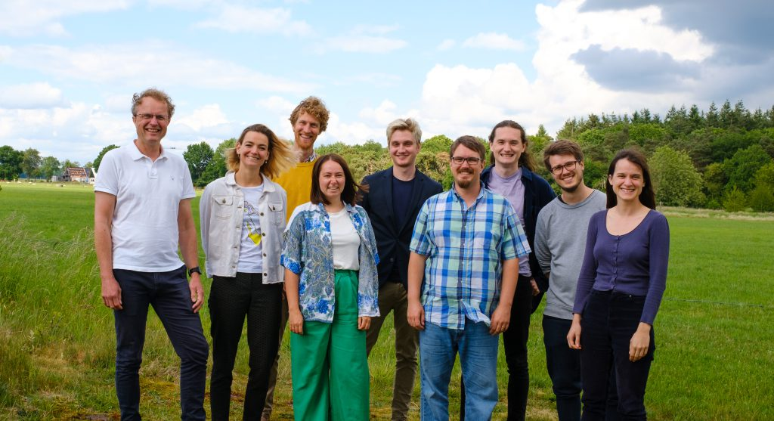
Who are the Centre for Economy Studies?
Notes:
1.5 min - We are part of a non-profit foundation called Our New Economy.
The ES project specifically works on improving and modernising economics education across Europe. We’ve written a book (online version is available for free on the website), we make open-access teaching materials and we work with educators and students to improve economics education at their universities.

Slide 3

Who am I?
Educated at Exeter and Bocconi
Campaigned as a student
Worked at the Bank of England
Moved to CfES last May
Workshops with academics
Notes:
1.5 min - Focusing on what led you to working here and what authority you have to speak on this
Obviously change if different presenter(s)

Slide 4
What do you want your students to take away with them?
A better understanding of economic theories
A better understanding of the economy
Thinking and learning skills
Readiness to be professional economists
A sense of excitement and purpose
Notes:
3 min - What’s the purpose? What’s it important that students take away? In reality it’s a mixture of different factors, but here are some of the most common. No wrong answers, we’d argue that all of these are important to some extent.
The ideas and skills should be intrinsically useful for understanding the economic world
Regardless of the intrinsic value of UG econ, it should prepare students to learn more later on
Give students what they need to be competent economists
Besides the content of the degree, another aim might be to kindle a passion for economics or social sciences more broadly
As well as economics education being important in itself, students also bring a lot of funding with them
Stress again that in reality it’s a mixture of these different factors.

Slide 5

Let’s find out what you think
menti.com
2228 0443
Notes:
3 min - Ask them to raise their hand if they don’t have a device with them.
Tell them it’s a good tool to use in their classes if they haven’t come across it before
Don’t let them see the answers until they’ve all submitted.
Mentimeter codes refresh every two days. Make sure the results from the previous workshop aren’t still there. https://www.mentimeter.com/app/presentation/al235tc2uudttumyv4qaxixb8ohzgn1g/t24s42euquea/edit

Slide 6
What are values? And how do they enter economics?

Slide 7

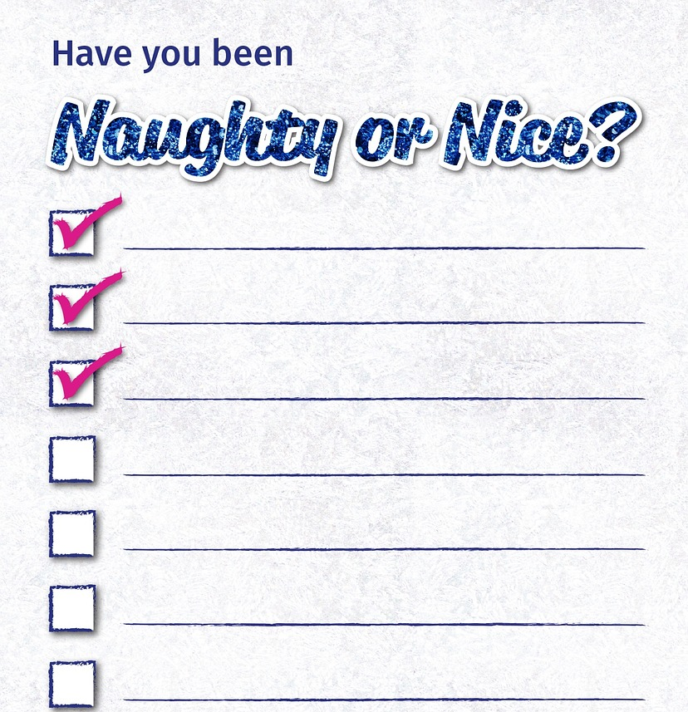
What do we mean by “values”?
Notes:
0.5 min - They tell us what’s important and what’s good.

Slide 8
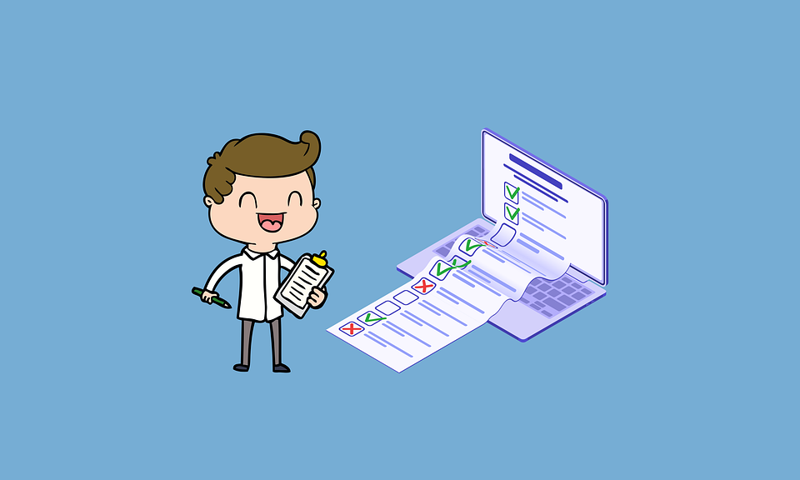
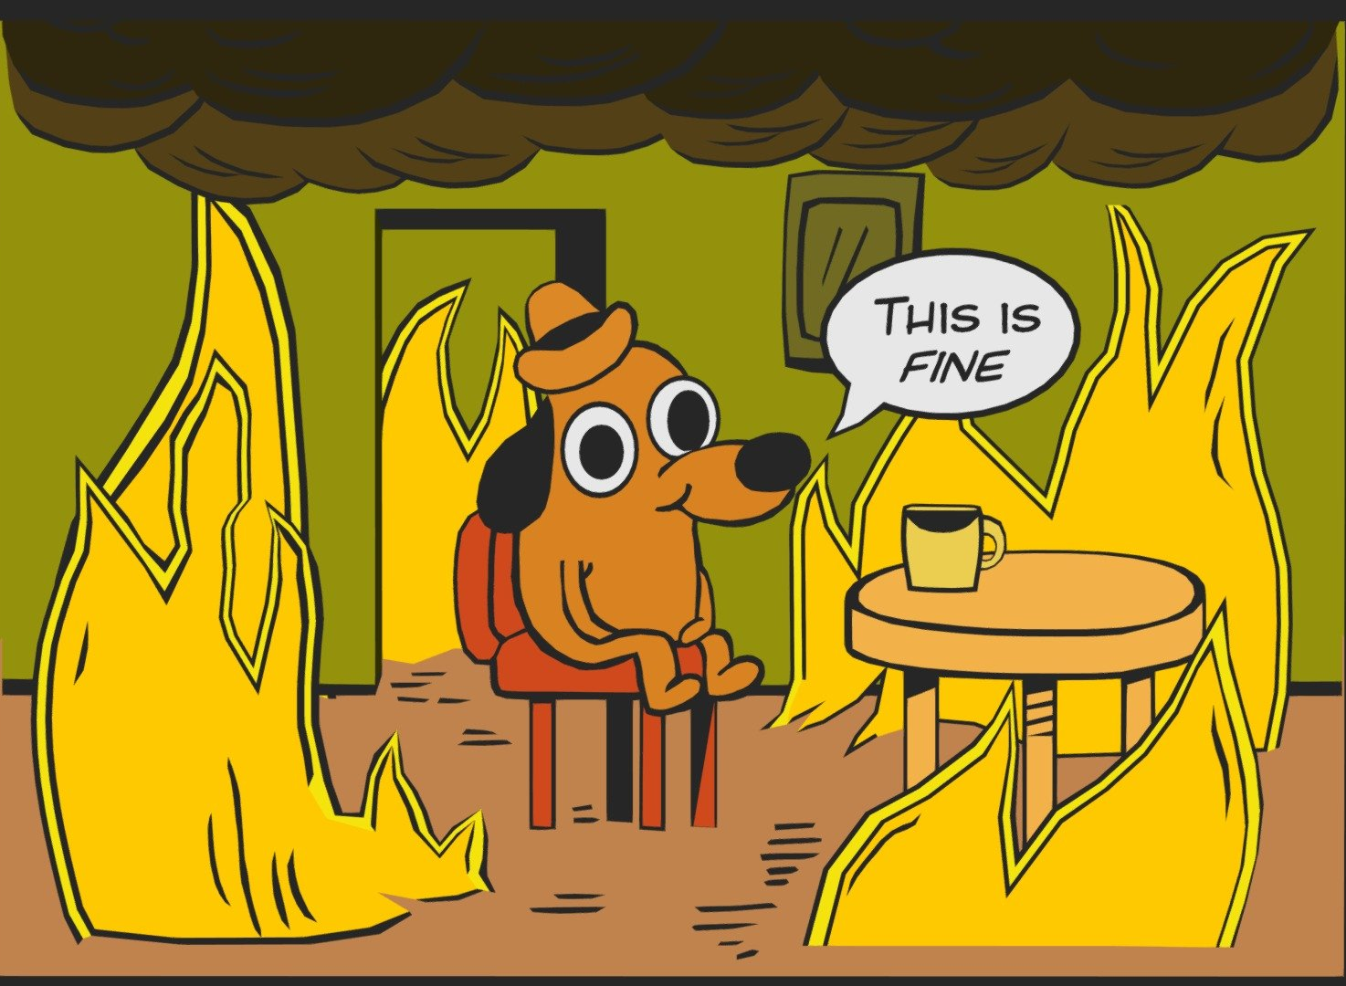
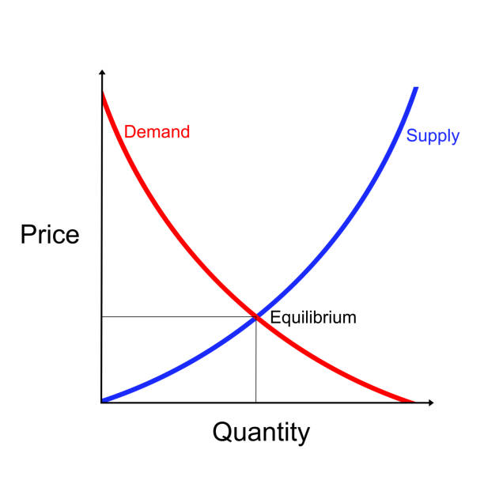


When do we make value judgements?
Notes:
3 min - Data collection (and choice); Building models (assumptions, exclusions, inclusions); Identifying problems; Proposing solutions; Visions for a good economy

Slide 9

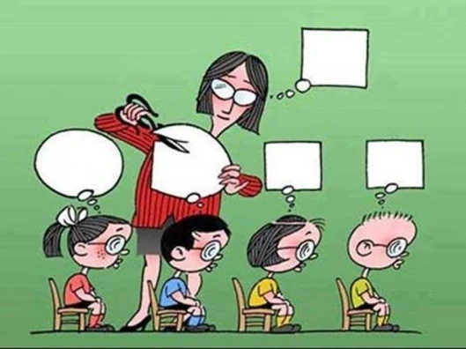
What don’t we mean by incorporating values into teaching?
Notes:
1.5 min - Not indoctrination or trying to instill particular values into them. Also not getting them to make decisions on behalf of others, generally they’re advisors not decision makers.

Slide 10
So what do we suggest?
As educators we should try not to impose our personal views.
But we should also accept that “neutral” does not exist.
Aiming for objectivity disguises current choices as inevitable.
Instead we should be as transparent and honest as possible.
And we should train our students to do the same.
Notes:
2 min - work through point-by-point

Slide 11
Why teach students about values?

Slide 12

Why teach about Values?
Because…
They’re embedded in economics.
It enhances academic integrity.
It reduces the risk of indoctrination.
Notes:
1.5 min - It’s true, be honest

Slide 13
Indoctrination definitions
The process of teaching a person or group to accept a set of beliefs uncritically.
The process of repeating an idea or belief to someone until they accept it without criticism or question.
The act or process of forcing somebody to accept a particular belief or set of beliefs and not allowing them to consider any others.

Slide 14
Helping students to understand theories
Point 2
Point 3
Directing attention
Essential context
Intellectual humility
Learning which assumptions and judgements are likely to hold or be relevant in which situations is an essential part of learning a theory.
Context helps students remember theory better.
All models make choices about what to include, exclude and emphasise. Students need to know when these are choices not facts.
Students need to see the difference between models and reality.
By identifying and explaining judgements you can direct students’ attention.
Abstract models and “heroic” assumptions can be very confusing for engaged students.

Slide 15
Giving students a better understanding of the economy
Point 2
Point 3
Applying theories
A diversity of values
A diversity of economies
Students need to know what judgements have been made within theories to know how and when to apply them.
Economic actors hold different values and these values motivate their behaviour.
Different choices and judgements have been made my economic actors in different countries and regions, decisively shaping those economies.

Slide 16
Training thinking and learning skills
Point 2
Point 3
Critical thinking
Intellectual humility
Understanding others
It’s very difficult to critique without contrast.
It’s even harder when you don’t know what’s a fact and what’s a choice.
All theories and models make judgements. There are multiple valid choices to be made at each step.
People can disagree over analytical approaches, but more often when they end up at different places, it’s because they had different starting points.

Slide 17
Preparing students to be economists
Point 2
Point 3
Applying theories
Judgement skills
Communication skills
Generally economists are advisors and not decision makers. Explaining economic ideas to non-economists takes practice, and is essential for democracy and accountability.
Students need to know what judgements have been made within theories to know how and when to apply them.
There are rarely easy answers in economics. Being able to make hard judgements and know how confident to be in those judgements is an essential part of the job.

Slide 18
Sparking excitement and purpose
Point 2
Open questions
Applying theories
Agency
Following a different judgement call or taking a different starting point can get you to a completely different conclusion. When exploring it helps to know what choices have already been made and why.
Being clear that choices matter in economics is motivating for students. Without choices how can you have any impact or make new contributions?
Students need to know what judgements have been made within theories to know how and when to apply them.

Slide 19
How to include value judgements into teaching

Slide 20
Adapting existing teaching
Pick out value judgements wherever you make them.
Show how value judgements lead to different conclusions.
Discuss together which values are relevant for each topic.
Notes:
1.5 min - Lowest effort to highest

Slide 21
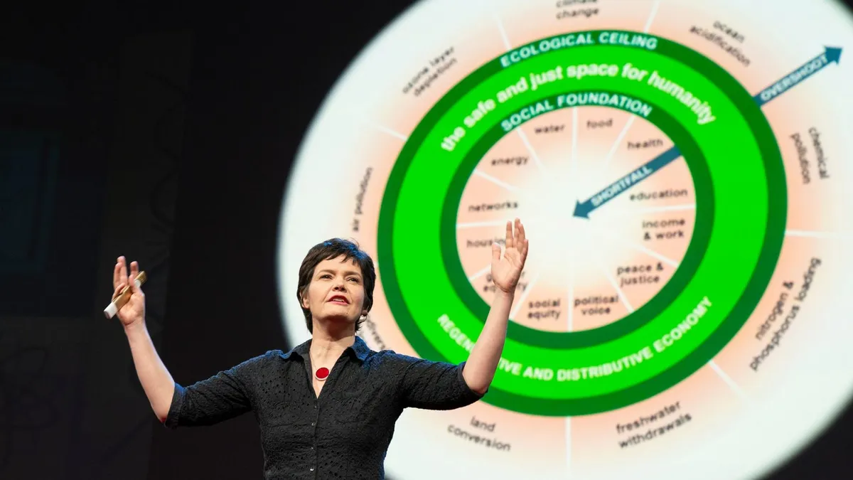
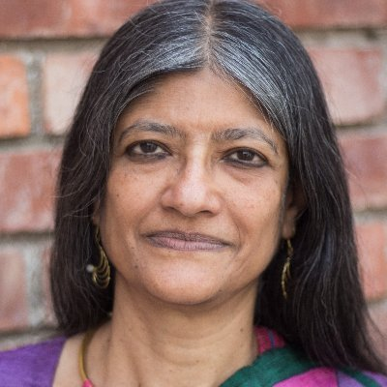
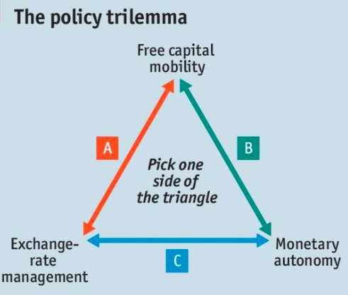
Adding to your teaching
Notes:
2.5 min - Acknowledge that it’s more work, worth spending less time on the algebra for this; Real-world case studies of policy dilemmas; Present theories that make different value judgements; Present work by scholars with different backgrounds

Slide 22
If your curiosity has been piqued
Explore the book and website: www.economy.st
Take this discussion back to your department.
Follow us on LinkedIn & Twitter @econstudies
Use our teaching materials.
Keep in touch: jamie.barker@ourneweconomy.nl
Notes:
4 min - If you use a handout for the activity, also try to get all this information on that so they can take it away. Leave this slide up for Q&A at the end.
If anyone is particularly keen, try to set up a call in a week or two to follow up on the ideas.
If someone else is running workshops then change the email address and please follow up afterwards: https://docs.google.com/document/d/1dUSKkztMZWCTI1tu1KlYJrp6UG-e1JkwIs2WCEeINUM/edit

