Slide 1
Relax
Introduce yourself to the people next to you.
Discuss: What sort of exams/qualifications did you experience at the end of high school?

Slide 2
“Somebody asked me: ‘What will people ask you in 10 years’ time?’ They won’t ask you anything about your A-level grades in 10 years’ time. They will ask you about other things you have done since then: what you have done in the workplace, what you did at university. And then, after a period of time, they don’t even ask you what you did at university. It is really all about what you do and what you can demonstrate and the skills that you learn in the workplace.”
Gillian Keegan – Secretary of State for Education, Speaking to Sky News, August 2023

Slide 3
An exam by any other name…
From A-level to University Assessment
Annika Johnson, Steven Proud, David Thornthwaite (University of Bristol)
DEE 2023

Slide 4
Today….
What is an A level?
A-level marking exercise
3. How might A levels affect a student’s understanding of learning and assessment?

Slide 5
1. What is an A level?

Slide 6
Secondary Education
England / Wales / Northern Ireland
PHYSICS
MATHS
ECONOMICS
Sixth Form/
College/
Year 12 and 13
KEY STAGE 5
A-LEVEL
YEAR 12-13
AGE: 16-18
ENGLISH
SCIENCE
MATHS
FRENCH
HISTORY
RELIGION
ART
DRAMA
KEY STAGE 4
GCSE
YEAR 10-11
AGE: 14-16
ENGLISH
SCIENCE
MATHS
FRENCH
GERMAN
HISTORY
GEOGRAPHY
RELIGION
ART
DRAMA
TECHNOLOGY
SPORT
KEY STAGE 3
YEAR 7-9
AGE: 11-13
Compulsory
Option Example
Notes:
Secondary education and exams (primary to A-level), a-levels and BTECs

Slide 7
2022 UCAS Accepted Applicants (18 yrs) by Qualifications
Data Source: UCAS UG-Level End of Cycle Data 2022
A-level
BTEC
SQA
IB
Notes:
A level still most common. -

Slide 8
A LEVEL EXAM BOARDS
A LEVEL SUBJECTS
A LEVEL EXAMINATIONS
AQA
Accounting
Further Maths
Ancient Languages
Paper 1: Markets and Business Behaviour (2hrs)
Edexcel (Pearson)
Archaeology
Art & Design
Biology
OCR
Paper 2: National and Global Economy (2hrs)
Business
Classical Civilisation
Chemistry
CCEA
Computer Science
Dance
Design & Technology
Paper 3: Microeconomics and Macroeconomics (2hrs)
WJEC (Eduqas)
Drama & Theatre
Economics
English Language
English Literature
Environment Science
Electronics
x 3 = 9 exams (18 hours)
Film Studies
Further Maths
Geography
Geology
History
History of Art
Law
Maths
Media Studies
Modern
Languages
Music
Music Technology
Physics
Politics
Physical Education
Religion / Philosophy
Sociology
Statistics
Notes:
An A-level isn’t just a single MCQ paper…. Boards / subjects / Exams.
Student have no input into boards.

Slide 9
2023 A level Entries by subject
Data Source: JCQ

Slide 10
A level grades, UK,
All subjects
Data Source: JCQ
A*
A
B
C
D
E
U

Slide 11
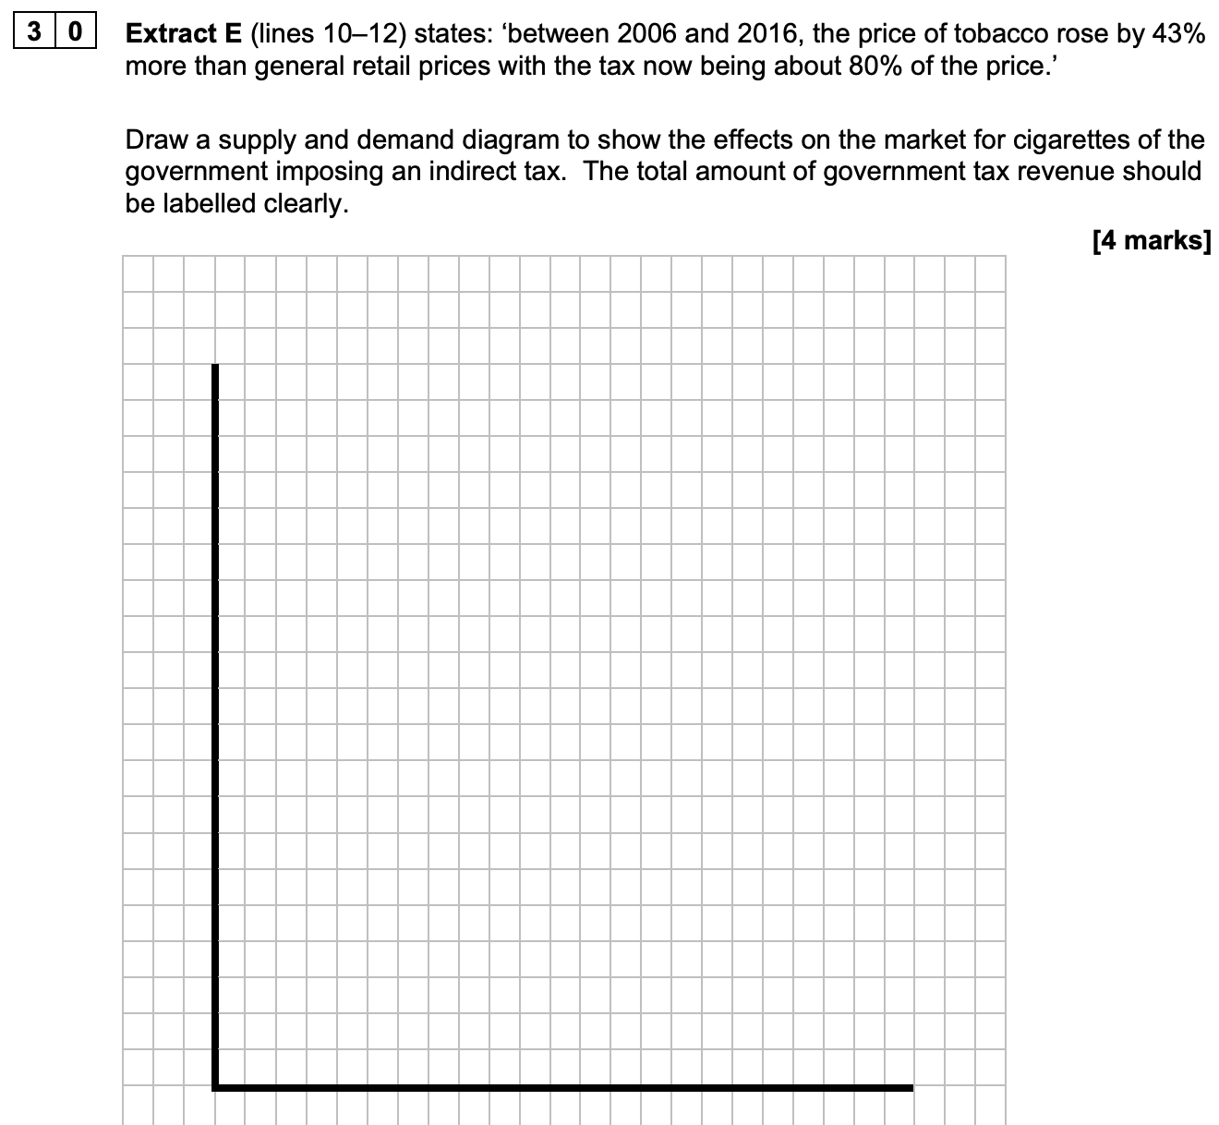
Exam Questions
Short Answer: AQA Paper 1
Extract E states: ‘between 2006 and 2016, the price of tobacco rose by 43% more than general retail prices with the tax now being about 80% of the price’.
Draw a supply and demand diagram to show the effects on the market for cigarettes of the government imposing an indirect tax. The total amount of government tax revenue should be labelled clearly.
Notes:
There are specific question styles and students are trained to answer them with specified lists of definitions, diagrams and answer formats. This is a short answer question.

Slide 12
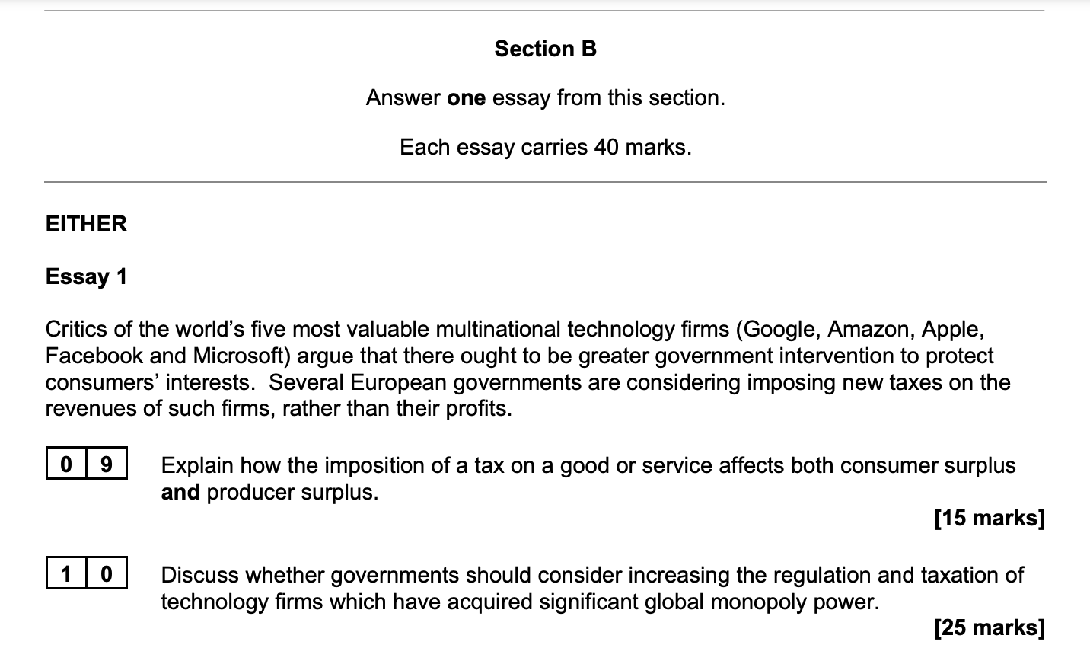
Exam Questions
Long Answer: AQA Paper 1
Notes:
There are longer essay questions too.

Slide 13
2. Your turn

Slide 14
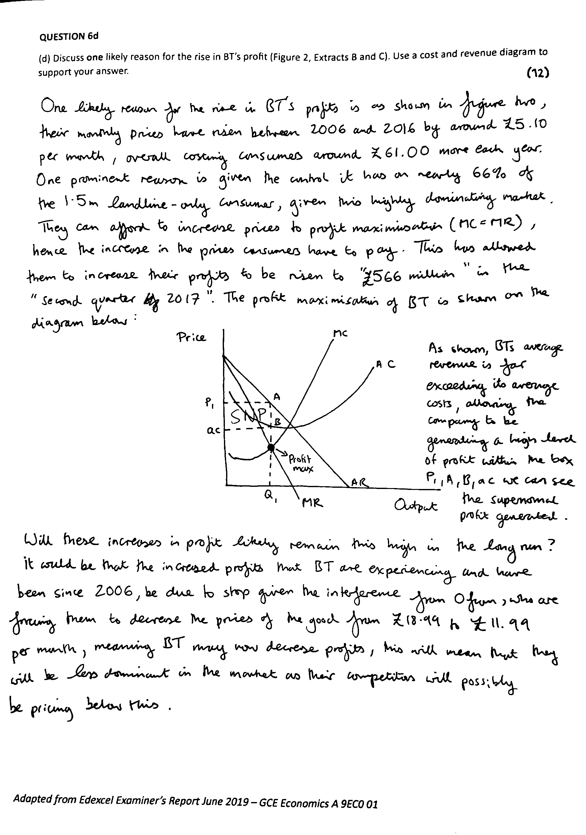
Your turn
Up to 8 for KAA
In groups, mark the sample answer using the official mark scheme and decide on a mark out of 12.
Up to 4 for Evaluation
Notes:
Question 6d, economics A, edexcel, June 2019, Paper 1

Slide 15
Examiners Report
The static cost and revenue diagram alone secured Level 1KAA as it did not provide one reason for the rise in BT's profit. The written answer on the same page lifted the overall response to Level 2 as it suggested in context that the ability to set a profit maximising price had now been secured. To achieve a Level 3 response the diagram would have been made dynamic by additional annotations showing the change in price for example from allocative efficiency pricing to profit maximising price. The evaluation on the next page secured Level 2ev- and required extending and/or an additional evaluative point to secure L2e+.
As such this answer scores
4KAA and 3ev = 7/12 marks.

Slide 16
Knowledge
Identifies a reason
Application
Uses info from the sources
Analysis
Diagram
Description of Profit Max
Evaluation
One reason why argument above might be wrong

Slide 17
3. How might A levels affect students’ approach to assessment?

Slide 18
Examiners Report
64 page report providing 2 sample answers and analysis and marks for each question
The static cost and revenue diagram alone secured Level 1KAA as it did not provide one reason for the rise in BT's profit. The written answer on the same page lifted the overall response to Level 2 as it suggested in context that the ability to set a profit maximising price had now been secured. To achieve a Level 3 response the diagram would have been made dynamic by additional annotations showing the change in price for example from allocative efficiency pricing to profit maximising price. The evaluation on the next page secured Level 2ev- and required extending and/or an additional evaluative point to secure L2e+.
As such this answer scores
4KAA and 3ev = 7/12 marks.

Slide 19
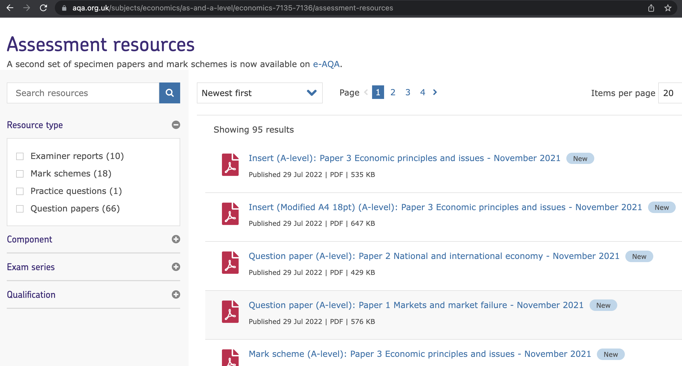
Notes:
Students are used to there being large bank of past exam papers, mark schemes and exam reports.

Slide 20
Notes:
There are a lot of them.
Students learn to do exams by past paper practice. This can become more important than the initial learning in the first place.
This is not effective at university because unit descriptions change, lecturers change and the discipline changes so exam reflect that each year. Unlike a level there is not a finite set of questions which can be asked.
However, students don’t realise that and will still search for past papers as a comforting learning aid.

Slide 21
Exam Questions
Long Answer
Notes:
The number of marks is meaningful. Different marks signify different answer structures (for example, the number of evaluation points a student should include).

Slide 22
Exam Questions
Long Answer
$$⇒$$
2 Knowledge Points
2 Application Points
3 Analysis Comments
3 Evaluation Points

Slide 23
Evaluation
Analysis
Application
Knowledge
Notes:
Knowledge/Application/Analysis/Evaluation sounds like it should relate to Bloom’s taxonomy…

Slide 24
Evaluation
Analysis
Application
Knowledge
Notes:
…but even if it once did, it doesn’t now. This is because so many past papers exist on the same material, with mark schemes that by learning and remembering and practicing these, you can simply ‘remember’ evaluation points rather than understanding them at the higher order skill level.

Slide 25
Repeat 2-3 of the bullet points you’ve pre-prepared
Evaluation
Draw the correct diagram from the 40 you’ve learned
Analysis
State how that definition/diagram relates to the question
Application
Repeat the correct definition from the 80 you’ve learned
Knowledge
Notes:
because so many past papers exist on the same material, with mark schemes that by learning and remembering and practicing these, you can simply ‘remember’ evaluation points rather than understanding them at the higher order skill level.

Slide 26
Exam Hacking
They can't be.
If they were, no one could possibly teach the answers.
Those are the rules of the game
Everything is fine! We’ve taught him everything on last year’s exam.
But the questions are surely different every year?!
Adapted from Vintage Stuff, Tom Sharpe (1982)
Notes:
ANIMATION OF
'Exactly,' said Dr Hardboldt. 'Now where most teachers go wrong is in failing to apply the methods used in animal training to their pupils. If a seal can be taught to balance a ball on its nose, a boy can be taught to pass exams.'
'But the questions are surely different every year, ' said Mr Clyde-Brown.
Dr Hardboldt shook his head. 'They can't be. If they were, no one could possibly teach the answers. Those are the rules of the game'

Slide 27
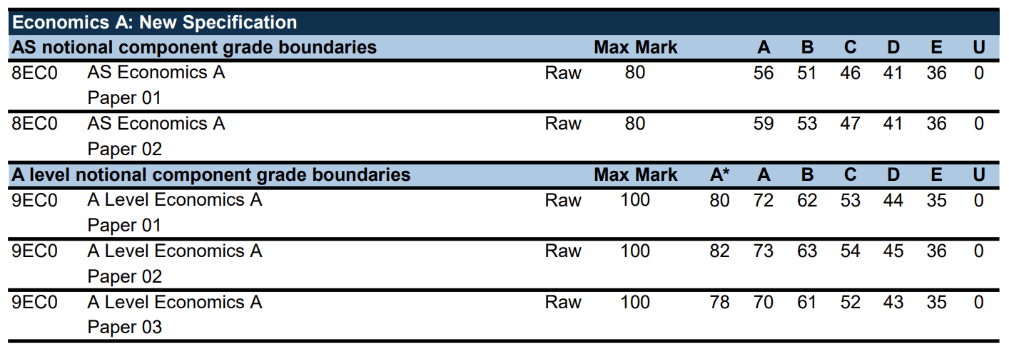
Grade
Boundaries
Edexcel 2019
Notes:
Link to Steve’s twitter?

Slide 28
Remarked Scripts
Notes:
Remarks are common and used strategically at A level. Students are likely to expect the same option at university because they don’t understand that there is no longer a national exam board (nor that the exam board is just a collection of people from the department) and that the exam is being marked by a handful, rather than hundreds of markers. When they ask a lecturer for a remark they aren’t being rude, they have simply been trained to do it.
Note, if you don’t like your final grade, you can also resit the A level (even if you got a good mark)

Slide 29
Retakes
Notes:
Remarks are common and used strategically at A level. Students are likely to expect the same option at university because they don’t understand that there is no longer a national exam board (nor that the exam board is just a collection of people from the department) and that the exam is being marked by a handful, rather than hundreds of markers. When they ask a lecturer for a remark they aren’t being rude, they have simply been trained to do it.
Note, if you don’t like your final grade, you can also resit the A level (even if you got a good mark)

Slide 30
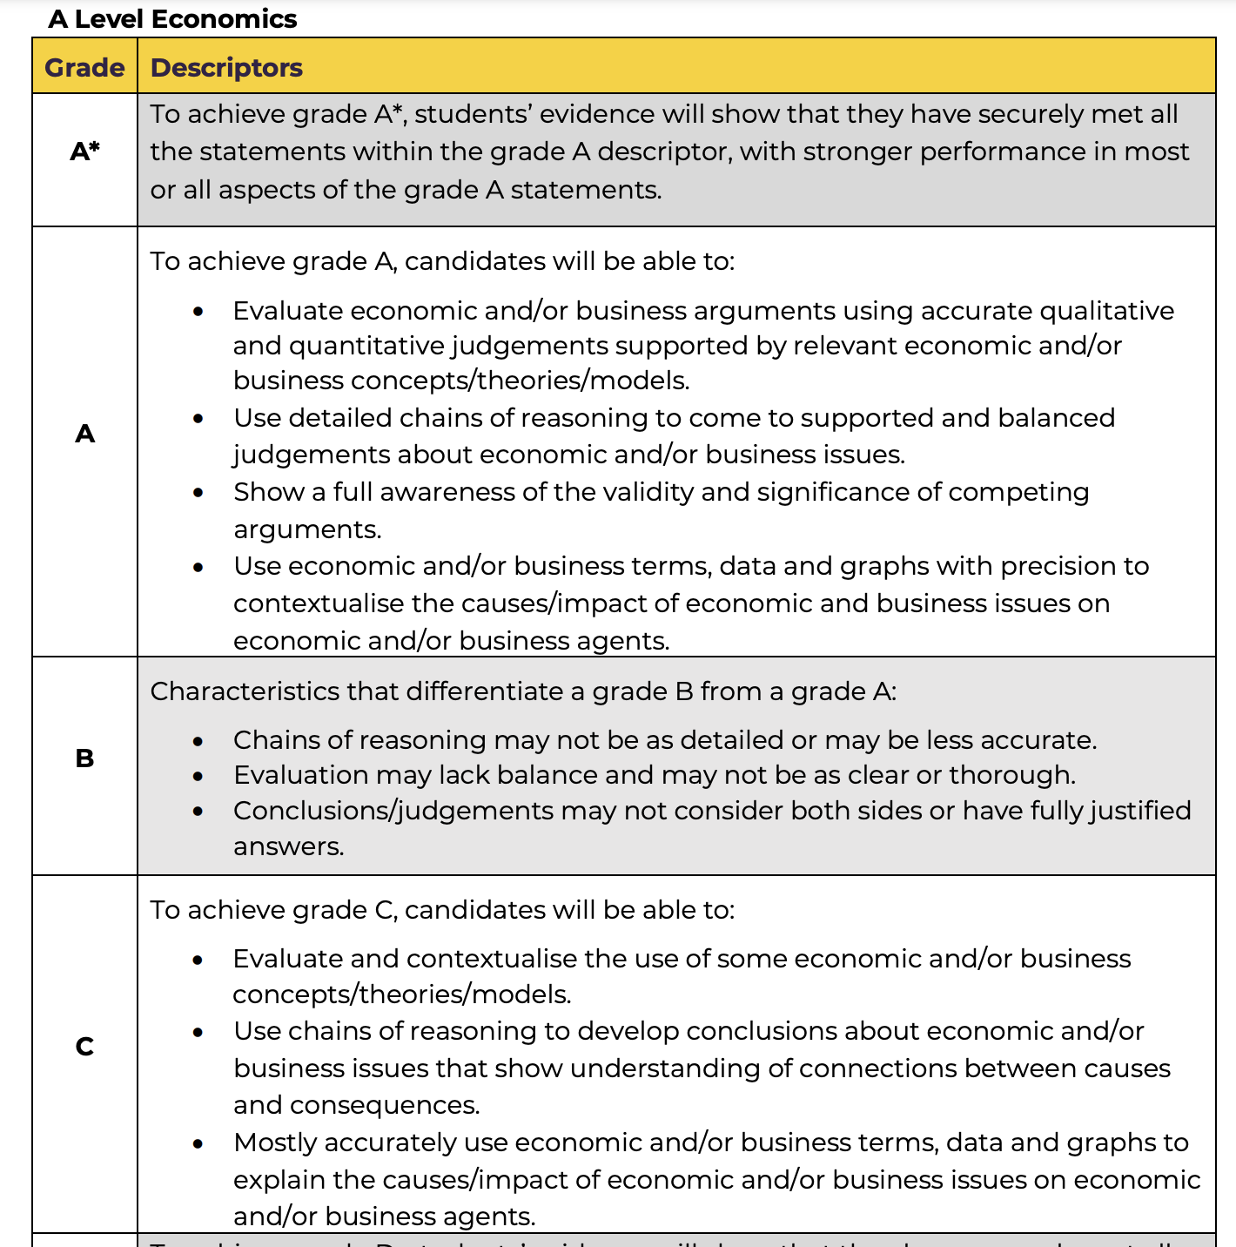
Grade
Descriptors
JCQ
Notes:
https://www.jcq.org.uk/wp-content/uploads/2021/04/Summer-2021-Grade-Descriptors-A-AS-Levels.pdf

Slide 31
Conclusion

Slide 32
Notes:
School exams v university exams…. They look the same. But experience is very different.
There are a number of things we can do to ease the transition (eg. Constructive Alignment – familiarize students with any new assessment approach)

Slide 33
Tell them it’s different
Together we can defeat the exam dragon
I’ve created a dragon… you’ll be needing this.
Errr…?
Teacher
Lecturer
Student
Pupil
SCHOOL
UNIVERSITY
Notes:
Many things about school and university look the same but we work very differently. We have to tell students that (and in such a way that they hear it).
Constructive Alignment – familiarize students with any new assessment approach

Slide 34
Any questions?
annika.johnson@bristol.ac.uk
steven.proud@bristol.ac.uk / @DrStevenProud
david.thornthwaite@bristol.ac.uk

Slide 35
Appendix

Slide 36
