Slide 1

The impact of Assessment Design on Student Attainment: an empirical investigation across dimensions of equality, diversity and inclusion
DEE 2025, Leeds
Fabio Aricò, Ritchie Woodard, and Laura Harvey

Slide 2
Motivation
Movement away from traditional assessment in HE
(closed book exams and essay-based coursework)
→ This process was accelerated by COVID
→ compounded by the disruption of Generative AI
→ in Economics there is evidence of resistance and conservatism
Increasing pressure to embrace authentic assessment and experiential learning for employability
Increasing consideration for inclusivity in assessment.
Yet, persistent degree awarding gaps

Slide 3
This paper
Using administrative data from a mid-sized, mid-ranked,
English university
Categorise assessment types and review changes
in trends over time
  → considering the contribution of COVID as a
  structural break in assessment norms.
Look at how exposure to different assessment types
impacts student performance
  → thinking about differences along EDI lines.

Slide 4
Literature
Shift from traditional exams/essays to authentic, diversified assessment (Bloxham & Boyd, 2007; Sambell & Brown, 2021; QAA, 2023a).
Growth of authentic/experiential assessment to better reflect real-world tasks and enhance graduate outcomes (Ashford-Rowe et al., 2014)
Persistent awarding gaps across gender, ethnicity, socio-economic background, and disability (Mountford-Zimdars et al., 2017; OfS, 2022).
Calls for inclusive assessment design as a mechanism to address attainment gaps (Thomas & May, 2010; Hockings, 2010).

Slide 5
Economics Education Literature
Assessment practices can perpetuate inequalities unless explicitly designed to recognise diverse student experiences. Inclusive approaches (e.g., scaffolded tasks, authentic assessments) can mitigate awarding gaps.
(Thomas & May, 2010; Cagliesi, Hawkes & Smith, 2023).
Economics experienced significant innovation in response to Covid-19…
(Birdi et al., 2023), evidenced by many case-studies from the Economics Network and contributions to the education literature (e.g. Stankov, 2024)…
…The most recent Economics QAA (2023b) Subject Benchmark Statement supports this trend for the long run…
…yet, the innovation initiated by Covid-19 does not seem long-lived.
(Aricò et al., 2022).

Slide 6
Data
University records
data protection and ethics cleared
39K observations, summarising the experience 13K home students
7 cohorts of around ~2K students each, who completed their degree
start years between 2014-2021.
→ Assessment Patterns: proportion of assessment types used to assess each student at each stage.

Slide 7
Classifying Assessment Types
Administrative records on assessments students take (% for stage).
End of semester exam
Assessment of Practice
Mid-semester tests
Closed Book Exam
Presentation
In class / course test
Performance
Language test
In person or invigilated exam
Attendance only
Exam open book
Clinical or practical examination
Pre-released questions/text
Open Book Exam
Test materials allowed
Coursework
PC based test
Project
Coursework
School based / organised
Written assessment
Specialist software exam
School
Exam
Dissertation
Formative Assessment
Notes:
Exam vs. Coursework; Traditional (closed book & coursework) vs. Non-traditional (open book & performance); In-person (closed book & performance) vs. submission (open book & coursework)

Slide 8
Summary Stats – Marks, EDI Characteristics & Controls
Marks (& Tariff) | N | Mean | Std. Dev. | Min | Max
Stage 1 Mark | 13148 | 62.69 | 7.92 | 21.35 | 96.33
Stage 2 Mark | 13144 | 64.02 | 7.43 | 39.92 | 92.38
Stage 3 Mark | 13148 | 65.86 | 7.19 | 32.25 | 93.22
Av. Stage Mark | 39440 | 64.19 | 7.63 | 21.35 | 96.33
Tariff (in 100pts) | 39440 | 1.378 | .33 | .06 | 3.8
EDI Characteristics |  | Mean | Std. Dev. | Controls |  | Mean | Std. Dev.
Female |  | .577 | .494 | Pre-qualification | A-Level | .795 | .404
Ethnicity | White | .819 | .385 |  | A-Level and BTEC | .058 | .234
 | Black | .05 | .218 |  | BTEC | .086 | .281
 | Asian | .068 | .252 |  | Access | .033 | .179
 | Other | .062 | .241 |  | Int Bacc | .013 | .114
Disability | None | .799 | .400 |  | Other | .014 | .119
 | Physical | .052 | .222 | Foundation Year |  | .088 | .283
 | Learning | .086 | .280 | Clearing |  | .11 | .313
 | Mental | .063 | .243 | Bursary |  | .197 | .398
Mature |  | .064 | .245 | Year Abroad |  | .058 | .233
IMD 1-2 |  | .226 | .418 | Year in Industry |  | .018 | .133

Slide 9
Summary Stats – Assessment Types
University-wide
Economics
Variable | N | Mean | Std. Dev. | Min | Max
Groupwork | 39440 | .012 | .048 | 0 | .717
Assess Types | 39440 | 2.25 | .819 | 1 | 5
HHI | 39440 | .666 | .217 | .258 | 1
Variable | N | Mean | Std. Dev. | Min | Max
Groupwork | 2637 | .021 | .057 | 0 | .42
Assess Types | 2637 | 2.94 | .494 | 1 | 4
HHI | 2637 | .494 | .097 | .297 | 1

Slide 10
Trends over time
University-wide
Economics

Slide 11
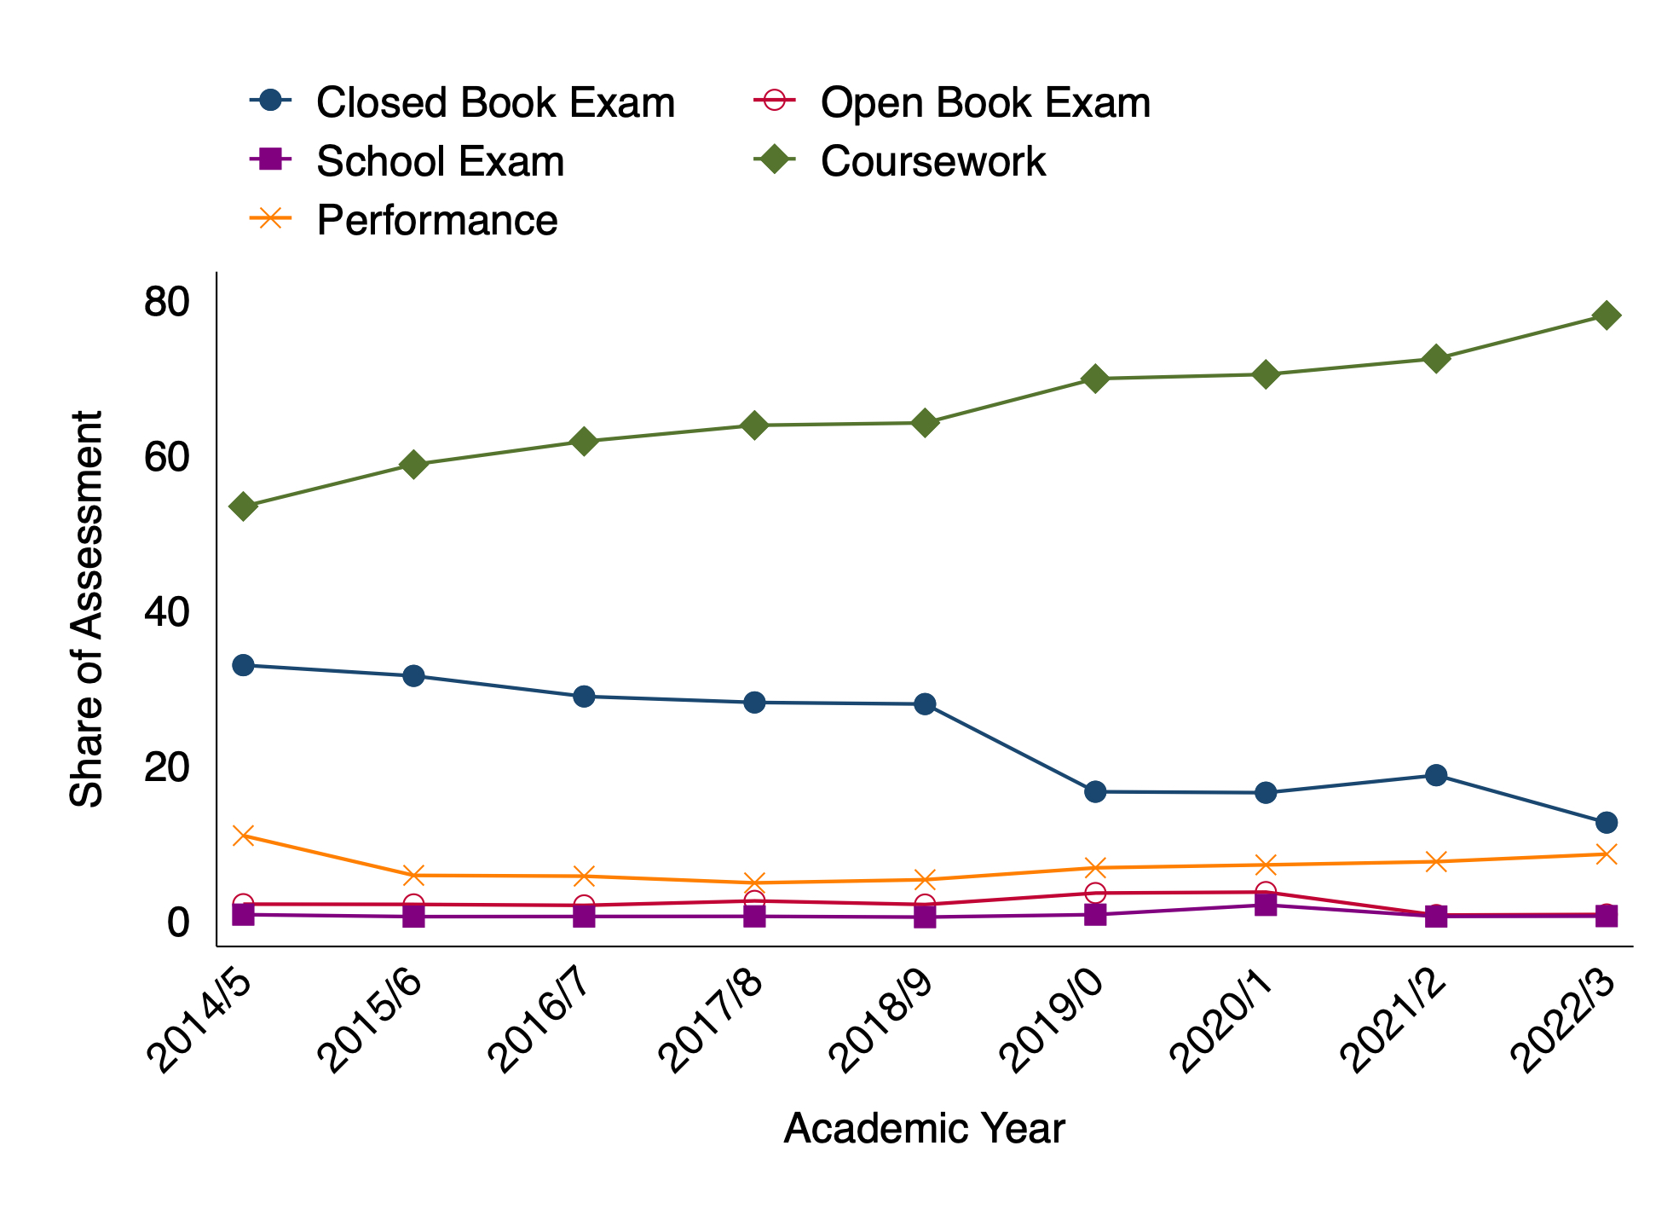
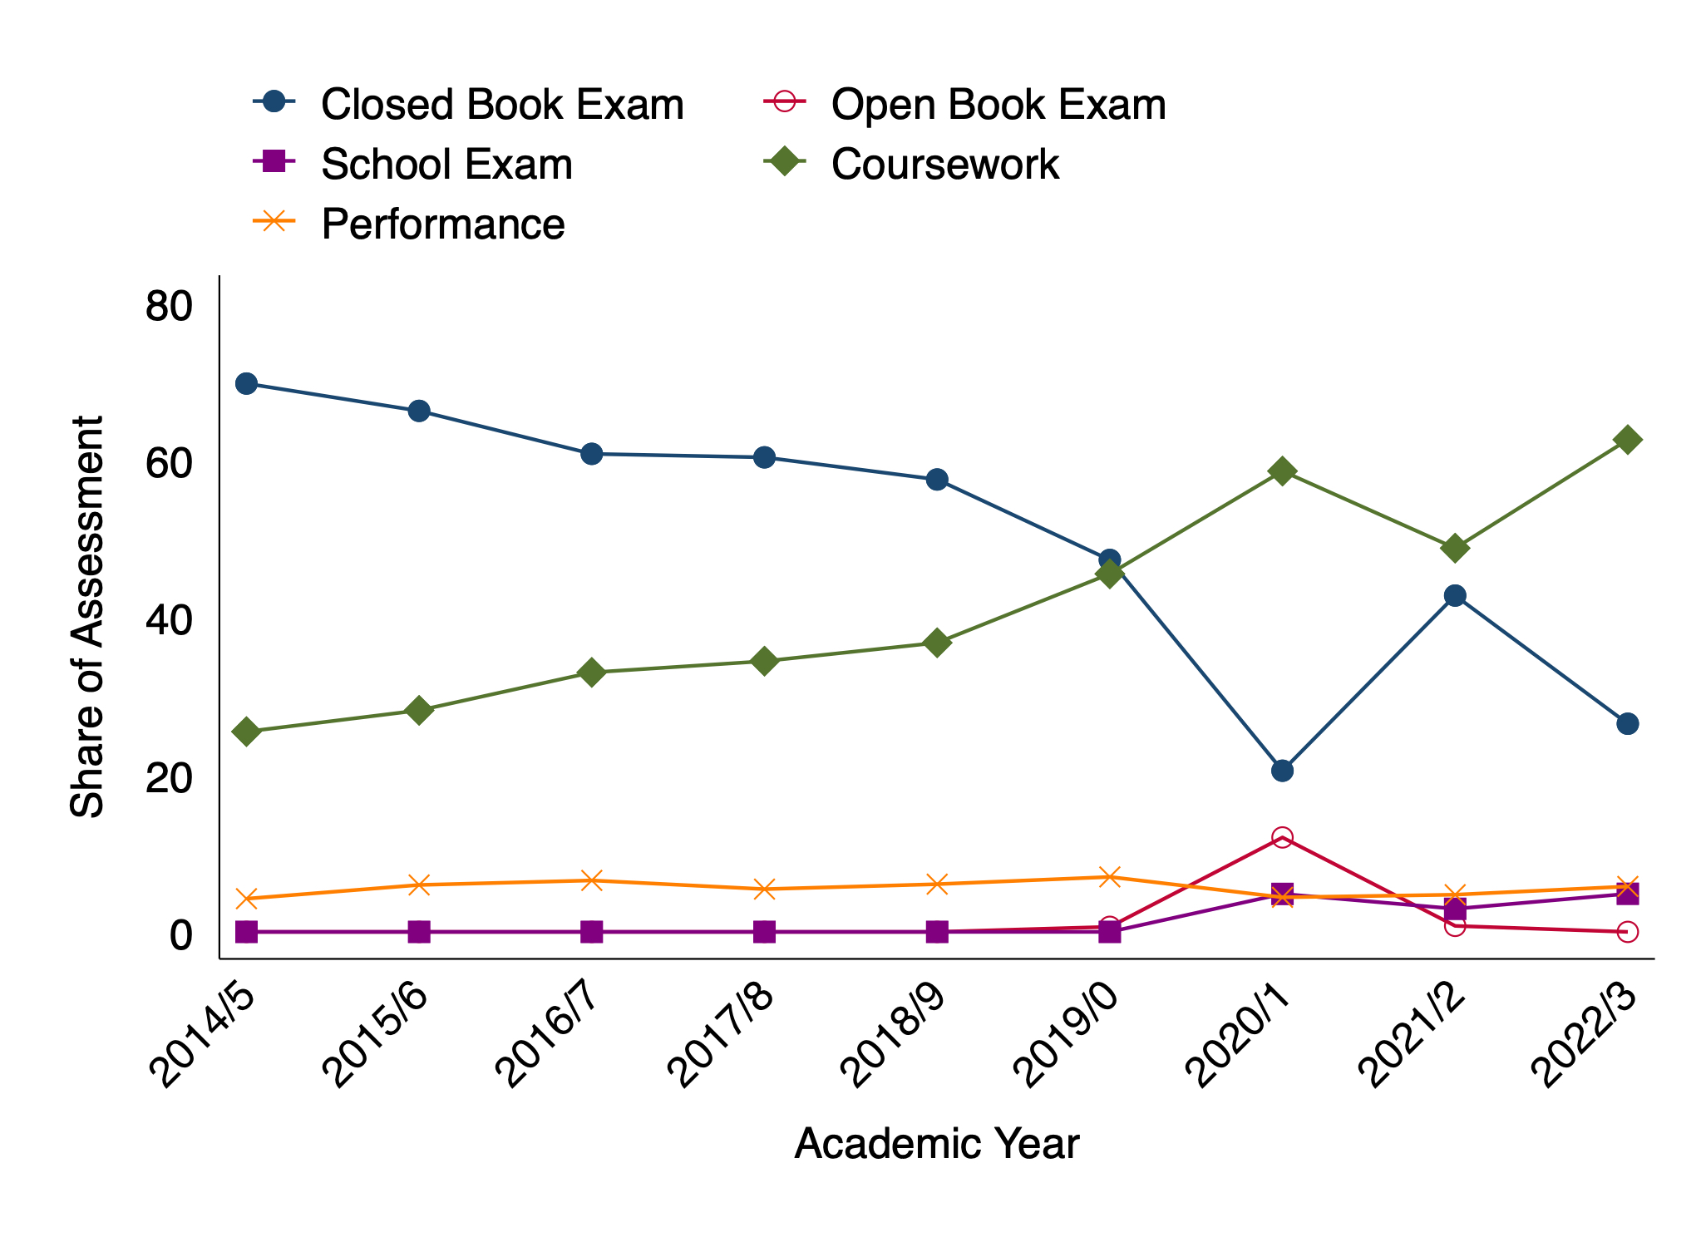
Trends over time
University-wide
Economics

Slide 12
Stage Mark Regressions – Uni v ECO
 | University-wide |  |  |  | Economics
 | (1) | (2) | (3) | (4) | (5) | (6) | (7) | (8)
 | Stage 1 | Stage 2 | Stage 3 | Av. Stage | Stage 1 | Stage 2 | Stage 3 | Av. Stage
OpenBookExam | -0.493 | 4.084*** | 0.118 | 0.162 | -3.487 | -2.160 | 3.507 | -2.080
 | (-0.45) | (4.02) | (0.09) | (0.26) | (-0.25) | (-0.20) | (0.45) | (-0.51)
SchoolExam | 24.75*** | -11.82*** | 14.12*** | 7.705*** | - | 27.01 | 15.01* | 22.60**
 | (5.12) | (-3.65) | (7.31) | (4.97) | - | (1.80) | (1.98) | (3.21)
Coursework | -1.799*** | -3.683*** | -0.894 | -1.952*** | -6.866* | -7.060** | -5.533*** | -5.544***
 | (-3.55) | (-8.04) | (-1.73) | (-7.81) | (-2.37) | (-2.60) | (-3.43) | (-4.48)
Performance | 5.195*** | 4.166*** | 7.540*** | 4.419*** | 32.39*** | -8.423 | -11.79* | 2.028
 | (6.64) | (6.65) | (10.07) | (11.71) | (4.21) | (-1.33) | (-2.34) | (0.62)
Level 2 |  |  |  | 1.565*** |  |  |  | 3.319***
 |  |  |  | (17.40) |  |  |  | (8.37)
Level 3 |  |  |  | 3.693*** |  |  |  | 6.351***
 |  |  |  | (36.20) |  |  |  | (13.28)
Constant | 56.99*** | 60.50*** | 62.50*** | 58.68*** | 52.11*** | 61.23*** | 63.70*** | 55.59***
 | (118.91) | (132.56) | (127.38) | (202.19) | (26.52) | (30.90) | (38.01) | (48.71)
Observations | 13148 | 13144 | 13148 | 39440 | 879 | 879 | 879 | 2637
Controls | ✓ | ✓ | ✓ | ✓ | ✓ | ✓ | ✓ | ✓
t statistics in parentheses
* p < 0.05, ** p < 0.01, *** p < 0.001

Slide 13
Stage Mark Regressions – A-Level v other
 | A-level |  |  |  | Non A-Level
 | (1) | (2) | (3) | (4) | (5) | (6) | (7) | (8)
 | Stage 1 | Stage 2 | Stage 3 | Av. Stage | Stage 1 | Stage 2 | Stage 3 | Av. Stage
OpenBookExam | -2.216 | 2.168 | -0.00261 | -1.108 | 3.440 | 10.70*** | 0.402 | 4.997***
 | (-1.83) | (1.94) | (-0.00) | (-1.66) | (1.35) | (4.40) | (0.09) | (3.39)
SchoolExam | 20.50*** | -12.25*** | 9.638*** | 3.814* | 32.17 | -2.229 | 30.49*** | 22.93***
 | (4.18) | (-3.73) | (4.68) | (2.34) | (1.90) | (-0.20) | (6.16) | (5.51)
Coursework | -3.913*** | -3.966*** | -1.354** | -2.925*** | 3.370** | -2.556* | 2.569 | 1.445*
 | (-6.76) | (-7.80) | (-2.58) | (-10.65) | (3.03) | (-2.40) | (1.52) | (2.45)
Performance | 0.600 | 2.307** | 4.013*** | 1.050* | 14.09*** | 6.731*** | 13.45*** | 10.42***
 | (0.66) | (3.05) | (4.55) | (2.35) | (8.56) | (5.33) | (6.85) | (13.32)
Level 2 |  |  |  | 1.499*** |  |  |  | 1.511***
 |  |  |  | (15.57) |  |  |  | (6.71)
Level 3 |  |  |  | 3.672*** |  |  |  | 3.129***
 |  |  |  | (33.73) |  |  |  | (11.94)
Constant | 55.58*** | 59.32*** | 61.24*** | 57.30*** | 57.12*** | 59.90*** | 62.24*** | 59.21***
 | (106.12) | (118.68) | (117.98) | (183.53) | (39.29) | (42.54) | (39.20) | (65.43)
Observations | 10453 | 10452 | 10453 | 31358 | 2695 | 2692 | 2695 | 8082
Controls | ✓ | ✓ | ✓ | ✓ | ✓ | ✓ | ✓ | ✓
t statistics in parentheses
* p < 0.05, ** p < 0.01, *** p < 0.001

Slide 14
Differences by EDI Characteristics
 | (1) | (2) | (3) | (4) | (5) | (6) | (7) | (8) | (9) | (10)
Comparator: | All | Female | Black | Asian | Other | Physical | Learning | Mental | Mature | IMD1-2
Baseline: |  | v Male | v White |  |  | v No Disability |  |  | v Not | v 3-5
OpenBookExam | 0.162 | 5.935*** | 2.234 | -3.781 | -8.355*** | 2.884 | 2.613 | 2.326 | 10.79*** | -0.582
 | (0.26) | (4.79) | (0.93) | (-1.84) | (-3.44) | (0.94) | (1.10) | (0.79) | (3.89) | (-0.41)
SchoolExam | 7.705*** | 11.30*** | 2.462 | -4.519 | -12.52* | -11.49 | -6.255 | -7.926 | 6.962 | -2.318
 | (4.97) | (3.30) | (0.43) | (-0.77) | (-2.06) | (-1.34) | (-1.14) | (-1.15) | (1.27) | (-0.65)
Coursework | -1.952*** | -0.0228 | 1.276 | -0.175 | 1.542 | 2.742* | 1.555 | 0.291 | -0.740 | 0.890
 | (-7.81) | (-0.04) | (1.19) | (-0.20) | (1.52) | (2.30) | (1.67) | (0.23) | (-0.66) | (1.54)
Performance | 4.419*** | 7.040*** | -1.273 | -3.837* | -1.475 | -1.252 | -2.638* | 0.198 | 3.403* | 1.991*
 | (11.71) | (8.65) | (-0.76) | (-2.46) | (-0.89) | (-0.71) | (-2.02) | (0.12) | (2.48) | (2.27)
Level 2 | 1.565*** | -0.465* | 0.229 | -0.311 | 0.248 | -0.0999 | 0.198 | -1.103** | -0.671 | 0.0825
 | (17.40) | (-2.55) | (0.56) | (-0.87) | (0.67) | (-0.25) | (0.61) | (-2.95) | (-1.82) | (0.39)
Level 3 | 3.693*** | -0.0426 | 0.406 | -0.250 | 0.216 | 0.0435 | 0.0746 | -0.921* | -1.272** | -0.121
 | (36.20) | (-0.21) | (0.85) | (-0.61) | (0.50) | (0.09) | (0.20) | (-2.13) | (-3.03) | (-0.50)
Constant | 58.68*** | 3.041*** | -1.128 | -1.218 | -3.247** | -1.347 | -1.109 | -0.306 | 3.419* | 0.822
 | (202.19) | (4.91) | (-0.81) | (-1.02) | (-2.75) | (-0.94) | (-0.99) | (-0.21) | (2.12) | (1.17)
Group size | 39440 | 22748 | 1979 | 2697 | 2448 | 2051 | 3386 | 2475 | 2533 | 30513
t statistics in parentheses
* p < 0.05, ** p < 0.01, *** p < 0.001
Notes:
Females tend to do better overall, but especially in non-traditional Assessments (open book, performance, and school)

Slide 15
Summary
Economics is more closed book exam heavy than the university average – less coursework
Trend of decreasing closed book exams over time – accelerated by COVID, bounce-back, then return to downward trend
Some differences in stage marks correlate with assessment type weights…
… informative for marking, but more importantly…

Slide 16
Final thoughts
Assessment design does affect attainment for students of different background. Previous qualification, main driver. But also EDI dimensions and gender.
Future work
  Acquiring weights (we do not have individual assessment weights now, just stage-level proportions)
  Number of assessment students → interaction with weight defines assessment patterns – investigate when less is more
  (or not) in terms of no. of assessment pieces.
Are students selecting into modules on the basis of assessment type? Is that a good idea?

Slide 17
Thank you
Any questions?

Slide 18
Reference List 1
Aricò, F. Cowell, P., Cox, A., Lait, A., and Latraille, P. (2022). Economics Teaching and Learning in the Covid-19 Pandemic: what was done and what should be done? Paper presented at the Royal Economics Society Conference, Glasow.
Ashford-Rowe, K., Herrington, J. & Brown, C. (2014). Establishing the critical elements that determine authentic assessment. Assessment & Evaluation in Higher Education, 39(2), 205–222. https://doi.org/10.1080/02602938.2013.819566
Birdi, A., Cook, S., Elliott, C., Lait, A., Mehari, T., & Wood, M. (2023). A critical review of recent economics pedagogy literature, 2020–2021. International Review of Economics Education, 43(C), Article 100264. https://doi.org/10.1016/j.iree.2023.100264
Bloxham, S. & Boyd, P. (2007). Developing Effective Assessment in Higher Education: A Practical Guide. Maidenhead: Open University Press.
Chaudhury, P., Buttle, H., Hao, O. & Asher, S. (2020). Measuring the Demographic Attainment Gap for Economics Undergraduates. Presentation at the CTaLE Teaching and Learning in Economics Conference, University College London, 2–3 June 2020. Available at: https://ctale.org/wp-content/uploads/2020/06/parama-chaudhury-day2-s1teacheconference2020-presentation.pdf [Accessed 6 September 2025].
Hockings, C. (2010). Inclusive learning and teaching in higher education: a synthesis of research. EvidenceNet, York: Higher Education Academy.
Medland, E. (2019). Assessment in higher education: drivers, barriers and directions for change in the UK. Assessment & Evaluation in Higher Education, 44(2), 193–207. https://doi.org/10.1080/02602938.2018.1507896

Slide 19
Reference List 2
Mountford-Zimdars, A., Sabri, D., Moore, J., Sanders, J., Jones, S. & Higham, L. (2017). What can universities do to support all their students to progress successfully throughout their time at university? Report to the Office for Students. London: OfS.
Office for Students (OfS). (2022). Addressing inequalities in student outcomes. Available at: https://www.officeforstudents.org.uk [Accessed 6 Sept 2025].
Quality Assurance Agency for Higher Education (QAA). (2023a). The rise of artificial intelligence in higher education: challenges and opportunities for assessment. Gloucester: QAA.
Quality Assurance Agency for Higher Education (QAA). (2023b). Subject Benchmark Statement: Economics. Gloucester: QAA. Published 8 March 2023. Available at: QAA (online) [Accessed 6 September 2025].
Sambell, K. & Brown, S. (2021). Changing Assessment for Good: A Practical Guide to Assessment Design for Academic Integrity and Assessment for Learning. Transforming Assessment eBook.
Stankov, P. (2024). The death of exams? Grade inflation and student satisfaction when coursework replaces exams. International Review of Economics Education, 46, Article 100289. https://doi.org/10.1016/j.iree.2024.100289.
Sutherland, K., Lewis, K. & Crowther, D. (2019). Student and faculty perceptions of academic integrity in online learning. Journal of Academic Ethics, 17(4), 345–361. https://doi.org/10.1007/s10805-019-09335-6
Thomas, L. & May, H. (2010). Inclusive Learning and Teaching in Higher Education. York: Higher Education Academy.
Watermeyer, R., Crick, T., Knight, C. & Goodall, J. (2021). COVID-19 and digital disruption in UK universities: afflictions and affordances of emergency online migration. Higher Education, 81, 623–641. https://doi.org/10.1007/s10734-020-00561-y.

Slide 20
Summary Stats – Assessment Types
Variable | N | Mean | Std. Dev. | Min | Max
ClosedBookExam | 39440 | .216 | .235 | 0 | 1
OpenBookExam | 39440 | .026 | .081 | 0 | 1
SchoolExam | 39440 | .003 | .025 | 0 | .5
Coursework | 39440 | .684 | .257 | 0 | 1
Performance | 39440 | .071 | .132 | 0 | 1
Groupwork | 39440 | .012 | .048 | 0 | .717
Broad Assess Types | 39440 | 2.25 | .819 | 1 | 5
Narrow Assess Types | 39440 | 2.98 | 1.128 | 1 | 7
Broad HHI | 39440 | .666 | .217 | .258 | 1
Narrow HHI | 39440 | .543 | .206 | .181 | 1

Slide 21
Differences by Gender, Mature, & IMD
 | (1) | (2) | (3) | (4) | (5) | (6) | (7)
 | All | Male | Female | Not Mature | Mature | IMD3-5 | IMD1-2
OpenBookExam | 0.162 | -2.081* | 3.854*** | -0.354 | 10.44*** | 0.333 | -0.249
 | (0.26) | (-2.24) | (4.61) | (-0.57) | (3.34) | (0.48) | (-0.19)
SchoolExam | 7.705*** | -0.543 | 10.75*** | 6.699*** | 13.66* | 8.279*** | 5.961
 | (4.97) | (-0.18) | (6.11) | (4.18) | (2.25) | (4.68) | (1.85)
Coursework | -1.952*** | -1.692*** | -1.715*** | -1.879*** | -2.619* | -2.180*** | -1.290*
 | (-7.81) | (-4.56) | (-4.92) | (-7.40) | (-2.06) | (-7.68) | (-2.44)
Performance | 4.419*** | -0.398 | 6.643*** | 3.813*** | 7.217*** | 3.762*** | 5.754***
 | (11.71) | (-0.58) | (14.00) | (9.65) | (4.75) | (8.77) | (7.19)
Level 2 | 1.565*** | 1.784*** | 1.319*** | 1.570*** | 0.899* | 1.540*** | 1.623***
 | (17.40) | (12.13) | (11.73) | (17.12) | (2.19) | (15.32) | (8.17)
Level 3 | 3.693*** | 3.640*** | 3.598*** | 3.713*** | 2.441*** | 3.708*** | 3.587***
 | (36.20) | (21.52) | (28.50) | (35.65) | (5.21) | (32.54) | (15.86)
Constant | 58.68*** | 57.68*** | 60.72*** | 58.11*** | 61.53*** | 58.36*** | 59.18***
 | (202.19) | (126.89) | (142.58) | (195.46) | (33.57) | (180.96) | (90.17)
Observations | 39440 | 16692 | 22748 | 36907 | 2533 | 30513 | 8927
t statistics in parentheses
* p < 0.05, ** p < 0.01, *** p < 0.001

Slide 22
Differences by Ethnicity
 | (1) | (2) | (3) | (4) | (5)
 | All | White | Black | Asian | Other Eth
OpenBookExam | 0.162 | 1.011 | 3.245 | -2.770 | -7.344**
 | (0.26) | (1.44) | (1.32) | (-1.36) | (-3.21)
SchoolExam | 7.705*** | 8.500*** | 10.96 | 3.981 | -4.024
 | (4.97) | (4.85) | (1.89) | (0.67) | (-0.70)
Coursework | -1.952*** | -2.094*** | -0.819 | -2.269* | -0.552
 | (-7.81) | (-7.48) | (-0.74) | (-2.58) | (-0.58)
Performance | 4.419*** | 4.586*** | 3.313 | 0.749 | 3.111*
 | (11.71) | (11.06) | (1.90) | (0.47) | (1.97)
Level 2 | 1.565*** | 1.550*** | 1.779*** | 1.239*** | 1.798***
 | (17.40) | (15.76) | (4.16) | (3.45) | (5.09)
Level 3 | 3.693*** | 3.648*** | 4.054*** | 3.398*** | 3.864***
 | (36.20) | (32.77) | (8.17) | (8.19) | (9.50)
Constant | 58.68*** | 58.73*** | 57.60*** | 57.51*** | 55.48***
 | (202.19) | (184.84) | (39.57) | (47.42) | (49.56)
Observations | 39440 | 32316 | 1979 | 2697 | 2448
t statistics in parentheses
* p < 0.05, ** p < 0.01, *** p < 0.001

Slide 23
Differences by Disability Type
 | (1) | (2) | (3) | (4) | (5)
 | All | No Disability | Physical | Learning | Mental Health
OpenBookExam | -1.215 | -1.314 | -1.737 | 0.481 | -2.618
 | (-1.76) | (-1.76) | (-0.50) | (0.18) | (-0.83)
SchoolExam | 6.968*** | 7.383*** | 4.442 | 4.090 | 9.942*
 | (6.26) | (6.02) | (0.83) | (1.05) | (2.06)
Coursework | -1.862*** | -2.263*** | 1.910 | -0.219 | -0.988
 | (-7.06) | (-7.87) | (1.53) | (-0.22) | (-0.77)
Performance | 4.309*** | 4.673*** | 2.616 | 1.780 | 4.782**
 | (11.22) | (10.94) | (1.48) | (1.35) | (2.88)
Assess_Types | 0.0639 | -0.0272 | 0.836** | 0.282 | 0.450
 | (0.99) | (-0.38) | (2.89) | (1.21) | (1.61)
Level 2 | 1.594*** | 1.649*** | 1.556*** | 1.829*** | 0.611
 | (17.72) | (16.50) | (3.90) | (5.68) | (1.70)
Level 3 | 3.737*** | 3.779*** | 3.862*** | 3.857*** | 2.920***
 | (36.58) | (33.36) | (8.52) | (10.41) | (6.99)
Constant | 58.45*** | 58.93*** | 54.48*** | 56.72*** | 56.83***
 | (160.01) | (147.21) | (31.09) | (41.00) | (33.01)
Observations | 39440 | 31528 | 2051 | 3386 | 2475
t statistics in parentheses
* p < 0.05, ** p < 0.01, *** p < 0.001

