Slide 1










Academic Mindset in Economics Degrees: An International Comparison
Carlos Cortinhas & Jana Sadeh (with Douglas McKee, Emily Marshall, Brandon Sheridon, et al.) c.cortinhas@exeter.ac.uk; jana.sadeh@soton.ac.uk
Notes:
Jana

Slide 2
Motivation & Literature
• Academic mindset significantly influences student outcomes. Positive correlation with achievement and retention (Han et al., 2017) and seems to be linked to psychological well-being (Tang & Zhu, 2024)
•Impact is nuanced, the institutional context and student characteristics may shape these outcomes. URM and non-male students display lower belonging, relevance, and growth mindset (e.g. Bayer et al., 2020) with disparities varying based on institution type (e.g. Krafft et al., 2023)
•Cultural Factors matter, interpretation of mindset concepts varies across cultures (e.g. Corradi et al., 2019; He & Zhang, 2024). Effects vary across student populations and learning environments (e.g. Yeager & Dweck, 2020)
•Our study extends recent large-scale US study by EENE (Marshall et al., 2025) to international context.
Notes:
Jana

Slide 3
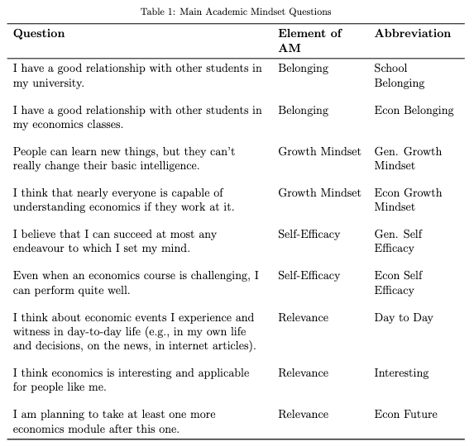
International Academic Mindset:
Main Academic Mindset Questions
Student pre + post survey (identical)
Staff survey
Notes:
Jana

Slide 4
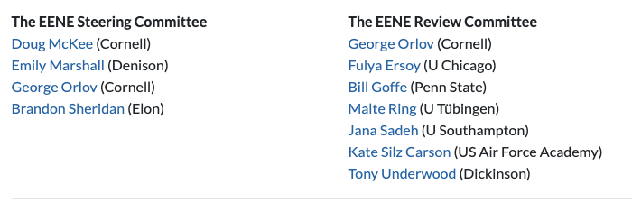

Economic Education Network for Experiments (EENE)
Founded in 2023 to create a collaborative space for cross-institution studies with pooled samples
Academic Mindset was first test study carried out
Welcomes economics instructors from around the world to participate and develop studies
EENE annual meeting follows CTREE meeting in USA (hybrid)
Join EENE (https://eene.org/join/)
Notes:
Jana

Slide 5
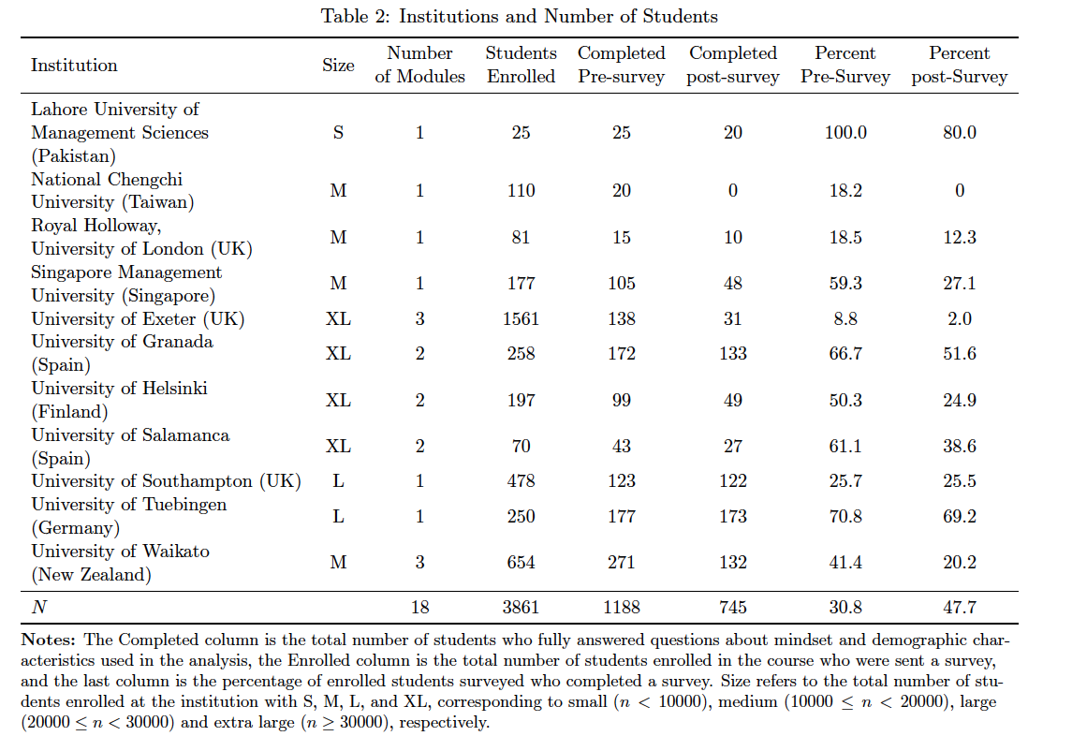
International Academic Mindset: Context
18 modules (courses) from 11 universities from 8 countries
1188 students answered the pre survey and 745 answered both the pre and post survey
Large variation in size, students enrolled and completion rates
Notes:
Jana

Slide 6
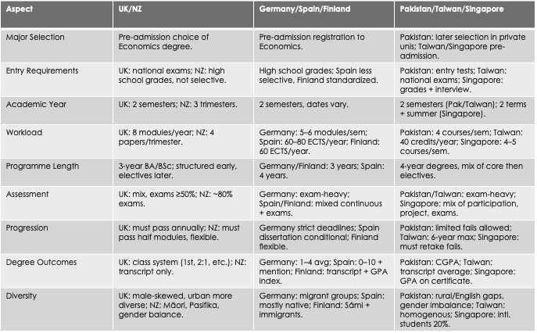
Notes:
Jana

Slide 7
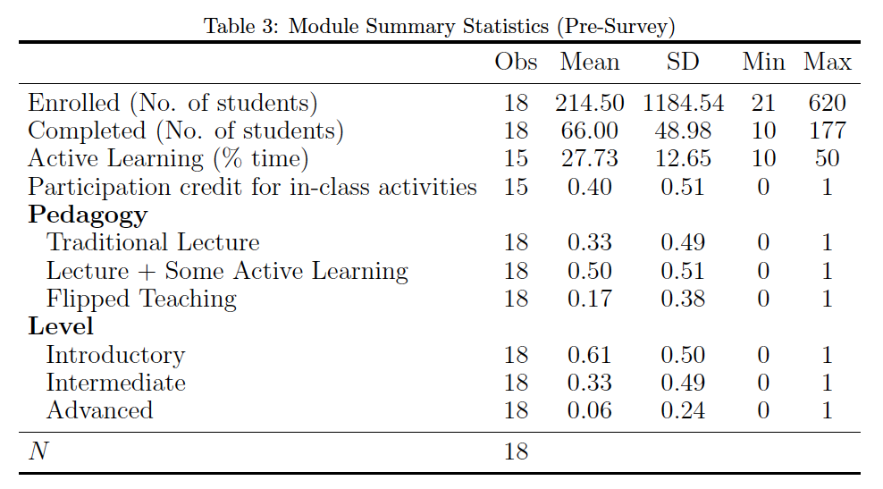
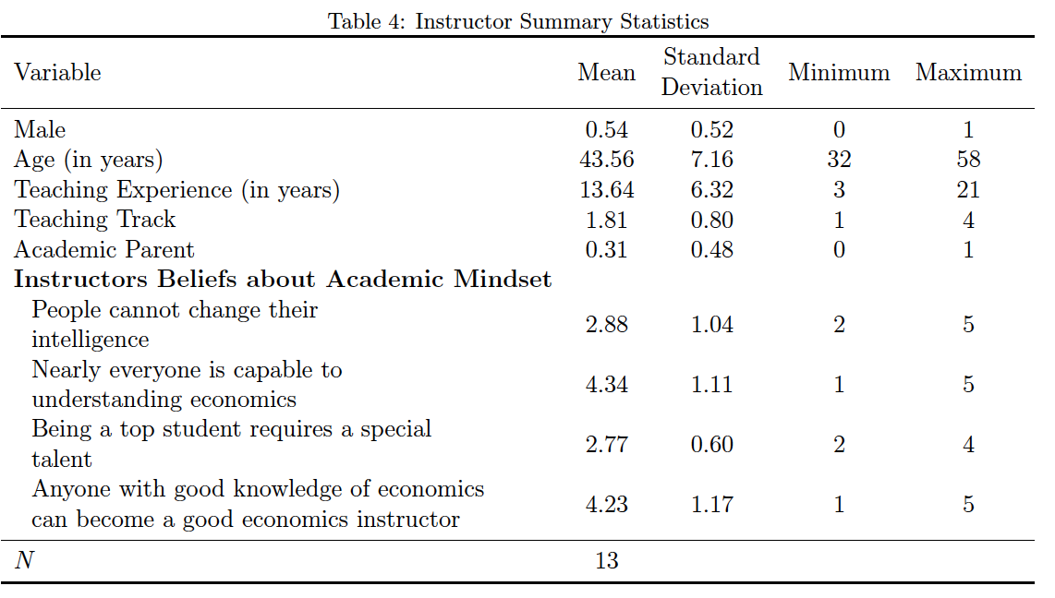
International Academic Mindset: Context
Notes:
Jana

Slide 8
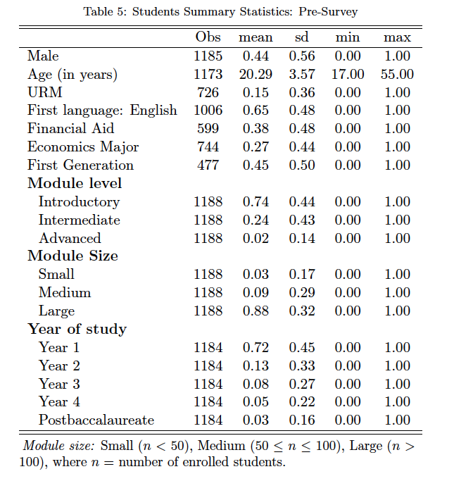
International Academic Mindset: Summary Statistics
Notes:
Carlos

Slide 9
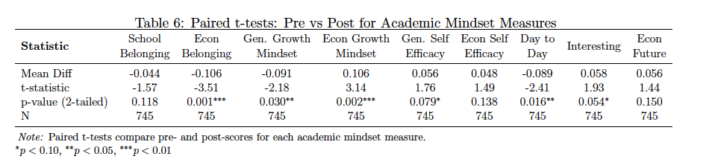
Measuring Academic Mindset: Univariate Analysis
Positive (improvement) on :
      - Belief that everyone can understand economics with effort (Econ Growth Mindset)
      - Belief that they can succeed at most endevours they set their mind to (Gen self Efficacy)
      - Perception of economics as interesting and personally relevant (Interesting)
Negative (worsening) on:
Sense of belonging in economics classes (Econ Belonging)
Belief that people can learn things but can’t change their intelligence (Gen Growth Mindset)
Students’ ability to relate economics to everyday life (Day to Day)
Notes:
Carlos

Slide 10
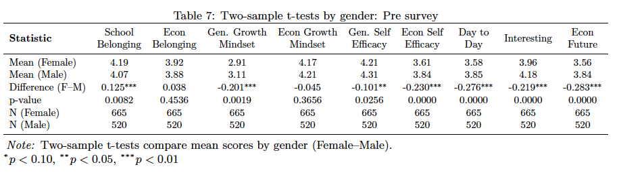
Univariate Analysis: The Role of Gender
Females report higher:
      - Stronger peer relationships (School Belonging)
      Female report lower:
- Belief that people can learn things but can’t change their intelligence (Gen Growth Mindset)
      - Belief that they can succeed at most endevours they set their mind to (Gen Self Efficacy)
- Belief they can perform well, even when the econ course is challenging (Econ self-efficacy)
- Students’ ability to relate economics to everyday life (Day to Day)
      - Perception of economics as interesting and personally relevant (Interesting)
- Intending to take further economics courses (Econ Future)
Notes:
Carlos

Slide 11
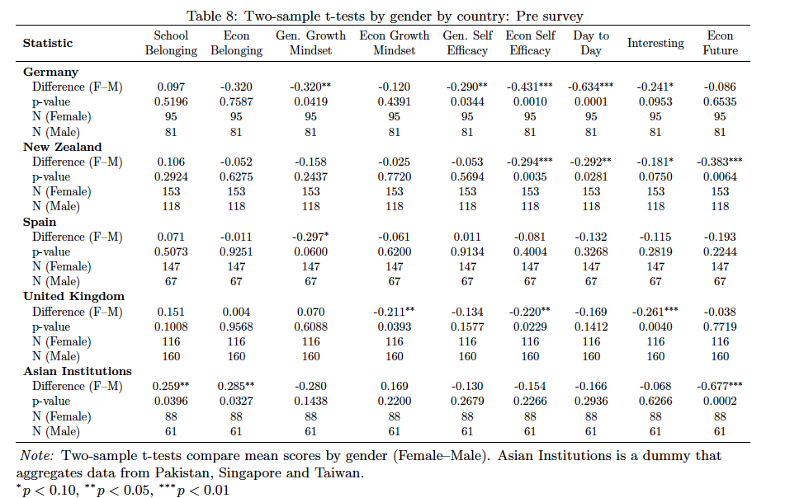
Univariate Analysis: The Role of Gender by Country
Notes:
Carlos

Slide 12
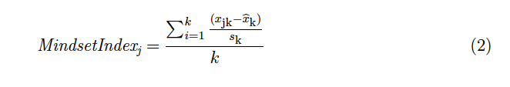
Multivariate Analysis: Framework
First, we recoded each of the 9 questions as in (1)
The we constructed 3 mindset indexes using (2):
- Overall Academic Mindset Index (Combines all nine academic mindset statements)
- General Academic Mindset Index (Based on three statements measuring School belonging, Gen. growth mindset, and Gen. self-efficacy )
- Economics Academic Mindset Index (Based on the six economics-specific statements)
Notes:
Carlos

Slide 13
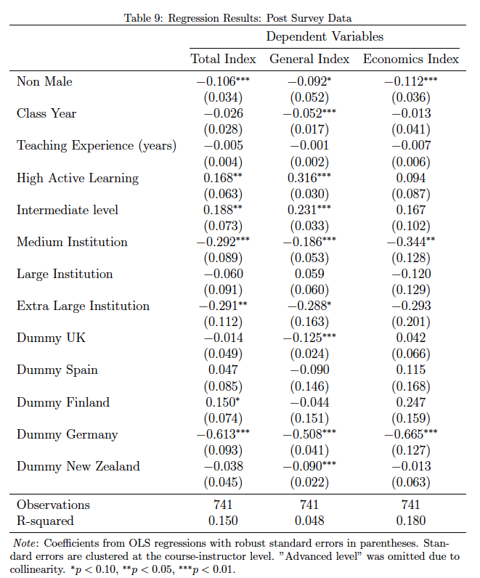
Multivariate Analysis: OLS regressions
Notes:
Class year = ordinal variable from 1-5 from a student’s class year.
High Active learning = binary variable if amount of active learning is above average
Medium Institution = between 10,000 and 20,000 students
Large institution = between 20,000 and 30,000 students
Extra Large Institution = over 30,000 students
Notes:
Carlos

Slide 14
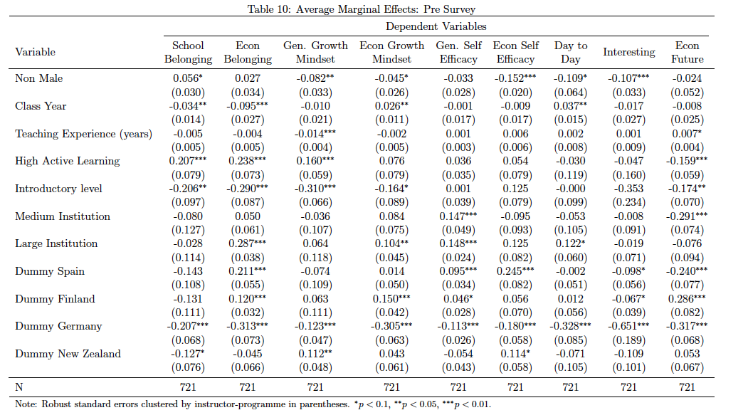
Multivariate Analysis: Logit
Notes:
Carlos

Slide 15
Multivariate Analysis: Key results
Gender
Non-male students are more likely to:
  Have a good relationship with other students at the university (5.6%)
  Report not believing that people can learn new things but can’t change their intelligence (8.2%)
  Report not believing that everyone is capable of understanding economics (4.5%)
  Report not believing that they can perform well even when an econ course is challenging (15.2%)
  Report not thinking about economic events they experience and witness in day-to-day life (10.9%)
  Report not thinking that Economics is interesting and applicable to them (10.7%)
Countries
Germany (when compared to the UK) report large, significant marginal effects in all 9 questions (ranging from 11.3% to 65.1%)
This pattern is quite different from other countries that have fewer significant results and have both positive and negative marginal effects.
Notes:
Carlos

Slide 16
Multivariate Analysis: Key results
Level of study
Introductory level students are more likely to:
  Report not having a good relationship with other students at the university (20.6%)
  Report not believing that everyone is capable of learning new things but not changing their intelligence (31%)
  Report not believing that everyone is capable of understanding economics (16.4%)
  Report not intending to take further economics courses (17.4%)
Class Year
The higher the class year, the more likely for students to:
  Report not having a good relationship with other students at the university (3.4%)
  Report not having a good relationship with students in their econ classes (9.5%)
  Believe that everyone is capable of understanding economics (2.6%)
  Report thinking about economic events they experience and witness in day-to-day life (3.7%)
Teaching Experience
No significant impact on academic mindset
Notes:
Carlos

Slide 17
Conclusions
Our results are broadly in line with the results from the US study.
However, we established that there are large international differences that suggest that the factors affecting academic mindset might not be universal.
Addressing gender gaps is critical in economics.
Future research should explore the causal mechanisms behind mindset change and investigate how different curriculum design, instructor and demographic characteristics interact to shape academic mindset over time.
Notes:
Both?

Slide 18
Thank you
Questions?

