Slide 1
Student Attitudes and Behavioural Responses to Online versus In-Person Examinations: Evidence from a UK University in the Post-Covid-19 Pandemic Era Carlos Cortinhas, Martha Omolo and Olayinka Oyekola c.cortinhas@exeter.ac.uk

Slide 2
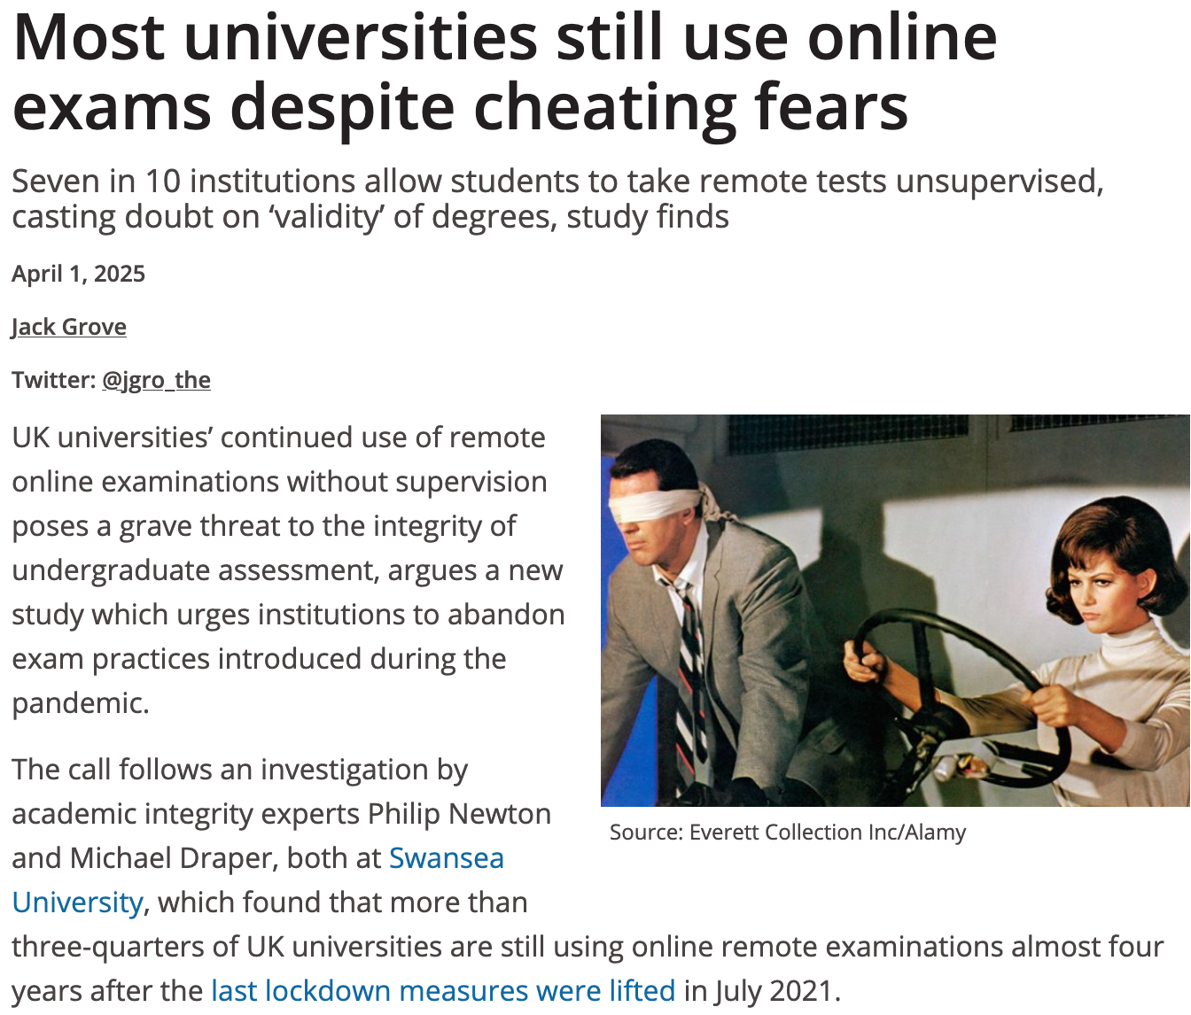
Motivation
Covid pandemic forced rapid transition to online teaching and assessments.
Many UK universities seek to maintain (and often expand) use of online assessments.
Royal Economic Society raised concerns about this trend, especially in relation to quantitative methods and core economic theory training.
Source: Times Higher Education

Slide 3
Online exams: some literature
Rapid shift to online assessment since the pandemic (Filson, 2023; Hill & LoPalo, 2024), with some studies showing this might have led to grade inflation (HESA, 2023; Hill & LoPalo, 2024).
Academic integrity concerns with online exams, particularly with gen AI (Stanoyevitch, 2024).
Student preferences influenced by multiple factors including academic ability and discipline, demographics, socioeconomic status, language proficiency, year of study and cultural background but evidence on how these are affected is often mixed (Marano et al., 2024, Tai et al., 2023, Tran & Reilly, 2019).
Notes:
While Filson (2023) is quite specific to the U.S. context, unlike Hill and LoPalo (2024) who focus primarily on exams, Filson highlights the innovative benefits of online assessments during Covid-19, benefits that may not have emerged otherwise. He emphasises the value of maintaining these innovations, such as shifting from traditional assessments with predetermined answers (e.g., MCQs or structured responses) to more open-ended, problem-based tasks. These assessments encourage students to construct arguments and counterarguments through presentations, discussions, or essays, mirroring real-world economic analysis and model application. Such approaches can be adapted to any course.

Slide 4
Online exams: some literature
Socioeconomic barriers and inequality concerns with online exams possibly widening existing performance gaps (Aucejo et al., 2020; Barrett, 2022; Mistry et al., 2024).
Growing employers' concern on academic standards with online exams and effect on wages (Dickerson et al., 2024; Feng & Graetz, 2017).
Limited research on student attitudes in the gen AI era.
Most studies use small or discipline specific and are not cross-disciplinary.
Notes:
While Filson (2023) is quite specific to the U.S. context, unlike Hill and LoPalo (2024) who focus primarily on exams, Filson highlights the innovative benefits of online assessments during Covid-19, benefits that may not have emerged otherwise. He emphasises the value of maintaining these innovations, such as shifting from traditional assessments with predetermined answers (e.g., MCQs or structured responses) to more open-ended, problem-based tasks. These assessments encourage students to construct arguments and counterarguments through presentations, discussions, or essays, mirroring real-world economic analysis and model application. Such approaches can be adapted to any course.

Slide 5
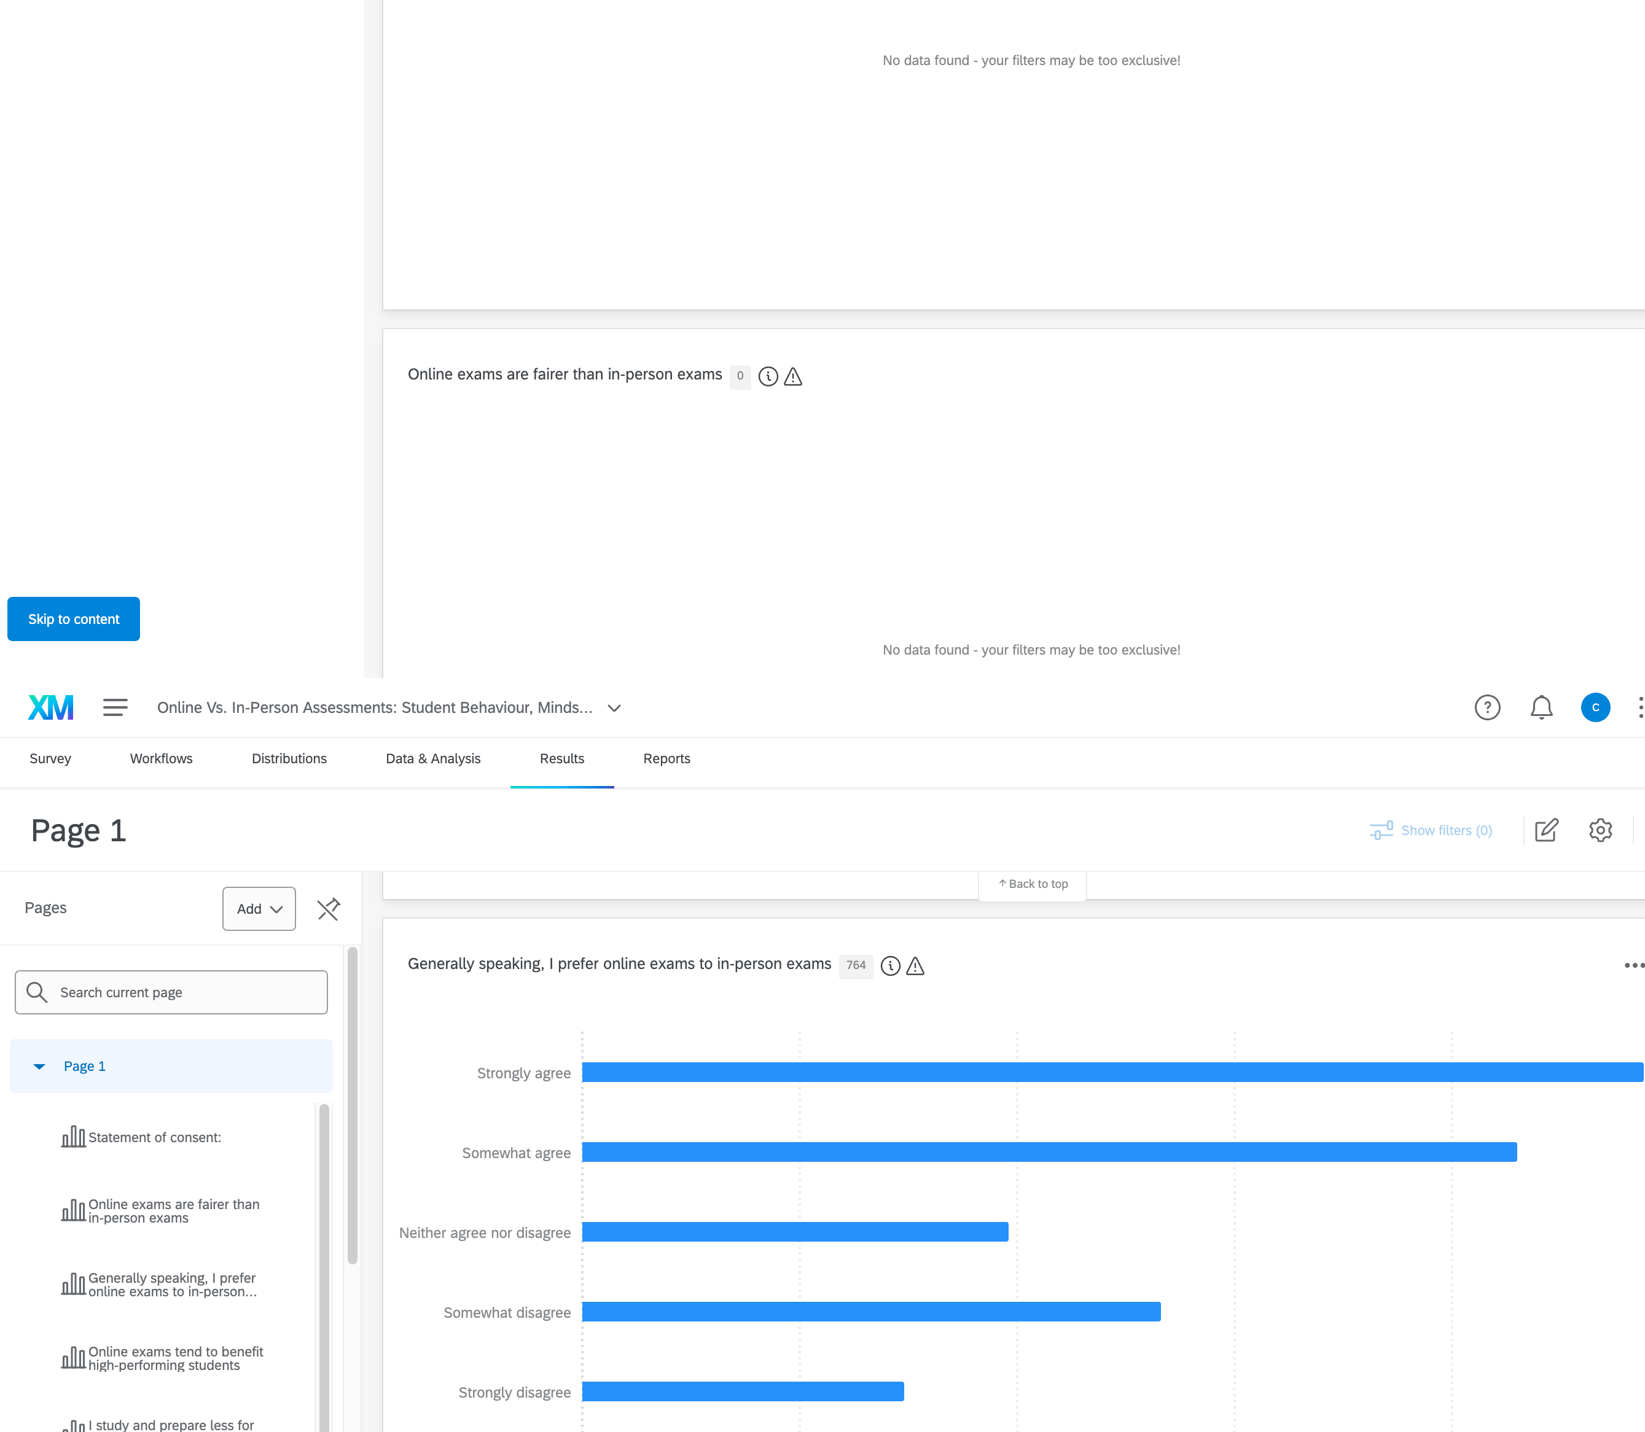
Context
Survey conducted at University of Exeter (UK) in 2024/25.
All university students (>30000) were invited via Student Bulletins.
Students were incentivised to participate by being invited to enter a prize draw (6 prizes, £400 in total)
735 students entered the draw.
Survey included 10 Likert-scale + demographic questions.

Slide 6
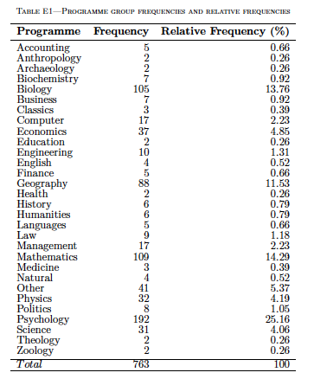
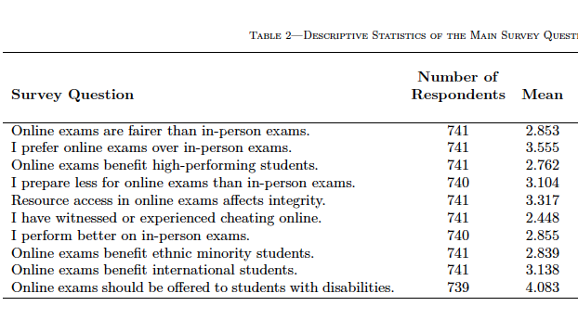
Summary Statistics

Slide 7
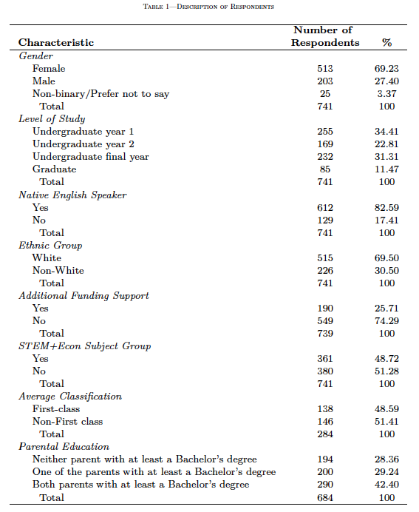
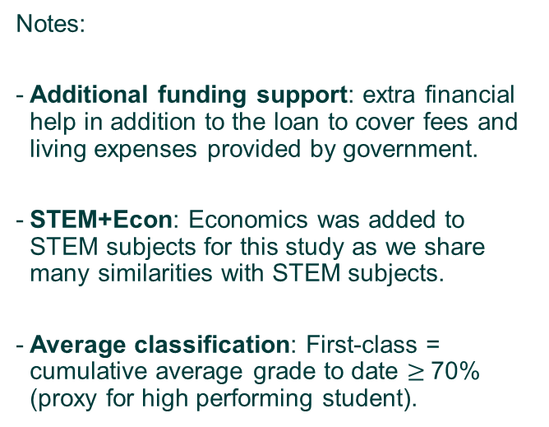
Summary Statistics (II)
Notes:
Additional funding support: extra financial help in addition to the loan to cover fees and living expenses provided by government.
STEM+Econ: Economics was added to STEM subjects for this study as we share many similarities with STEM subjects.
Average classification: First-class = cumulative average grade to date $≥$70% (proxy for high performing student).

Slide 8
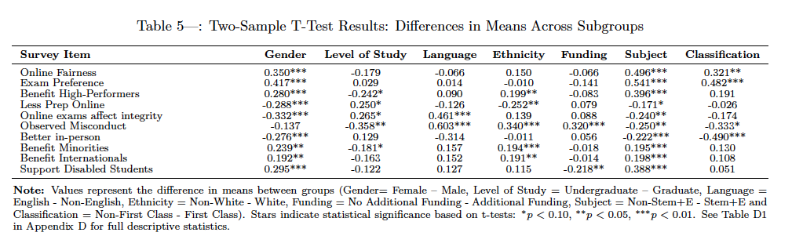
Main results: Univariate analysis
We conducted univariate test statistics (2-sample t-tests), for all 10 survey questions disaggregated by the most relevant demographic characteristics…

Slide 9
Main results: Univariate analysis
Main (significant) results:
Female students view online exams as fairer and prefer them to in-person exams.
Male students prepare less for online exams, believe online exams affect exam integrity more, and report better performance in in-person exams.
Post-graduate students report having witnessed or experienced cheating significantly more during online exams.
Undergraduate students marginally prepare less for online exams and are more concerned about academic integrity.

Slide 10
Main results: Univariate analysis (II)
Non-native speakers believe online assessment affects academic integrity and report much higher rates of witnessing or experiencing cheating.
Non-white students are more likely to believe that online exams benefit high-performing, ethnic minority, and international students. They also report higher rates of witnessing or experiencing cheating in online settings. Also, White students prepare significantly less for online exams.
STEM+Econ students viewed online exams as being unfair, thus preferred in-person exams, do not believe online exams benefit top students (but believe they benefit ethnic minority and international students) and are more concerned about misconduct.
Low performing students showed more favourable attitudes toward online exams and were more likely to see them as fairer and were less likely to report better performance in in-person exams.

Slide 11


Main Results: Multivariate Analysis
First, we recoded each of the 10 statements as in (1)
Then we ran Logit regressions for each statement, with robust standard errors, clustered at programme level as in (2)

Slide 12
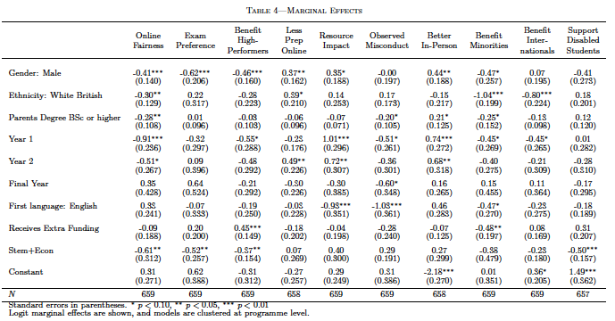
Multivariate Analysis: Marginal Effects (I)
Notes:
Marginal effects, even in models like probit or logistic regression that predict probabilities between 0 and 1, can sometimes appear to be larger than 1. This isn't necessarily an error:
The marginal effect is the slope of the prediction function, and while the function itself is bounded, its derivative (the marginal effect) can be larger than 1, especially when the predictor variable is scaled differently or when the model is non-linear.

Slide 13
Multivariate Analysis: Marginal Effects (I)
Gender
Male students are more likely to:
Believe online exams are unfair (41%)
Prefer in-person exams (62%)
Report not believing that online exams benefit top students (46%) nor minorities (47%)
Prepare less for online exams (37%)
Believe they perform better in in-person exams (44%)
Believe online exams impact academic integrity (35%)
Ethnicity
White students are more more likely to:
Perceive online exams as being unfair (30%)
Believe online exams do not benefit minorities (100%) or international students (80%).
Prepare less for online exams (39%)

Slide 14
Multivariate Analysis: Marginal Effects (I)
Year of study
Year 1 students (when compared to post-graduate students) are more likely to:
Believe that online exams are unfair (91%)
Report not having observed academic misconduct (51%)
Believe online exams do not benefit minorities (45%), international students (45%) or top students (55%)
Believe online exams impact academic integrity (100%)
Believe they perform better in in-person exams (74%)
Year 2 students are more likely to:
Believe that online exams are unfair (51%)
Believe online exams impact academic integrity (72%)
Believe they perform better in in-person exams (68%)
Final year students are more likely to:
Report not having observed academic misconduct (60%)

Slide 15
Multivariate Analysis: Marginal Effects (I)
Native speakers are more likely to:
Report not believing online exams impacts academic integrity (93%)
Report not having observed academic misconduct (100%)
Field of Study
STEM+Econ students are more likely to:
Report that online exams are unfair (61%)
Prefer in-person exams (52%)
Believe online exams do not benefit top students (37%)
Believe online exams should not always be offered to disabled students (50%)

Slide 16
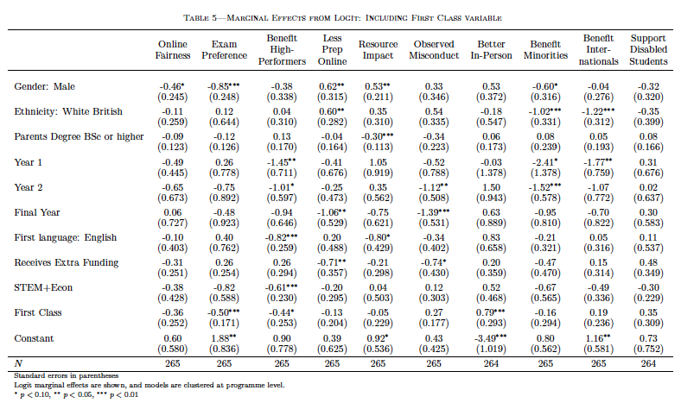
Multivariate Analysis: including First Class
Student Performance
High performing students are more likely to:
Prefer in-person exams (50%)
Believe online exams do not benefit top students (44%)
Believe they perform better in in-person exams (79%)

Slide 17
Conclusions
Our survey reveals substantial variation in students’ attitudes and preferences regarding online exams, shaped by multiple factors.
Some key results:
Female students perceive online exams as fairer and show a stronger preference for online formats than male students.
STEM+Econ, and high-performing students prefer in-person exams and express greater concern about academic integrity (and equity) in online assessments.
Widespread concerns about academic misconduct in online exams persist across the student body, especially in the first two years of undergraduate study.
A "one size fits all" approach is unlikely to be effective. Instead, universities should consider flexible and tailored online assessment policies.

Slide 18
Many thanks
Any Questions??

Slide 19
Extra Slides

Slide 20
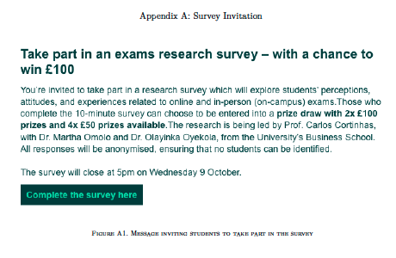
Survey Invitation

Slide 21
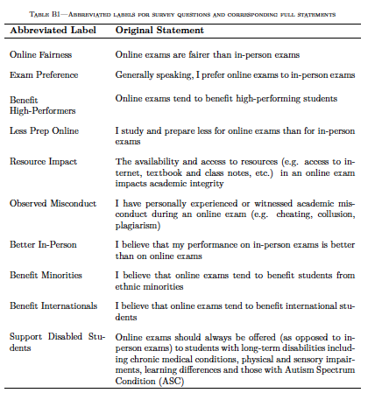
Survey Questions

Slide 22
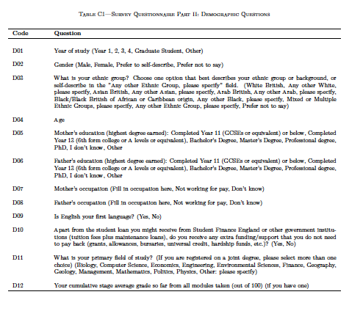
Demographic Questions

Slide 23
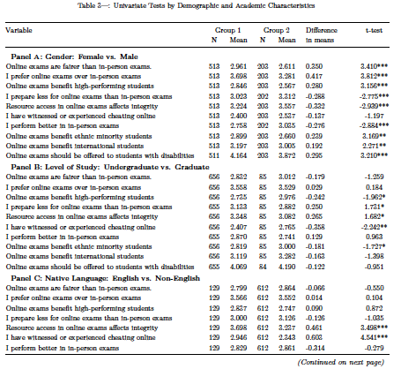
Univariate Analysis: Full Results (I)

Slide 24
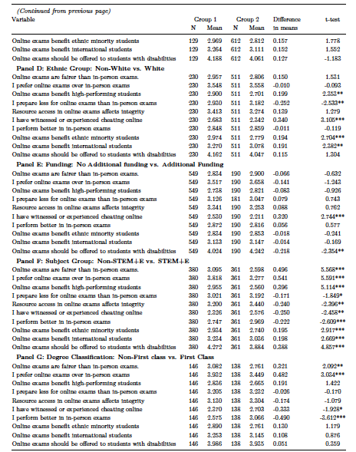
Univariate Analysis: Full Results (II)

