Slide 1

The UK Economics Degree in 2025
Annika Johnson (Bristol), Ashley Lait (Bath), with Khalid Ossoble and Millie Stark (Bristol)

Slide 2
MOTIVATION
CHANGES IN HE SECTOR:
Widening Participation
Cost pressures
International Outlook
Employability
CHANGES IN ECON AS A DISCIPLINE:
Data Science and AI
Changing topics
Changing Skills
DESIGNING AND UPDATING NEW PROGRAMMES
THIS PROJECT:
What does an ‘Economics’ degree look like?
Notes:
Econ of European Integration v Environmental
Coding: from STATA to R and Python etc.

Slide 3



RELATED WORK
UK Studies
Degree Approach: Pomorina (2001, 2013) –Departmental Survey, Economics Network
UG Pipeline Diversity: Parades Fuentes et al. (2023) – Who Studies Economics?, RES
Skills: Economics Network (2019) – Employers Survey
Choice and Entry: Discover Economics/ Econ Network (2025)
UK Policy
QAA Subject Benchmark Statement (2023)
US Studies
STEM: Marshall and Underwood (2017, 2020, 2025)
Entry requirements: Marshall, Underwood and Hyde (2024)
PPE: Halliday et. Al (2025)

Slide 4
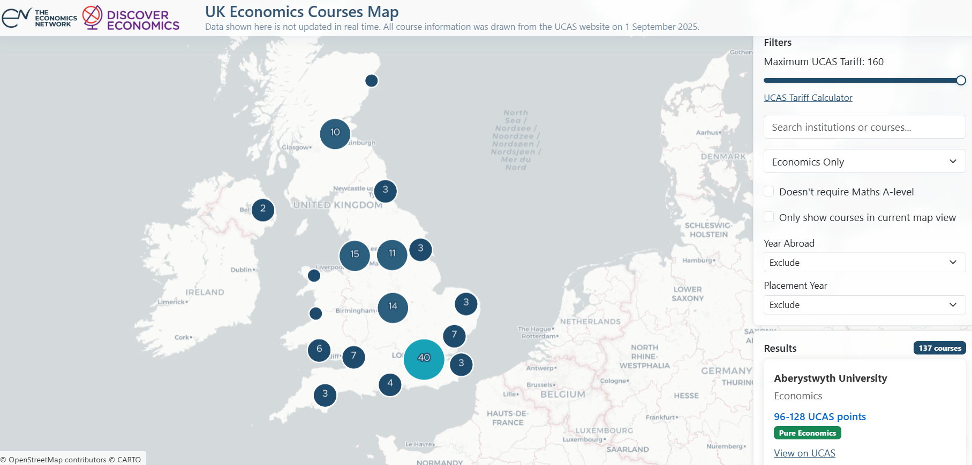

Slide 5
THIS PROJECT
Aim: To understand what a UK undergraduate, single honours degree with the title ‘Economics’ is in 2025.
Data: Collected for 45 universities (so far):
Prospectus Data available in Summer 2025
Single honours programmes only
Degree Type (BA, BSc, MA etc.)
Entry Requirements (including Maths)
Degree Variants (foundation years, study abroad, industrial placement, integrated masters)
Module titles across years if available
Module assessment information if available
Notes:
Data collected from 45 universities so far (we will collect the rest)
The data is all collected from publicly available prospectus web pages. This does mean we rely on what the universities make available there (which isn’t always everything), but on the upside it does mean they are bound by the CMA so there is some level of commitment to providing what’s stated.
Wherever possible we’ve tried to collect degree type entry reqs, and what module detail there is.
Data was all collected manually. We didn’t web scrape because every single university has different prospectus organisation and terminology. Examples….

Slide 6
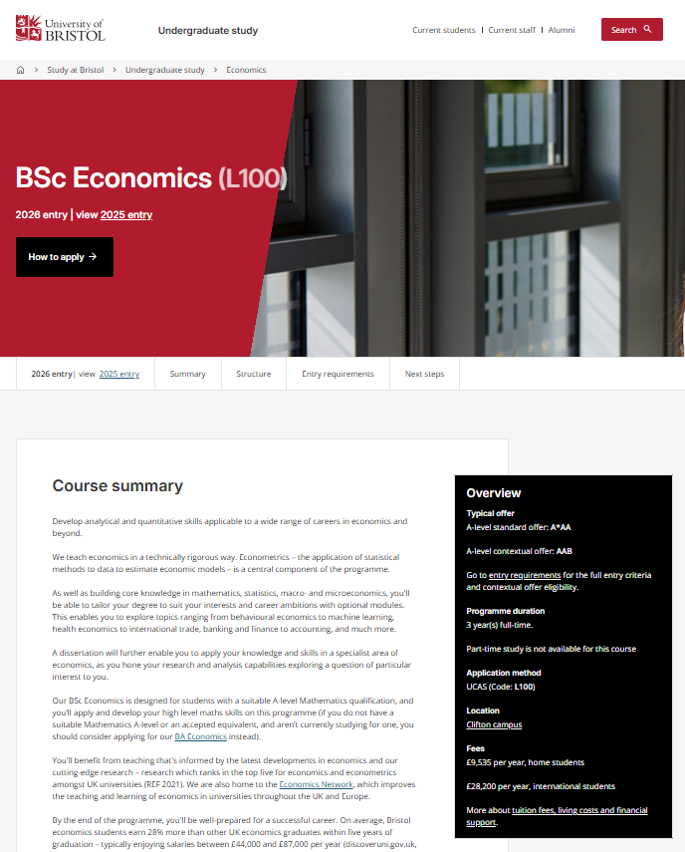
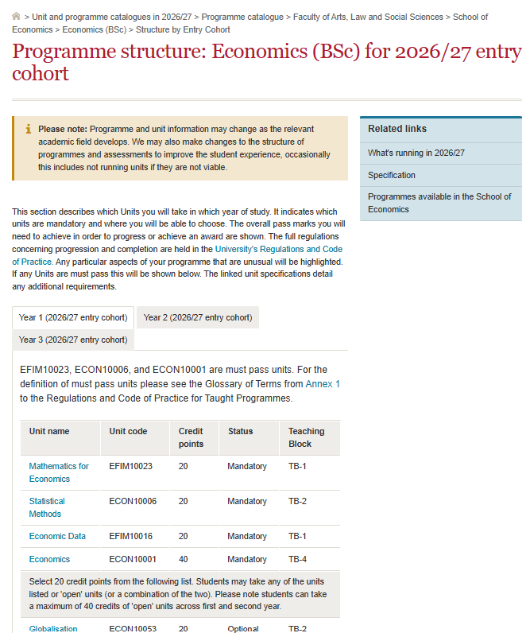

DATA

Slide 7

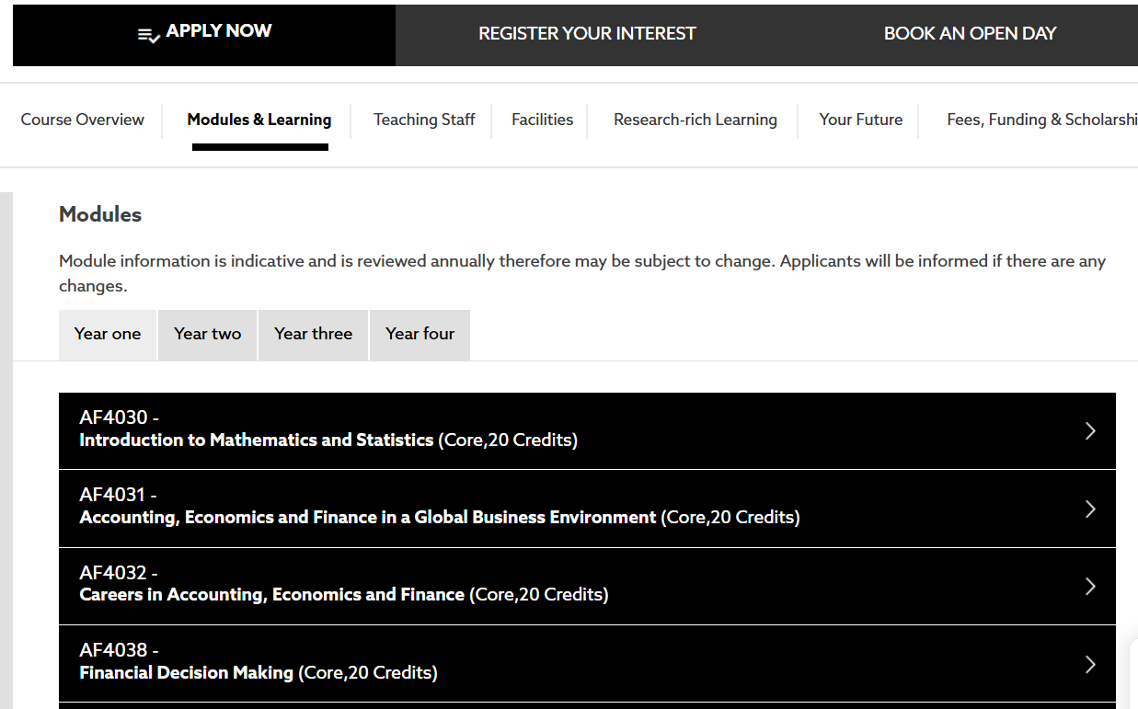

DATA

Slide 8
DATA SUMMARY
 |  | RG |  | Post 92 |  | Other |  | Total
 |  |  |  |  |  |  |  | No. | %
Institutions
 |  | 22 |  | 12 |  | 11 |  | 45
Programmes
All |  | 25 |  | 13 |  | 14 |  | 52
BA |  | 4 |  | 2 |  | 3 |  | 9 | 17%
BSc |  | 19 |  | 11 |  | 10 |  | 40 | 77%
MA |  | 2 |  | 0 |  | 1 |  | 3 | 6%
Modules
All |  | 814 |  | 234 |  | 406 |  | 1454
Assessment Detail |  | 511 |  | 65 |  | 31 |  | 607 | 42%
Variants
Foundation |  | 1 |  | 10 |  | 6 |  | 17 | 33%
Placement |  | 14 |  | 13 |  | 6 |  | 33 | 63%
Study Abroad |  | 18 |  | 6 |  | 5 |  | 29 | 56%
Integrated Masters |  | 2 |  | 0 |  | 0 |  | 2 | 4%
Entry Reqs
UCAS Range |  | A*A*A-ABB |  | BBB-DDE |  | AAA-BCC |  | A*A*A-DDE
Maths A level |  | 16 |  | 0 |  | 2 |  | 18 | 35%
Maths GCSE |  | 8 |  | 11 |  | 11 |  | 30 | 58%
Notes:
Most are BScs. The MAs are Scottish MAs.
52 programmes in total, but many more modules (note some double counting because a few universities offer both BA and BSc). Module detail for about 40% of that.
Foundations and Placements are very common at Post 92s, not at RG
Notable differences in grade requirements and maths qualifications
How much detail (z modules, q with detail)
Tried to look at core v optional but not always easy to understand

Slide 9
PRELIMINARY FINDINGS

Slide 10
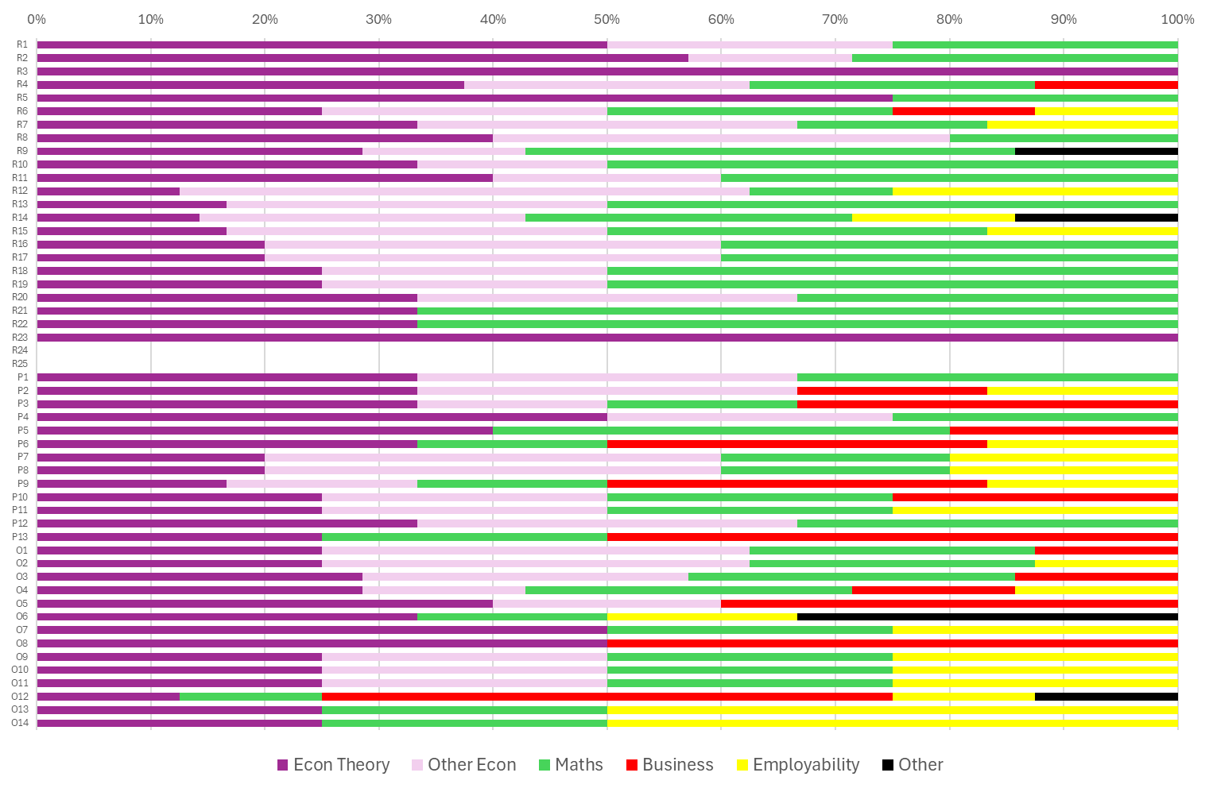
RG
1. COMPULSORY UNITS IN YEAR 1
P92
Other

Slide 11
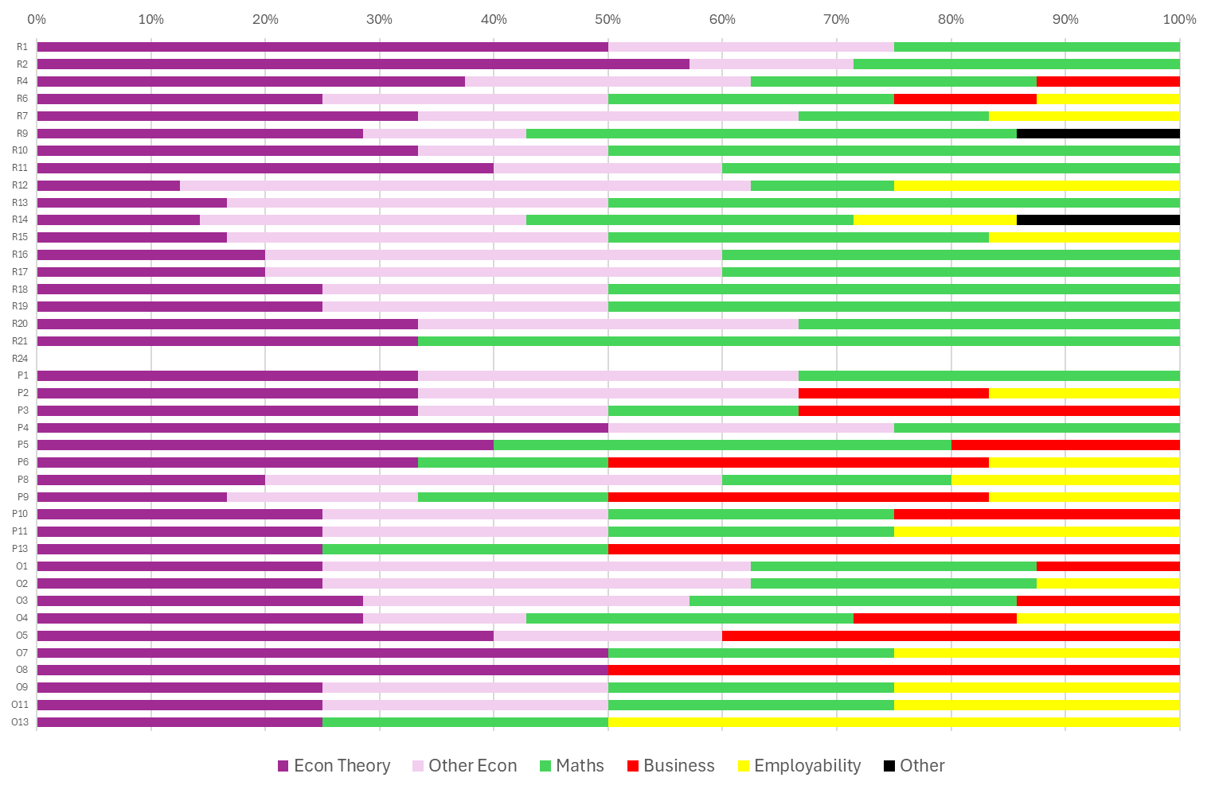
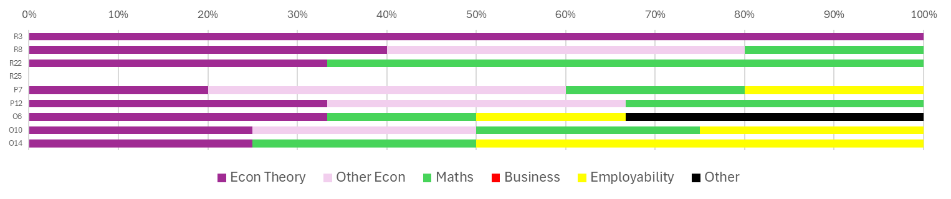
1. COMPULSORY UNITS IN YEAR 1
BSc
BA

Slide 12
2. SUMMATIVE ASSESSMENT
 |  | Total
 |  | No. | %
Compulsory Units
 |  | 178
Asst Type
Exam Only |  | 37 | 21%
Coursework Only |  | 18 | 10%
Mixed |  | 123 | 69%
Group Work?
Group Work |  | 19 | 11%
Assessed Components
1 |  | 35 | 20%
2 |  | 112 | 63%
3 |  | 19 | 11%
4 |  | 12 | 7%

Slide 13
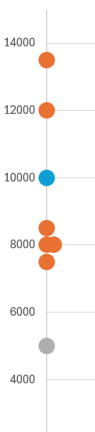
3. DISSERTATIONS
Total Word Count in Unit
 |  | RG |  | Post 92 |  | Other |  | Total
 |  |  |  |  |  |  |  | No.
Programmes
 |  | 25 |  | 13 |  | 14 |  | 52
Diss Availability
Mandatory |  | 8 |  | 4 |  | 0 |  | 12
Optional |  | 10 |  | 3 |  | 6 |  | 19
Not specified |  | 7 |  | 6 |  | 8 |  | 21
Alternative |  | 0 |  | 2 |  | 3 |  | 5
Assessed Components
1 |  | 5 |  | 1 |  | 1 |  | 7
2 |  | 4 |  | 2 |  | 0 |  | 6
3 |  | 3 |  | 0 |  | 0 |  | 3
4 |  | 0 |  | 0 |  | 0 |  | 0
5 |  | 0 |  | 0 |  | 0 |  | 0
6 |  | 2 |  | 0 |  | 0 |  | 2
Detail Available |  | 14 |  | 3 |  | 1 |  | 18
Russell Group
Other
Post 92

Slide 14


4. UNITS BY TOPIC
GENDER,
RACE,
DIVERSITY,
DISCRIMINATION
ARTIFICAL
INTELLIGENCE
Applied Econ
Economics of Growth and Innovation in the Age of AI
Digital Economics and Artificial Intelligence
Artificial Intelligence and Labour Economics and the Future of Work
Applied Econ
Gender and Ethnicity in the Economy
Economics of Race and Gender
Economics of Diversity and Discrimination
Gender, Race and Identity in Economics
Econometrics
AI-Enhanced Further Econometrics
Interdisciplinary
Ethics of Artificial Intelligence
How can we control AI?
Russell Group
Other
Post 92

Slide 15
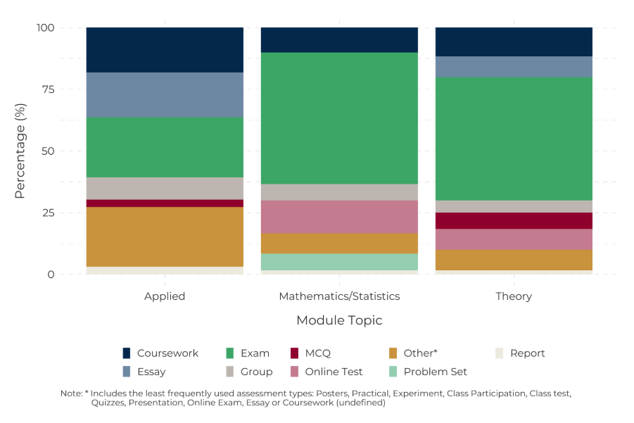
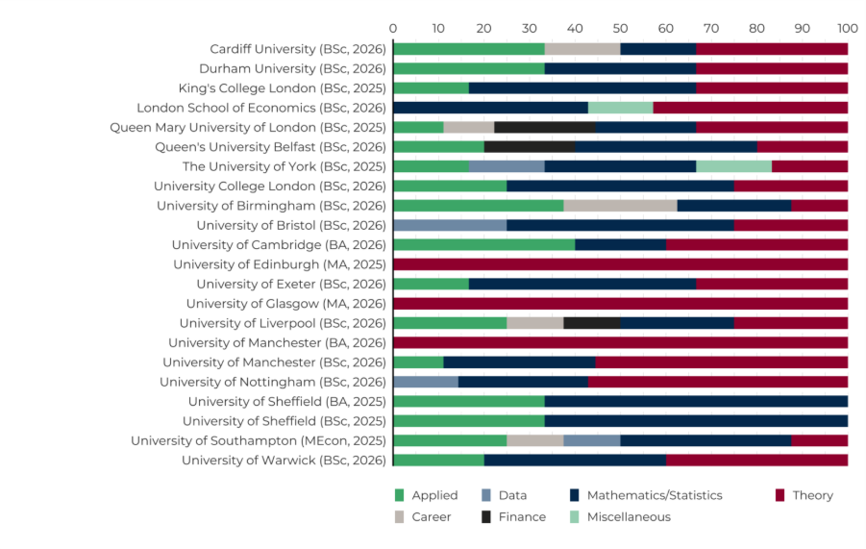
CONCLUSION / COMING NEXT
More Data! – complete P92 + other
Report on all single honours UG Economics degrees
Any thoughts?

Slide 16
APPENDIX: Universities
RUSSELL GROUP
Cardiff University
Durham University
The University of York
University College London
University of Birmingham
University of Cambridge
University of Exeter
University of Warwick
University of Southampton
University of Southampton
University of Sheffield
University of Sheffield
King's College London
Queen's University Belfast
University of Leeds
University of Bristol
London School of Economics
Newcastle University
Queen Mary University of London
University of Liverpool
University of Manchester
University of Manchester
University of Nottingham
University of Edinburgh
University of Glasgow
POST 92
Birmingham City University
Bournemouth University
Cardiff Metropolitan University
Coventry University
De Montfort University
Edge Hill University
Kingston University
Liverpool Hope University
London South Bank University
Manchester Metropolitan University
Manchester Metropolitan University
Middlesex University
Northumbria University
OTHER
Aberystwyth University
Aston University
Bangor University
Birkbeck, University of London
Brunel University London
City, University of London
Goldsmiths, University of London
Goldsmiths, University of London
Heriot-Watt University
Keele University
Keele University
Lancaster University
Lancaster University
Loughborough University

