Slide 1

Through Student Eyes: Graduate Attributes in the Economics & Finance Curriculum
Kulnicha Meechaiyo (km364@st-andrews.ac.uk)
Ian Smith (is@st-andrews.ac.uk)
Gosia Mitka (mmm25@st-andrews.ac.uk)

Slide 2
Graduate Attributes
Institutionally determined (by committee & consultation)
Identify competencies expected to develop at university for employability, citizenship, life-long learning
Attributes developed through curricular, co-curricular & extra-curricular activities
Typically, low awareness of attributes & low engagement from students & staff
Notes:
Most British universities have a list of graduate attributes. The focus is usually on professional skill development and employability, helping students and their lecturers to understand the attributes they are developing through their modules which will be of benefit for their careers even if their courses are not directly vocational.
Students have opportunities to develop attributes during their university career through their curricular, co-curricular and extra-curricular activities combined. It is not expected then that the curriculum, or any given degree programme alone, will necessarily generate all the attributes.
Low awareness and engagement so the challenge is to embed graduate attributes in the institution in a way which generates value to stakeholders.

Slide 3
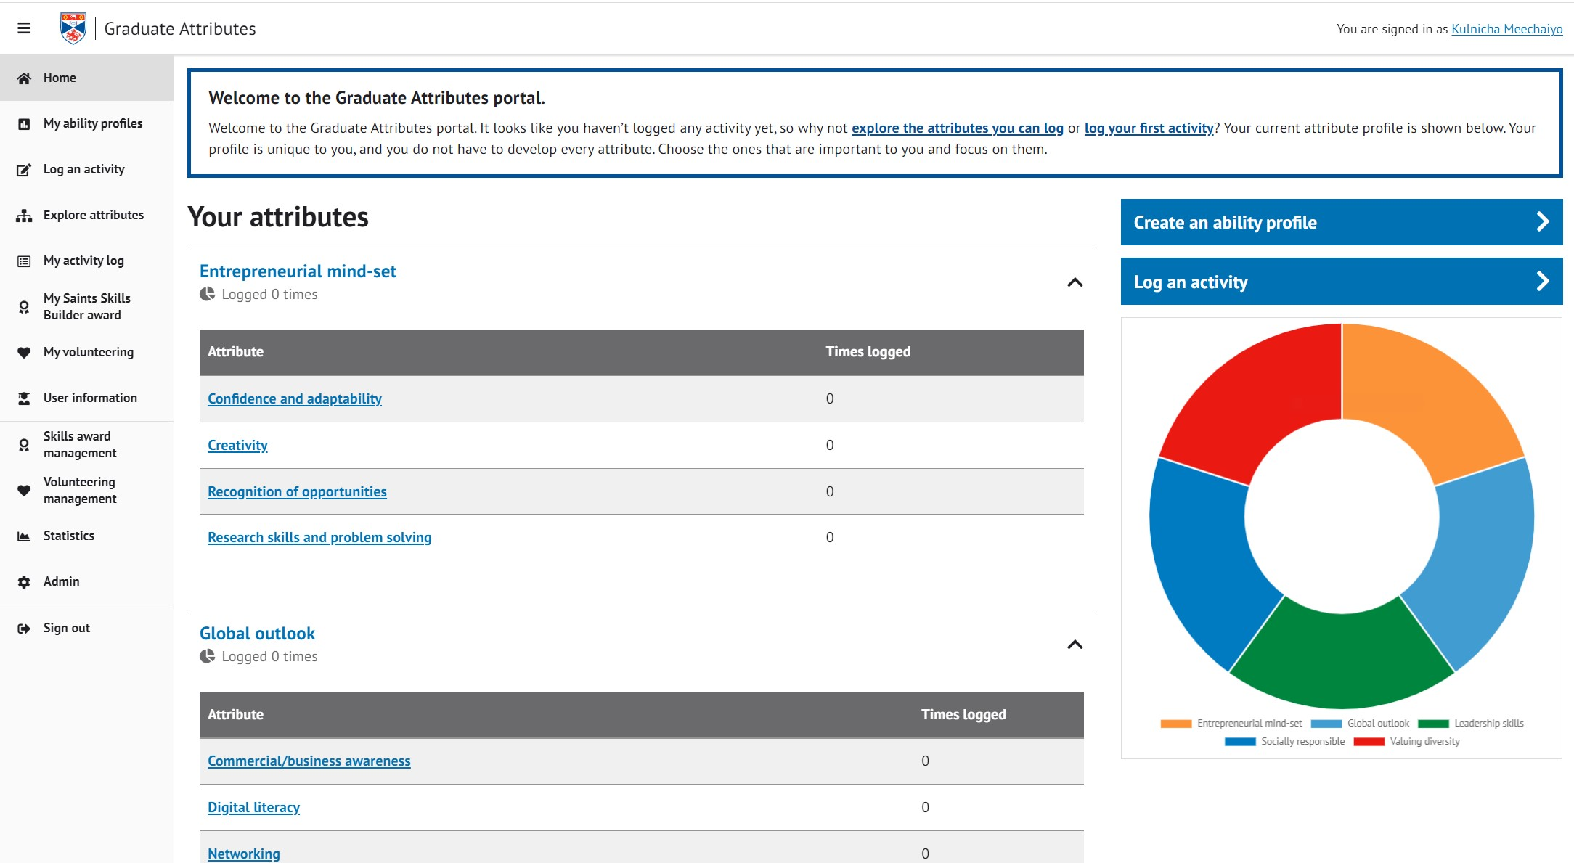
Dashboard enables students to log & track their Graduate Attribute development
Notes:
Have portal/dashboard which enables students to log and track the development of their graduate attributes across their curricular, extra-curricular and co-curricular activities.

Slide 4
University of St Andrews – 20 Graduate Attributes Launched in 2020-2021
Commercial/Business awareness
Confidence and adaptability
Creativity
Digital literacy
Diversity Awareness
Effective team contribution
Influencing and negotiation
Interpersonal skills
Leading others
Networking
Numeracy
Oral communication
Organisation
Recognition of opportunities
Research skills and problem solving
Resilience
Self-awareness and reflection
Socially responsible
Technical and specialist academic skills and disciplinary knowledge
Written communication
Notes:
Why 20? Longer list than most universities. Variation across universities. Some attributes commonly found on other university lists are not included – e.g. critical thinking.

Slide 5
Graduate Attributes item added to all pre-existing student Module Evaluation Questionnaires (MEQ)
Aims
Help students articulate the attributes they have developed in their modules
Diagnostic tool - a student generated map of attributes across the curriculum
Students – identify attributes needing further enhancement
Staff – evidence base for programme or module (re-)design
Select the 5 graduate attributes you have developed in the module the most from the list of 20
Notes:
All students are invited to complete a voluntary end of semester Module Evaluation Questionnaire (MEQ) in which they provide feedback on their experience of the module. Alongside standard questions which evaluate learning and teaching, students are asked to identify up to a maximum of five attributes from the list of 20 which they have enhanced the most in each module.
Students can select fewer than 5 attributes but in 88% of cases, students chose 5 responses.
The aim is to help students to think about and articulate the skills they have developed. It also provides module coordinators and the institution with feedback on students’ perceptions. This is potentially a useful diagnostic tool for the design or re-design of modules and programmes.

Slide 6
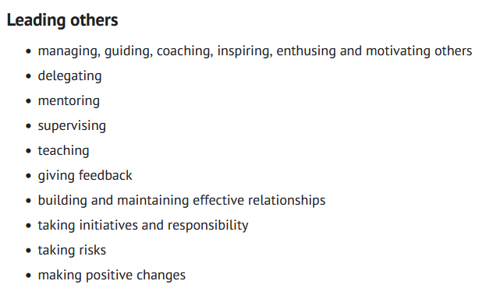
Students given a link in MEQ to descriptions of attributes https://www.st-andrews.ac.uk/careers/improve-your-skills/graduate-attributes
Example:

Slide 7
Limitations of Graduate Attributes item in the end of semester Module Evaluation Questionnaire (MEQ)
Interpretation & meaning of attributes may be discipline-specific (or even student specific)
Students not required to complete MEQ, can skip Graduate Attributes item
Students limited to choosing 5 attributes, not evaluating all 20, and not on an interval (ordered) scale
Anonymous - cannot track individual student attribute development
Notes:
Since completion of the MEQ is not compulsory, the sample is self-selected rather than random. As a result, the student responses may not be representative, especially for those modules where the sample size is small. Furthermore, even if students engage with the MEQ, they are not required to answer the graduate attributes question or to select as many as five attributes. It is the students who think they have enhanced skills who are most likely to respond. These caveats imply that the results must be interpreted cautiously.
As the responses are anonymous, we are not able to identify and track responses from individual students across modules.

Slide 8
Data from 8 semesters, 2021-2025 All University Schools & Departments
Repetitions of a module | Number of modules
1 | 666
2 | 484
3 | 376
4 | 602
5 | 8
6 | 6
7 | 2
8 | 3
Total number of modules, including repetitions = 5,284 | Number of different modules = 2,147 Total number of respondents = 58,754
Notes:
Majority of modules are repeated every year which permits us to investigate whether known innovations in assessment, in pedagogy or the curriculum generated any change in the graduate attribute responses chosen by students – will give an example later.

Slide 9
Data from 6 levels of study All University Schools & Departments
Level | Number of modules | Number of respondents
Foundation | 84 | 505
1000 | 481 | 13,831
2000 | 532 | 11,520
3000 | 1,129 | 11,194
4000 | 1,623 | 13,251
5000 (PGT) | 1,434 | 8,452
Notes:
Note that it is a four year undergraduate degree programme in Scotland. The number of modules includes duplicates, that is, modules repeated across semesters or years.

Slide 10
Department of Economics 8 semesters, 2021-2025
Repetitions of a module | Number of modules
1 | 6
2 | 8
3 | 11
4 | 36
Total number of modules, including repetitions = 199 | Number of different modules = 61 Total number of respondents = 5,239
Notes:
Majority of modules are repeated every year which permits us to investigate whether known innovations in assessment, in pedagogy or the curriculum generated any change in the graduate attribute responses chosen by students – will give an example later.

Slide 11
Department of Economics Data from 5 levels of study
Level | Number of modules | Number of respondents
1000 | 16 | 1,619
2000 | 12 | 881
3000 | 26 | 459
4000 | 94 | 1,833
5000 (PGT) | 51 | 447
Notes:
Note that it is a four year undergraduate degree programme in Scotland. The number of modules includes repetitions.

Slide 12
Graduate Attribute Shares Key variable for comparisons across modules & attributes
For each module, we calculate the % of respondents who selected each of the 20 Graduate Attributes in their five responses
e.g. for module EC1009, 30% of students selected Written Communication, 9% selected Resilience, 75% selected Numeracy etc.

Slide 13
Graduate Attribute Mean Shares Key variable for comparisons across academic disciplines & attributes
For each academic subject, we calculate the mean share of each Graduate Attribute across all the modules in the subject. This measures the average share for the academic discipline.
Using the median share gives very similar results

Slide 14
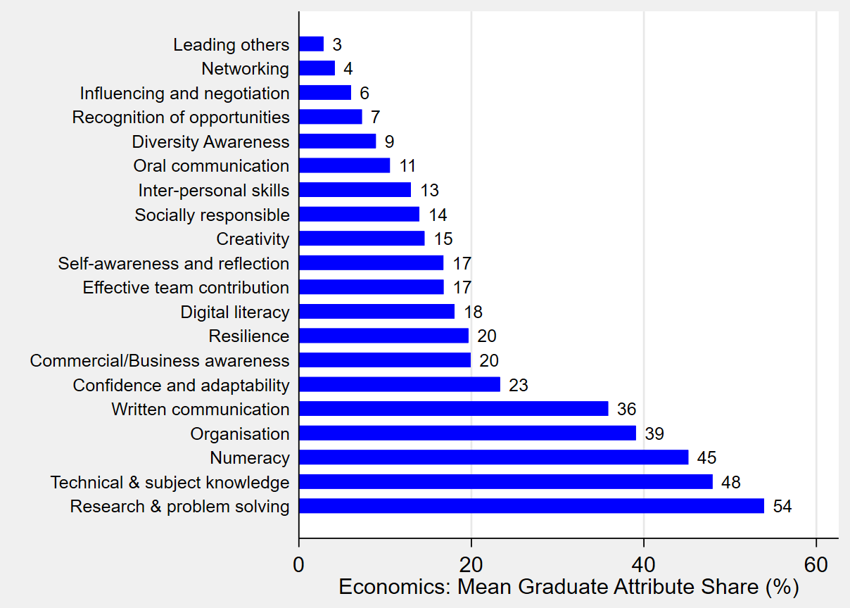
Notes:
For typical module in Economics, few select leading others or networking but numeracy, technical and specialist knowledge, and research & problem solving are frequently selected in the typical module. We can use the data as a diagnostic tool to compare Economics with other disciplines. For example, oral communication looks surprisingly low with a mean share of around only 11% of respondents choosing it on average.

Slide 15
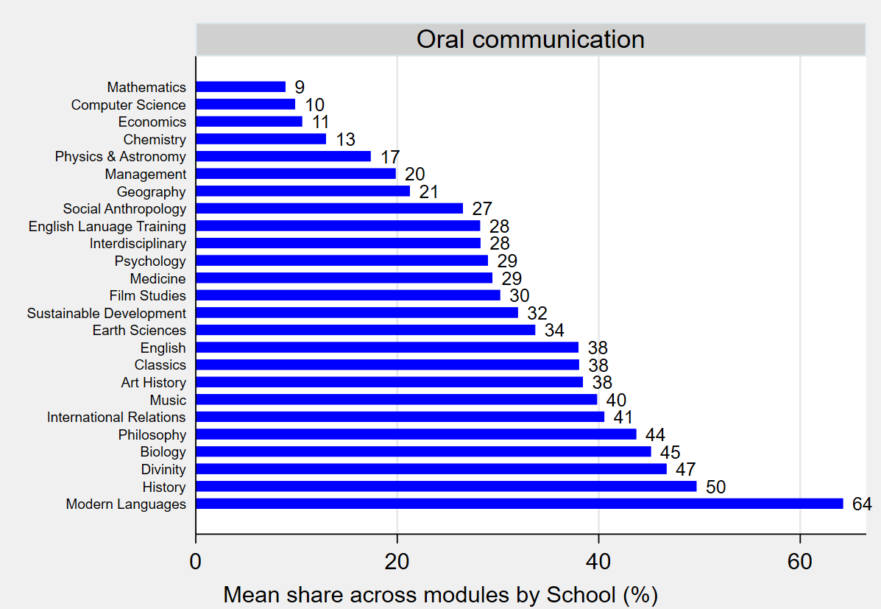
Notes:
Here we see that Economics is similar on this GA to the hard sciences P&A, Maths, Chemistry, CS. Be that it is may, in designing the Economics programme, we might want to consider whether it is desirable to enhance the quantity of presentations to practice oral communication further. Of course, while the mean is a measure of the central tendency, it doesn't tell us what the distribution or spread of graduate attributes looks like across modules.

Slide 16
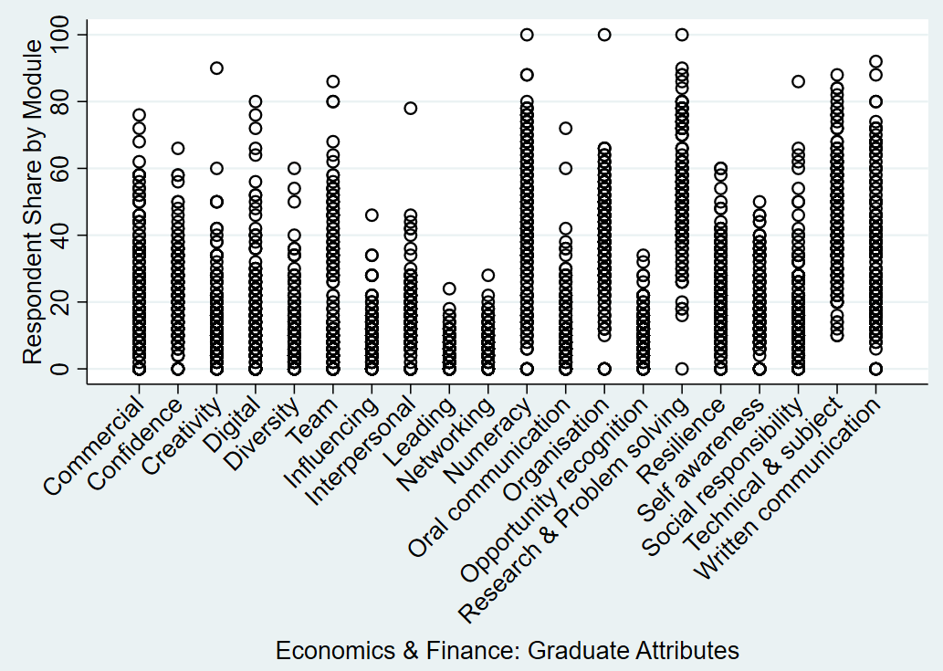
Notes:
Dotplot of distribution of attributes for modules with at least 5 respondents. Each circle represents a module. Mean is a useful summary but the distribution shows variation in shares of responses for each GA in each module. Written communication (far right) ranges from 0 to 100%. Useful for identifying outliers (graph is for at least five students in a module). Outlier on oral communication (shaded red) for which 72% of respondents indicated that they had developed their skills in oral communication. This belongs a module with a flipped classroom approach.

Slide 17
Investigating the outlier in oral communication
A 4000 level module with a flipped classroom approach
Assigned readings before each lecture
Guided discussions & student questions during “lecture” time slot
Far more oral contributions compared to traditional lectures
Modules without oral assessment can enhance oral communication
Pedagogy can be a powerful factor influencing selected attributes.
Notes:
According to the module coordinator, his teaching method follows a strong flipped classroom pedagogy

Slide 18
Investigating the impact on Graduate Attributes of flipping lectures at the PGT level
PGT module in Finance
2021-2022 Standard lectures
2022-2024 All lectures flipped to become group work seminars with assigned readings prior to class meetings

Slide 19
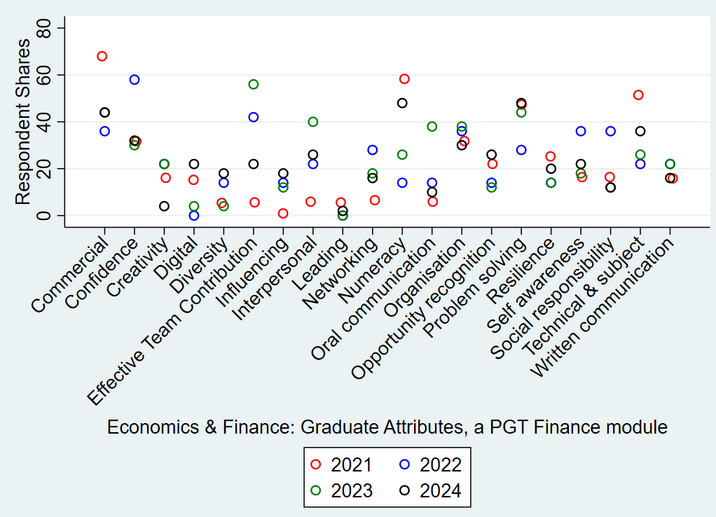
Notes:
Increase in effective team contribution, influencing and interpersonal skills.
Of course, if some attributes are being chosen more frequently in students list of 5 then others must decline. Apparent in numeracy and technical and subject specific skills.

Slide 20
Investigating the impact on Graduate Attributes of changes to module assessment
First year module in Economics
2021-22 Coursework assessment - problem solving Moodle quizzes
2022-23 & 2023-24 Quizzes + group video project with equal weight
Project - production of 3 minute video in groups of 4 or 5 students
Groups meet once per week for 4 weeks & keep a meeting log

Slide 21
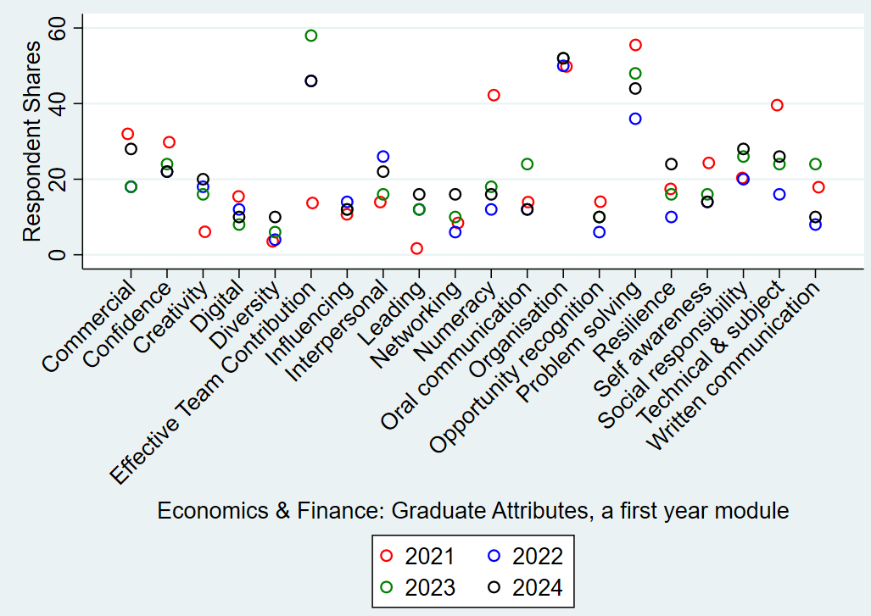
Notes:
Significant increase in effective team contribution from and creativity from as well as leading others. Effective team contribution is the same in 2022 and 2024 (46%) hence cannot distinguish the circles. Leading others is the same in 2022 and 2023 (12%)
Of course, if some attributes are being chosen more frequently in students list of 5 then others must decline. Apparent in numeracy and problem solving and technical and subject specific skills (same as for the PGT Finance module).

Slide 22
Learning Tools
The tools used in modules influence perceived attribute development.
Example: Modules using statistical or mathematical software (e.g., Mathematica, Stata, Excel).
These modules rank digital literacy highly among the developed attributes.

Slide 23
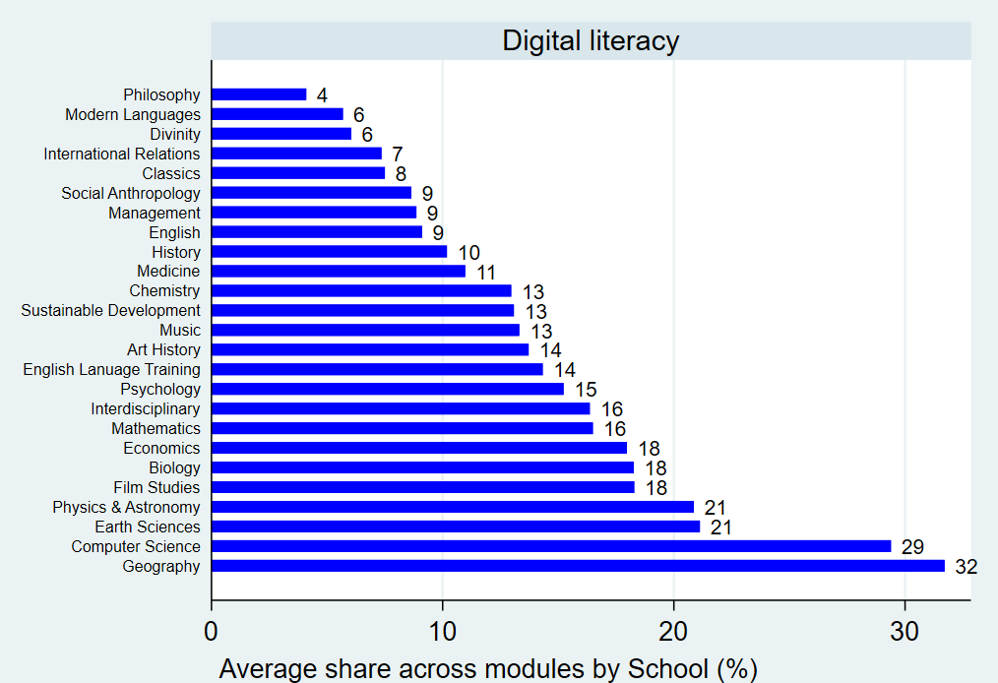
Notes:
Interestingly digital literacy is the same in Economics as Film Studies – evidence of the digital humanities in action.. Also reflects point that the extent to which a student considers themselves to have developed an attribute depends on their starting point. Suppose a module, for example, requires students to make use of spreadsheet software. If the class is already highly competent in using a spreadsheet, the students may not identify the module as strongly developing their digital literacy it at all, compared to students who are less well acquainted with spreadsheets.

Slide 24
Syllabus Content
Syllabus content plays a role in shaping selected graduate attributes.
Examples
Modules in finance and industrial organisation foster commercial/business awareness.
Social responsibility ranks highly in modules addressing wellbeing, standard of living, development, inequality, and public policy.

Slide 25
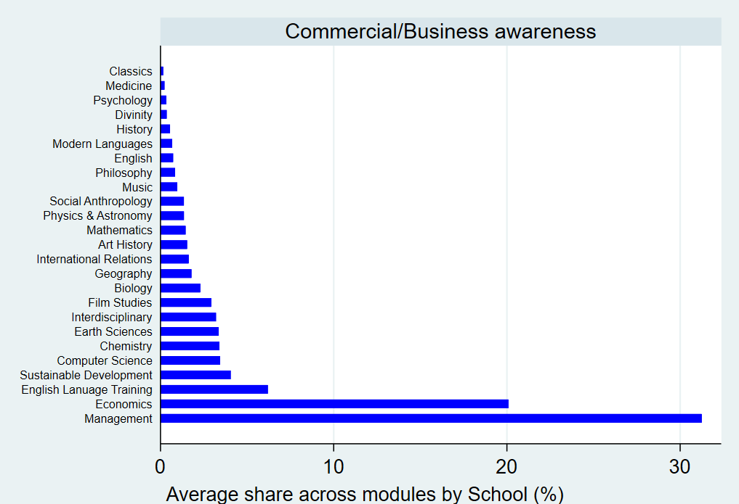

Slide 26
Notes:
Modules with social responsibility shares above 50% are those which focus on the environment (3 instances, including the ,highest shares), inequality, economic development, health economics, public economics and experiments in economics.

Slide 27
Summary of Factors Influencing Attribute Selection
Assessment
Pedagogy
Learning tools
Syllabus content

Slide 28
Conclusions
Student generated graduate attribute data provides a tool for institutions
To assess influence on competencies of module/programme design
To identify potential gaps in graduate attribute enhancement
Also a tool for students
In module selection
Tracking & articulating their attribute development
Notes:
Tried to illustrate that…

Slide 29

Thank you

