Slide 1
Co-creating group summative assessment with undergraduate student collaborators.
Satadru Mukherjee, Lecturer, University of Bristol

Slide 2
Project summary
Co-created the group coursework for a year 1 unit ECON 10003 (Probability, Statistics & Econometrics).
Co-created elements of this assessment with year 2 students (previously taken this unit).
Educational development project 2024/25 —Agency and Choice in Assessment Design.
Funded by the Bristol Institute for Learning and Teaching (BILT).
Project developed through four, 2- hour group meetings during TB2 2024/25.

Slide 3
Why assessment co-creation?
Raise student agency in assessment (facilitates democratic assessment design).
Design stemming from student’s subject interests.
In-depth engagement with study interests, what students value in their learning.
Potential to shape curriculum in stimulating and impactful ways.
Contributes to authentic assessment.
Raise assessment literacy.
Develop study skills, employability skills.
Strengthen student’s sense of belonging with university.

Slide 4
Why co-creation?
Promotes authentic learning (Lubicz-Nawrocka & Bovill 2023).
Contributing towards
Deeper learning
Better assessment performance
Better student engagement
Higher assessment literacy
(Deeley & Bovill 2017, Doyle, Buckley & McCarthy 2021)

Slide 5
Why co-creation?
Meaningful rewarding process for students and staff (Lubicz-Nawrocka & Bovill 2023).
Meaningful context provided by constructivism: Actively constructing meaning and knowledge through experiences, interactions, reflections (Doyle, Buckley & Whelan 2019)
Improves student’s professional and personal development (Lubicz-Nawrocka & Bovill 2023).
Redresses traditional hierarchies between teachers and learners (Bovill & Woolmer 2019).

Slide 6
Assessment
Group coursework in Year 1 ECON 10003 (Probability, Statistics & Econometrics).
Summative assessment.
30% weightage to final unit mark.
Examining statistical theories using data, hypothesis testing, examining data sets, presenting visualizations, summarising data.
In 2023/24 students worked in groups of 7 (26 groups in total).
In 2024/25 students worked in groups of 8 (29 groups in total).

Slide 7
Advertisement and recruitment
Project advertised via email to all Year 2 Economics and finance students (mid-late October TB1 2024/25).
Involved 2nd year students to gain from their experience and expertise.
When signing up students were required to answer questions on:
What interests them about the project?
What according to them is an authentic assessment?
What skills they would like to develop?
6 students signed up for the project (recruitment done through University TSS system).
Work began and completed in TB2 2024/25.
Work developed using inputs from the project’s critical friend.

Slide 8
Assessment co-creation process summary
Meeting 1: Introduced co-creation, offered training on statistical question design, scrutinized previous year’s assessment, brainstormed/generated project ideas.
Meeting 2: Explored ideas, discussed articles, created preliminary questions.
Meeting 3: Further brainstorming, developed questions, evaluated data sets.
Meeting 4: Reviewed and developed the assessment further.
Students encouraged to share reflections after each meeting.
Focus group held during Meeting 4 to discuss, reflect upon, share feedback on the project.

Slide 9
Meeting 1
Project aims/Timeline.
Discussion/activity—Defining a statistical question.
Discussion/activity—Characteristics of a good statistical question.
Two Financial Times articles shared with students—Students created questions that could be investigated on these themes.

Slide 10
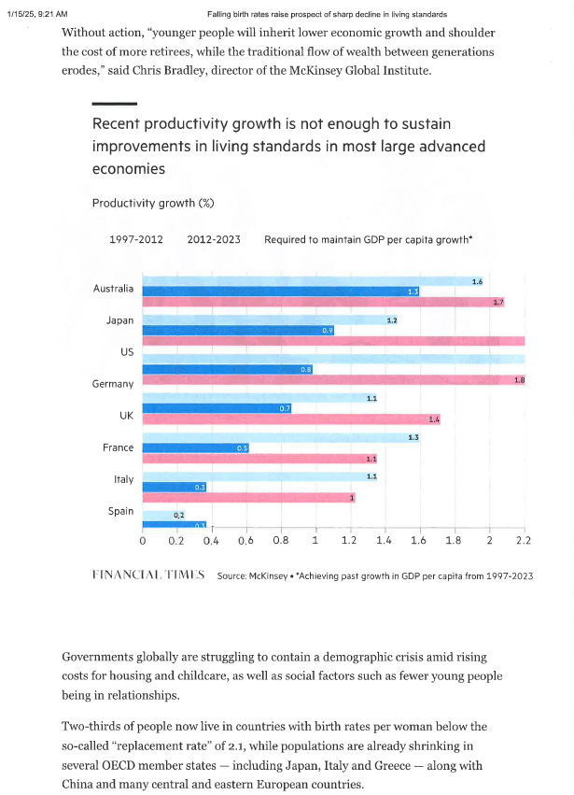

Question themes
Evaluating rise in productivity in the US.
Drivers of productivity growth—The impact of a shrinking workforce on dependency ratios
Economics Growth models
Data/variables required
Fiscal policy and labor market implications

Slide 11
Meeting 1
Revisited the group coursework of 2023/24.
Discussion on assessment details/marking criteria.
What works and what can be improved?
At the end of meeting 1—two students shared project themes (and everyone agreed to work on them).
Covid-19 and its labour market impact in the UK.
The impact of the 2008 global financial crisis on socio-economic outcomes.

Slide 12
Meeting 2
Students discussed articles (shared with them), created preliminary questions.
Questions created within the chosen themes covered:
The impact of the financial crisis on unemployment/poverty/economic inequality/intergeneration inequality/private sector credit/remittances (examining the variation in impact).
Policy implications—Social protection systems/Risk management strategies.
Evaluating the impact of the crisis on socio-economic outcomes through before/after comparisons.
The impact of Covid-19 on unemployment/economic inactivity/labour market dynamics/ remote working/worker burnout.
Industrial and employment recovery post-pandemic (examining the variation in impact).

Slide 13
Meeting 3/4
Developed existing questions.
Created new questions.
Explored/evaluated data sets.
Focus group held during meeting 4 to discuss and reflect upon the student experience of working on the project.
Focus group led by BILT student fellow.

Slide 14
Meeting 3/4 Questions (adding details)
Capturing variation in the impact of the financial crisis on socio-economic outcomes (by age/income)—Graph suggestions, exploring associations. Justifying choice of variables used for data analysis.
Forming a hypothesis and describing the steps to testing. Exploring the type of testing that is important. Discussing results and limitations of the findings.

Slide 15
Focus group: summary of discussions
Overall experience
Liked group aspect/collaboration/exploring how assessments are made.
Liked crafting questions with latest news.
Choosing themes
Stemmed from prior interests in American Civil Studies.
Based on experiences of the Covid-19 period.
Co-creation benefits
Content creation done in a more dynamic way.
Inputs make the assessment more relatable and accessible for students.
Fun experience which boosts critical thinking.

Slide 16
Focus group: summary of discussions
Benefits of group work
Experience with guidance
Good guidance on layout of sessions.
Working with an academic
Discussion based experience made it easier to interact.
Not the usual student teacher experience.
Helpful guidance on aims of the project.
Getting different perspectives/insights helped form questions.
Figure out new ideas through discussions.
Stories shared by academic relevant and interesting

Slide 17
Focus group: summary of discussions
Skills development
Project management.
Potential benefits of co-creation in other units
Accessing a range of perspectives.
Bridges the gap between academics and students.
Challenges
Getting started with question formation.
Deciding which questions are super important.
Logical question designing.
Critical thinking.
Teamwork.
Dynamic way of thinking.

Slide 18
Next steps
Develop the existing content further to create the group coursework.
Documenting details of the co-creation experience.

Slide 19
Student reflections
Meeting 1
Meeting 2
Discussed practical and applicable scenarios on use of statistical methods.
Meeting 3
Productive discussions and effective collaboration.
Explored how to structure questions using specific data
Good introduction (provided a good foundation)
Understood aims and objectives of the project.
The articles were interesting.
Enjoyed collaboration/group discussion.
Enjoyed going through the 2 different reports and trying to grasp which parts could be used for creating assessment questions.
Found both articles interesting to read and dissect.
Found useful to hear peer’s idea to expand on questions.
Found the questions that were formed as a group worthwhile to investigate.
The meeting was well thought of in the wider scheme of things.

Slide 20
References
Susan J. Deeley & Catherine Bovill (2017) “Staff student partnership in assessment: enhancing assessment literacy through democratic practices”, Assessment & Evaluation in Higher Education, 42:3, 463-477.
Elaine Doyle, Patrick Buckley & Joanne Whelan (2019) “Assessment co-creation: an exploratory analysis of opportunities and challenges based on student and instructor perspectives”, Teaching in Higher Education, 24:6, 739-754,
Catherine Bovill & Cherie Woolmer (2019) “How conceptualisations of curriculum in higher education influence student-staff co-creation in and of the curriculum?”, Higher Education, 78, 407-422.
Elaine Doyle, Patrick Buckley & Brendan McCarthy (2021) “The impact of content co-creation on academic achievement”, Assessment & Evaluation in Higher Education, 46:3, 494-507.
Tanya Lubicz-Nawrocka & Catherine Bovill (2023) “Do students experience transformation through co-creating curriculum in higher education?”, Teaching in Higher Education, 28:7, 1744-1760.

