Slide 1
Understanding Lecture and Tutorial Absenteeism in UK Higher Education: An Empirical Investigation
Carlos Cortinhas, Olha Matviiets, Hiren Nisar and Samuel Odewunmi

Slide 2
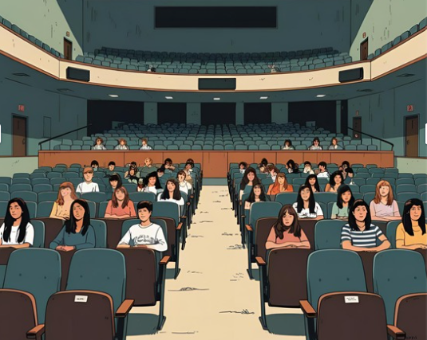

Motivation
Attendance is dropping!
Why does it matter?
Attendance → Academic Performance
Attendance → Discipline → Student development
Post-COVID reality
Long-term success
What does motivate students to attend
in-person classes, and what holds them back?
Notes:
Warm-up question: Who here has taught a class with less than 5 students? 1%? No one showed up?
There is no need to say that student attendance is a growing concern in higher education. While the decline has become more visible since the COVID-19 pandemic, it was already a challenge long before.
Why does it matter?
Much of the existing research focuses on academic performance and consistently shows a strong link between attendance and achievement. But performance isn’t the only factor at stake. Attending in-person sessions also helps students build motivation, discipline, and structure—key elements for long-term success.
How will students succeed in a workplace that demands real-time collaboration, accountability, and human interaction—if they rarely, if ever, practice these skills at university?
So we do understand the importance of attendance.
But what about the students? What actually motivates them to attend in-person sessions, and what holds them back? These questions are at the heart of our work!!!!

Slide 3

Literature: Reasons for and Barriers to Attending
Reasons for Attending
Barriers to Attending
Research shows that attendance varies by student profile:
Gender
Ethnicity
Grades
Care/work responsibility
Year of study
Value Perception & Engagement:
Perceived usefulness and instructional quality
Scheduling Issues:
Timetabling conflicts or inconvenience
Motivation:
Intrinsic drive and personal connection to the subject
Structural Barriers:
Logistical and financial constraints to attendance
Social Engagement:
Desire to connect, collaborate, and participate socially
Health & Well-being:
Health, stress, and mental/emotional well-being
Attendance Policy:
Mandatory/monitored attendance requirements
Strategic / Pragmatic Attendance:
Practical and efficiency-driven attendance decisions
Notes:
What literature says? We reviewed lots of papers and summarized the findings into two groups: reasons for attending and barriers to attendance.
Results show that students are more likely to attend when sessions are interactive, engaging, and clearly valuable. Teaching quality, intrinsic motivation, and social belonging all play a role, while policies—such as compulsory attendance—can also drive participation.
On the other hand, barriers such as scheduling issues, structural challenges (logistics, travel time), health concerns, and strategic decision-making (deadlines for assessments) often lead to non-attendance.
It’s also important to note that attendance patterns are not uniform—they vary significantly depending on student characteristics such as gender, ethnicity, academic performance, responsibilities outside of study, and year of study.
However, the existing research presents mixed and sometimes inconsistent findings, with no clear consensus. More importantly, there is a lack of focused research on Economics students within UK universities particularly regarding the differences between lectures and tutorials. This gap calls for further clarification—and it’s exactly where our research aims to contribute.

Slide 4
Study Design
Questionnaire/Protocol
Attendance Patterns
Reasons for Attending Class
Survey
  All economics undergraduate students at Exeter
  (March 2025)
Barriers to Attending Class
Suggestions for Improvement
Focus groups
  4-8 students in 4 sessions
  (June 2025)
Demographics
Notes:
To address our main research question — that is, understanding why students miss classes and what motivates them to attend — we designed a mixed methods study.
First, we conducted a survey, which allowed us to gather quantitative data from a large number of students. Initially, we focused on Economics students, but there’s potential to expand the survey to students across the university, especially if interesting trends emerge.
Second, to complement the survey, we held four focus groups aimed at gathering more in-depth, qualitative insights. Each group represented a different student sample — grouped by year of study — and we also held one specifically for international students.
We aligned both the survey and the focus group questions with our literature review, particularly focusing on the factors that have been shown to influence class attendance and reasons for missing class.
Importantly, we separated these factors for lectures and tutorials, as the literature suggests students may value these differently.
We’ll also look at demographic breakdowns to explore how these patterns may vary across groups.

Slide 5
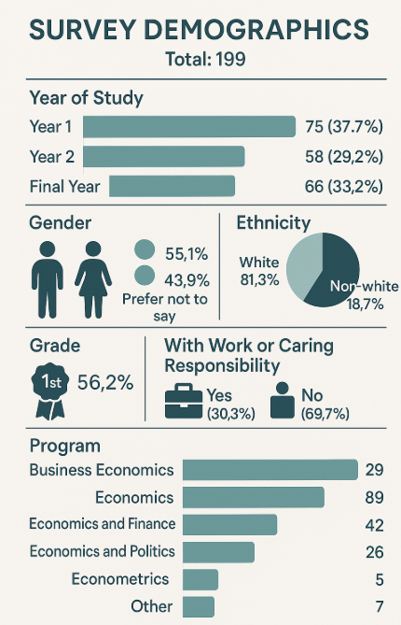












Survey respondents are more skewed towards (compared to enrolled):
- female
- white
- high-achieving
Notes: 199 out of 1400 (approx. 15%) of economics undergraduate students completed the survey
Notes:
Let me briefly walk you through the demographics of our survey sample, which included a total of 199 participants.
After cleaning the responses, our survey was completed by 199 out of approximately 1400 economics undergraduate students, representing about 15% of the invited population.
• Observed Skew in Sample: Compared to the overall enrolled student body, our survey respondents were notably skewed towards:
◦ Female students
◦ White students
◦ High-achieving students
• Potential Reasons for this Skew:
◦ Alignment with Academic Engagement: This skew, particularly towards high-achieving students, is consistent with existing literature. Research shows a strong, consistent correlation between class attendance and better academic outcomes. Therefore, students who are already more engaged and performing well academically may be more inclined to participate in a survey about attendance and engagement.
◦ Gender and Motivation: Female students generally tend to attend more, often linked to higher levels of conscientiousness, motivation, and academic diligence. This could contribute to their higher representation in a survey about educational habits.
◦ Ethnicity and Belonging: While the reasons are complex, some literature indicates that ethnic minority students can face barriers such as feelings of isolation. Conversely, white students may report higher intrinsic motivation and enjoyment of interactions, which might lead to greater participation in such a survey.
◦ Self-Selection Bias: It's a common characteristic of voluntary surveys that individuals who are already more engaged or have a particular interest in the topic (in this case, attendance and academic performance) are more likely to respond.
Understanding this demographic context is crucial as we interpret the attendance patterns and the factors influencing them, particularly when we move to the multivariate analysis and subgroup findings.
In terms of year of study, our sample is skewed to first-year students – as about 38% were first-year students, 29% were in their second year, and 33% were in their final year.
Gender-wise, the sample was 55% male, 44% female, and about 1% preferred not to disclose.
Looking at ethnicity, 81% of respondents identified as white, while 19% identified as non-white.
When we asked about grades, 56% of students self-reported achieving a first-class classification.
Regarding work or caring responsibilities, around 30% said they had such commitments alongside their studies, while about 70% did not.
As for degree programs, the majority were studying Economics (89 students), followed by Economics and Finance (42), Business Economics (29), Economics and Politics (26), Econometrics (5), and a small number from other related programs (7).
It's also important to note that our sample differs somewhat from the broader population of economics undergraduates.
Specifically, our respondents were more likely to be white and female, and a larger proportion had attained a first-class degree.
For comparison, based on final-year graduation data shared with us: only 25% of economics graduates were female, 30% identified as non-white, and 45% achieved a first-class degree, compared to 56% in our sample.
Additional info:
Respondents were predominantly white and female, with a notable concentration of students attaining first-class honours compared to the data from the final year graduation (graciously provided by Shaun) –
25 percent were females
30 percent identified themselves as non-white
45 percent graduated with first class
Survey Demographics – Total 199
Year of Study : Year 1 (75 or 37.7 percent), Year 2 (58 or 29.2 percent), Final Year (66 or 33.2 percent)
Gender: Male (55.1 percent), Female (43.9 percent ), Prefer not to say (1 percent)
Ethnicity: White (81.3 percent) Non-white (18.7 percent)
Grade: 1st (56.2 percent)
With Work or Caring Responsibility: Yes (60 or 30.3 percent) No (138 or 69.7 percent)
6. Program: Economics (89), Economics and Finance (42), Business Economics (29), Economics and Politics (26), Econometrics (5), Other (7)
Additional Info:
Survey response rates by Program
Business Economics = 29/436 = 6.7 percent
Economics = 89/505 = 17.6 percent
Economics and Finance = 42/271 = 15.5 percent
Economics and Politics = 26/141 = 18.4 percent
Econometrics = 5/21 = 23.8 percent
Focus Group Demographics – Total 23 students
Year of Study : Year 1 (7), Year 2 (5), Final Year (11)
Gender: Male (16), Female (7)
International: Yes (5) Domestic (18)
Grade: 1st (9) 2:1 (10) Lower (4)
With Work Experience: Yes (11) No (12)
Program: Business Economics (7), Economics (5), Economics and Finance (5), Economics and Politics (2), Econometrics (2), Other (2)

Slide 6
Reasons for Attending
***
***
***
Higher for Lectures:
Prefer taking my notes
Enjoy interaction with mates
Convenient time
***
***
***
Higher for Tutorials:
Content not available elsewhere
I want to ask questions
Notes:
Survey question: How valuable do you find the following factors for attending lectures/tutorials? (Select all that apply)
* p < 0.10, ** p < 0.05, *** p < 0.01
Notes:
This chart offers some really interesting insights into what students value differently in lectures versus tutorials. and it’s organized by lecture responses from highest to lowest
In the bar graph, you’ll see lectures represented in blue and tutorials in orange.
Let’s start with some shared value areas. Both lectures and tutorials scored quite similarly on a few fundamental points — for example, students feeling obligated to attend (72.4% for lectures and 69.8% for tutorials), and how engaging they found the teaching.
Lectures stood out for their social and practical advantages:
Students also preferred lectures for note-taking (+16.5 points).
Social interaction saw the largest difference, with lectures scoring 18 percentage points higher.
And lectures were rated more positively for convenient scheduling (+13.6 points).
So overall, student attended lectures that seem to provide value in terms of both independent and communal learning experiences.
On the other hand, tutorials were seen as much more valuable for interactive and personalized learning:
The opportunity to ask questions showed a huge difference — over 34 points higher for tutorials.
Access to content that students felt was only available in tutorials came in 27 points higher than lectures.
So what does this all suggest?
Lectures are often appreciated for their flexibility and social aspects, which may explain why students sometimes choose to skip them if they can access the content elsewhere.
But tutorials are viewed as more essential — they offer direct engagement and a level of support students feel they can’t get elsewhere, making them harder to replace.
Additional Info:
The data reveals dramatically different value propositions: tutorials excel at interactive, exclusive learning (64.3% unique content, 51.3% questions vs 37.2%/17.1% for lectures), while lectures provide superior individual control and social connection (47.2% note-taking, 43.7% social interaction vs 30.7%/25.6% for tutorials). This suggests students view them as complementary rather than competing formats.

Slide 7
Barriers to Attending
***
**
**
Higher for Lectures:
Recorded material accessible
Illness/stress
Inconvenient times
Assignment deadlines
***
***
***
***
Notes:
Survey question: To what extent do the following factors influence your decision to miss a lecture/tutorial? (Select all that apply)
* p < 0.10, ** p < 0.05, *** p < 0.01
Notes:
This next chart provides a detailed look at the reasons students give for missing classes, and it’s organized by lecture responses from highest to lowest. Again, lectures are shown in blue, and tutorials in orange.
It highlights some key patterns in student behavior and helps us understand the different pressures or motivations behind non-attendance for lectures and tutorials.
Let’s start with the biggest differences for lectures:
The availability of recorded alternatives (+33.7%)
Illness or stress, reported by over half of respondents — 53.8% (+12.2%).
Inconvenient timing is another major factor that hits lectures harder — about 50% of students said poor timing affected their lecture attendance, versus only 31% for tutorials (19.6%).
Clashes with assignment deadlines (+17.1 %),
We also see some reasons that impact both formats equally — for example:
- Feeling the class is not stimulating shows only a 5-point gap.
- And the belief that they can pass without attending is about the same across both formats.
Lectures are more affected by generally, more schedule-related conflicts and a general sense that lectures are more easily replaced or skipped — showing a clear disadvantage in terms of perceived necessity when materials are available elsewhere or when deadlines take priority.
Mostly students being more pragmatic in their approach.
This has important implications for how we think about designing lectures — especially if we want to increase engagement and attendance.

Slide 8
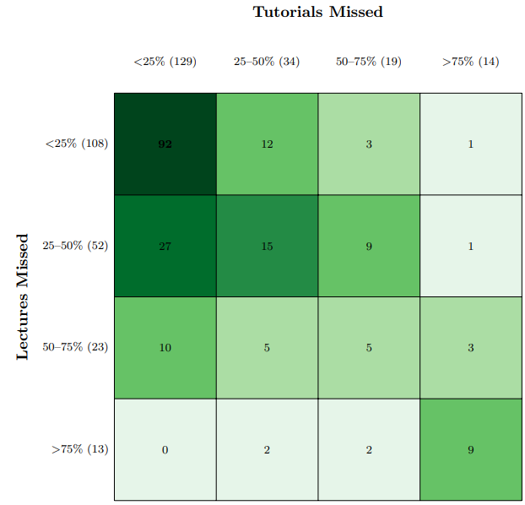
Survey respondents have strong attendance habits
92
27
15
Notes:
Survey question: In the past four weeks, approximately how many lectures (tutorials) have you missed?
• < 25%
• 25–50% of sessions
• 50–75% of sessions
• >75% of sessions
> 50% of sessions
Notes:
Before we dive into the ordered logit model, it's crucial to understand the attendance patterns of our survey participants.
• Students were asked: "In the past four weeks, approximately how many lectures/tutorials have you missed?".
• A significant majority of students, 92 out of the 199 respondents, reported missing less than 25% of their sessions.
• The survey responses reveal that, as a group, our survey respondents exhibited strong attendance habits.
Fewer students reported higher rates of absenteeism:
◦ 36 students missed >50% of lectures.
◦ 33 students missed >50% of tutorials.
This group we are focussing on and compare against our baseline (those who missed 25% of the classes) in the multivariate analysis.
• Demographic Context: It's also worth noting that our survey sample was somewhat skewed towards high-achieving and female students, which aligns with the literature indicating a strong, consistent correlation between class attendance and better academic outcomes. This might contribute to the observed strong attendance habits in our respondent pool.
This slide sets the stage for our multivariate analysis.

Slide 9
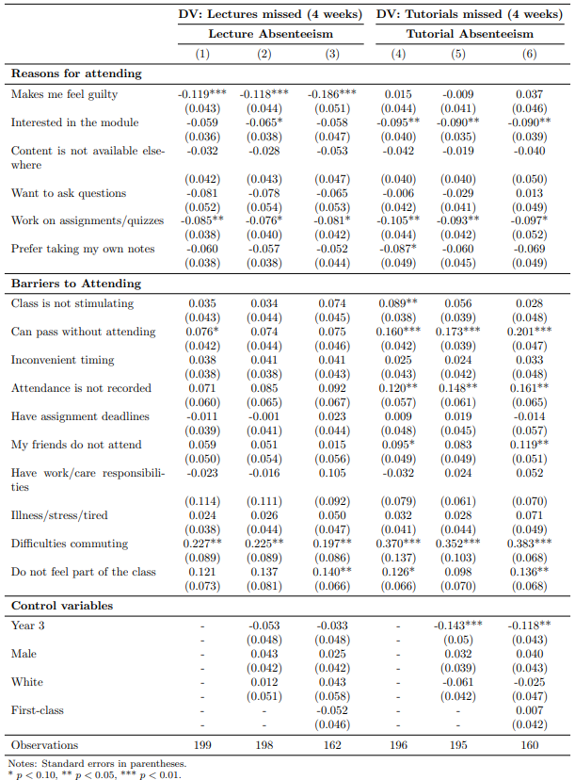
Multivariate Analysis: Ordered Logit
Notes:
Dependent Variable (DV): Categorial variable of percent of classes missed in past 4 weeks
Baseline: Comparison group of students who missed < 25% of classes
Independent Variable: Dummy variables for factors related to reasons for and barriers to attend (removing overlaps across the two sets)
Coefficient: predicted probability for a student having that barrier or reason to fall into the outcome category of missing > 50% of classes
  Barriers to attending should have positive sign
  Reasons for attending should have negative sign
Notes:
This is work in progress, so we are interested in your thoughts. Currently, we have run an Ordered Logit model to identify the specific factors that differentiate students with high absenteeism from their more consistently attending peers.
◦ Our dependent variable is a categorical variable (we discussed in the slide before) representing the percentage of classes missed by students over the past four weeks. This allows us to model different levels of absenteeism.
◦ The baseline group consists of students who reported missing less than 25% of their classes. This group represents students with consistently strong attendance habits, as we discussed previously.
• Independent Variables (IVs):
◦ We utilized dummy variables for all factors related to both reasons for and barriers to attending class.
◦ Care was taken to remove any overlapping variables between these two sets to ensure distinct independent effects.
• Interpretation of Coefficients:
◦ Each coefficient represents the predicted probability for a student to fall into the outcome category of missing more than 50% of classes, given they report having that specific barrier or reason, compared to our baseline group (those missing less than 25% of classes).
◦ Specifically, we expect:
▪ Barriers to attending should have a positive sign, indicating an increased likelihood of missing more than 50% of classes.
▪ Reasons for attending should have a negative sign, indicating a decreased likelihood of missing more than 50% of classes.

Slide 10
Multivariate Analysis: Ordered Logit
Key findings for lecture absenteeism:
Students are less likely to miss > 50% of lectures when
                they feel guilty for not attending
                they work on assignments/quizzes in class
Students are more likely to miss > 50% of lectures when
  they have difficulties commuting
  they do not feel part of the class
Baseline: Compared to students who missed < 25% of lectures
Notes:
For Lecture Absenteeism:
• Reduced Likelihood of High Absenteeism: Students are less likely to miss more than 50% of lectures when:
◦ They feel guilty for not attending or
◦ They work on assignments/quizzes in class.
• Increased Likelihood of High Absenteeism: Students are more likely to miss more than 50% of lectures when:
◦ They have difficulties commuting.
◦ They do not feel part of the class.

Slide 11
Multivariate Analysis: Ordered Logit
Key findings for tutorial absenteeism:
Students are less likely to miss > 50% of tutorials when
                they are interested in the module
                they work on assignments/quizzes in class
Students are more likely to miss > 50% of tutorials when
  they can pass the module without attending
  attendance is not recorded
  their friends do not attend
  they have difficulties commuting
  they do not feel part of the class
Baseline: Compared to students who missed < 25% of tutorials
Notes:
For Tutorial Absenteeism:
• Reduced Likelihood of High Absenteeism: Students are less likely to miss more than 50% of tutorials when:
◦ They are interested in the module.
◦ They work on assignments/quizzes in class.
• Increased Likelihood of High Absenteeism: Students are more likely to miss more than 50% of tutorials when:
◦ They believe they can pass the module without attending.
◦ Attendance is not recorded.
◦ Their friends do not attend.
◦ They have difficulties commuting.
◦ They do not feel part of the class.
These findings highlight distinct drivers for absenteeism in different session types and underscore the importance of in-class activities, module interest, logistical factors and social belonging.

Slide 12
Subgroup Findings: Univariate Analysis
We conducted univariate test statistics (2-sample t-tests)
  by the relevant demographic characteristics (gender, ethnicity, and grade-level)
  for all factors related to reasons for and barriers to attending lectures/tutorials
Reasons for Attending Lectures | Reasons for Attending Tutorials
Females report higher I enjoy interacting with classmates Lecture is at convenient time | Females report higher Tutorial content not available elsewhere We work on assignments/quizzes in class I prefer taking my own notes
Barrier to Attending Lectures | Barrier to Attending Tutorials
Females report higher I need to complete assignments for another class I was ill/stress/tired | Females report higher I need to complete assignments for another class I was ill/stress/tired
Females report more stress/tiredness or completing assignments as a barrier to attendance, but also highly engaged and preference for autonomy
Gender
Notes:
The literature also emphasizes that a student's background can influence their reasons for attending or missing classes. So, to explore this further, we carried out a series of basic statistical tests — specifically, two-sample t-tests — to see if there were any meaningful differences across student groups.
We looked at a few key demographic factors:
Gender,
Ethnicity,
Level of study,
Grades, and
Whether students had caring or work responsibilities.
We then applied these tests to the core survey questions — focusing on students’ perceived value of classes and the barriers to attendance, for both lectures and tutorials.
1. Let’s begin with gender:
Female students are more likely to report attending because they see value in the class, enjoy social engagement, and prefer learning autonomy — that’s shown with the green upward arrows.
But on the flip side, females are also more likely to report health and wellbeing barriers — particularly stress, illness, or feeling tired — as reasons for missing class.
Females report more stress/tiredness as a barrier to attendance, but also highly engaged and preference for autonomy.
This helped us see not just that differences exist, but how they cluster around certain patterns — which can inform more tailored interventions or policy decisions.

Slide 13
Subgroup Findings: Univariate Analysis
Reasons for Attending Lectures | Reasons for Attending Tutorials
White students report higher I feel like I should attend I am interested in the module Teacher is engaging | White students report higher I feel like I should attend Tutorial content not available elsewhere I enjoy interacting with classmates
Barrier to Attending Lectures | Barrier to Attending Tutorials
Minority students report higher I can access recorded materials Lecture time does not work for me Lecture attendance is not recorded I was ill/stress/tired | Minority students report higher I do not feel part of the class
White students are more intrinsically motivated and enjoy interactions.
Minority students show more strategic attendance patterns and report a lack of belonging
Ethnicity
Reasons for Attending Lectures | Reasons for Attending Tutorials
High performing students report higher Content not available elsewhere I prefer taking my own notes I enjoy interacting with classmates Lower-performing students report higher - Attendance is recorded | High performing students report higher I prefer taking my own notes I enjoy interacting with classmates Lower-performing students report higher We work on assignments/quizzes in class
Barrier to Attending Lectures | Barrier to Attending Tutorials
Lower-performing students report higher I do not feel part of the class | Lower-performing students report higher I do not feel part of the class
High performing students are more intrinsically motivated and socially connected.
Lower-performing students make decisions to attend more for assessment-driven reasons and report a lack of belonging
Grades
Notes:
2. Ethnicity:
White students are more likely to report being engaged, motivated, and socially connected in class.
Non-white students, however, tend to show more strategic attendance patterns and are more likely to report a lack of belonging, which may be an important area for future intervention.
3. Now looking at academic performance — particularly first-class vs. low-performing students:
First-class students often attend because they genuinely see value in the teaching as in the teacher is engaging.
But interestingly, lower-performing students also report attending — but more often when there’s an immediate, task-related value, such as working on assignments or quizzes.
In other words, high performing students tend to be intrinsically motivated and socially connected, while lower-performing students may make decisions to attend more for assessment-driven reasons.
Additional
4. Working or caring responsibilities:
These students face greater structural barriers, especially around time and scheduling.
Yet, many still report feeling motivated and socially engaged.
However, they tend to be more strategic — that is, selective — in deciding when attendance is worth their time.
5. Year of study:
Final-year students are also more strategic and face more structural and time pressures — often balancing job searches or dissertations, or actual jobs — so they attend strategically when they see clear value.
In contrast, first- and second-year students are more likely to report health and wellbeing barriers, suggesting a different type of support might be needed earlier in the degree.
"So overall, this analysis tells us that attendance behavior is shaped by more than just individual preference — it's deeply connected to identity, performance, and life context. These patterns highlight the need for more tailored approaches to supporting student engagement."
Additional Info:
Females report more stress/tiredness, but also higher social engagement and preference for autonomy.
FirstClass students are more motivated, autonomous, and socially connected, but some peers feel less belonging.
White students are more engaged and motivated, while non-White peers report more barriers and less belonging.
Working students experience greater structural and time-related barriers, yet remain motivated and strategically selective.
Final-year students are more pragmatic, have more barriers, but show focused engagement where value is perceived

Slide 14
Student’s Suggestions for Improvement
Lectures | Tutorials
Timing & Scheduling: Avoid 8:30am starts; cluster sessions to reduce long gaps; add short breaks in long sessions Engaging Delivery: Go beyond reading slides; bring energy, examples, and insights. Interactivity: Use quizzes, polls, and discussions (e.g., Mentimeter, Kahoot). Relevance to Assessment: Ensure content links clearly to coursework/exams. Logistics: Reduce commuting barriers having better coordination between lectures and tutorials. | Quality of Teaching: Prepared, clear, engaging tutors who explain concepts well. Relevance & Structure: Align tutorials with lectures and assessments; focus on application. Convenient Timing: Avoid very early/late slots; link scheduling with lecture content. Interactive Methods: Small group work, problem-solving, balance between guidance & activity. Motivation & Incentives: Consider in-class rewards or attendance recognition. Supportive Atmosphere: Reduce stress, avoid putting students on the spot, foster inclusivity.
*160 students provided responses to the question, ‘What improvements could be made to lectures to increase your attendance? Please explain briefly’ | *136 students provided responses to the question, ‘What improvements could be made to tutorials to increase your attendance? Please explain briefly’
Frequency of Themes in Student Responses
Frequency of Themes in Student Responses
Notes:
We asked students what could be improved to increase their attendance at lectures and tutorials. Their responses were grouped into themes, which are quite similar across both formats, though with some clear differences. The themes are presented here in order of how frequently they were mentioned.
For lectures, students mainly focused on practical issues—things like avoiding 8:30am starts, cutting down long gaps, and better scheduling. But just as important was how lectures are delivered. Students told us they’re much more likely to attend when sessions are interactive, engaging, and clearly tied to their assessments.
For tutorials, the emphasis shifted. Here, the quality and preparedness of tutors really stood out. Students value tutorials that connect directly with lecture content, focus on application, and are scheduled at convenient times. They also want tutorials to feel motivating and supportive, not stressful.
So, what’s common across both? Students want sessions that are engaging, interactive, relevant, and scheduled sensibly.
But the key difference is this: in lectures, it’s mainly about structure and logistics, while in tutorials, it’s more about the learning environment, motivation, and support.
Summary:
Students are asking for sessions that are well-timed, engaging, interactive, and relevant. The main distinction is that for lectures, practical issues of structure and logistics are more important, while for tutorials, the focus is on the quality of the learning environment, motivation, and support.

Slide 15
Recommendations
If we want to boost attendance, we need a student-centred approach—removing logistical barriers while also prioritizing engaging teaching and a supportive atmosphere.
 | 💡 Low-Effort / Low-Cost | ⚙️ Structural / Higher-Effort
📖 Lectures | Interactive polls & quizzes in class Highlight value of in-person attendance (add real-world examples) Absence reminder emails Explicit alignment with assessments | Schedule compulsory modules in blocks Flipped or team-based redesign Expanded support for inclusive pedagogy & belonging Limit access to recordings Mandatory attendance policies
👥 Tutorials | Highly interactive activities such as quizzes and puzzles through gamification Attendance nudges/follow-up on absences Community-building activities | Tutor training for inclusivity Preparatory assignments Peer-observation Attendance monitoring systems Optimized scheduling & hybrid options
Notes:
We summarized results and here are some recommendations that could be implemented.
For lectures, some low-effort, low-cost options include using interactive polls and quizzes, making the value of in-person attendance clearer, sending absence reminders, and aligning sessions more explicitly with assessments.
On the higher-effort side, universities could look at restructuring modules into blocks, redesigning courses with flipped or team-based formats, and putting more emphasis on inclusive teaching. Some institutions also consider limiting access to recordings or introducing mandatory attendance policies.
For tutorials, quick wins include gamified activities, follow-up on absences, and community-building exercises. Longer-term changes could involve tutor training (PhD students), prep (mock) assignments, peer-observation, and more systematic attendance monitoring. Optimized scheduling and hybrid options can also help address logistical barriers.
Overall, the key message is that boosting attendance requires a balance: small nudges can make an immediate difference, but structural reforms are also needed for lasting impact.

Slide 16
Conclusion and Contribution
Our study
Identifies a complex interplay of factors influencing attendance
Offers insights into factors influencing attendance for lectures versus tutorials
Details how attendance varies by student profile, including gender, ethnicity, grades
Gathers student-centric feedback on attendance improvement
Lays the groundwork for actionable recommendations

Slide 17
Any Questions?

Slide 18
Appendix
Extra Slides

Slide 19

Attendance: some literature
Reasons for Student Attendance and Non-Attendance
1. Educational Value & Engagement Students attend when content is useful, engaging, and tied to performance. | Paisey & Paisey (2004); Martínez-Serna et al. (2024); Friedman et al. (2014); Kottasz (2005); Romer (1993); Devadoss & Foltz (1996); Andrietti & Velasco (2015); Shieh et al. (2022)
2. Motivation & Attitudes Intrinsic motivation, self-efficacy, and goal orientation improve attendance. | Oldfield et al. (2017); Khong et al. (2016); Gump (2006); Menendez Alvarez-Hevia et al. (2021); Sloan et al. (2020)
3. Institutional & Structural Barriers Rigid formats, traditional lectures, and online alternatives reduce need to attend. | Sloan et al. (2020); Mearman et al. (2014); Yoon et al. (2014)
4. Scheduling Issues Morning, Friday, or poorly timed classes lead to absenteeism. | Paisey & Paisey (2004); Kelly (2012); Sloan et al. (2020); Triado et al. (2013); Mearman et al. (2014)
5. External Commitments Work, family duties impact attendance—but not always primary cause. | Paisey & Paisey (2004); Rodgers (2001); Oldfield et al. (2017); Menendez Alvarez-Hevia et al. (2021); Shieh et al. (2022); Sloan et al. (2020)
6. Health & Well-being Illness, stress, and mental health limit attendance. | Oldfield et al. (2017); Sloan et al. (2020); Friedman et al. (2014); Stripling et al. (2013); Paisey & Paisey (2004); Kottasz (2005); Woodfield & McMillan (2006)
7. Policy Impact Mandatory and punitive policies boost attendance, but risk disengagement (“presenteeism”). Reward-based methods are less effective. | Devadoss & Foltz (1996); Self (2012); Teixeira (2014)
Notes:
While Filson (2023) is quite specific to the U.S. context, unlike Hill and LoPalo (2024) who focus primarily on exams, Filson highlights the innovative benefits of online assessments during Covid-19, benefits that may not have emerged otherwise. He emphasises the value of maintaining these innovations, such as shifting from traditional assessments with predetermined answers (e.g., MCQs or structured responses) to more open-ended, problem-based tasks. These assessments encourage students to construct arguments and counterarguments through presentations, discussions, or essays, mirroring real-world economic analysis and model application. Such approaches can be adapted to any course.

Slide 20

Attendance: some literature
The Impact of Absenteeism on Academic Performance
1. Positive Link: Attendance ↔ Performance Strong, consistent correlation between class attendance and better academic outcomes— even after controlling for variables like GPA and motivation. | Romer (1993); Devadoss & Foltz (1996); Teixeira (2014); Büchele (2020)
2. Attendance Across Formats Impact on learning holds across in-person and virtual modes, as long as students are engaged. | Büchele (2020)
3. Student Profiles Matter Lower-achieving students benefit more from attending class; attendance effect varies by student type. | Andrietti (2014); Andrietti & Velasco (2015)
4. Correlation vs. Causation Some argue attendance is a marker—not cause—of good performance. Attendees may already have better habits, motivation, or fewer life constraints. | Teixeira (2014); Martínez-Serna et al. (2024); Chen et al. (2023)
Notes:
While Filson (2023) is quite specific to the U.S. context, unlike Hill and LoPalo (2024) who focus primarily on exams, Filson highlights the innovative benefits of online assessments during Covid-19, benefits that may not have emerged otherwise. He emphasises the value of maintaining these innovations, such as shifting from traditional assessments with predetermined answers (e.g., MCQs or structured responses) to more open-ended, problem-based tasks. These assessments encourage students to construct arguments and counterarguments through presentations, discussions, or essays, mirroring real-world economic analysis and model application. Such approaches can be adapted to any course.

Slide 21
Attendance: some literature
Demographic and Socioeconomic Factors Influencing Attendance
1. Gender Patterns in Attendance Female students generally attend more, linked to conscientiousness, motivation, and academic diligence. | Woodfield & McMillan (2006); Khong et al. (2016); Kelly (2012); Chen, Chen & Yang (2023); Gump (2006)
Some studies show no statistically significant gender differences in attendance or motivation. | Friedman, Fred & McComb (2014); Sloan et al. (2020); Gump (2006)
2. Socioeconomic & Care Responsibilities Constraints like caregiving, work, and commuting impact attendance, often affecting women and disadvantaged groups. | Cotton et al. (2015); Menendez Alvarez-Hevia, Lord & Naylor (2021); Oldfield et al. (2017); Triado et al. (2018)
3. Ethnicity & Cultural Influences Ethnic minority students often face barriers (e.g., language, isolation) but may also attend more regularly. | Mearman et al. (2014); Cotton et al. (2015); Khong et al. (2016); Menendez Alvarez-Hevia, Lord & Naylor (2021)
4. Year of Study Effects Findings vary: some show improved attendance over time; others see drops in later years or no effect at all. | Kelly (2012); Triado et al. (2018, 2013); Gump (2006); Oldfield et al. (2017); Sloan et al. (2020); Khong et al. (2016)
Notes:
While Filson (2023) is quite specific to the U.S. context, unlike Hill and LoPalo (2024) who focus primarily on exams, Filson highlights the innovative benefits of online assessments during Covid-19, benefits that may not have emerged otherwise. He emphasises the value of maintaining these innovations, such as shifting from traditional assessments with predetermined answers (e.g., MCQs or structured responses) to more open-ended, problem-based tasks. These assessments encourage students to construct arguments and counterarguments through presentations, discussions, or essays, mirroring real-world economic analysis and model application. Such approaches can be adapted to any course.

Slide 22
References
Stripling, C., Roberts, G., & Israel, G. (2013). Class attendance: An investigation of why undergraduates choose to not attend class. NACTA Journal, 57, 47–59
Paisey, C., & Paisey, N. J. (2004). Student attendance in an accounting module – reasons for non-attendance and the effect on academic performance at a Scottish University. Accounting Education, 13(sup1), 39–53.
Shieh, J.-J., Simoes, C., & Santos, A. (2022). Does class attendance really matter? Perspectives of faculty members and students in two universities. Journal of Taiwan Education Studies, 3, 145–176.
Martínez-Serna, M. I., Baixauli-Soler, J. S., Belda-Ruiz, M., & Yagüe, J. (2024). The effect of online class attendance on academic performance in finance education. The International Journal of Management Education, 22(3), 101023
Menendez Alvarez-Hevia, D., Lord, J., & Naylor, S. (2020). Why don’t they attend? Factors that influence the attendance of HE students of education. Journal of Further and Higher Education, 45(8), 1061–1075.
Gump, S. E. (2006). Guess who’s (not) coming to class: student attitudes as indicators of attendance. Educational Studies, 32(1), 39–46.
Sloan, D., Manns, H., Mellor, A., & Jeffries, M. (2019). Factors influencing student non-attendance at formal teaching sessions. Studies in Higher Education, 45(11), 2203–2216.
Oldfield, J., Rodwell, J., Curry, L., & Marks, G. (2017). A face in a sea of faces: exploring university students’ reasons for non-attendance to teaching sessions. Journal of Further and Higher Education, 43(4), 443–452.
Devadoss, S., & Foltz, J. (1996). Evaluation of Factors Influencing Student Class Attendance and Performance. American Journal of Agricultural Economics, 78(3), 499–507.
Teixeira, A. (2014). The impact of class absenteeism on undergraduates’ academic performance: Evidence from an elite Economics school in Portugal. Innovations in Education and Teaching International, 53(1), 1–13.
Kelly, G. E. (2011). Lecture attendance rates at university and related factors. Journal of Further and Higher Education, 36(1), 17–40.
Triadó-Ivern, X., Aparicio-Chueca, P., Guàrdia-Olmos, J., & et al. (2013). Empirical approach to the analysis of university student absenteeism: Proposal of a questionnaire for students to evaluate the possible causes. Quality & Quantity, 47(5), 2281–2288.
Yoon, C., Oates, G., & Sneddon, J. (2013). Undergraduate mathematics students’ reasons for attending live lectures when recordings are available. International Journal of Mathematical Education in Science and Technology, 45(2), 227–240.
Friedman, Paul & Rodriguez, Fred & McComb, Joe. (2014). Why Students Do and Do Not Attend Classes. College Teaching. 49. 124-133.
Khong, R. W. L., Dunn, J. S., Lim, C.-M., & Yap, W. S. P. (2016). Why do students attend lectures? Exploring justifications for attendance among undergraduate students from a British university in Asia. The Journal of Developing Areas, 50(5), 497–506.

Slide 23
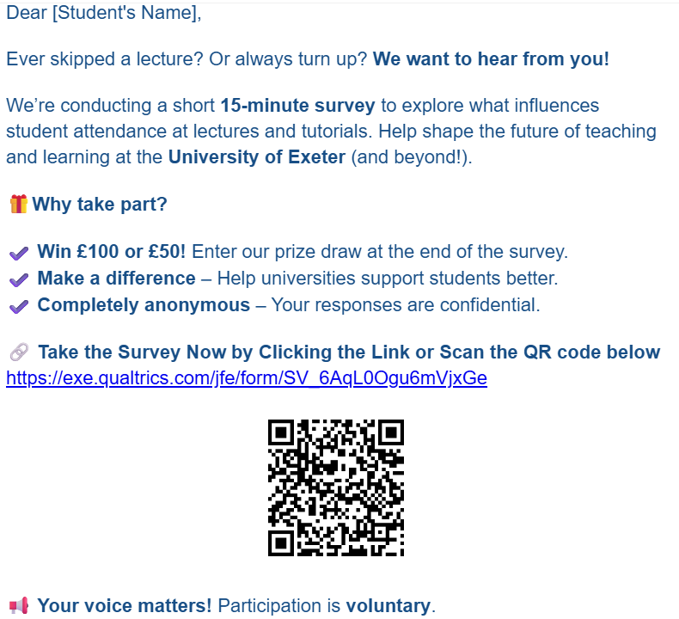
Initial Survey Invitation

Slide 24
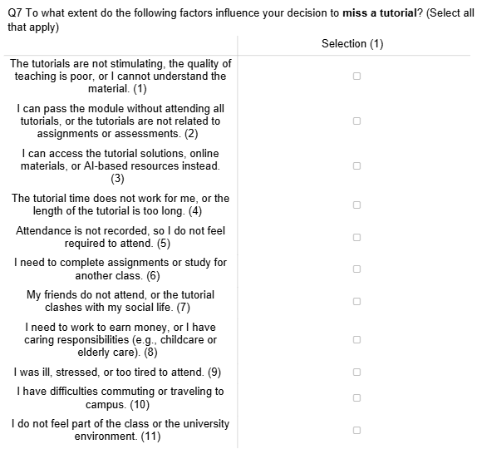
Survey
Questions – Reasons for Missing a Class

Slide 25
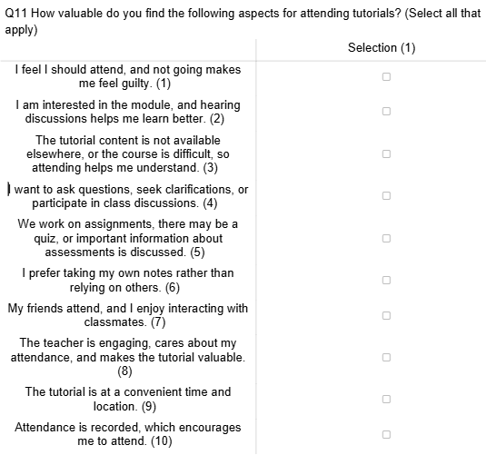
Survey
Questions – Reasons for Attending Class

Slide 26
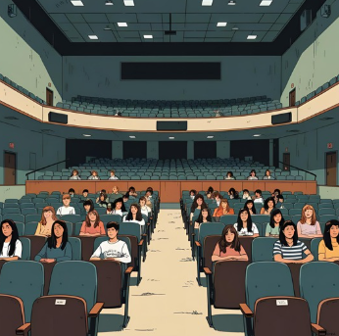

Results from Survey Data
199 survey completers (15 percent) out of the 1400 economics undergraduates who were invited to participate

Slide 27
Eight Themes Aligned With the Literature
Theme | Core Focus | Survey Items
Reason for Attending
🎓 Value Perception and Engagement | Perceived usefulness and instructional quality | - “Teacher is engaging”/“Teacher is not stimulating” - “Content not available elsewhere” - “We work on assignments/quizzes”
❤️ Motivation / Interest in Module | Intrinsic drive and personal connection to the subject | - “I feel I should attend”/"I do not feel required to attend" - “I am interested in the module”
✍️ Learning Autonomy | Preference for independent, self-managed learning | - “Prefer taking my own notes”
🤝 Social Engagement / Class Interaction | Desire to connect, collaborate, and participate socially | - “My friends attend, or I enjoy interacting with classmates”/“My friends do not attend” - “I want to ask questions”
Barriers to Attending
💸 Structural Barriers (Time / Money) | Logistical and financial constraints to attendance | - “I need to work to earn money” - “I have difficulties commuting” - “Session time does not work for me”/“Session is at a convenient time”
🧮 Strategic / Pragmatic Attendance | Practical and efficiency-driven attendance decisions | - “I need to complete assignments for another class” - “I can access recording and other materials.” - “I can pass without attending” -“Attendance is recorded”
🌧️ Health and Wellbeing Barriers | Health, stress, and mental/emotional well-being | - “I was ill, stressed, or tired”
🧍‍♂️ Feeling of Belonging | Emotional and social inclusion in the class environment | - “I do not feel part of the class”
Notes:
From our analysis, we grouped the significant findings into eight overarching themes — four reasons students tend to attend classes, and four key barriers that keep them away (ALIGNING IT WITH THE LITERATURE).
Let’s start with the reasons for attending:
🎓 Value Perception and Engagement – This reflects how useful students perceive the class to be, along with the quality of instruction. If they feel the teaching is effective and relevant, they’re more likely to show up.
❤️ Motivation and Interest in the Module – This theme captures students’ intrinsic interest in the subject. If they’re genuinely curious or passionate about the topic, they tend to attend more regularly.
✍️ Learning Autonomy – Some students prefer independent learning. This group often weighs the value of attending against how much they believe they can learn on their own.
🤝 Social Engagement and Class Interaction – This theme is about connection — students who value discussion, collaboration, or simply being around peers are more inclined to attend.
And now, the barriers to attendance:
⏰ Structural Barriers – These are practical issues like inconvenient scheduling, commuting challenges, or financial concerns that make attending difficult.
🧮 Strategic or Pragmatic Attendance – Some students make calculated decisions — they might skip if the material is recorded or if they feel they can still succeed without being there.
🌧️ Health and Wellbeing – This includes both physical and mental health issues, such as stress, illness, or burnout, which can prevent students from attending regularly.
🧍‍♂️ Feeling of Belonging – Finally, we saw that a lack of emotional or social connection to the class environment can be a real barrier. Students who don’t feel they ‘fit in’ are less likely to attend.
Each of these themes is supported by specific survey items, which we’ve summarized in the final column of the slide — helping us trace exactly how these ideas came through in the data.

Slide 28
Key Findings from Univariate Analysis
Theme | Gender (Female) | First Class | White | Working Responsibility | Final Year (Y3 vs Y1/Y2)
Reasons for Attending
🎓 Value Perception and Engagement | ↑ (more) | (Mixed) | ↑ (more) |  | ↑ (more)
❤️ Motivation / Interest in Module |  |  | ↑ (more) | ↑ (more)
✍️ Learning Autonomy | ↑ (more) | ↑ (more) |  |  | ↑ (more)
🤝 Social Engagement / Class Interaction | ↑ (more) | ↑ (more) | ↑ (more) | ↑ (more)
Barriers for Attending
💸 Structural Barriers (Time / Money) |  |  |  | ↑ (more) | ↑ (more)
🧮 Strategic / Pragmatic Attendance |  |  | ↓ (less) | ↑ (more) | ↑ (more)
🌧️ Health and Wellbeing Barriers | ↑ (more) |  |  |  | ↓ (less)
🧍‍♂️ Feeling of Belonging |  | ↓ (less) | ↓ (less)
Notes:
Let me take a moment to walk you through this slide slowly, since it brings together a lot of nuanced patterns in attendance behavior based on student characteristics.
I’ll break it down into two parts — reasons for attending and barriers to attending — and highlight where we see clear trends, mixed findings, and meaningful differences.
1. Let’s begin with gender:
Female students are more likely to report attending because they see value in the class, enjoy social engagement, and prefer learning autonomy — that’s shown with the green upward arrows.
But on the flip side, females are also more likely to report health and wellbeing barriers — particularly stress, illness, or feeling tired — as reasons for missing class.
Females report more stress/tiredness as a barrier to attendance, but also highly engaged and preference for autonomy.
2. Now looking at academic performance — particularly first-class vs. low-performing students:
Looking at the red downward arrow, students achieving first class are less likely to say that they don’t belong, meaning they feel more comfortable in class.
Flip that around, and we see that lower-performing students are more likely to cite 'not feeling a sense of belonging' as a barrier to attendance.
We also found mixed effect (shown in orange) when it comes to value perception:
First-class students often attend because they genuinely see value in the teaching as in the teacher is engaging.
But interestingly, lower-performing students also report attending — but more often when there’s an immediate, task-related value, such as working on assignments or quizzes.
In other words, high performing students tend to be intrinsically motivated and socially connected, while lower-performing students may make decisions to attend more for assessment-driven reasons.
3. Ethnicity:
White students are more likely to report being engaged, motivated, and socially connected in class.
Non-white students, however, tend to show more strategic attendance patterns and are more likely to report a lack of belonging, which may be an important area for future intervention.
4. Working or caring responsibilities:
These students face greater structural barriers, especially around time and scheduling.
Yet, many still report feeling motivated and socially engaged.
However, they tend to be more strategic — that is, selective — in deciding when attendance is worth their time.
5. Year of study:
Final-year students are also more strategic and face more structural and time pressures — often balancing job searches or dissertations, or actual jobs — so they attend strategically when they see clear value.
In contrast, first- and second-year students are more likely to report health and wellbeing barriers, suggesting a different type of support might be needed earlier in the degree.
"So overall, this analysis tells us that attendance behavior is shaped by more than just individual preference — it's deeply connected to identity, performance, and life context. These patterns highlight the need for more tailored approaches to supporting student engagement."
Additional Info:
Females report more stress/tiredness, but also higher social engagement and preference for autonomy.
FirstClass students are more motivated, autonomous, and socially connected, but some peers feel less belonging.
White students are more engaged and motivated, while non-White peers report more barriers and less belonging.
Working students experience greater structural and time-related barriers, yet remain motivated and strategically selective.
Final-year students are more pragmatic, have more barriers, but show focused engagement where value is perceived

Slide 29
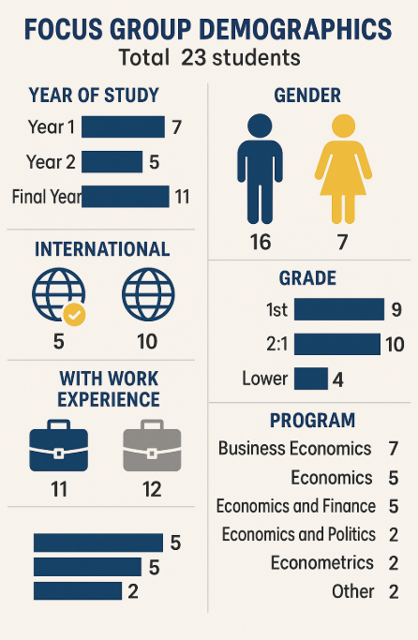
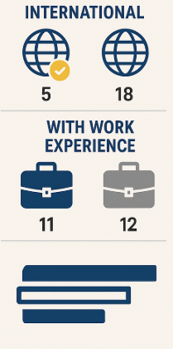
Results from Focus Group
Four groups of 5-8 students separated by year of study and for international students
Notes:
This slide gives an overview of the demographics of the 23 students who participated in our focus group discussions.
We conducted four separate sessions, each involving 5–8 students. These were grouped by year of study and included a dedicated group for international students to ensure a range of perspectives.
In terms of year of study, we had a good spread.
The gender balance skewed male, with 16 male and 7 female participants.
5 participants were international students, while the rest were home students.
Just under half of the participants—11 students—had some work experience, such as placements or internships.
In terms of academic performance:
9 were on track for a First
10 were expecting a 2:1
4 were performing below that level
We also ensured coverage across all major Economics programmes and 2 FCH students

Slide 30
Focus Group Data Analysis
We distilled the information into the following areas:
Perceived Value of Attending
Barriers to Attending
Suggestions for Improvement
Final Reflections

Slide 31
Perceived Value of Attending
📄 Lectures = Often Passive and Slide-Driven (Value Perception)
“Sometimes [lectures] can be quite long for quite a small amount of content.”
🎯 Tutorials = More Interactive & Exam-Focused (Value Perception)
“Tutorials have much more value because I’m actually… I have to think about it rather than just passively taking information… I had the opportunity to ask questions…”
🧠 Active Teaching Boosts Engagement (Value Perception and Motivation/Interest)
“One professor did a case study thing… every single week… that would be my ideal.”
📊 Technical Modules Prefer In-Person Support (Strategic/Pragmatic Attendance)
“If you don’t understand something by the next lecture… then you just have no understanding.”
Notes:
Our focus group discussions revealed that students' decisions to attend sessions are strongly influenced by their perceived value of those sessions.
Lectures were often described as passive and overly reliant on slides, which reduced their perceived usefulness. In contrast, tutorials were viewed much more positively—they were seen as interactive, exam-focused, and offering opportunities for deeper engagement.
Students also responded well to active teaching strategies, such as regular case studies, which they felt made learning more engaging and meaningful.
Additionally, technical modules stood out as areas where in-person support was considered essential—students felt that missing even one session could significantly hinder their understanding.

Slide 32
Barriers to Attending
⏰ Timetable Schedule/Timing (Structural Barriers)
“I just don’t naturally wake up in time for an 8:30… I’ll often skip those.”
📅 Timetable Gaps & Inefficiencies (Structural Barriers)
“If I’ve got just one [lecture], then I’m less likely to go… not as much to catch up on.”
📚 Competing Priorities (Strategic/Pragmatic Attendance)
“If I attended every lecture, I wouldn’t be able to work as much… I don’t know if I could continue with my studies.”
🎥 Recorded Lectures Reduce In-Person Attendance (Value Perception)
“Sometimes I prefer [recordings] anyway… it makes me just want to skip all my lectures.”
Notes:
Our focus group participants identified several key barriers that impact their in-person attendance.
Timing issues—like early start times and inefficient timetabling—were frequently mentioned. For example, students were less likely to attend isolated or early-morning sessions, which they found disruptive or impractical.
Strategic and pragmatic considerations also played a role; some students reported needing to prioritise part-time work to afford their studies, making regular attendance challenging. Finally, the availability of recorded lectures was a major factor.
While recordings offer flexibility, many students admitted they reduce the perceived necessity of attending live sessions. Together, these insights highlight that attendance decisions are not just about academic engagement—they’re also shaped by logistical, personal, and economic realities.

Slide 33
Suggestions for Improvement
💡 Make Teaching Interactive (Value Perception and Motivation/Interest)
“Interaction with students is the most important thing… real world application.”
🔄 Flexible Scheduling Options (Structural Barriers)
“If you could choose which lecture to go to… best for your schedule… people would go more.”
🤝 Boost Peer Connection (Feeling of Belonging)
“If there was a way of influencing what group… based on your friend… that would help with engagement.”
🎓 Attendance Incentives (Strategic/Pragmatic Attendance)
“A 5% or 10% just for attending… everyone would turn up then.”
“Check-in to register the attendance … implemented for all students would be definitely a good way to have more attendance.”
Notes:
When asked how attendance could be improved, students offered several practical and insightful suggestions.
First, they emphasized the importance of interactive teaching—sessions that involve real-world applications and student engagement were seen as far more valuable.
Flexibility in scheduling was another strong theme; participants felt that having more control over which sessions to attend could increase attendance, particularly when it fits better with personal timetables.
Social factors also mattered (belonging)—students said they’d be more likely to attend if they were grouped with friends, highlighting the role of peer connection and a sense of belonging.
Finally, some suggested incentivizing attendance directly, for example through small grade-related rewards. These ideas underline that boosting attendance requires a mix of pedagogical, logistical, social, and motivational strategies.
How effective do you find the following teaching methods in encouraging your attendance? (from low (1) to high (5))
Teaching Interactive and Problem-Based Learning - 83 percent chose high (4) to very high (5). 12 percent chose indifferent (3).
Group discussions or activities -
Interactive |
or PBL | Freq. Percent Cum.
------------+-----------------------------------
1 | 1 0.51 0.51
2 | 8 4.08 4.59
3 | 24 12.24 16.84
4 | 102 52.04 68.88
5 | 61 31.12 100.00
------------+-----------------------------------
Total | 196 100.00
r; t=0.00 21:55:20
. tab Q13_2
Group |
discussions | Freq. Percent Cum.
------------+-----------------------------------
1 | 11 6.01 6.01
2 | 59 32.24 38.25
3 | 49 26.78 65.03
4 | 51 27.87 92.90
5 | 13 7.10 100.00
------------+-----------------------------------
Total | 183 100.00
r; t=0.00 21:55:27

Slide 34
Final Reflections
🧍Discipline Feels Isolating (Feeling of Belonging)
“Economics… is quite isolating… it's up to the professors and staff to make it more interesting.”
🧩 Call for Personalized Learning (Value Perception/Learning Autonomy)
“More regular quizzes… keeps you engaged the whole way along.”
🧳 Post-Placement Students Attend More (Maturity affects Structural Barriers)
“Coming from placement… you come back with a different work ethic.”
🤖 AI Changing Learning Behavior (Value Perception)
“People say, ‘Why are you wasting time on that when you can just put it in AI?’”
Notes:
In their final reflections, students highlighted that Economics can feel isolating, and called for staff to create more engaging, connected learning environments.
Many suggested more personalised tools—like regular quizzes—to help maintain motivation.
Students returning from placements reported stronger work habits and greater appreciation for attendance.
Lastly, AI tools are starting to influence learning choices, with some students questioning the need to attend in person when quick answers are available online.

Slide 35
Next Steps
Our research highlights variation in students’ attitudes and preferences towards lecture/tutorial attendance, shaped by contextual, personal, and institutional factors.
Ongoing and future work
  Conduct in-depth analysis of remaining survey questions
  Conduct detailed thematic analysis of focus group transcripts
  Undertake regression analysis (e.g. multinomial logit models) to explore how attendance patterns relate to key factors
  Integrate insights from the literature review, survey responses, and qualitative data
    Conduct principal factor analysis to validate our themes
  Actionable recommendations for improving student engagement
  Begin drafting the final report and recommendations
Next Milestone: Present findings at the DEE Conference in September

