Slide 1

Parama Chaudhury, Carlos Cortinhas and Ramin Nassehi
DEE2025
(co-authored with Antonio Mele, Cloda Jenkins, Denise Hawkes, Silvia Dalbianco and Stefanie Paredes Fuentes)

Slide 2

The challenge we face
November 30, 2022: ChatGPT 3.0 launches
By 2025: 95% of students using GenAI (up from 66% in 2024)
The fundamental question: How do we protect the value of economics degrees while preparing students for an AI-transformed world?
GenAI
Employability/”Futures” Skills
Academic Integrity
Inclusivity and Equity
GenAI

Slide 3
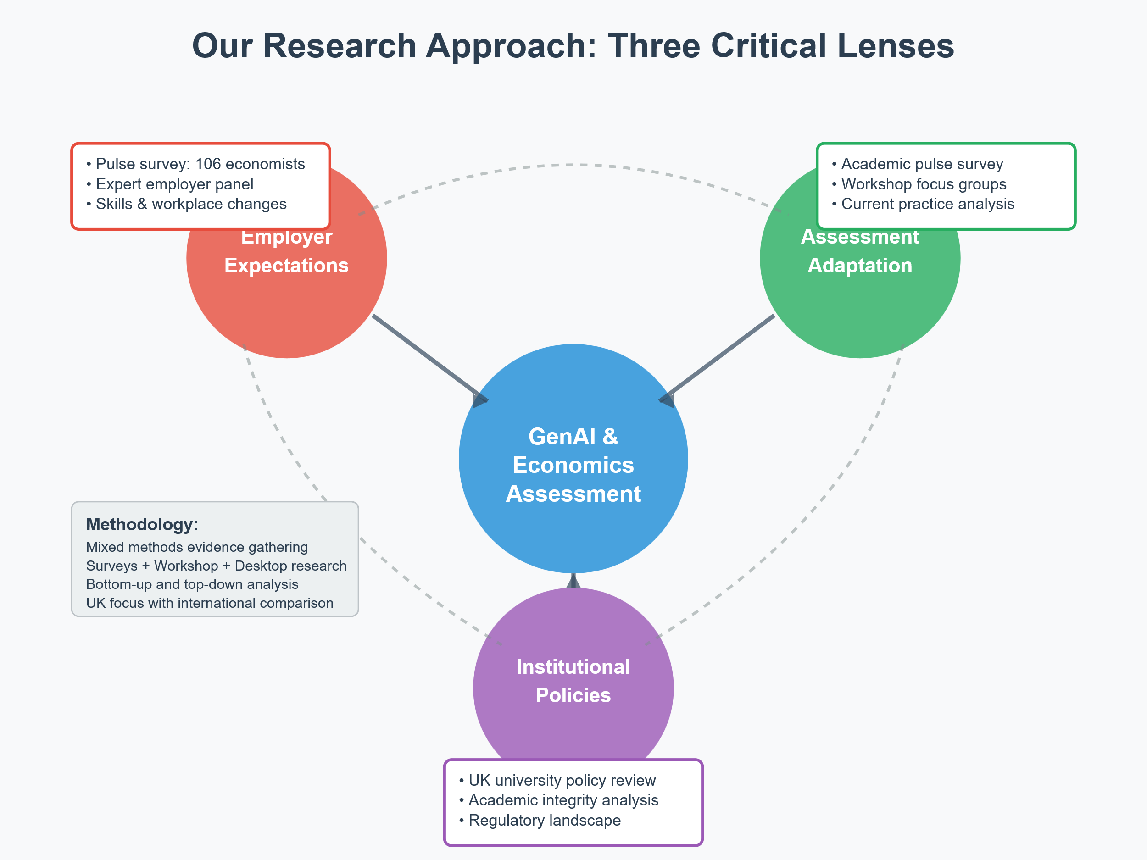
Our Research Approach

Slide 4
Employability and Future skills
          -GenAI literacy (Coding, prompt engineering etc)
        -Being able to use GenAI across diverse tasks
        -Being able to use GenAI critically
-Ethical and responsible use of GenAI

Slide 5
Employability and Future skills
          -GenAI literacy (Coding, prompt engineering etc)
        -Being able to use GenAI across diverse tasks
        -Being able to use GenAI critically
-Ethical and responsible use of GenAI

Slide 6
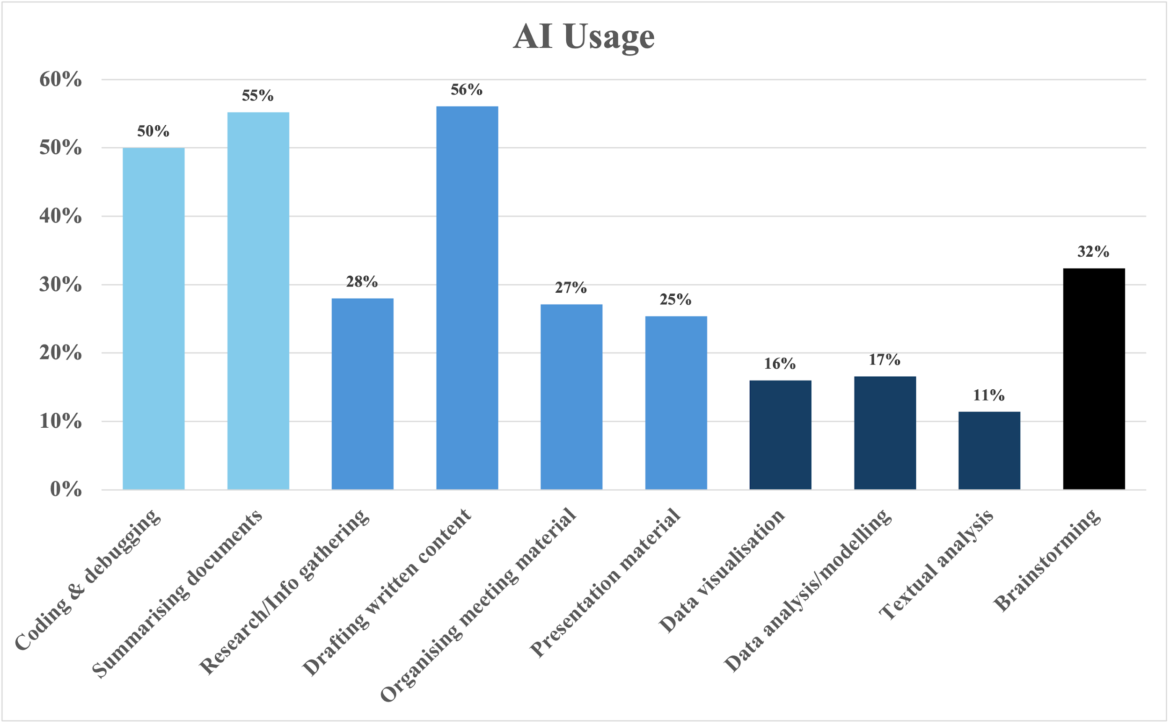
Employability and Future skills
“How do you use AI in your work?”
Analytically narrow
(Well defined)
Analytically broad
(Open ended)

Slide 7
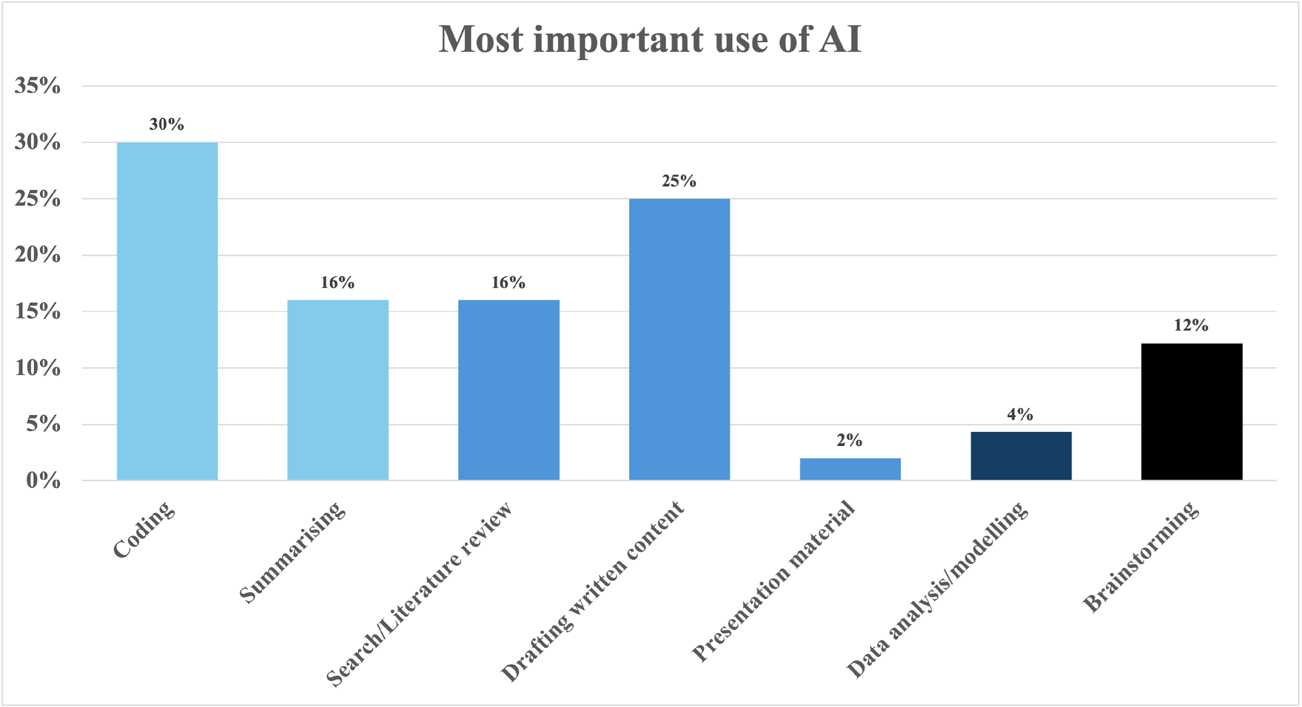
Employability and Future skills
“What is the most important use of AI for you at work?”
Analytically narrow
(Well defined)
Analytically broad
(Open ended)

Slide 8
Employability and Future skills
          -GenAI literacy (Coding, prompt engineering etc)
        -Being able to use GenAI across diverse tasks
        -Being able to use GenAI critically
-Ethical and responsible use of GenAI

Slide 9
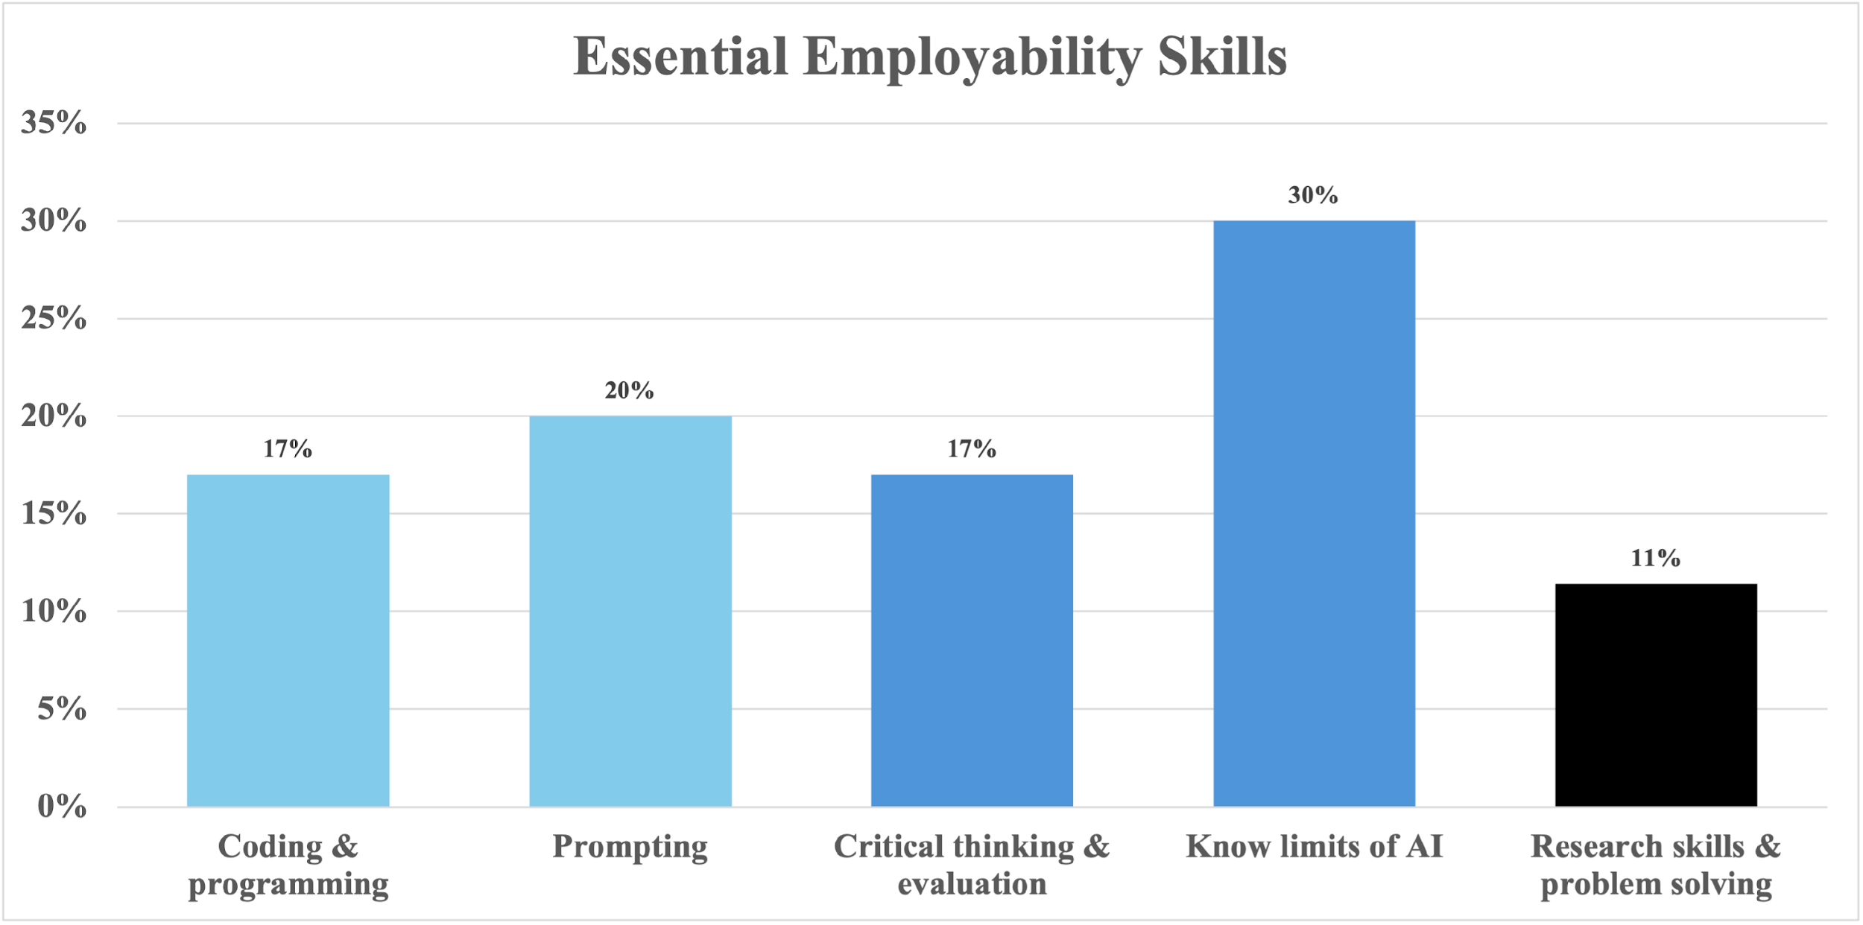
Employability and Future skills
Essential employability skills for new graduates
Analytically narrow
(Well defined)
Analytically broad
(Open ended)

Slide 10
What is happening in the workplace?
Essential employability skills for new graduates
“Know how to use AI as an assistant tool, without excessively relying on that (still be able to double check, have a critical attitude on the outcome proposed)”

Slide 11
Employability and Future skills
          -GenAI literacy (Coding, prompt engineering etc)
        -Being able to use GenAI across diverse tasks
        -Being able to use GenAI critically
-Ethical and responsible use of GenAI

Slide 12
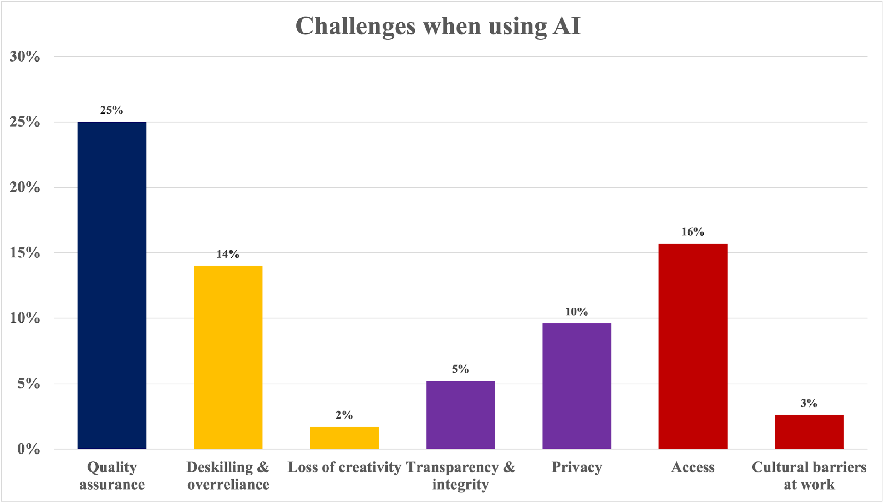
“What challenges do you or your colleagues face when using AI in your workplace?”

Slide 13
Employability and Future skills
          -GenAI literacy (Coding, prompt engineering etc)
        -Being able to use GenAI across diverse tasks
        -Being able to use GenAI critically
-Ethical and responsible use of GenAI

Slide 14
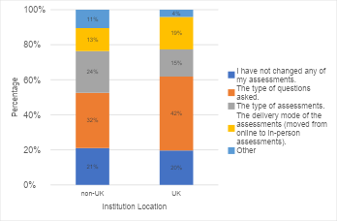
How are Econ assessments changing?
80% of academics report making changes.
Top changes: modified question design, format changes, applied/contextualised tasks.
But: fragmented, module-level, reactive an inconsistent approaches.

Slide 15
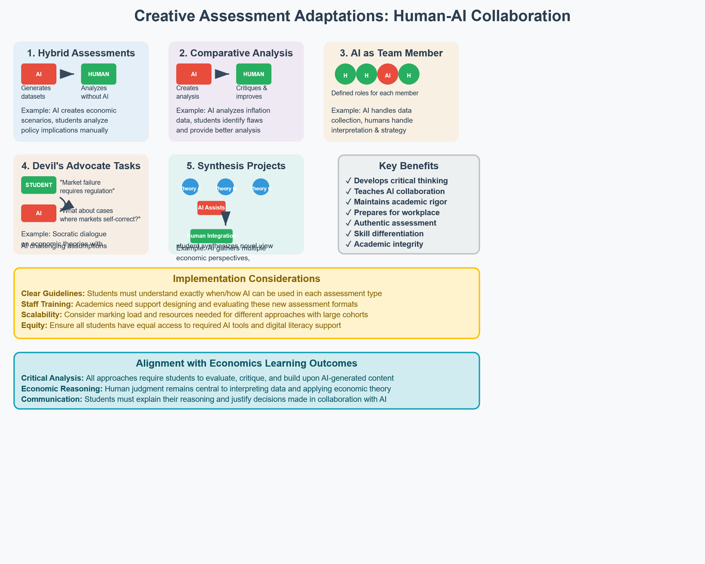
Examples of assessment adaptations

Slide 16
The push back to on-campus Exams
Current trend: Rush back to in-person exams
Points to watch:
Takeaway: On-campus exams can address some challenges, but should be complemented with strategies that build skills needed in the future
Drivers: Academic integrity fears, perceived "quick fix"
Ensuring continued opportunities for diverse skill development
Preserving inclusivity gains from COVID-era innovations
Preparing students for AI-supportive and collaborative workplaces
Considerations: While this supports integrity, it also raises questions about skill development and effective use of AI in learning.

Slide 17
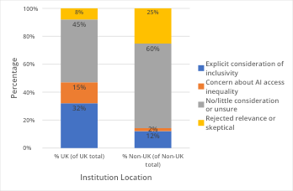
Inclusivity & Equity Concerns
Many changes ignore inclusivity and awarding gaps.
GenAI may worsen inequalities (access to tools, hidden curriculum of Ai literacy, biases).
But: GenAI can also support personalised learning if well designed.

Slide 18
A Balancing Act is needed
We need both GenAI-enabled and GenAI-free assessments.
Protect academic value while supporting skill development.
Programme-level design essential.
GenAI-free Assessments
(Exams, presentations)
GenAI-enabled Assessments
(Projects, critical evaluation)

Slide 19
Academic Integrity Reality Check
Detection challenges:
AI detection tools: unreliable, biased
Oral exams: don't scale to large cohorts
Manual checking: inconsistent, time-intensive
A shift in focus is needed…
From catching cheating
To guiding responsible use

Slide 20
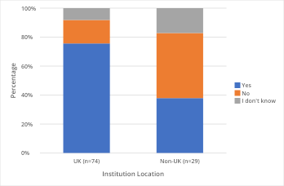
A policy gap?
Do you know what your university policy is on the use of GenAI for assessment?
Unclear rules make academics cautious.
Lack of programme-level guidance stifles innovation.
Discipline-specific leadership needed.

Slide 21
Our Three-Pillar Framework
Assessment
Protect Academic Value
Support Adaptation
Develop Essential Skills
Ensure degree classifications reflect genuine student achievement
Prepare students for GenAI-collaborative workplaces
Help students and staff navigate this transition effectively

Slide 22
A programme-level Strategy is needed
Not: all exams vs. no exams.
Instead, we need a strategic assessment mix: Mix of exams, projects, group work, and AI-enabled tasks.
Avoid defaulting to 100% exams.
Consider inclusivity, skill mix, and integrity together.
Exams
Group Work
AI Tasks
Projects
Presentations

Slide 23
What does Economics Need?
Leadership Level:
CHUDE endorsement of need for change
RES coordination of discipline response
Institutional influence on university policies
Practical Level:
Discipline-specific guidance (not just generic AI policies)
Practice-sharing platforms (move from problems → solutions)
Co-creation opportunities (collaborative assessment design)

Slide 24
Essential Support Structures
For Staff:
High-quality training on GenAI integration
Time and resources for assessment redesign and experimentation
Networks for sharing best practice, challenges and co-creation
For Students:
Critical AI literacy development
Ethical use guidance
Learning-with-AI skill building
Investment Required:
Scaling through Economics Network, CTaLE, regional networks (e.g. SWEETS, BEES)

Slide 25
A Call to action
GenAI = unprecedented challenges + opportunities.
    Either React defensively and retreat to traditional methods or instead Lead proactively and shape the future of economics education
Economics departments have the analytical tools and quantitative skills to evaluate what works and what doesn’t
We need to protect degree value and create evidence-based, inclusive, valuable degrees for the AI age

Slide 26

Thank you
Access the executive summary of the report here:

