Slide 1





The Unwritten Path: Mid-Career Transitions and Challenges for Economics Educators
Stefania Paredes Fuentes
Tim Burnett
University of Southampton and National Bank of Slovakia
Aston University

Slide 2
This paper (no need to present this slide)
Considers the experiences of mid-career economists in education pathway roles.
Contextualise these experiences using data on the evolution of education-focused roles since 2012/13 and on the broader literature on the challenges of mid-careers and the evolution of education focused pathways.
Provides a conceptual framework that links these experiences to the broader literature and provides the basis for reinterpreting these lived experiences and making the “unwritten path” more navigable for economists in education roles.

Slide 3
This presentation
Voices from the mid-career workshop for academic economists
Contextualising these voices:
The emerging space of education-focused roles in economics
The culture in economics
The broader literature
Writing the path: navigating progression as economics educators

Slide 4
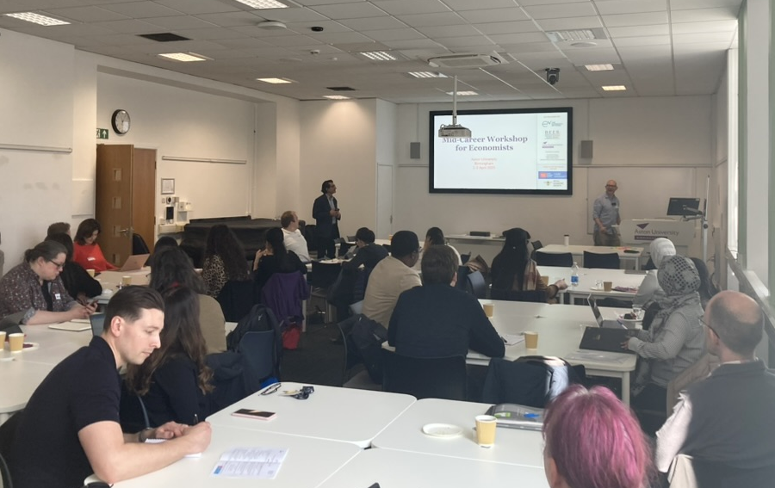
A Workshop for Mid-Career Economists
Aston University, 1-2 April 2025, in person
Support of the Economics Network, Aston University, BEES, iLead (KCL), Royal Economic Society
50 applicants, 41 eligible, 30 participants from various universities
Focused on education, but open to all academic economists

Slide 5
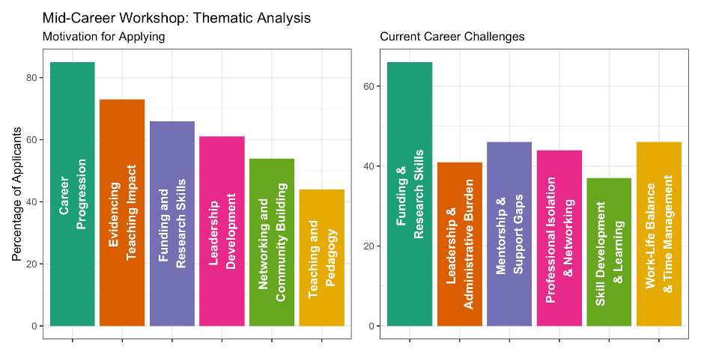
A Workshop for Mid-Career Economists
“What motivates you to participate in this workshop?”

Slide 6
A Workshop for Mid-Career Economists
“What specific challenges or goals do you currently face in your mid-career academic journey? How do you see this workshop helping you address these challenges or achieve your goals?”

Slide 7
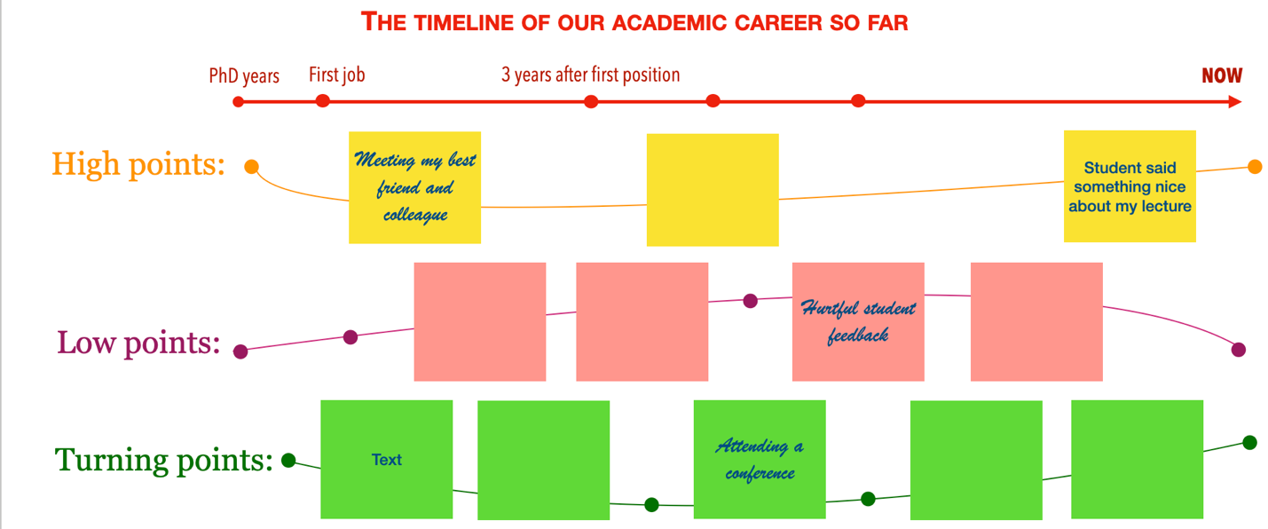
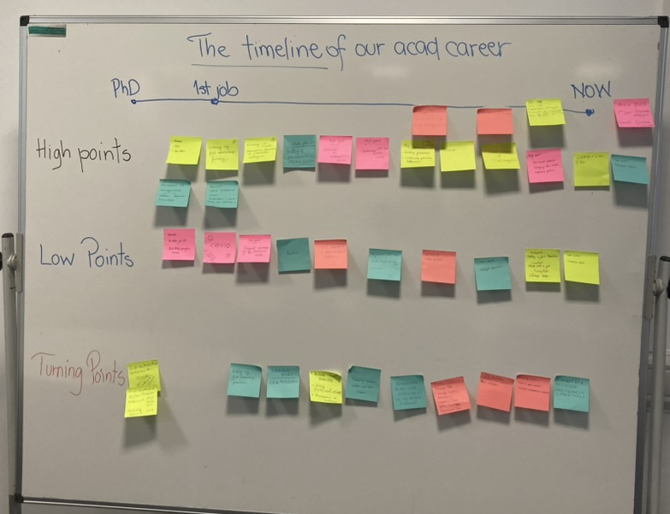
A Workshop for Mid-Career Economists
High points: Permanent position, recognition
Low points: COVID19, delayed promotions, feeling stuck, burnout, rejection
Turning points: Leadership positions, securing funding, joining professional networks, changing jobs

Slide 8

Contextualising Experiences: The Emerging Education-focussed Pathway

Slide 9
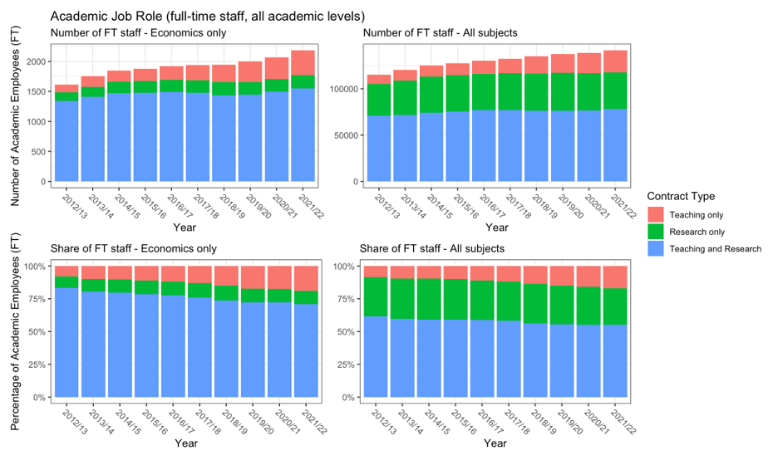
The Emerging Space of Education-Focussed Roles in Economics: Employment

Slide 10
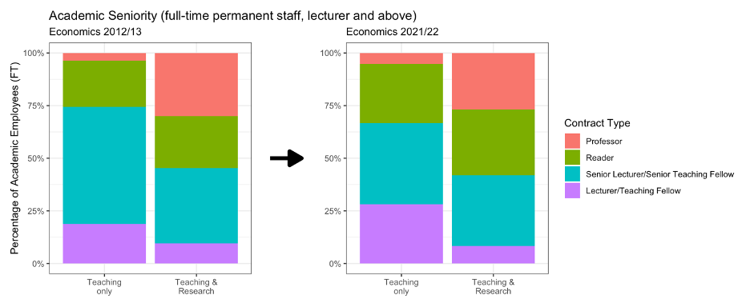
The Emerging Space of Education-Focussed Roles in Economics: Academic Seniority

Slide 11
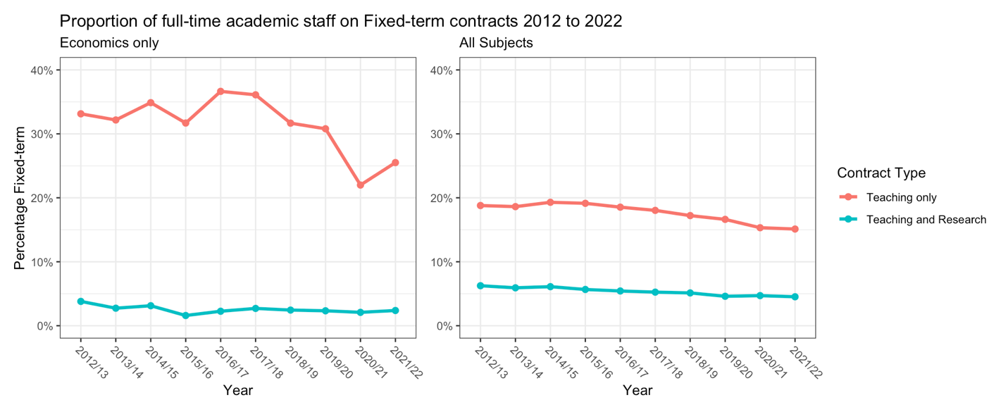
The Emerging Space of Education-Focussed Roles in Economics: Job Precarity

Slide 12
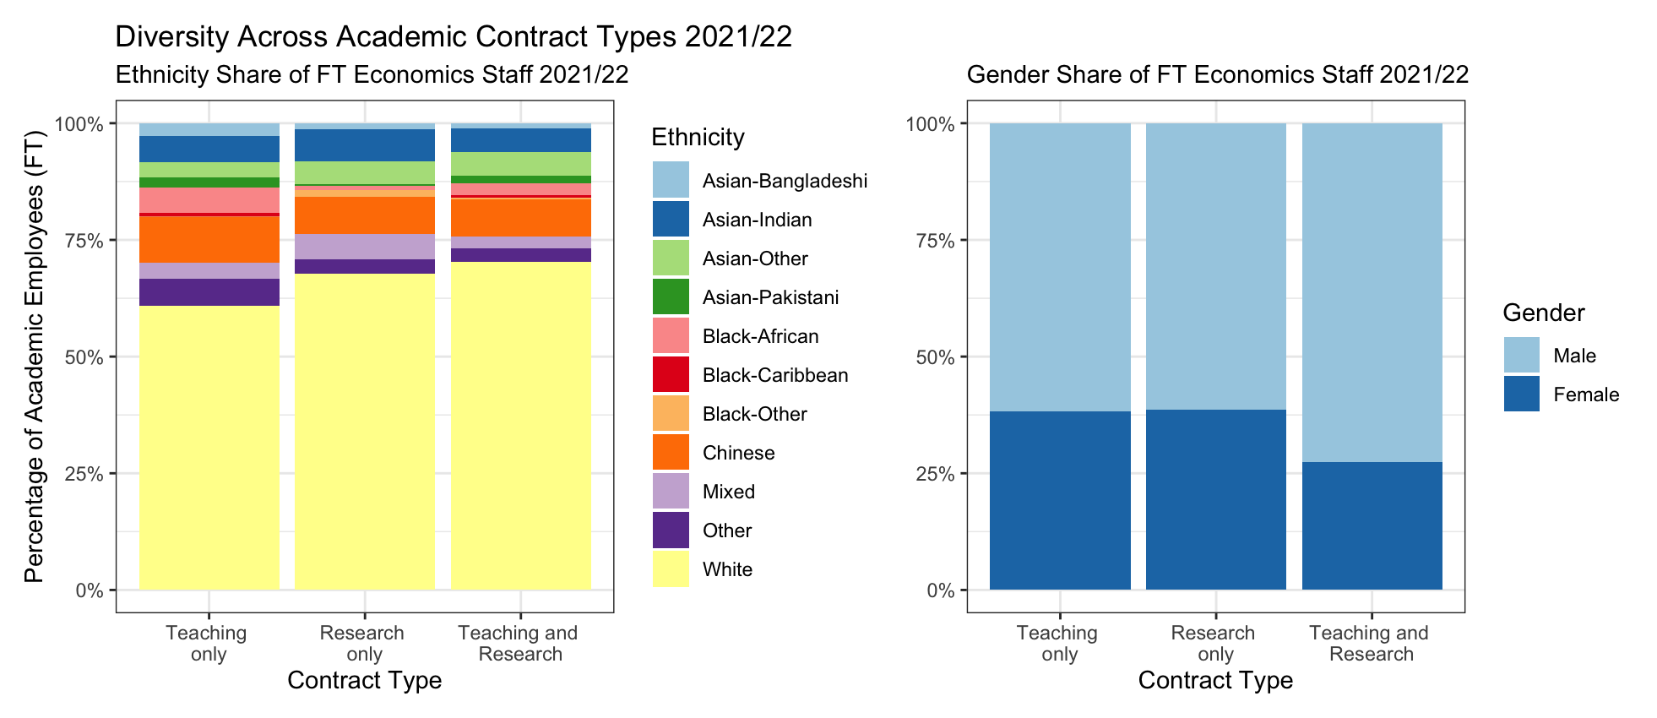
The Emerging Space of Education-Focussed Roles in Economics: Diversity

Slide 13
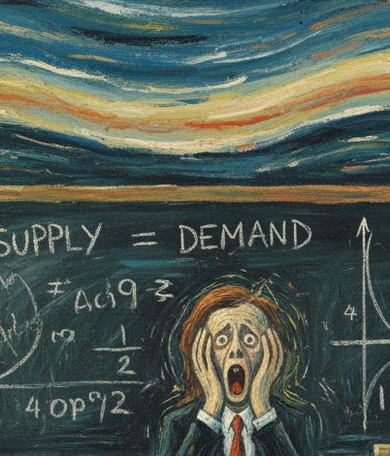

Contextualising Experiences: The Culture of Economics

Slide 14
Culture in Economics Impacts Education-focussed Staff!
Economics stands out for its insularity, prestige hierarchies, rigidity, and resistance to change (Fourcade et al. 2015)
Under-representation and barriers to promotion for many groups (Paredes et al., 2023)
“Publish or Perish” still impact the culture in economics:
Influence research agendas (Akerlof, 2020)
Affects wellbeing (Miller et al. 2011; Scheneider, 2019)
Determines attrition (van Dalen, 2021)
Some researchers are willing to give up a limb for an AER! (Atterna et al. 2014)
Economists across all pathways may internalise these social norms

Slide 15

Contextualising Experiences: Previous Literature

Slide 16
Literature on mid-career and on education pathways
Research on academic career development tends to focus on early career. Mid-career remains comparatively underexplored.
No consistent definition of “mid-career” (Treebak and Thomsen, 2022):
Midcareer is both a situation and an emotion
Multiple sources of midcareer stuckness
Associated with ‘narrowed horizon for action’
Modern literature: mid-career as a dynamic period of reassessment, identity negotiation, and adaptation (Baldwin et al. 2005; Brown, 2015; Treebak and Thomsen, 2022)

Slide 17
Literature on mid-career and on education pathways
In academia:
Challenges are intensified by rigid norms and structures that privilege specific outputs (Treebak and Thomsen, 2022; Whitchurch et al. 2021)
Structural challenges persist through midcareer: publication pressure, limited autonomy, unclear progression pathways, widespread casualisation of academic labour (Dore & Richards, 2024; Hollywood et al., 2020; Khanijou & Zakariah, 2023)
Fixed-term contracts translate in slower career progression, unfair working conditions, mental health concerns (Ackers and Oliver, 2007, Bryson & Barnes, 2000, Menard & Shinton, 2022, Solomon & Du Plessis, 2023).

Slide 18
Literature on mid-career and on education pathways
Recurring theme: Education pathway staff reports feelings of professional isolation, lack of clarity of expectations, and perceived lower professional status within their institutions (Bennett et al. 2018b, Smith and Walker 2024, Bull et al. 2025).
Common challenges:
Lack of standardised promotion criteria across institutions
Inconsistency in job titles (e.g. Bamber & McCormack, 2017, 2023)
Absence of tailored professional development opportunities
Challenges are more acute in research-intensive institutions (Bull et al. 2025)
Misrecognition of Scholarship of Teaching and Learning (Kern et al., 2015)
Experiences in career progression are also shaped by intersections of gender, ethnicity, socio-economic background, disability and other social identities.

Slide 19
Conceptualising the Mid-career: Writing the Path (kind of, in progress)

Slide 20
Writing the Path: A Narrative for Economists in Education Pathways
Individual trajectory
Disciplinary culture
Institutional structures
An individual’s experienced career pathway is determined by three interacting domains

Slide 21
Writing the Path: A Narrative for Economists in Education Pathways
Lack of professional identity/agency
Not clear job description (or one that does not reflect real responsibilities)
Personal background
Lack of validation
Individual trajectory
Disciplinary culture
Institutional structures
UNWRITTEN PATH
No clear promotion criteria
Unclear workloads
Lack or recognition
Feelings of career stagnation
Lack of community
Increase sense of marginality
Lack of recognition for teaching
Sense of alienation

Slide 22
A Narrative for Economists in Education Pathways: Navigating the Pathway
Identity
Developing professional identity
Develop a professional identity that reflects your teaching and scholarly contributions.
Why it matters? For sustaining progression and maintaining long-term job satisfaction.
Constraints
Lack of clear job descriptions and workloads that accurately reflect day-to-day activities.
Promotion criteria that doesn’t recognise achievements in education and leadership.
Who has been promoted in the last 3 years?
(Re)claim agency
Actively seek for opportunities, clarify your career trajectory (based on your professional identity). Be proactive (instead of reactive) in shaping your role (Ansberg et al., 2022).
Why it matters? Maintain work balance.
Constraints
No transparent pathways for leadership in education (e.g. you don’t know how decisions on these roles are made).
Lack of support for innovation in education, institutional recognition for this work.
Limited autonomy over teaching-related decisions
Agency
Notes:
Identity may involve a period of self-reflection and a conscious deprogramming of norms that have been internalised. What makes you happy? It is the first step in finding satisfaction in the midcareer.

Slide 23
A Narrative for Economists in Education Pathways: Navigating the Pathway
Find where you belong
Cultivate communities of practice where your contributions are valued. This can be within your department but also at institutional and discipline level.
Why it matters? Contributes to reinforce your sense of belonging as an economist and as an academic.
Constraints:
No mentors to lead the way.
In some departments, education staff may not be invited to engage in decision processes.
Lack of support/recognition for engaging with external networks.
Culture
Document the impact of your work
Develop a system to evidence your contributions. Check which mechanisms are used in your department and in your communities to track impact.
Why it matters? Ensures you understand your progress and can explain this to your institution.
Constraints:
Some contributions may not be seen as valid as research outputs.
No recognition of contributions to student outcomes, departmental results, institutional success.
Lack of visibility of education-focused achievements
Impact

Slide 24
Wrapping Up
Education-focussed mid-career can be challenging and there is not a lot of support!
Every academic’s experienced career path is subjective…
…BUT… Education pathway is more variable (between individuals) owing to a range of factors
Navigating the path is a constrained optimisation (there are things we can control, and things we cannot)
You cannot (and shouldn’t) try to do everything: find an identity—your objective function—which works for you
Be deliberate in the things you do—where possible, focus on things that move you in the right direction
Find community!

