Slide 1
Do students at a UK Business School feel a sense of belonging to their University?
Karishma Patel and Robert Riegler (Aston University)
DEE 2025, Leeds

Slide 2


What is belonging?
Lewis and Hodge (2014) describe two dimensions of belonging: social fit and ability fit.
Boulton (2022) provides examples:
Social fit | Ability fit
Connection with peers, staff and mentors | Feeling capable and comparable in their abilities to their peers
Low levels of concern about negative stereotypes and bias about ability to fit in socially | Low levels of concern about negative stereotypes and biases about academic abilities
Feeling accepted and valued socially, as part of a cohort | Feeling accepted and valued academically, as part of course cohort

Slide 3
Why does it matter?
Students feeling part of a community of staff and students is essential to feelings of fairness in the assessment design, marking and learning from the feedback given (WonkHE, 2023)
Sense of belonging among students has emerged as a crucial element for academic success, student retention, and overall wellbeing (Advance HE, 2024)
Many universities recognise the importance of belonging in their 2030 strategies.

Slide 4
Project aims
Identify the sense of belonging of Business School students at a “Broad Access University”
Identify its determinants
Evaluate impact of interventions on students’ sense of belonging

Slide 5
Data collection
Through online questionnaire students had to complete in-class:
First year: During the welcome week
Second year and final year: During welcome back sessions delivered by Course directors
Sample covers economics courses.
Response rates per year between 24.3 to 67.1%

Slide 6
Sample Statistics
 |  | Pct.
Gender | Female | 29.3
 | Male | 70.7
Year of Study | First year | 23.9
 | Second year | 52.7
 | Final year | 23.4
Ethnicity | Asian/ Asian British | 52.2
 | Black/ Black British | 22.0
 | White | 16.6
 | Mixed / Other / prefer not to say | 9.2
Term accommodation | Living at home with my family | 37.6
 | Living away from family | 62.4
Accommodation location | In Birmingham | 85.9
 | Outside of Birmingham | 14.1

Slide 7
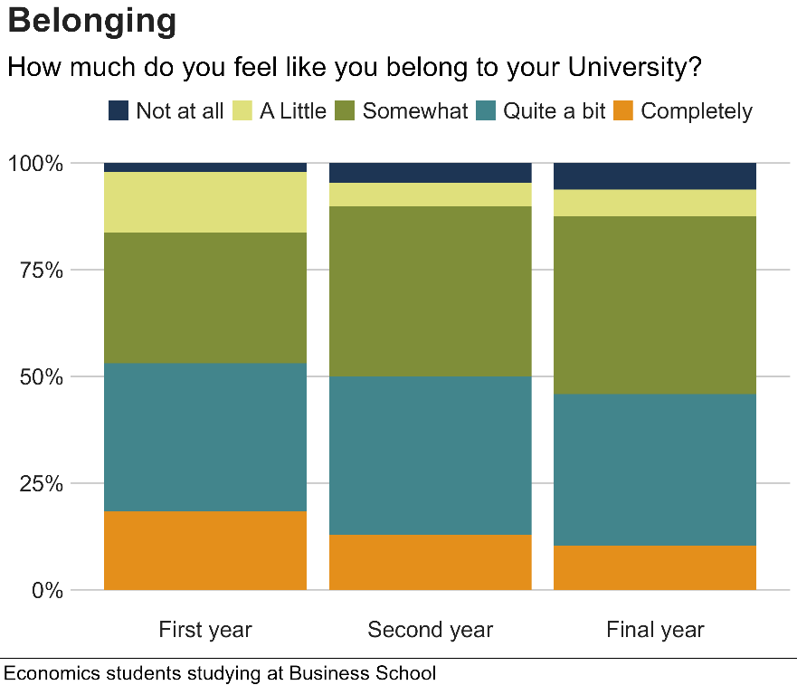
What is sense of belonging at your University?

Slide 8
Determinants
Dep. Var.: Belonging
Stage 1
Stage 2
Stage 3
Constant
3.279***
3.232***
-
0.245
Male
0.157
0.153
0.055
ethnicity Black/ Black British
0.185
0.086
0.168
Ethnicity White
-
0.092
-
0.178
-
0.214
Ethnicity Other
0.440*
0.382
0.264
Level 4
0.131
0.153
-
0.104
Level 6
-
0.081
-
0.146
-
0.104
Term accom: Flat/house
0.337
0.140
Term
accom
: Halls
off
-
campus
0.138
0.165
Term
accom
: Halls
on
-
campus
0.111
0.096
Location: Outside of Birmingham
-
0.030
0.050
Respect student
0.210***
Respect staff
-
0.0005
Connected to staff
0.117*
Welcoming
0.215***
Enriching experience
0.505***
Observations
205
205
205
R
2
0.029
0.039
0.536
Adjusted R
2
-
0.0005
-
0.011
0.499
Note: *p<0.1; **p<0.05; ***p<0.01

Slide 9
Determinants: Ethnicity
Dep. Var.: Belonging
 | Asian eth. | Black eth. | White eth.
Constant | -0.561 | 0.218 | -0.087
Male | 0.14 | 0.121 | 0.279
First Year | -0.103 | 0.297 | -0.241
Final Year | -0.117 | -0.024 | -0.377
Respect student | 0.192** | -0.001 | -0.208
Respect staff | 0.087 | 0.151 | 0.126
Connected to staff | 0.006 | 0.057 | 0.258
Welcoming | 0.185* | 0.263 | 0.314
Enriching experience | 0.634*** | 0.477** | 0.481*
Observations | 107 | 45 | 34
R² | 0.65 | 0.393 | 0.359
Adjusted R² | 0.621 | 0.258 | 0.154

Slide 10
Students and extra-curricular events

Slide 11
Interventions
According to Thomas (2012), belonging interventions:
should be for everyone – not just aimed at a particular group of students
should be delivered in ‘the academic sphere’ and have an “overt academic purpose”
Should aim at supporting peer networking and meaningful staff-student interactions
We created three “Thinking like and Economist” workshops
Co-created sessions with students’ economic society
All had academic purpose (programming, policy briefings, and experiments)
Was open to all economics students across years

Slide 12
Motivation and Feedback

Slide 13
Summary
We do not find that ethnicity or gender have an impact on students’ sense of belonging
However, our results suggest that there could be differences in the impact of ethnicity on different dimensions of social fit variables
We found that students are mostly interested in attending extra-curricular events if they are academic / career talks
Intervention of co-created workshops allowed students to get to know their peers and gave them the opportunity to talk to staff

Slide 14
What’s next?
Undertaking focus group meetings to learn more about students’ perceptions of interventions
Further Intervention: How do other extra-curricular events and involvement in departmental activities affect students belonging? E.g.
Peer Assisted Learning
Personal tutoring
Social media initiative

Slide 15
THANK YOU!!! Any questions?

