Slide 1
Intro Slide Title 1
The ‘forum effect’: how does participation in online forums affect student retention and academic performance?
Developments in Economics Education conference,
Leeds University, Friday 12th Sept 2025, 11.00-12.30
Emilie Rutledge, Head of Economics,
Senior Lecturer, The Open University

Slide 2


FASSTEST Funded Scholarship
FASSTEST scholarship project #100, began April 2023
Project #100 title: Assessing the effectiveness of targeted forum activities in relation to student retention
Project team members:
  Emilie Rutledge (project lead), The Open University (OU)
  Julia Chukwuma (co-investigator), OU
  Roberto Simonetti (co-investigator), OU
  Michael Ng ( co-investigator), University of Roehampton
  Hannah Sam (co-investigator), University of West London

Slide 3
Motivation and rationale
Substantial research on student retention in HE but a relatively under-researched factor is the impact of student participation in online forums.
In 2020/21 DD126 Economics in Context student satisfaction survey
The ‘forum effect’ – impact of student forum participation on their learning (Alzahrani, 2017) , outcomes and success.
Students benefit from collaborative learning, feeling part of an academic community and increased exposure to ideas related to their course, all having a positive impact on student success and outcomes such as continuation (Goggins & Xing, 2016).
For educators, they are a pedagogical tool to encourage students to engage with and discuss course content.
More empirical research needed to ascertain the extent of forum participation needed to improve retention and also on how to encourage participation.

Slide 4
Literature on retention and the ‘forum effect’
Extant literature on student retention in HE finds institutional, situational and dispositional factors as influencing student attrition (see e.g., Bowles and Brindle, 2017).
Griffin and Roy (2022) -Hutton and Robson (2019) - interventions to improve student forum engagement led to marginal improvement in retention rates.
“forums [are] a welcome source of peer and tutor support” (Griffin and Roy, 2022) yet, were also considered to cause anxiety.
Kear et al. (2014) - students use forums to increase their ‘social presence’ and get to know each other better.
Dommett (2019) - peer interaction is a crucial part of developing online academic communities and that forums are widely used by students in this regard.
Pinchbeck and Heaney (2022) - student engagement in asynchronous forums has a positive association with student retention
Notes:
If we look at the literature on retention, more broadly Bowles and Brindle undertook a systematic review of the literature on student retention in HE and grouped together the factors that have been found to influence retention into three areas: institutional, situational and dispositional issues, institutional for example might be the tutor-student relationship, quality of the student experience etc., situational relates to factors such as student Socio-economic status for example and dispositional factors include things such as student demographics amongst others.
Focusing in on the literature on the influence of forum participation on student retention, there is a relatively small but growing body of research,
Qualitative research, such as that by Hutton and Robson (2019) found that interventions to improve student forum engagement led to a marginal improvement in retention rates. In a further applied study conducted at the OU, Griffin and Roy (2022) conclude that, “forums [are] a welcome source of peer and tutor support” yet, were also considered to cause anxiety.
Research by other OU academics, Pinchbeck and Heaney (2022) investigated the correlation between forum participation and retention. They found that in a distance or online learning environment student engagement in asynchronous forums has a positive association with student retention.

Slide 5
The forums in focus
DD126 Economics in Context - large introductory 30 credits economics module
21J and 22J student cohorts - 748 students and 665 students respectively, a total of 1413 students.
42% from the Business Management qualification, 17% reading a BA in Economics, 8% reading a PPE degree, 6% reading a Maths and Economics degree, 3% reading an Open degree and 1% reading a BA in Social Sciences.
Approx 60% male, 16% ethnic minority, 18% have disability, 15% low SES
Three forums - welcome, cluster and tutor forums – all moderated

Slide 6
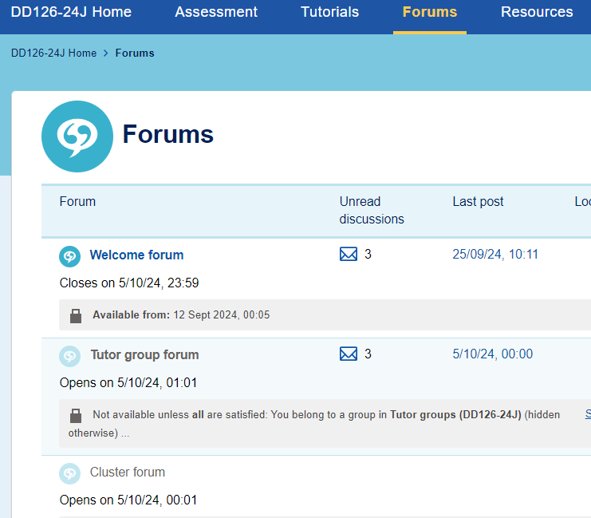
Targeted forum activities
Forum activities voluntary except for one which links to TMA02 and has 3% for participation
In 2021J - 6 forum activities, following student survey responses requesting more peer interaction an additional 6 forum activities were added in 2022J
Tutors were provided with moderation notes and template initial posts for these activities
Activities related to module content, encouraged diverse views on current economic topics, allowed students to draw on authentic experiences
12 activities embedded in VLE at regular intervals across 30 weeks

Slide 7
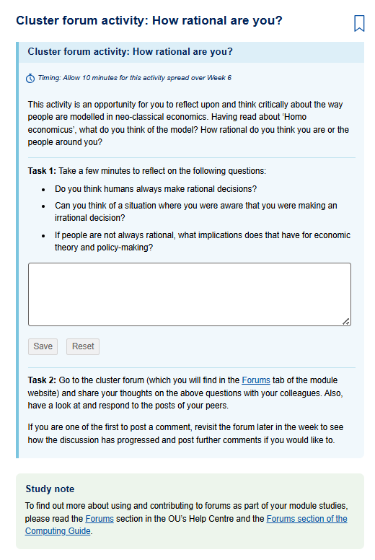
Example of forum activity on DD126

Slide 8

Research questions
RQ1: To what extent does student participation in online forum activities affect retention?
RQ2: To what extent does student participation in online forum activities affect student academic performance?
RQ3: What are the reasons students participate or don’t participate in online forum activities?

Slide 9
Research methods
Mixed methods research using student data and forum participation from DD126 and semi-structured interviews with students
Ethical approval required from HREC, SRPP and DPIA
Quantitative methods
  Econometric modelling to determine the influence of known factors, including forum participation, on student retention and academic performance
  Student data collection from OU systems – demographics, previous module performance and measures of forum participation
Qualitative methods
  Semi-structured Interviews with students on DD126

Slide 10
Slide Title 30
Quantitative analysis

Slide 11
Slide Title 10
Econometric models – Independent variables (1)
5 different ‘forum effect’ measures
the number of posts in the Tutor-group forum;
the number of replied posts in all three forums;
a dummy variable – when a student initiated a forum post;
total number of posts in all three forums;
total number of word count in all forum posts
Other Indep. Variables
Student’s (i) gender, (ii) age, (iii) their highest educational attainment before joining the OU [Edu]; (iv) Socio-economic status [SES]; (v) Learning, mental or physical disability [Disab]; (vi) Caring responsibilities [Care]
The external environment [External environment] as indicated by whether the student was in the 2021 cohort or the 2022 cohort.

Slide 12
Slide Title 10
Econometric models – Independent variables (2)
Possible missing variable bias
A positive correlation could be due to student ability influencing both forum activity and performance
Student’s previous academic results in other OU modules
  number of passes [No_of_Pass];
  number of fails [No_of_Fail];
  number of withdrawals [No_of_Withdrawn];
  number of concurrent modules they are studying [No_of_Concurrent_Module].

Slide 13
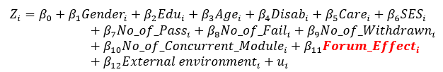
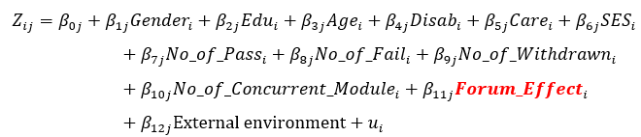
Slide Title 10
Econometric models
Model 1 – Student Retention
Zi = Retention is a binary variable, (0 = withdrawn, 1 = retained)
The binary logit model for student retention (Zi) is expressed as following:
Model 2 - Student Academic Achievement
Zij = Academic result is an ordinal variable, (1: Fail with resit, 2: Pass, 3: Distinction)
The Multinomial logit model for Student Academic Achievement (Zij) is expressed as following:

Slide 14
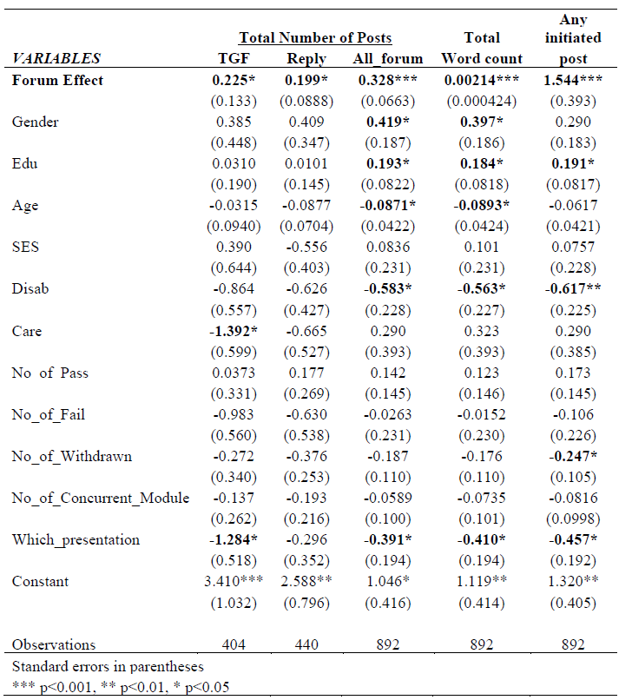
Slide Title 10
Binary logit model results – Model 1 Student Retention

Slide 15
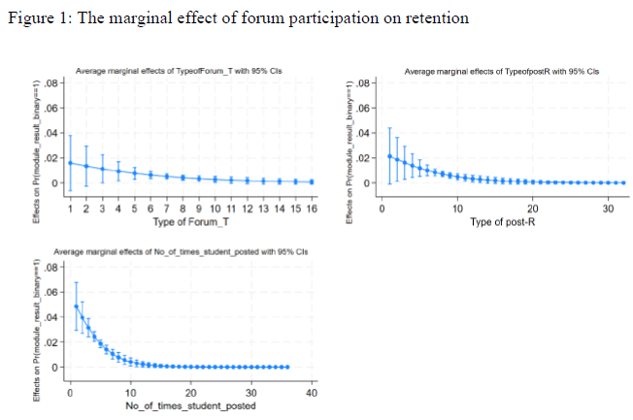
Slide Title 10
Binary logit model results – Model 1 Student Retention

Slide 16
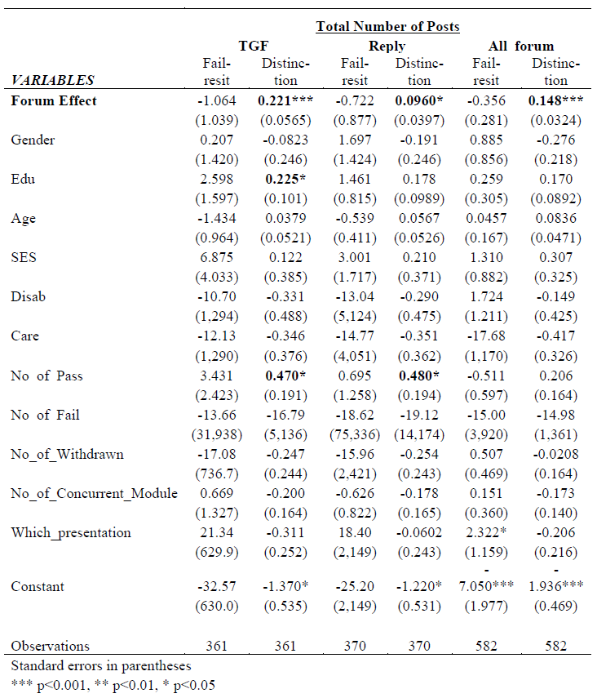
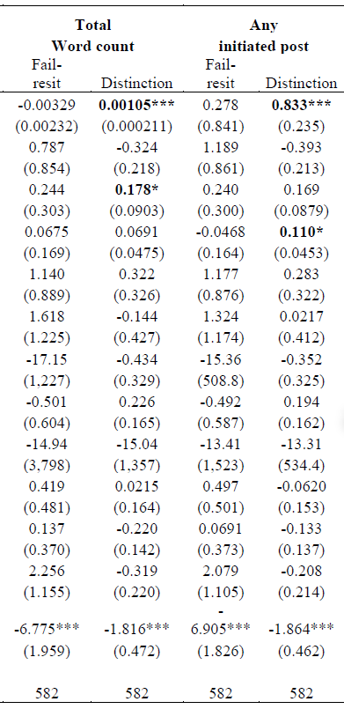
Slide Title 10
Multinominal logit model results – Model 2 Student Academic Achievement

Slide 17
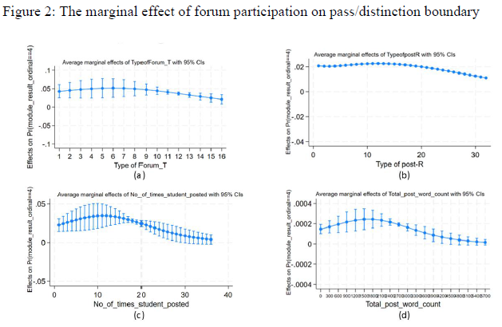
Slide Title 10
Multinomial logit model results – Model 2 Student Academic Achievement

Slide 18
Slide Title 30
Qualitative analysis

Slide 19
Interviews with DD126 students
Interview questions designed to assess RQ3: What are the reasons students participate or don’t participate in online forum activities?
Following ethical approval, each interview was conducted over MS Teams and lasted 15-20 minutes.
Eight interview questions focusing on why they did/or didn’t participate in course forums
We conducted interviews until saturation was reached and in total, eleven online interviews were conducted and transcribed.
The ‘saturation’ point’ of interviews – the point at which no new themes will emerge from the research – can occur at relatively small numbers (Hennink & Kaiser, 2022; Hennink et al., 2017).
The responses were then coded using thematic analysis in MS Excel.

Slide 20
Interviews with DD126 students
N = 11 interviews

Slide 21
Interview quotes – reasons for forum participation
Student community building
“It's really important because when you're at home and you're doing it and you don't have much contact with anybody, you look forward to that. And I actually really wanted to know when someone had replied to my posting” (INT3).
“it's great to sort of build the relationships and network and all that kind of thing.” (INT4).
Sense of obligation
“Well, I participated in all the all the activities that [sic] requested it, so yes. I suppose I'm high on compliance, so if I'm asked to do something, I'll do it” (INT7).
“It was partly because we were told to do it. I probably wouldn't have done it if not prompted” (INT2).

Slide 22
Interviews with DD126 students
N = 11 interviews

Slide 23
Interview quotes - reasons for not participating
Time involved
“For me, my work is very demanding during the day and catching up on studies on odd hours” (INT12).
“I missed the [forum activities] as I had some family commitments and was not actively engaging at a point. I also was studying in college” (INT10).
Lack of responses
“I didn't get much interaction back from people, so it kind of felt a little bit pointless and … I wasn't really getting anything back” (INT6).
Anxiety over unknown audience
“It's difficult for me to write my views and thoughts without knowing the audience. I feel hesitant if I don't know who I am writing to on the forums” (INT1).

Slide 24
Slide Title 30
Conclusions and recommendations

Slide 25
Conclusions
Econometric evidence of a significant positive forum effect on student retention and student academic performance.
Prompting and encouraging students to post was important because there was a positive ‘forum effect’ regardless of whether or not the student initiated the post.
Even if a student posts just a few times it can have a positive impact, because the marginal benefit of forum posting is diminishing with the first post being most critical to student retention.
Qualitative evidence from interviews suggests that the nature of the forum activities and the time aspects involved are important factors influencing participation
Dispositional and situational determinants of retention:
  being male, relatively young and having higher educational attainment have a significant positive impact on retention
  Having a disability, caring responsibilities, or previously withdrawing from a module have a significant negative impact on retention

Slide 26
Recommendations
Integrate forum activities into the VLE, spread throughout the module at regular intervals and follow our ‘ideal recipe’ for a forum activity
An alternative ‘quick-win’ might be for module team members or tutors (a forum moderator) can add a post on a contemporary event once a month to the cluster forums and ask students to discuss and comment on a certain aspect of it.
All modules should have a specific forum moderator to ensure that student forum posts are responded to and that student participant and discussion is encouraged
Raise student awareness of the benefits of forum participation in terms of improving the odds of their completing the course and their academic performance at the start of the module
Students who have previously withdrawn from one module (or have been previously registered on the module) should be flagged to their tutors on the system as they are at higher risk of dropping out, just like we flag disability.
Continue to address male biases in economics as females are more likely to withdraw
‘

Slide 27

‘Ideal recipe’ for forum activities
Based on qualitative interview evidence, the following are tips for creating a forum activity that is most likely to elicit student participation:
They should be at frequent intervals throughout the course (every 2-4 weeks)
They should not be too time consuming (e.g., 10-20 minutes)
Students should be clearly instructed to participate in the forum activity
They should relate to the topics in the course materials and be of a level that is easily accessible to all students
They should allow students to draw on their own authentic experiences
They should connect module topics to real world events or issues

Slide 28
Slide Title 30
References
Alzahrani, M. G. (2017). The Effect of Using Online Discussion Forums on Students’ Learning. TOJET : The Turkish Online Journal of Educational Technology, 16(1).
Bowles, T. V., & Brindle, K. A. (2017). Identifying facilitating factors and barriers to improving student retention rates in tertiary teaching courses: a systematic review. Higher Education Research and Development, 36(5), 903-919. https://doi.org/10.1080/07294360.2016.1264927
Dommett, E. J. (2019). Understanding student use of twitter and online forums in higher education. Education and information technologies, 24(1), 325-343. https://doi.org/10.1007/s10639-018-9776-5
Hennink, M., & Kaiser, B. N. (2022). Sample sizes for saturation in qualitative research: A systematic review of empirical tests. Social science & medicine (1982), 292, 114523-114523. https://doi.org/10.1016/j.socscimed.2021.114523
Hennink, M., Kaiser, B. N., & Marconi, V. C. (2017). Code Saturation Versus Meaning Saturation: How Many Interviews Are Enough? Qualitative Health Research, 27(4), 591-608. https://doi.org/10.1177/1049732316665344

Slide 29
Slide Title 30
References cont.
Hutton, C., & Robson, J. (2019). Breaking barriers, building community: improving student engagement with preparation for studying online multidisciplinary science by distance learning - a case study. New directions in the teaching of physical sciences (Online)(14). https://doi.org/10.29311/ndtps.v0i14.3217
Goggins, S., & Xing, W. (2016). Building models explaining student participation behavior in asynchronous online discussion. Computers and education, 94, 241-251. https://doi.org/10.1016/j.compedu.2015.11.002
Griffin, L., & Roy, J. (2022). A great resource that should be utilised more, but also a place of anxiety: student perspectives on using an online discussion forum. Open Learning: The Journal of Open, Distance and e-Learning, 37(3), 235-250. https://doi.org/10.1080/02680513.2019.1644159
Kear, K., Chetwynd, F., & Jefferis, H. (2014). Social Presence in Online Learning Communities: The Role of Personal Profiles. Research in learning technology, 22, 1-15. https://doi.org/10.3402/rlt.v22.19710
Pinchbeck, J., & Heaney, C. (2022). Case Report: The Impact of Online Forum Use on Student Retention in a Level 1 Distance Learning Module. Athens Journal of Education, 9(1), 103-118. https://doi.org/10.30958/aje.9-1-7

Slide 30
Slide Title 30
Thank you, any questions?

