Slide 1
Women into Studying Economics (WiSE)
Dr Peter Hughes b.orsi@leeds.ac.uk
Dr Bianca Orsi,
Dr Juliane Scheffel

Slide 2
Content
#1
Motivation and Background
#2
Quantitative Analysis
#3
Qualitative Analysis

Slide 3
Motivation and Background
We live in a society that is recognising the prevalence and costs caused by gender inequality and lack of diversity
Economics is marked by the lack of diversity across many facets, such as ethnicity, socioeconomic status, and gender
Literature on gender: research on women in STEM (Science, Technology, Engineering and Maths), but little is said about economics (exceptions: Loupi et al, 2025)
Women make up approximately…
26% of undergraduate students in STEM disciplines (2022)
44% of undergraduate students in physical sciences (2022)
27% of undergraduate students in Economics (2018)
Notes:
24% in physics (2017)
Physical sciences: Astronomy, physics, chemistry, and the Earth sciences
https://www.governmentevents.co.uk/increasing-female-students-uptake-of-stem/#:~:text=According%20to%20the%20recent%20UCAS,UK%20are%20women%20%5B1%5D.&text=The%20percentage%20of%20female%20graduates,split%20is%20still%20just%2026%25.
https://www.nature.com/articles/s42005-024-01579-9#:~:text=At%20present%2C%20only%2024%E2%80%9325,US5%20identify%20as%20women%2B.

Slide 4
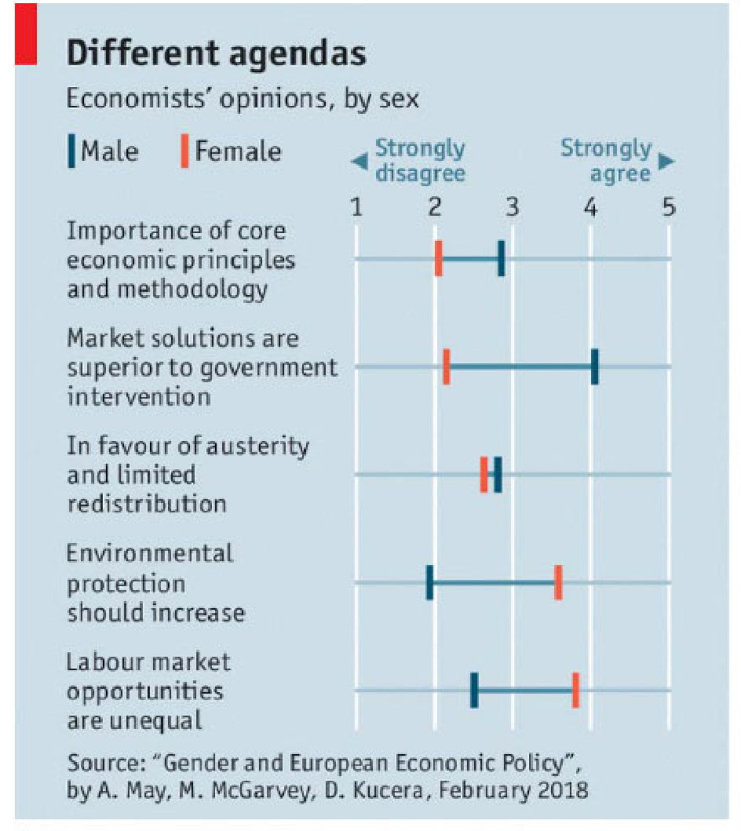
Motivation and Background
Performance of organisations – Organisations with diverse teams tend to perform better than their counterparts.
Bias/Quality of advice – Economic analysis and policy advice being provided may suffer from implicit bias and/or lack of diversity
Pay Equality – Under‐representation in professions like economics is one fact
Source: Jenny Bates, Department for Business, Energy and Industrial Strategy (BEIS), Government Economic Service

Slide 5
Methodology
Literature, three main topics:
Perceptions and interest 🡪 lack of knowledge discourages students
Role Model 🡪 mixed results on whether
Self-efficacy 🡪 importance of maths?
Mixed methods study
Quantitative
Survey with students in Years 9 and 10
Sample size: 340 students
Multivariate analysis of variance (MANOVA)
Qualitative
Focus groups (80 students), separated by gender

Slide 6
Quantitative Analysis – Values
Egotistic values 🡪 focus on self-interest, emphasising personal gain, success, status, or power
“I want to be a leader, where people listen to my ideas and follow my suggestion.”
“I want to have a lot of money and things, so I can buy what I need and want.”
Altruistic values 🡪 prioritise the well-being of others, emphasising compassion, social justice, and helping those in need
“I want to work towards a world where everyone has the same chances and is treated equally.”
“I want to make the world a better place.”

Slide 7
Quantitative Analysis – Perception
No statistical difference by gender:
“Economics is only for smart people.” 🡪 generally disagree
“People who study economics make a lot of money.”
“Maths skills are very important to learn economics.”
“Economics is just about finance, business and banking.”
“Economics helps us understand how the world works.”

Slide 8
Quantitative Analysis – Grades and Assessment
Does performance in maths affect students’ decision to study economics?
Self-efficacy 🡪 girls are much less confident, although there is no statistical difference between grades

Slide 9
Quantitative Analysis – Role Model
Influence from parents and teachers 🡪 (male) students who outperform in mathematics

Slide 10
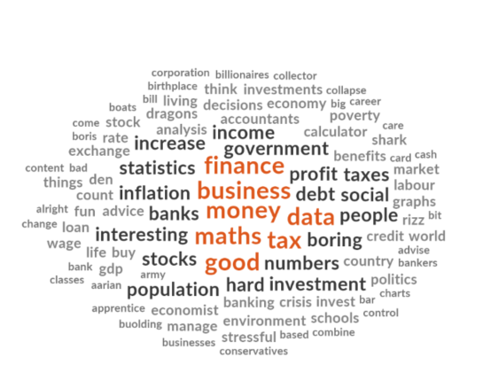
Qualitative Analysis – What is Economics about?
“It’s all about money”
Economics is conflated with Finance.
It's self-interested; focused on business and money.
It's also a pathway to being rich.

Slide 11
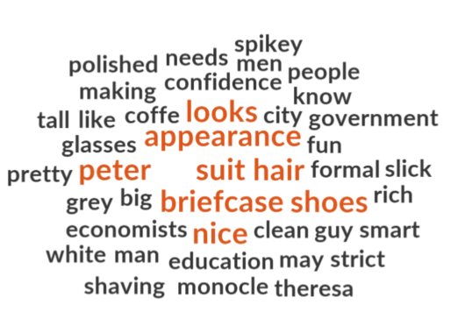
Qualitative Analysis – How do Economists look like?
“Men, with slicked hair and shiny shoes”
Smart, powerful people do it.

Slide 12
Qualitative Analysis – Attributes to be a successful economist
“It’s for alpha/sigma-male”
A sigma male: man who is independent, self-reliant, and often seen as a “lone wolf” 🡪 popular and successful, yet they prefer solitude and autonomy over social interactions.
While alpha males are dominant and seek leadership roles, sigma males operate outside traditional social hierarchies
“Very confident”
“L-Rizz and W-Rizz”
Hashtag rizz has nearly six billion views on TikTok 🡪 short for charisma
W rizz (a win) 🡪 success, positive outcome, and L rizz (a loss) 🡪 “down in investments”

Slide 13
[Partial] Conclusions
Generally, values are different across gender, which may influence decisions in life, such as career
This may partially explain the gender imbalance issues
Female students seem to have a greater perception of the gender imbalances in Economics
Economics is often associated with mathematics and finance
Boys are more confident, on average, particularly in math-related modules 🡪 although grades are not statistically different across gender, this discourage girls to study Economics
Girls do not associate themselves with the features of an economist, while boys are often suggested to study economics
Further insights from qualitative analysis suggest this confident/aggressive behaviour of economists 🡪 often not associated with women/girls

Slide 14
Bianca Orsi
b.orsi@leeds.ac.uk
Peter Hughes
p.t.hughes@leeds.ac.uk

Slide 15
Survey Questions
General Questions
Gender/Income/School Year (9-11)/Ethnicity
Parents’ education level/Parent’s profession
Values, Interests and Motivation
“Economics is interesting”
Perception
“People who study economics make a lot of money”
“Economics is just about finance, business and banking.”
Role Model Representation
“Economics is only for smart people”
“Famous economists are mostly men.”
Grades and Assessment
“Maths skills are very important to learn economics”
“When I receive a bad grade in a subject, I doubt myself and am put off the subject.”

Slide 16
Focus Groups
[INTEREST] What subjects do you enjoy the most at school, and why do you think they appeal to you?
[PERCEPTION] When you hear the word 'economics,' what comes to mind? How do you feel about it?
[ASSESSMENT] What kind of skills does a student need to be a successful economist?
[VALUES] What kind of attributes does a student need to be a successful economist?
[INTEREST] What sounds interesting/boring about economics? Why?
[ROLE MODEL] In the UK, 27% of the economics students are female. Why do you think this is the case?

