Slide 1
The Effects of Socioeconomic Deprivation on Academic Outcomes
Yin Zhang and Martin Jones
Developments in Economics Education Conference 2025

Slide 2
Motivation and Policy Context
Since 2014 Scotland has widened access to higher education for students from multiply deprived areas (“Blueprint for Fairness”, Scottish Government 2016).
Policy tools: contextual admissions, articulation pathways, reduced entry grades, recruitment targets.
Question: beyond access, are academic outcomes equalised by graduation?

Slide 3
Research Questions
Do students from deprived areas start with lower first-year average grades?
Do they improve over time relative to peers?
By final year, do they catch up, or does the gap persist?

Slide 4
Contribution
Measure of deprivation: Scottish Index of Multiple Deprivation (SIMD)
Domains: income, employment, health, education, housing, crime, geographic access to services
Area measure captures contextual disadvantage but is not individual SES
Policy instrument used for widening-access targets in Scotland → results have direct policy relevance
Focus of study: performance during university
Prior studies: school outcomes or HE decisions (entry, subject choice, dropout)
Method: Difference-in-Differences (DiD)
Direct estimate of differential improvement of low-SIMD students versus others

Slide 5
Data
Sample: 2,343 students
Scottish domiciled students at University of Dundee starting in 2011-2017
Subject areas: Economics, but also other students from Humanities, Law, Social Science and Business
Variables
starting date, age on entry, level of entry (first or second year), level of exit (third or fourth year), programme of study, gender (male or female), disability, marks in first and final years of study
SIMD quintile ((Q1 most deprived to Q5 least)

Slide 6
Table 1
Summary Statistics

Slide 7
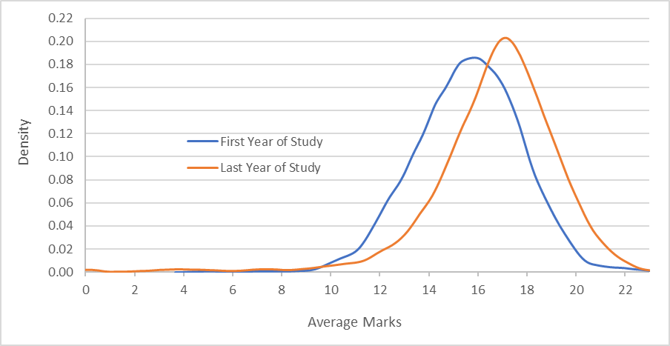
Figure 1 Distribution of average marks for all students in their first and last year of study (sample size = 2,343)

Slide 8
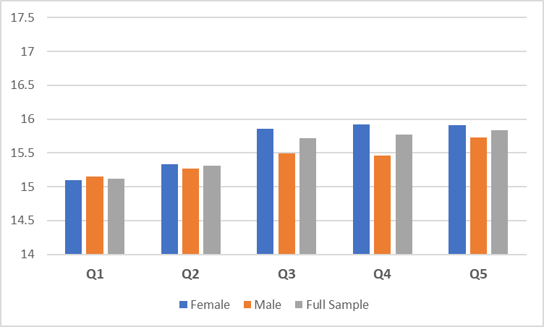
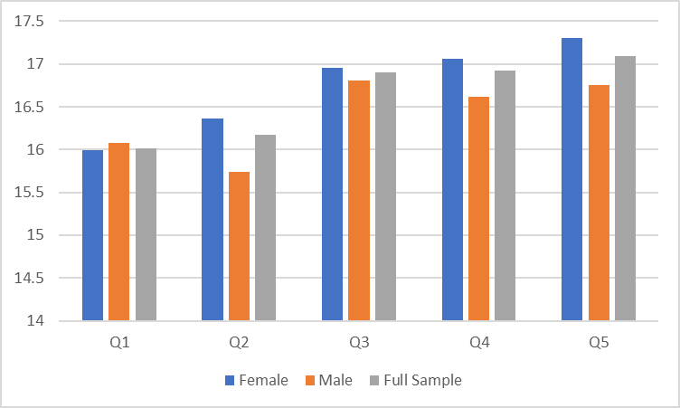
Figure 2 Mean Average Marks for the First Year of Study by Gender and SIMD Quintiles
Figure 3 Mean Average Marks for the Final Year of Study by Gender and SIMD Quintiles

Slide 9
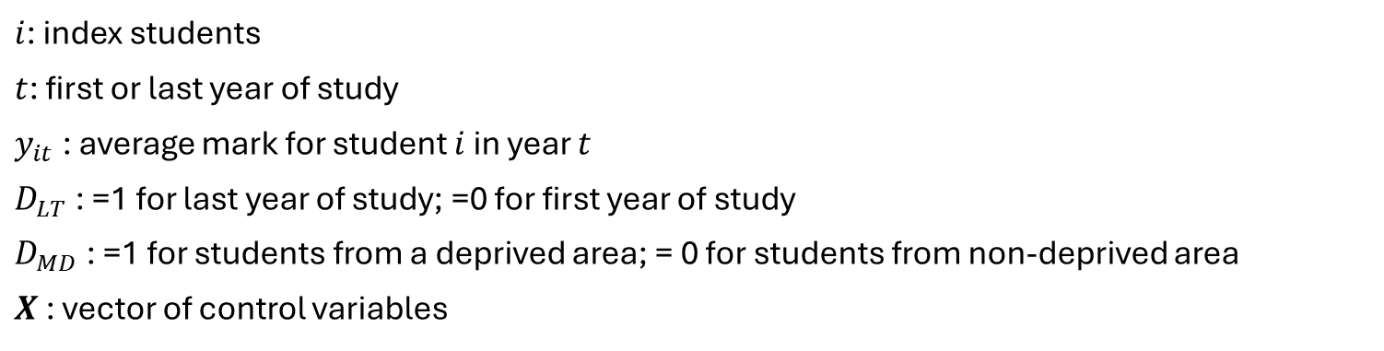
Empirical Strategy
Difference-in-differences (DiD) with fixed effects
Deprivation definitions: Q1; Q2; or Q1 ∪ Q2; Comparison group: Q3–Q5 or Q5 only.
Controls: gender, age, programme of year, entry level, exit level, start-year, reported disability
$$y_{it}=β_{0}+β_{1}D_{LT}+β_{2}D_{MD}+β_{3}D_{LT}D_{MD}+β_{4}X+ε_{it}$$
$i$: index students
$t$: first or last year of study
$y_{it}$: average mark for student $i$ in year $t$
$D_{LT}$: =1 for last year of study; =0 for first year of study
$D_{MD}$: =1 for students from a deprived area; = 0 for students from non-deprived area
$X$: vector of control variables

Slide 12
Limitations
Area-based measure of deprivation may misclassify non-deprived individuals; individual socioeconomic status not observed.
Single-institution context may limit generalisability.
SIMD updates and data zone changes addressed via cohort fixed effects but not fully eliminable.
Potential unobserved heterogeneity remains.
Notes:
SIMD 2020: https://simd.scot/#/simd2020/BTTTFTT/9/-4.0000/55.9000/

Slide 13
Conclusion and Policy Implications
Key finding
Students from more deprived areas do not close the attainment gap by graduation.
Everyone improves, but improvement is smaller for deprived groups.
Implications for universities
Admissions alone are not enough; outcomes require in-programme support
Implications for government and the sector
Monitoring should track progression and attainment, not only entry.
Tie a portion of widening-access funding to progression/attainment metrics to sustain support beyond admissions.
Earlier intervention: invest in school-level preparation and transition programmes to reduce pre-entry gaps.

