Slide 1
How is the role of teaching-focused academics evolving in UK economics departments?
DEE
September 2025
Cloda Jenkins (Imperial College), Christian Spielmann (University of Bristol), Fabio Aricò (University of East Anglia), Alvin Birdi (University of Bristol), Caroline Elliott (University of Warwick) & Ashley Lait (The Economics Network)

Slide 2

The Birth of the Project
Increasing prevalence of teaching-focused academics since 2000
Intriguing but unclear career alternative to traditional research positions
April – July 2023: qualitative interviews, literature review and baseline survey with international economics focus: UK, Canada and US
A research team of 10 academics from 3 countries.
Aims of the baseline study:
Describe the landscape of teaching-focused positions in US, Canada, and UK
Understand perceptions of economists in these positions and the impact they have
Discover successes, challenges, and opportunities

Slide 3



Key Themes of Initial Research
International Results:
Trailblazing career path
UK & Canada greater job security
Lack of promotion criteria clarity
Perceptions of relative value
UK Results:
Importance of administration roles
Importance of networking beyond departments
Workload concerns
What is SoTL and lack of time to spend on it

Slide 4
The 2025 UK Pulse Survey
Keep track, with regular surveys, of how the landscape and experience of teaching-focused economics academics continues to evolve
Hone in on the UK experience
Pulse survey consists of a selection of baseline questions and new questions (2025 focus: financial challenges in UK HE, collegiality and networks)
March 2025: contacted teaching-focused academics, using web search and personal knowledge
Descriptive analysis of survey results today

Slide 5
We had 67 respondents in 2025, spread across different university types
Removed 4 responses from project team
Notes:
Removed project team responses – consistency with previous research
93 UK respondents previously (but not all the same respondents)

Slide 6
The gender split differs between 2023 and 2025 surveys – respondents or on the ground?

Slide 7
A mix of titles are used for teaching-focused economists, with some clustering of titles
Notes:
Lecturer/Assistant/Teaching Fellow: 50%
Senior Lecturer/Associate/Senior Teaching Fellow/Reader: 43%
Professor: 5%
Other: 3%

Slide 8
Increasing majority on permanent contracts
Notes:
Permanent went from 79% in 2023 to 88% in 2025
One year or less went from 5% I 2023 to 2% in 2025.

Slide 9
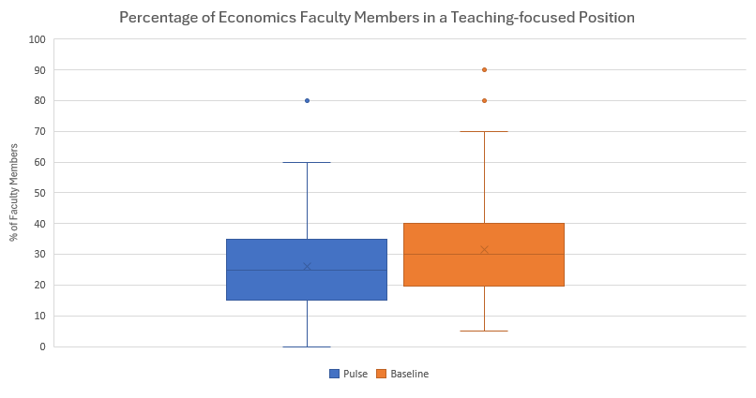
Teaching-focused faculty make up on average 27% of economics departments, with a small drop since 2023
Notes:
Mean: 27% 2025 and 32% 2023
Range also dropped from 20-40% to 15-35%

Slide 10
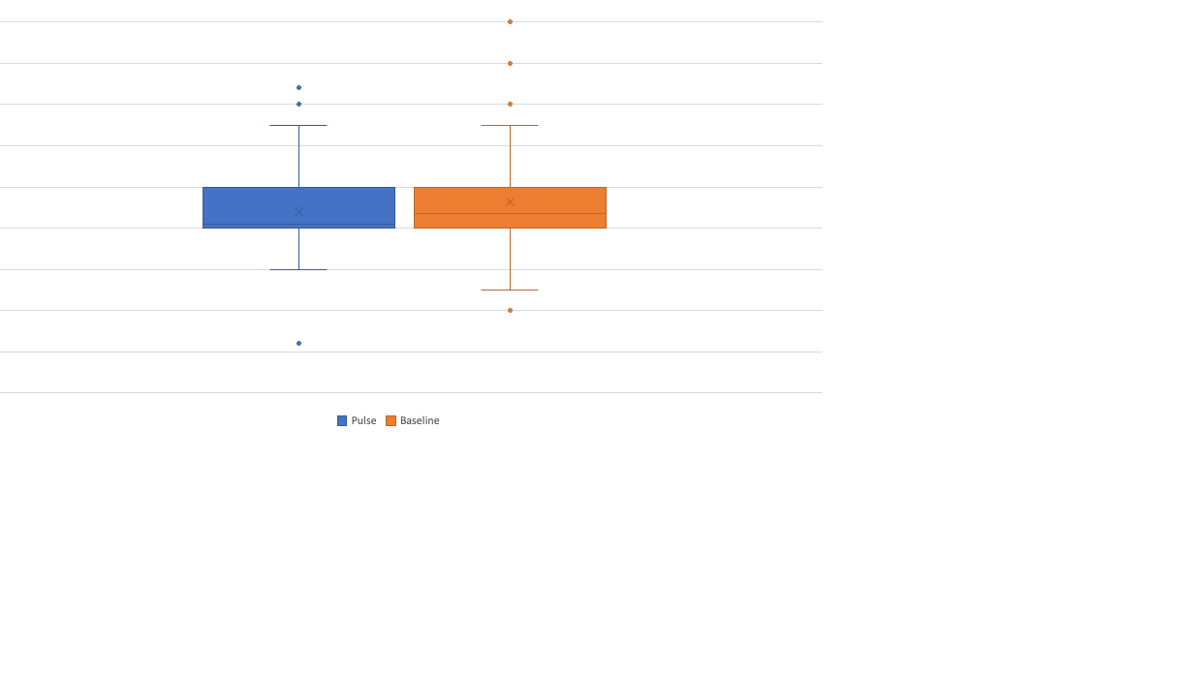
Teaching-focused faculty continue to work long hours
Notes:
Mean 2023 was 46.26 hours and 2025 was 44.12; range is 40-50 hours in both surveys

Slide 11
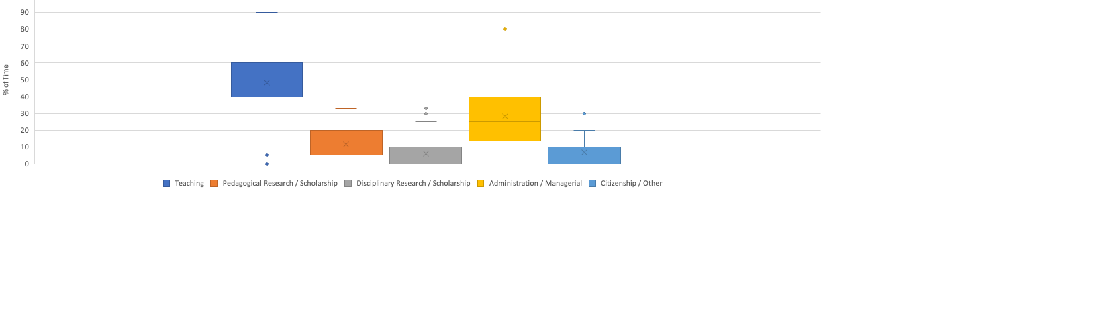
Teaching-focused faculty are contracted to spend most of their time on teaching and admin
PULSE SURVEY | Teaching | Pedagogical Research / Scholarship | Disciplinary Research / Scholarship | Administration / Managerial | Citizenship / Other
Mean | 49.33 | 11.05 | 6.43 | 27.36 | 6.44
Median | 50 | 10 | 0 | 25 | 5
BASELINE | Teaching | Pedagogical Research / Scholarship | Economic Research / Scholarship | Administration / Managerial | Service / Citizenship | Other
Mean | 49.45 | 10.43 | 11.43 | 19.15 | 9.28 | 2.46
Median | 50 | 10 | 10 | 20 | 10 | 0
Notes:
Highlight changes to time spent on:
Disciplinary research
Administration / management

Slide 12
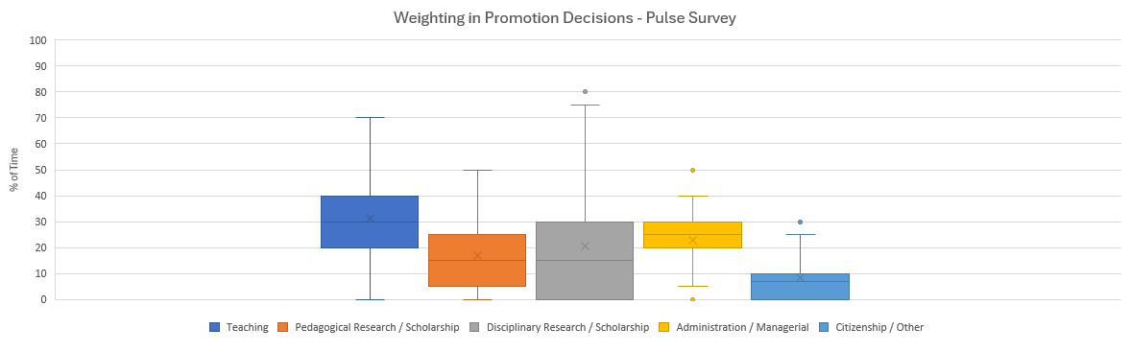
Respondents think more weight is placed on research and scholarship in promotion than is allocated in workload and that they have actual time for
PULSE SURVEY | Teaching | Pedagogical Research / Scholarship | Disciplinary Research / Scholarship | Administration / Managerial | Citizenship / Other
Mean | 31.36 | 17.00 | 20.42 | 22.98 | 8.31
Median | 30 | 15 | 15 | 25 | 7

Slide 13
Teaching-focused economists feel less of a sense of community with their department research-focused colleagues than in 2023

Slide 14
Survey respondents feel like they have job security but are less sure of finding a similar job elsewhere in 2025 compared to 2023
Divide with some finding promotion criteria clear and others not
Notes:
Result of climate in HE – cuts, general financial constraints

Slide 15
Teaching-focused economists are broadly satisfied with their job, but less so with pay and with extent to which they are valued by research-track colleagues.
Notes:
Story of no change in some ways but given work to try and get change so more respect that is not positive

Slide 16
Pulse survey respondents have access to resources to support their roles

Slide 17
Not surprisingly in 2025, budgetary constraints are being discussed more, with slightly less of an impact on those teaching in Business Schools
Notes:
Think data relates to Q21: is your department discussing budgetary constraints in 2024/25 more than in the past?

Slide 18

This Photo by Unknown Author is licensed under CC BY
Notes:
Suggest ask room what they are taking away

Slide 19
Conclusions (1)
Teaching track in economics a viable career alternative to traditional academic pathway giving job satisfaction
BUT
Mismatch between practice and requirements for promotion - can lead to frustration and a sense of relative inferiority.
- Practice - very large teaching component & seen by leaders and colleagues as primarily teaching support
- Promotion requirements –high quality scholarship, research and specialised leadership; time allocation and resources are insufficient.
Notes:
Additional note on diversity:
On (1) we can add (from HESA data, cf the Women's Committee report) that the pathway is notably more diverse than the traditional pathway (despite our particular sample this time round). However, this diversity is still very much in the pipeline and is low at senior levels. Dealing with the mismatch noted previously will improve diversity in the profession.

Slide 20
Conclusions (2)
Sense of not being valued by colleagues on traditional track
Slight fall in connecting with teaching-focused colleagues
- could be sample issues
- could be related to employment & budget (e.g. conference fee) issues
Notes:
Lessons for HoDs as well as providing confidence to ask for:
Clarity on promotion criteria
Resources and support
Thank you for coming but also importantly thank you for completing the survey

Slide 21

Conclusions
Rewarding career choice
Importance of feeling valued
Importance of networking
Promotion criteria
Resources and support
Challenging time for sector
Plans
Continue conversations with CHUDE
Share details in a report
Notes:
Lessons for HoDs as well as providing confidence to ask for:
Clarity on promotion criteria
Resources and support
Thank you for coming but also importantly thank you for completing the survey

Slide 22
Relevant Literature
Aricò et al. (2024 a, b) AEA P&P
Godbold et al. (2023) Journal of Higher Education Policy and Management
Smith & Walker (2022) Innovations in Education and Teaching International
Hilmer & Hilmer (2020) Economics of Education Review
Notes:
Godbold et al. – Australia
Smith & Walker – UK
Hilmer & Hilmer – US + Economics focus

