Slide 1

AI Tutors for Mathematical Instructions in Economics Courses
INERME Conference 2025
Daniel Göller daniel.goller@uia.no
Ida Landgärds-Tarvoll ida.landgards@uia.no

Slide 2
Research Questions Guiding our Project
How do students perceive the use of AI tools—specifically LLM—for solving mathematical exercises? (Phase 1)
What do students perceive as instructional strengths and limitations of AI-generated explanations compared to traditional teaching methods in large-group settings? (Phase 1)
Does the integration of AI as a learning aid lead to measurable improvements in student comprehension and performance compared to traditional materials, when evaluated under controlled conditions? (Phase 2)

Slide 3
Our Project Consists of two Distinct Phases
Phase 1: Exploratory Implementation & Evaluation
Context: AI used during lectures to solve exercises live in front of students in the “Mathematics for Economists” course.
Student Interaction: Encouraged to engage with both AI and lecturer.
Evaluation:
Structured survey (quantitative + qualitative)
Focus group discussion with student representatives
Key Findings:
Mixed motivation impact
AI explanations often clear but less preferred than human instruction
Visual presentation and pacing matter in lecture settings

Slide 4
Our Project Consists of two Distinct Phases
Phase 2: Controlled Intervention (Post-Conference)
Design: Randomized Controlled Trial (RCT)
Setup:
Intro to AI and prompting for all students
Lecture on some microeconomics topic
Random assignment:
Group A: ”Traditional materials”
Group B: AI-assisted learning
Assessment: Digital test without tools to measure learning outcomes
Goal: Identify causal impact of AI vs. traditional aids

Slide 5
Selected Insights from the Literature on AI in Education
Xing et al. (2025), International Journal of Artificial Intelligence in Education → Editorial outlines three major strands: feedback automation, fine-tuning, adaptive learning → Gap identified: Little focus on AI use in live lectures or group instruction — our study addresses this
AI Tutors in 1:1 Settings Chowdhury et al. (2025), arXiv preprint → AI outperforms human tutors in empathy and scaffolding in text-only tutoring
LLMs vs. Traditional Math Tools Matzakos et al. (2023), International Journal of Emerging Technologies in Learning (iJET) → LLMs show pedagogical advantages but limited computational reliability

Slide 6
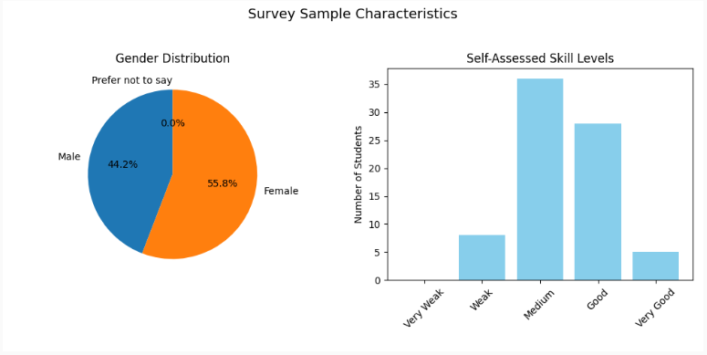
Survey Sample Overview – Course: MA-138 “Matematikk med anvendelse i Økonomi”

Slide 7
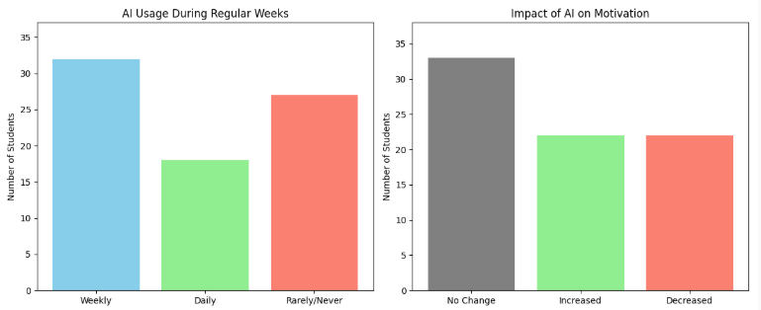
How Do Students Use AI — and How Does it Affect Their Motivation?
Note: AI usage increases during exam periods — more students report using it 3–4 times per week or daily.

Slide 8
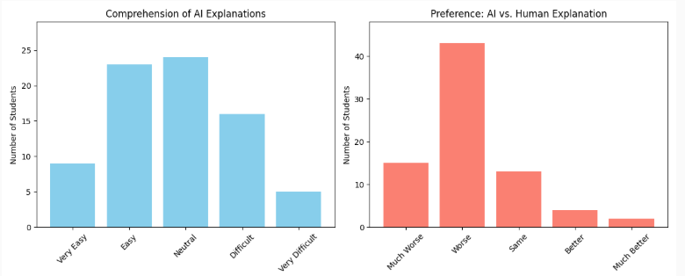
How Well Do Students Understand AI Explanations — and Do They Prefer Them?

Slide 9
Students report understanding AI explanations — but still prefer human instruction.
Insights from Focus Group Discussions:
AI explanations often appear as dense blocks of text.
In contrast, human instructors use well-designed slides that:
Structure information clearly
Use layout, color, and emphasis to guide attention
This makes human explanations easier to follow in a lecture setting, even if AI explanations are logically clear.

Slide 10
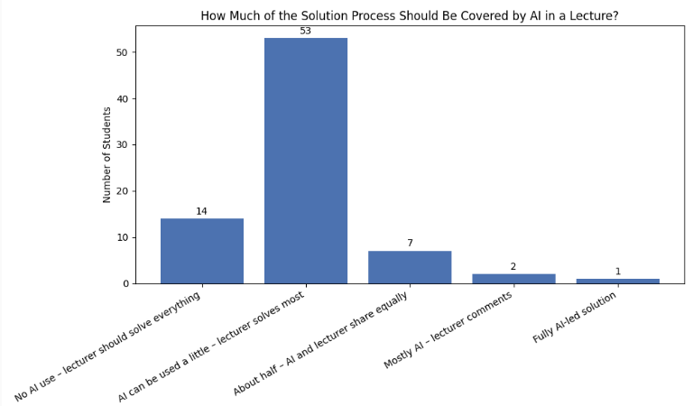
How Much of the Solution Process Should Be Covered by AI?
Students clearly favor a supportive role for AI, not a replacement — emphasizing the importance of the lecturer’s active role.

Slide 11
Conclusion and Discussion
1. Students use AI regularly, especially during high-stakes periods
2. AI explanations are often understood — but not preferred
Presentation format matters
Students value well-designed slides and structured delivery
Dense AI text blocks hinder accessibility in large lecture settings
4. Students want AI to play a supportive role
69% prefer AI to assist (a little), but not replace, the lecturer
5. Implication for Phase 2
Students use AI as a learning aid when practicing exercises.
A randomized controlled trial (RCT) will be conducted to evaluate its impact.

