Slide 1


Mathematics in economics: marginal or integral?
Duncan Lawson
Xxxxxxx

Slide 2
Overview
A bit of history
Dissenting voices
Mathematics in economics degree programmes
Conceptualising mathematics in economics
Mathematical Competencies
Implications for teaching
Questions rather than answers

Slide 3
A bit of history
Léon Walras is widely regard as the early pioneer of the use of mathematics in economics through his 1874 book Éléments d’Économie Politique pure ou Théorie de la Richesse sociale
“Most national economists have no idea about the mathematics, and only know the basic arithmetic operations … They are wrong! The application of mathematics in economics is to consider utility, output, effective demand, effective supply, price, etc as quantities, and to reason about how these are related.”
Translation by Jaffé (1971), quoted by Feudel (2024)

Slide 4
A bit more of history
Significant advances in use of mathematics in economics in mid-20th century, notably by future Nobel Laureate Paul Samuelson Foundations of Economics Analysis based on his PhD thesis.
Mathematics features strongly in the work of several other Nobel Laureates such as Debreu, Simon, Krugman, Buchanan and famously (due to Hollywood) Nash

Slide 5
The rise and rise of mathematics
Stigler, Stigler & Friedland (1995) carried out what would today be called a bibliometric analysis, looking at publications in leading economics journals. They classified articles published in five leading economics journals according to the highest level of technique in the article
Time | Primarily verbal techniques | Geometry | Algebra or econometrics | Calculus or more advanced techniques
1892-93 | 95 | 3 | 2 | 0
1922-23 | 95 | 1 | 2 | 2
1962-63 | 33 | 8 | 13 | 46
1989-90 | 5 |  | 39 | 56

Slide 6
Dissenting voices
Question posed in an online forum: “Is math really indispensable for economics?”
Drew the response “Mathematics helps to make any discipline look more scientific, even when it isn’t”.
According to Cord (2011) Keynes had an “aversion to applying mathematics to economics” (although others have challenged this)
A controversial paper by Lawson (2009) (no relation) on the 2008 financial crisis asserted: “For many years now, economic policy analysis emanating from the academy has been framed mostly in terms of properties of mathematical deductivist models. This modelling activity has not provided too much insight.”

Slide 7
Dissenting voices
On a visit to the London School of Economics in 2008, Queen Elizabeth II asked why economists had not spotted the impending financial crisis.
Responses to that question are broadly polarised into two camps
The mathematical models used were too simplistic – more complex mathematics is needed
There is an over-reliance on mathematics to the exclusion of other evidence such as history, anthropology, sociology and other social sciences
“Better maths will help, but what will help more would be to allow economics to become an eclectic subject again.” (Kitson, 2014)

Slide 8
Economics degree programmes
The debate does not seem to have affected economics degree programmes
London School of Economics:
Having a good grasp of mathematics is key to understanding modern economics
Iowa State University Economics Department:
You are obviously aware of the indispensable role of mathematics in economics

Slide 9
Economics degree programmes
What’s the role of mathematics in an economics degree programme?
QAA Subject Benchmark Statement 2023 suggests a typical programme level learning outcome might be
An understanding of verbal, graphical, mathematical and econometric representation of economic ideas and analysis
How might such a learning outcome be achieved?

Slide 10

Conceptualising mathematics in economics
The Toolbox
You select the right “mathematical tool” for the task in front of you
You might need the “straight line tool” for one task, the “calculus tool” for another
Requires students to be able to identify which tool they need for which problem
Also needs them to be able to transfer knowledge from one domain to another

Slide 11
Problems with the toolbox
Philosophically, it suggests teaching
mathematics in abstract – you might use
straight lines in many different places, if taught
in a single context may restrict student thinking
Students have difficulty transferring knowledge
from one domain to another
May put focus on procedures rather than understanding (how rather than why)
Presents mathematics as a set of discrete activities rather than as a whole

Slide 12

A way of thinking
Rather than focusing on a set of methods and techniques, presents mathematics holistically
Explicitly consider linkages between different mathematical activities
Mathematics as a way of being a better economist, not as something external that is artificially bolted onto economics

Slide 13
Mathematical competencies
Ground-breaking work by Niss (2003) (the Danish KOM project) further developed in Niss & Højgaard (2019)
Definition: Mathematical competence is someone’s insightful readiness to act appropriately in response to all kinds of mathematical challenges pertaining to given situations
The authors propose a set of eight mathematical competencies divided into two sets of four

Slide 14
Mathematical competencies (cont)
Posing and answering questions in and by means to mathematics
C1: Mathematical thinking competency
Engaging in mathematical inquiry
C2: Mathematical problem handling competency
Posing and solving mathematical problems
C3: Mathematical modelling competency
Analysing and constructing models of extra-mathematical contexts and situations
C4: Mathematical reasoning competency
Assessing and producing justification of mathematical claims

Slide 15
Mathematical competencies (cont)
Handling the language, constructs and tools of mathematics
C5: Mathematical representation competency
Dealing with different representations of mathematical entities
C6: Mathematical symbolism and formalism competency
Handling mathematical symbols and formalism
C7: Mathematical communication competency
Communicating in, with and about mathematics
C8: Mathematical aids and tools competency
Handling material aids and tools for mathematical activity

Slide 16
Content free mathematics?
Niss and colleagues are trying to set out what it means to be mathematically competent in generic terms “independent of specific mathematical subject matter as well as specific educational levels”
They are clear that subject matter is vitally important: “the fact that mathematical competence can neither exist without mathematical subject matter nor be reduced to a specification of that subject matter suggests that there is an intricate relationship between competence and subject matter that needs to be addressed.”

Slide 17
Implications for teaching
How do existing learning outcomes measure up to developing mathematical competencies.
Here are the LOs for a 1st year Maths for Economics module I found
On completion of this module students should be able to:
  Apply mathematical concepts and techniques to solve complex economic problems
  Use calculus to solve unconstrained and constrained optimisation problems in economics
  Analyse and interpret function properties
  Perform basic operations in matric algebra and solve systems of several simultaneous equations.

Slide 18
Implications for teaching
If we focused on developing mathematical competencies in an economics setting (subject matter content in the language of Niss) we might:
  Put less emphasis on procedures and more emphasis on understanding
  Have less content
  Focus on how mathematical concepts align with economics concepts
  (e.g. elasticity, marginal)
  Spend more time exploring the importance of assumptions underlying mathematical models in economics
  Ensure consideration is given to the significance of parameters (for example, what happens if we vary the exponents in a Cobb-Douglas model)
  Strengthen collaboration between mathematics and economics departments
  Set assignments that assess what really matters rather than what is easy to mark

Slide 19

What about C8?
C8: Mathematical aids and tools competency

Slide 20
What about C8?
I gave CoPilot the following prompt
A consumer has a utility function of U=x^0.4 * y^0.6. The price of good x is £0.5 and the price of good y is £1. The consumer has income of £30. What is the optimal bundle of goods?

Slide 21
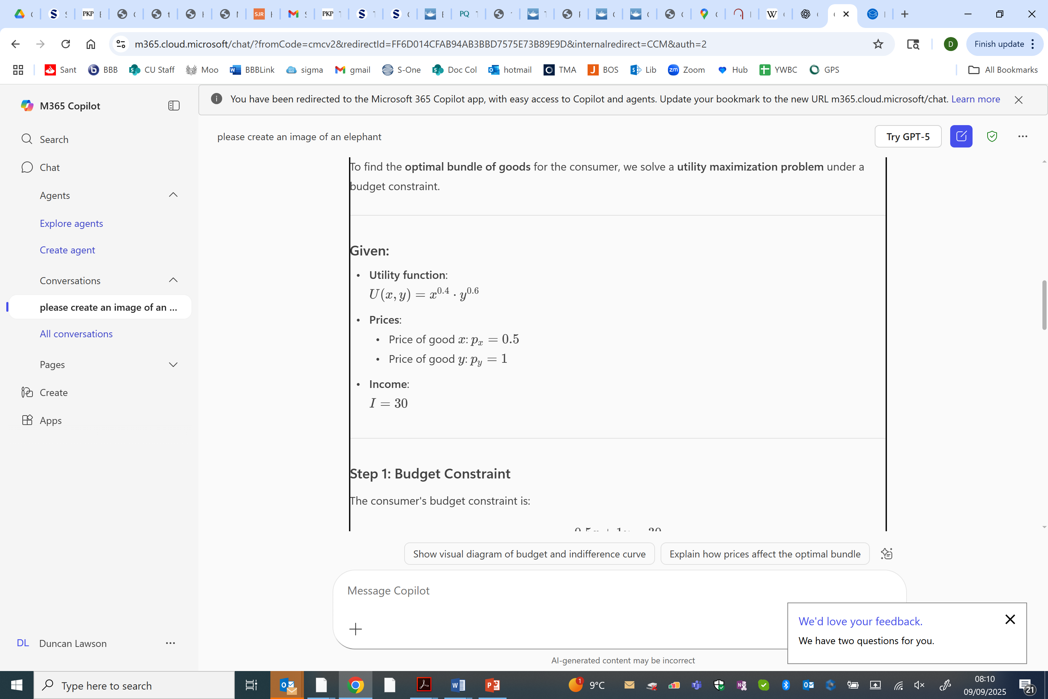
What about C8?

Slide 22
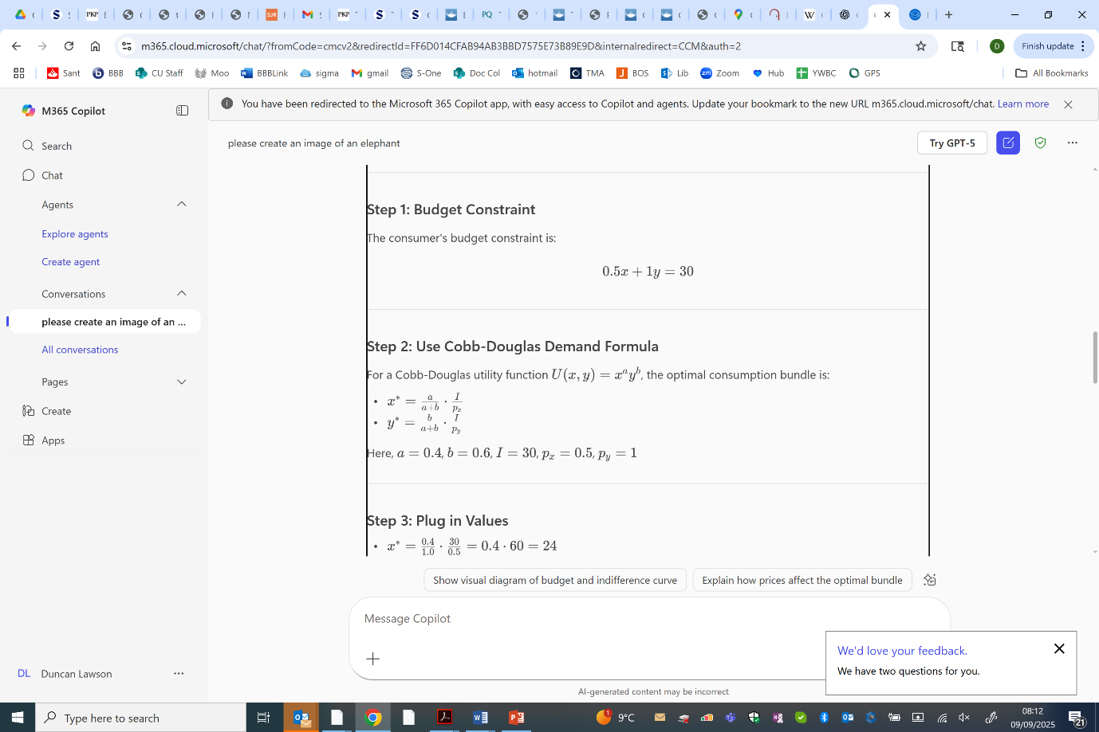

Slide 23
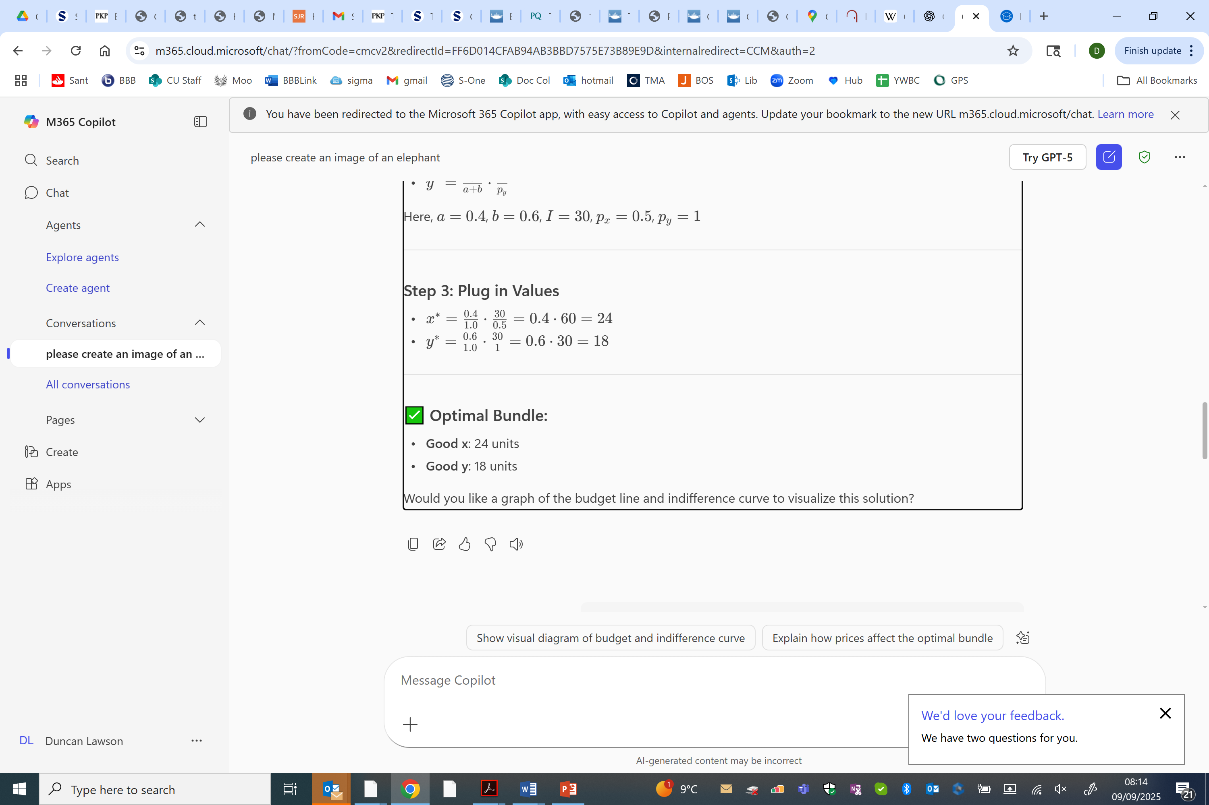

Slide 24
What do we want students to do in a world of AI?
Is there still a value in teaching procedures?
How do we encourage productive use of AI?
What is productive use of AI?
There is a message in small letters across the bottom of the AI screen saying “AI-generated content may be incorrect”. How do we teach our students to recognise when this has happened?

Slide 25

Thank you.

