Slide 1


Conferences for educators: education research and teaching
International Network for Educational Research on Mathematics in Economics (INERME) 2025
Char Leung, PhD FHEA Cstat
Leicester Medical School, Department of Population Health Sciences
University of Leicester

Slide 2

About me… (also why I’m here!)
B. Arts (Politics)/ B. Econ (Hons 1) (La Trobe, Australia)
PhD (Econometrics) (La Trobe, Australia)
JLL & Colliers International (real estate market data)
Postdoc in virology and public health (HKU & CUHK, HK)
MPhil (Population Health Sciences) (Cantab)
Lecturer of Medical Statistics and Epidemiology (Leicester)

Slide 3
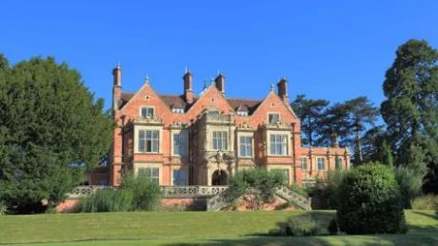
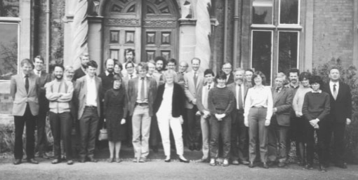

Burwalls: the history
A building in Bristol
April 1979: Manchester
April 1980 & 1981: Bristol
1980: 24 participants from different medical schools
Led to publications in the BMJ
Revived in 2001

Slide 4


Burwalls in brief
Network for teachers of statistics in health and life sciences
Committee
Conferences, working groups, and seminars

Slide 5
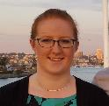
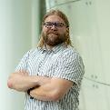
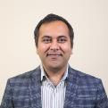
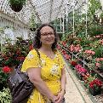
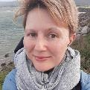
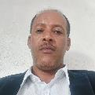
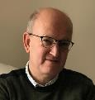


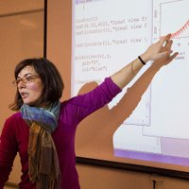
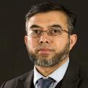
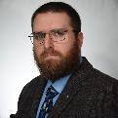
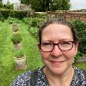
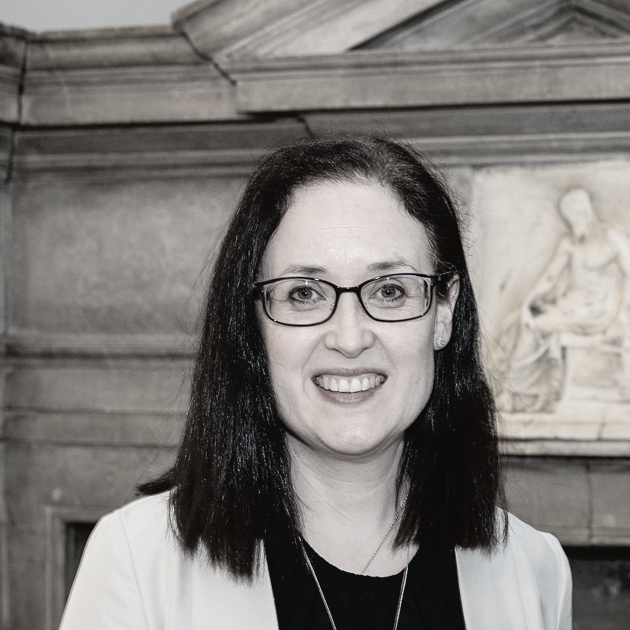
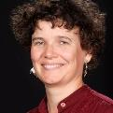
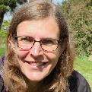
The committee
Chair & Deputy Chair
Secretary & Treasurer
Event Coordinator & committee members

Slide 6
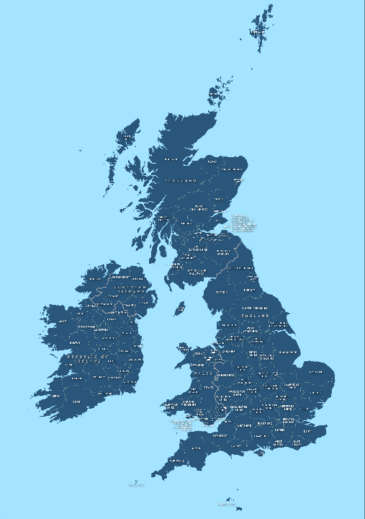
Conference
Research in teaching statistics
Introducing teaching strategies, tricks, issues, etc.
2014
2011
2018
2022-23
2009
2025
2012, 2024
2007
2010, 2026
2017
2019
2020-21
2013
2001-06, 2008
2015
2016

Slide 7



Working groups
Dental statistics
Public health
Artificial intelligence

Slide 8
Teaching statistics in medicine and health sciences
Education in statistics (compared to undergrad eco & fin students)
  Limited in most health sciences courses
  Almost none in medicine
A strong focus on cause-and-effect (also see Bradford Hill criteria)
  Model building and calibration with data in eco & fin
Adherence to study design and pre-determined hypotheses
  Mitigating biases (missing data, selection bias, etc)
  Adjusting for confounding

