Slide 1
Preparedness and Perception: Investigating the Influence of A-Level Mathematics on Economics Undergraduates
International Network for Educational Research on Mathematics in Economics (INERME)
September 2025
Dr Karishma Patel (Aston University) & Dr Adam Thompson (Aston University)

Slide 2
UK Education System Structure
Secondary – School (compulsory)
  Age: 11-16
  Qualification: GCSEs
  Maths compulsory
Further Education – College/Sixth Form
  Age: 16-18
  Qualifications: A-Level (alternatives such as BTEC or T Levels etc.)
  Maths optional – if taken, then also covers topics in statistics and mechanics
Higher Education (HE) – University/HE provider
Notes:
https://assets.publishing.service.gov.uk/media/5a7ef84040f0b62305b8450d/Additional_text_SR45_2014.pdf
The further education (optional) is a bit of a weird one as they do legally have to remain in education until 18, but they don’t have to be in school, they can get vocational training.

Slide 3
Aston University Background
Offers several degree programmes in economics:
  BSc. Economics
  BSc. Economics and Management
  BSc. International Business and Economics
Aston does not require prior study of A-level Maths to enroll in any of its economics programmes
The first year of all economics degree programmes include compulsory modules in:
  Quantitative Modules (Mathematics for Economics & Statistics for Economics)
  Economics Modules (Micro, Macro & Applied Topics)
Notes:
I think we should assess the full economics degrees only – I think incorporating maths with economics and politics and economics is too wide
Offers modules to equip students with the necessary mathematical skills needed to understand and apply economics.

Slide 4
Motivation
“
I really want to study economics, but maths isn’t my best subject.
Maths is one of the most important subjects for an economics application, but it’s not always a requirement. There are normally only a couple of maths intensive modules, and less so for a BA as opposed to a BSc.
UCAS (Undergraduate admissions service)
Approx. 25% of economics degree programmes require maths A-level
Discover Economics
Approximately 25% of economics degree programmes require maths A-level
Discover Economics
”

Slide 5
Background – Academic Preparedness
Outside of UK context some evidence of positive relationship between prior study of mathematics and performance on economics degrees (e.g. Arnold and Rowaan, 2014 and Ballard and Johnson, 2004).
Relatively fewer studies in the UK context & evidence appears more mixed (e.g. Lumsden and Scott, 1987 and Jones, 2013).
Limited studies post 2017 A-level Maths reforms
Importance of academic preparedness may be relevant when considering student experience, retention and progression.
Notes:
Advanced British Standard for 16-19 year-olds, a new Baccalaureate-style qualification that takes the best of A-levels and T-levels and brings them together into a single qualification (Department for Education, 2023) ------- On 29 July 2024, Rachel Reeves, Chancellor in the new Labour government, announced the Advanced British Standard would not be going ahead. She highlighted the planned cost and said “if we cannot afford it, we cannot do it.”

Slide 6
Background – Perceptions of Own Ability
Self-perception can shape outcomes independently of actual ability (e.g. Everingham et al., 2013).
UK Economics students tend to see A-Level Mathematics as good preparation for their degree (Darlington and Bower, 2017).
Economics Network Annual Surveys have indicated that students without A-Level Mathematics are more likely to feel their degree falls short of expectations, citing mathematical content as a key concern.
Mathematical confidence, when controlling for ability, strongly predicts economic performance (Al-Bahrani et al., 2018).
Limited studies focusing specifically on economics students' perceptions of mathematical ability
Students' self-belief may significantly shape engagement, achievement and the overall academic experience.
Notes:
Advanced British Standard for 16-19 year-olds, a new Baccalaureate-style qualification that takes the best of A-levels and T-levels and brings them together into a single qualification (Department for Education, 2023) ------- On 29 July 2024, Rachel Reeves, Chancellor in the new Labour government, announced the Advanced British Standard would not be going ahead. She highlighted the planned cost and said “if we cannot afford it, we cannot do it.”

Slide 7
Research Questions
Student Perceptions
RQ1: How do first-year economics students’ perceptions change over the course of their first year, and how do these changes differ between students with and without A-Level Mathematics?
Student Performance
RQ2: To what extent does studying A-Level Mathematics predict first-year academic performance in economics and quantitative modules, and how does this align with students’ self-perceptions?

Slide 8
Methodology – RQ1 (Perceptions)
Data Collection
Timing:
Survey 1: September 2024
Survey 2: January 2025
Participants:
N = 49 matched students
25 with A-Level Maths
24 without A-Level Maths
Context:
First-year Economics modules
Key Variables
Perception Measures (5-point Likert scale):
Anxiety: “Maths makes me feel anxious”
Confidence: “I feel confident solving maths problems”
Ability: “I am better at maths than most peers”
Analysis
Descriptive Statistics:
Mean perception scores at T1 and T2
Group comparisons by A-Level Math status
Change Analysis (within subjects):
Paired-sample t-tests (e.g. Anxiety T1 vs T2)
Group Comparison (between groups):
Independent-sample t-tests
Notes:
Background Variables:
A-Level Mathematics (yes/no)
A-Level Economics (yes/no)
Age group, gender
Perceived importance of A-Level Maths

Slide 9
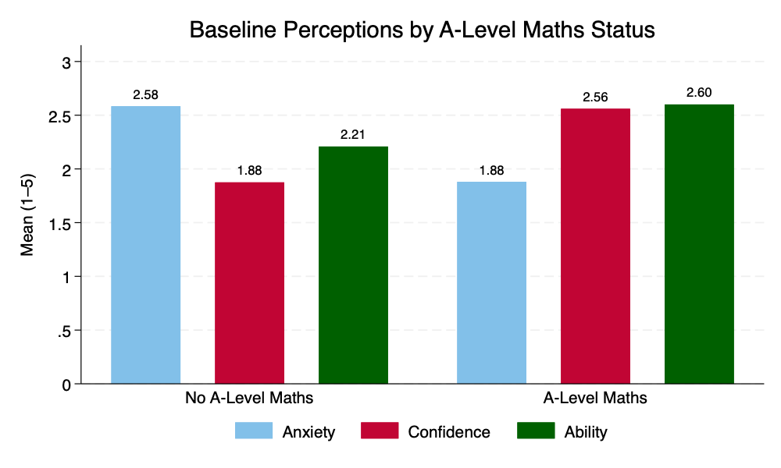
RQ1: Baseline Perceptions
Compared to their peers with A-Level Maths, students without A-Level Maths reported:
Higher Anxiety
Lower Confidence
Lower Perceived Ability
Notes:
All of which were significant at the 5% level.
These differences aren’t just directional — they’re statistically significant across all three measures. Even before any formal teaching begins, we see a clear confidence gap between these two groups.

Slide 10
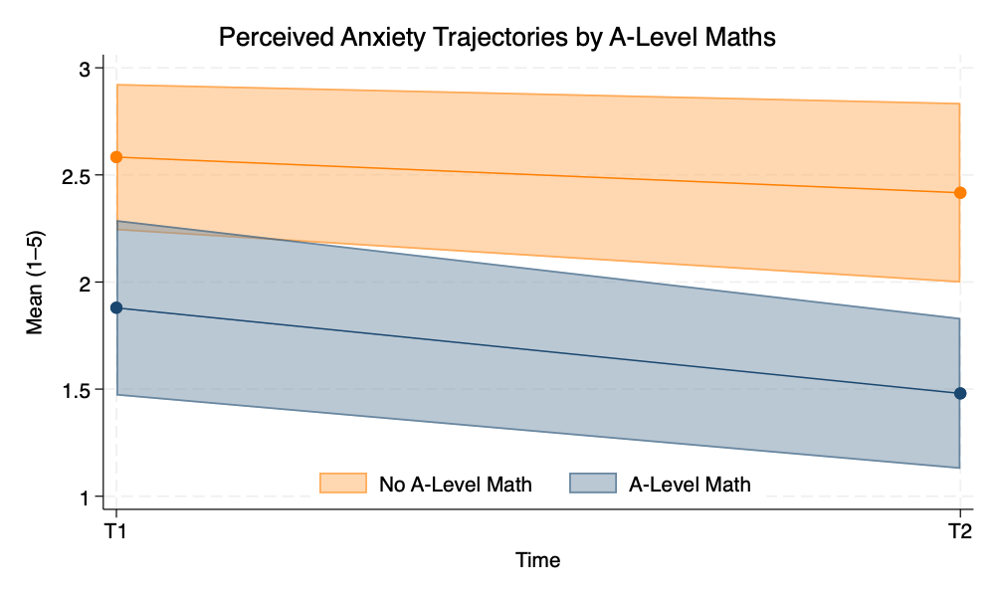
RQ1: Anxiety
Students without A-Level Maths started with higher anxiety at T1
Both groups improved, but the A-Level Math group showed a significant reduction (p = .020)
At T2, the anxiety gap remained large and statistically significant (mean diff = 0.94, p = .001)
2.58
2.42
1.88
1.48
Notes:
We found that, overall, students became less anxious about maths over the term — but when we break it down, only the students with A-Level Maths experienced a statistically significant drop. For those without A-Level Maths, anxiety levels decreased slightly, but not enough to be meaningful in statistical terms. So while anxiety improves overall, the gap between groups persists.
Key Results
Non A-level: Mean Q5a = 2.58; Mean Q5b = 2.41; d_Q5 = -0.17
A-level: Mean Q5a = 1.88; Mean Q5b = 1.48; d_Q5 = -0.4
For the cohort, anxiety decreased significantly, falling from 2.22 at entry to 1.94 at the end of the semester (mean change = –0.29, t(48) = –2.4, p = .022).
Students without A-level Maths, anxiety decreased but not significantly, falling from 2.58 to 2.42 at the end of the semester (mean change = –0.17, t(48) = –0.89, p = .38).
Students with A-level Maths, anxiety decreased significantly, falling from 1.88 to 1.48 at the end of the semester (mean change = –0.4, t(48) = –2.62, p = .02).

Slide 11
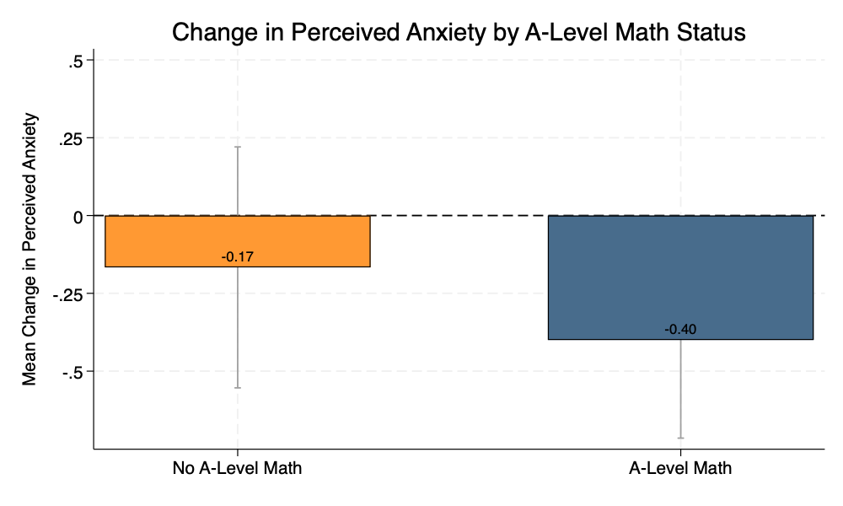
RQ1: Anxiety
Students without A-Level Maths showed a small, non-significant change (-0.17, p = .38)
Only students with A-Level Maths experienced a significant reduction in anxiety (-0.40, p = .020)
The difference in change between the two groups was not statistically significant (p = .34)
Notes:
While both groups saw anxiety decline, only the A-Level group’s reduction was statistically significant. The gap in anxiety perceptions remained and widened slightly by the end of the term.
Key Results
At T2 students without A-level Maths have significantly higher perceptions of anxiety when contrasted with students that have studied A-level maths with a mean difference of 0.94 (t(47) = 3.46, p = .001).
When contrasting the students without A-level maths with the students with A-level maths, there is no statistical difference between the changes in reported perceptions of anxiety (t(47) = 0.97, p = .34).

Slide 12
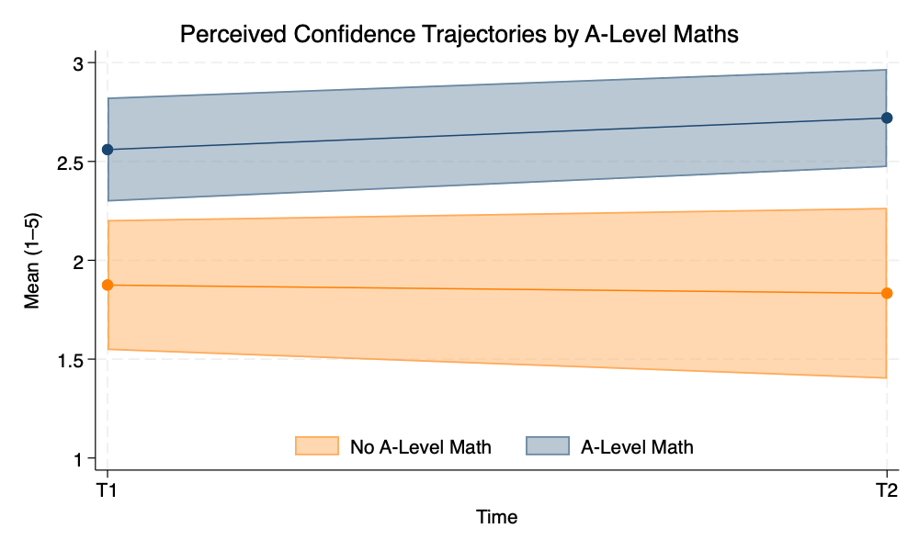
RQ1: Confidence
At T1, students with A-Level Maths reported significantly higher confidence than those without
Confidence increased slightly across the cohort, but not significantly (p = .61)
At T2, the gap remained statistically significant (mean diff = –0.88, p < .001)
2.72
2.56
1.88
1.83
Notes:
“We can see that confidence levels start out quite different between groups — and that difference remains at the end of the term. The A-Level group reports higher confidence at both time points, and while both groups show small changes, those changes aren’t statistically meaningful.”
Key Results
For the cohort, confidence increased but not significantly, rising from 2.22 at entry to 2.29 at the end of the semester (mean change = +0.06, t(48) = 0.52, p = .61).
Students without A-level Maths, confidence decreased but not significantly, falling from 1.88 at entry to 1.83 at the end of the semester (mean change = -0.04, t(48) = -0.24, p = .81).
Students with A-level Maths, confidence increased but not significantly, rising from 2.56 at entry to 2.72 at the end of the semester (mean change = +0.16, t(48) = 1.00, p = .33).

Slide 13
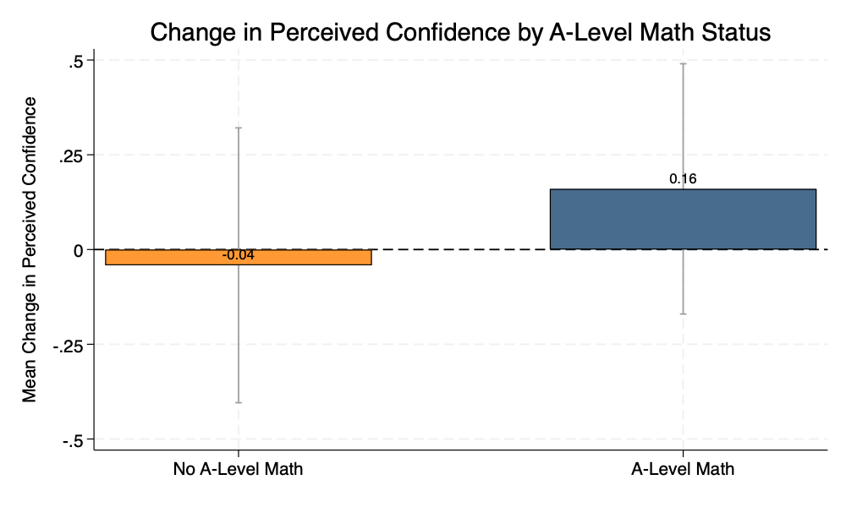
RQ1: Confidence
Students without A-Level Maths reported a small decrease (–0.04), also not significant (p = .81)
Students with A-Level Maths showed a small increase in confidence (+0.16), but it was not statistically significant (p = .33)
The difference in change between the two groups was not statistically significant (p = .40)
Notes:
Here we’re looking at how confidence changed from the start to the end of the term for each group.
For students with A-Level Maths, confidence increased slightly — but the change wasn’t statistically significant.
Interestingly, students without A-Level Maths saw a small decrease in confidence, though again, it wasn’t significant.
Overall, the difference in change between the two groups is minimal and not statistically meaningful, which suggests that the confidence gap we saw at the start of the year remains stable rather than narrowing.
Key Results
At T2 students without A-level Maths have significantly lower perceptions of confidence when contrasted with students that have studied A-level maths with a mean difference of -0.88 (t(47) = -3.63, p < .001).
When contrasting the students without A-level maths with the students with A-level maths, there is no statistical difference between the reported changes in confidence (t(47) = -0.85, p = .40).

Slide 14
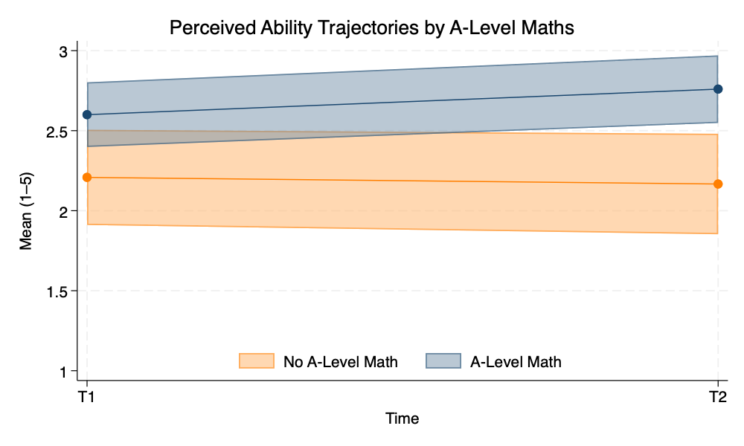
RQ1: Ability
2.76
At T1, students with A-Level Maths reported higher perceived ability than those without
Both groups showed slight changes over time, but neither change was statistically significant
At T2, the gap remained and was statistically significant (mean diff = –0.59, p = .002)
2.60
2.21
2.17
Notes:
Looking at self-reported mathematical ability, we again see that students with A-Level Maths begin the year more confident in their skills, and that gap persists over the semester.
While there’s a slight increase in ability ratings for the A-Level group and a slight decrease for the non-A-Level group, neither change is significant, and the gap between them remains statistically meaningful at the end of term.
Key Results
For the cohort, self-reported ability increased but not significantly, rising from 2.41 at entry to 2.47 at the end of the semester (mean change = +0.06, t(48) = 0.55, p = .58).
Students without A-level Maths, self-reported ability decreased but not significantly, falling from 2.21 at entry to 2.17 at the end of the semester (mean change = -0.42, t(48) = -0.25, p = .80).
Students with A-level Maths, self-reported ability increased but not significantly, rising from 2.6 at entry to 2.76 at the end of the semester (mean change = +0.16, t(48) = 1.07, p = .29).

Slide 15

RQ1: Ability
Students without A-Level Maths showed a slight decrease (–0.04, p = .80)
Students with A-Level Maths reported a small, non-significant increase in perceived ability (+0.16, p = .29)
The difference in change between the groups was not statistically significant (p = .37)
Notes:
When we look specifically at how perceptions of ability changed over time, neither group experienced a statistically significant shift.
The A-Level group showed a slight improvement, and the non-A-Level group a slight decline, but these changes are small and not meaningful in statistical terms.
Importantly, the difference in how much the groups changed was not significant either, so while the A-Level group continues to report higher ability, the gap isn’t narrowing — nor is it growing significantly.
Key Results
At T2 students without A-level Maths have significantly lower perceptions of ability when contrasted with students that have studied A-level maths with a mean difference of -0.59 (t(47) = -3.19, p = .002).
When contrasting the students without A-level maths with the students with A-level maths, there is no statistical difference between the reported changes in self-reported mathematical ability (t(47) = -0.91, p = .37).

Slide 16
Research Questions
Student Perceptions
RQ1: How do first-year economics students’ perceptions change over the course of their first year, and how do these changes differ between students with and without A-Level Mathematics?
Student Performance
RQ2: To what extent does studying A-Level Mathematics predict first-year academic performance in economics and quantitative modules, and how does this align with students’ self-perceptions?

Slide 17
RQ2: Descriptive Results
VARIABLES | N | Mean | Min | Max
Male | 574 | 0.71 | 0.00 | 1.00
Age | 574 | 18.26 | 17.00 | 24.00
A-Level Maths | 574 | 0.53 | 0.00 | 1.00
A-Level Further Maths | 574 | 0.01 | 0.00 | 1.00
A-Level Economics | 574 | 0.76 | 0.00 | 1.00
Overall Score (1st Year) | 574 | 61.84 | 0.60 | 82.54
Quant Score (1st Year) | 574 | 65.22 | 0.00 | 94.00
Economics Score (1st Year) | 574 | 59.58 | 1.00 | 80.10
Notes:
Descriptive stats – based on first years studying modules in...... in all three years across all programmes
A Level maths – 53 % of students do it
A Level further maths excluded from sample
Overall = BS1111, BS1112, BS1113, BS1197, BS1196

Slide 18
RQ2: First Year Overall
Score Results
 | (1) | (2) | (3)
VARIABLES | 2020/21 | 2021/22 | 2022/23
A-Level Math - Yes | 1.121 | -2.208 | 2.391
 | (1.611) | (2.385) | (1.991)
A-Level Econ - Yes | 2.349 | 0.297 | -1.775
 | (1.905) | (3.129) | (2.234)
Gender - Male | 1.157 | 0.073 | 0.342
 | (1.661) | (2.067) | (2.469)
Age | 0.786 | -0.009 | -0.303
 | (1.357) | (1.168) | (1.959)
Ethnicity - Arab | -19.484** | 9.912* | -8.390
 | (9.721) | (5.811) | (5.848)
Ethnicity - Asian | 1.624 | 6.330 | 1.033
 | (2.000) | (5.240) | (2.367)
Ethnicity - Black | -2.177 | 8.127 | 0.184
 | (2.745) | (5.021) | (2.760)
Ethnicity - Mixed | -3.410 | 7.795 | 2.140
 | (3.344) | (5.307) | (3.963)
Ethnicity - Other | -3.482 | 3.171
 | (3.215) | (12.593)
Constant | 47.702* | 50.849** | 64.355*
 | (25.377) | (24.283) | (35.128)
Observations | 252 | 163 | 159
R-squared | 0.055 | 0.043 | 0.068
Robust standard errors in parentheses
*** p<0.01, ** p<0.05, * p<0.1
Notes:
Is A-Level math a predictor of overall first year performance – No.

Slide 19
RQ2: First Year Quantitative Score Results
 | (1) | (2) | (3)
VARIABLES | 2020/21 | 2021/22 | 2022/23
A-Level Math - Yes | 0.870 | -2.376 | 1.470
 | (1.949) | (2.966) | (3.001)
A-Level Econ - Yes | 2.984 | -0.752 | -1.357
 | (2.339) | (3.660) | (3.564)
Gender - Male | 2.143 | 0.772 | 0.912
 | (1.993) | (2.867) | (3.663)
Age | 0.474 | 1.249 | -0.619
 | (1.510) | (1.472) | (3.177)
Ethnicity - Arab | -21.687*** | 8.774 | -8.417
 | (4.131) | (9.901) | (9.508)
Ethnicity - Asian | 2.425 | 6.531 | 0.984
 | (2.454) | (5.747) | (3.833)
Ethnicity - Black | -2.515 | 7.472 | -0.571
 | (3.288) | (5.723) | (4.427)
Ethnicity - Mixed | 0.887 | 5.148 | 2.149
 | (3.992) | (6.376) | (6.766)
Ethnicity - Other | -3.047 | -0.394
 | (4.652) | (14.970)
Constant | 59.429** | 29.656 | 69.046
 | (28.175) | (30.270) | (56.609)
Observations | 252 | 163 | 159
R-squared | 0.056 | 0.028 | 0.040
Robust standard errors in parentheses
*** p<0.01, ** p<0.05, * p<0.1
Notes:
Just looking at impact on stats and maths average result – not significant.

Slide 20
RQ2: First Year Economics Score Results
 | (1) | (2) | (3)
VARIABLES | 2020/21 | 2021/22 | 2022/23
A-Level Math - Yes | 1.288 | -2.096 | 3.005*
 | (1.522) | (2.288) | (1.578)
A-Level Econ - Yes | 1.925 | 0.996 | -2.054
 | (1.750) | (3.036) | (1.701)
Gender - Male | 0.500 | -0.393 | -0.037
 | (1.574) | (1.840) | (1.934)
Age | 0.994 | -0.847 | -0.093
 | (1.342) | (1.174) | (1.319)
Ethnicity - Arab | -18.015 | 10.670** | -8.372**
 | (13.879) | (4.927) | (3.730)
Ethnicity - Asian (All) | 1.089 | 6.195 | 1.066
 | (1.898) | (5.262) | (1.719)
Ethnicity - Black (All) | -1.951 | 8.564* | 0.687
 | (2.601) | (4.907) | (2.074)
Ethnicity - Mixed | -6.274* | 9.560* | 2.134
 | (3.561) | (5.063) | (2.909)
Ethnicity - Other | -3.772 | 5.548
 | (2.546) | (11.329)
Constant | 39.884 | 64.977*** | 61.228**
 | (25.182) | (24.330) | (24.061)
Observations | 252 | 163 | 159
R-squared | 0.053 | 0.069 | 0.096
Robust standard errors in parentheses
*** p<0.01, ** p<0.05, * p<0.1
Notes:
Impact on econ average
Mildly significant result at the 10 % level in 2022/23

Slide 21
At First Glance...
Student Perceptions
Perceptions of students with and without A-Level Mathematics are significantly different both at the start and end of term.
Student Performance
It appears that studying A-Level Maths is not a predictor for first year performance.
Student Performance
Applied Mathematics versus A-Level Mathematics Curriculum
Do A-Level Mathematics students overestimate their ability at the start of term?
Do non A-Level Mathematics students underestimate their ability at the start of term?
=> Rationale for targeted support?
Notes:
While anxiety of A-level maths students significantly decreases by the end of the first teaching term, the gap between A-level an dnon a level maths students remains significant.
Why?
Teaching & Support
Students' approaches to first year quants modules
Course-based approach
Covid-19
So what?
Entry requirements
Streaming of students based on A-Level Maths?
We wanted to see the impact of A levels on first year performance.
Why?
The support offered on the quantitative modules – PAL, LDC Support, Office Hours/ Drop-ins, Continuous Assessment
Integrating Micro/Maths and Macro/Stats.
Covid-19 Caveats
(1) and (2) assessment was online examination
Uneven application of the A-level curriculum

Slide 22
What’s Next?
Is A-Level Maths grade a predictor of first year performance?
Further consider the alignment between student performance and perceptions.
Widen sample to include other institutions?
Notes:
We’ve only looked at Aston, and moving forward it would be interesting to look at other Universities.
How do we incorporate grades? Continuous variable or Dummy variable for each grade. Interaction?

Slide 23
References
Al-Bahrani, A., Buser, W., and Patel, D. (2018). Does Math Confidence Matter? How Student Perceptions Create Barriers to Success in Economics Classes. Journal of Economics and Finance Education. 17(1), pp.61-77.
Arnold, I.J. and Rowaan, W., 2014. First-year study success in economics and econometrics: The role of gender, motivation, and math skills. The Journal of Economic Education, 45(1), pp.25-35.
Ballard, C.L. and Johnson, M.F., 2004. Basic math skills and performance in an introductory economics class. The Journal of Economic Education, 35(1), pp.3-23.
Darlington, E. and Bowyer, J., 2017. Students’ views of A-level Mathematics as preparation for degree-level economics. Citizenship, Social and Economics Education, 16(2), pp.100-116.
Everingham, Y., Gyuris, E., and Sexton, J. 2013. “Using Student Feedback to Improve Student Attitudes and Mathematical Confidence in a First Year Interdisciplinary Quantitative Course: From the Ashes of Disaster!” International Journal of Mathematical Education in Science and Technology 44(6), pp.877- 892.
Jones, C., 2013. The impact of prior study in economics and maths on first year performance.
Lumsden, KG., Scott, A. (1987). The economics student reexamined: Male–female differences in comprehension. Journal of Economic Education 18(4), pp.365–375.

Slide 24
Methodology – RQ2 (Performance)
Data Collection
Source:
Anonymised university data
Participants:
First-year Economics students (entire cohorts)
Included Data:
Module grades (Economics, Maths, Stats, Overall average)
A-Level qualifications and grades
Age, gender, prior Economics study, socio-economic status
Note: This dataset is separate from the perception survey and cannot be matched at the individual level
Key Variables
Dependent Variables:
Economics score = average of micro + macro modules
Quantitative score = average of maths + stats modules
Overall Year 1 average
Independent Variables:
A-Level Mathematics (binary: Yes/No)
A-Level Maths grade (A*, A, B, etc.)
Control Variables:
Age group
Gender
School background
A-Level Economics (Yes/No)
Analysis
Descriptive Statistics:
Compare mean module scores by A-Level Maths status
OLS Regressions:
Estimate effect of A-Level Maths on performance outcomes
Model 1: A-Level Maths (binary)
Model 2: A-Level Maths grade (subset only)
Control Adjustments:
All models control for demographic and academic background
Separate models run for each performance metric
Notes:
OLS [??]
Anonymised student-level data from a broad access University (incl. Module grades, prior qualifications in maths and economics, and demographic variables)
Three performance metrics:
Economics Score (average of micro and macro)
Quantitative Score (average of maths and stats)
Overall First-Year Average

Slide 25
Aims and Research Questions
Does studying A-level Mathematics (or equivalent) significantly affect student performance on the first year of economics degrees?
Research Objectives
Assess whether A-level Maths affects overall first year performance on economics degrees
Assess whether A-level Maths affects performance on first year quantitative modules
Assess whether A-level Maths affects performance on first year economics modules
Notes:
Adam - I was thinking this should be changed slightly so that it fits more with the theme of the journal. “Does studying mathematics at A-level (or equivalent) effect student performance on the first year of economics degrees"
Old research question: Should A-level mathematics be a compulsory pre-requisite for undergraduate economics degrees?

