Slide 1
From Policy to Practice: AI in Economics Teaching
Dr Vicky Ziqing Wang
Senior Lecturer in Economics
Sheffield Hallam University

Slide 2
Why AI is Changing Our Classrooms
🔍 In maths & economics, AI can do the calculation — but will students understand the 'why'?
"If ChatGPT gives me the answer, what else do you want me to do?" – a real student
⚠️ Students often see AI as the answer, not the starting point.
⚠️ Risk: less deep thinking, weaker problem-solving skills.

Slide 3
Contributions of This Study
Systematic Literature Review
Reviews AI in higher education and subject-level applications (math & economics).
UK Policy Review
Examines Russell Group universities and their AI-related policy frameworks.
Case Study Evidence
Demonstrates practical application of AI, integrating theoretical insights into practice.

Slide 4
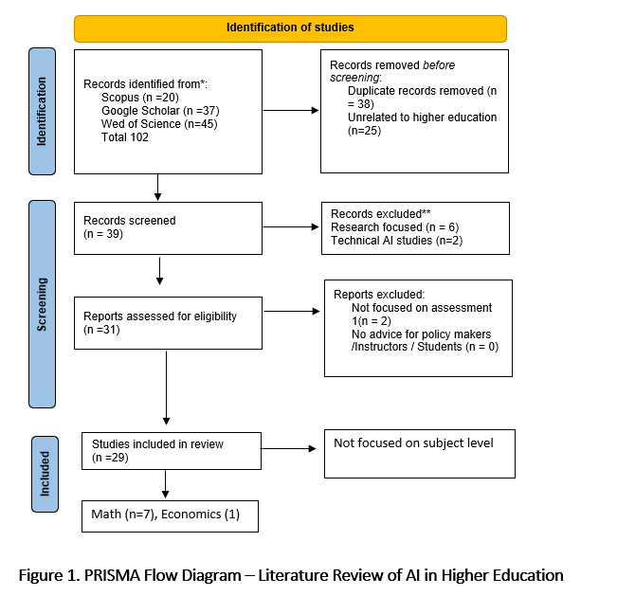
PRISMA Flow Diagram – Literature Review of AI in Higher Education

Slide 5
AI Challenges in Math and Economics Education
Challenge | Description | Authors
Overreliance on AI tutors | AI solves routine/procedural problems quickly (ITS/ALS/auto-grading). Students may outsource perseverance/self-regulation to AI, weakening habits of sustained problem-solving. | Awang et al. (2025); Panaoura (2025) Göktepe Yıldız & Göktepe Körpeoğlu (2024); Awang et al. (2025) Gunawan & Mulyadi (ICETI 2025); Lu & Zhou (2021)
Personalization vs. privacy | AI enables adaptive, individualized learning and immediate feedback, but raises data-privacy concerns. | Göktepe Yıldız & Göktepe Körpeoğlu (2024); Panaoura (2025)
Equity & access | AI can widen opportunity (early identification, personalization) but also risks inequity without safeguards. | Göktepe Yıldız & Göktepe Körpeoğlu (2024)

Slide 6
Triangle of Shared Responsibility
University
- Set AI policy
- Ensure equity
- Refine with feedback
Instructor
- Redesign assessments
- Teach AI literacy
- Foster critical thinking
- Gather feedback
Student
- Use AI responsibly
- Disclose AI use
- Critique outputs
- Share experiences
*Bronfenbrenner’s Ecological Systems Theory
*Hadwin & Oshige (2011) on co-regulation: learning responsibility is distributed among teacher, learner, and environment

Slide 7
AI Policies in UK Universities – Overview
80%
76%
73%
Rapid adoption (92% of students now use AI — HEPI 2025) vs. slow policy adaptation.
Source: HEPI Student Generative AI Survey 2025

Slide 8
Methodology Overview
- Data source: Publicly accessible university AI policies collected
- Method: deductive thematic analysis
- Coding framework: red–amber–green classification
• Red → minimal/no AI-specific policy
• Amber → partial guidance, limited detail
• Green → comprehensive, accessible, clearly articulated

Slide 9
Table 1. Inclusion and Exclusion Criteria
Item | Inclusion | Exclusion
Date of issue | After November 30, 2022 | Before November 30, 2022
Type of documents | Official and public-facing documents issued by Russell Group universities, such as institutional AI policies, guidelines, teaching/assessment regulations, or faculty/departmental guidance (e.g., Mathematics, Economics). | Non-policy-oriented documents, such as news reports, blog posts, media commentary, or individual academic opinions.
Scope | Documents explicitly addressing the use of AI in learning, teaching, or assessment. | Documents focusing on AI research, technical development, or unrelated administrative issues.
Accessibility | Policies and guidelines available through official university websites or equivalent public sources. | Internal-only documents inaccessible to the public, or informal guidance not issued through official university channels.

Slide 10
Policy Maturity colour coding
🟩 Green – Fully Embedded (with economics / math departmental resources):
• University-wide + subject-specific (Maths/Econ)
• Module briefs include AI statements
• Clear permitted/restricted uses
🟨 Amber – Moderate Detail:
• Defined principles, some operational detail
• Limited subject-specific content, pilot initiatives
🟥 Red – Basic Guidance:
• Generic, early-stage policies
• No subject-level guidance

Slide 11
UK HE AI Policy Maturity
Green = Dept-level/strong subject guidance • Amber = General/partial guidance • Red = Limited
Green 5 (21%)
Amber 15 (62%)
Red 4 (17%)
Green
London School of Economics and Political Science (LSE)
University of Cambridge
University of Edinburgh
University of Oxford
University of Warwick
Amber
Cardiff University
Imperial College London
Newcastle University
Queen Mary University of London
Queen's University Belfast
University College London (UCL)
University of Exeter
University of Glasgow
University of Leeds
University of Liverpool
University of Manchester
University of Nottingham
University of Sheffield
University of Southampton
University of York
Durham University
Red
King's College London
University of Birmingham
University of Bristol

Slide 12
Subject-Specific AI Policies
University | Discipline | Policy Detail
Oxford | Mathematics | Explicit MSc dissertation AI rules
Cambridge | Mathematics | CATAM ban on AI-generated code/reports
Edinburgh | Mathematics | Refers to central AI guidance; misconduct warning
Warwick | Economics | Dept. requires disclosure of GenAI use
LSE | Economics | School framework; piloting GenAI use

Slide 13
Transparency & Inconsistency
- Some universities publish detailed, visible AI guidance
- Others embed AI policy within broader conduct handbooks
- Students face inconsistent access to clear rules

Slide 14
Student Support & Guidance
- Few policies provide practical examples of acceptable AI use
- Limited resources or training offered to students
- Emphasis largely on restriction/boundaries rather than guidance

Slide 15
Staff Responsibility
- Some universities highlight staff responsibility in adapting assessments
- Mention of AI-resilient assessment approaches (e.g., oral exams, authentic tasks)
- Varying emphasis on staff training and preparedness
- Policies shifting responsibility onto teaching staff

Slide 16

Case Study: Poster Project in Quantitative Methods Module
Task Setup:
• Provided dataset on a real-world economics topic.
• Output: Academic-style poster using multiple chart types + Presentation .
Requirements:
• Step-by-step process notes showing chart creation in statistical software.
• Short poster presentation session for Q&A.
AI-Resilient Elements:
• Focus on visual storytelling and interpretation.
• Process notes and live Q&A discourage AI-only work.
• Encourages collaboration and peer feedback.

Slide 17
Thanks for your listening

