Slide 1
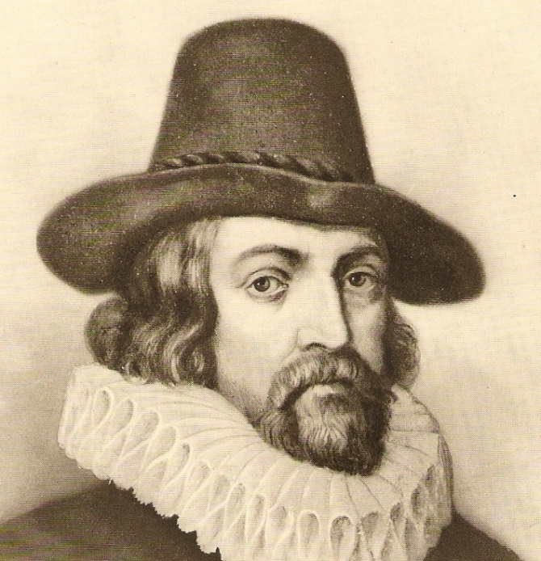
From the “Economics of Education”
to “Education & Economics”…and back!
A pluralist perspective
Fabio R. Aricò @FabioArico
Ecuator Seminar Series
June 2016

Slide 2
YOUR PRESENTER
Fabio Aricò
Senior Lecturer in Macroeconomics School of Economics – UEA
Convenor of UEA Higher Education Research Group
Research fields
Higher Education policy and practice (access, satisfaction)
Self-Assessment and Academic Self-Efficacy
Technology Enhanced Learning
Learning Gain in HE

Slide 3
OUTLINE
1. Autobiographical note (only what strictly needed)
2. The divide between researchers in Education and Economics
3. An example based on the attack to Human Capital Theory
4. The notion of Capital in Education and Economics
5. An example of how Economics of Education can do more than HCT
6. Re-defining myself as a social scientist
7. A pluralist epilogue

Slide 4
AUTOBIOGRAPHICAL NOTE
I was initially trained in a traditionally heterodox department in Italy. I was suggested to embrace the mainstream. I moved to the UK.
I worked on my PhD using mainstream tools, I enjoyed it. But it did not last long…
I have come back to appreciate heterodoxy and I embraced a pluralist view in terms of how we develop teaching and research in Economics.
I have done something a bit more radical…I started to do research in Education, but using my own background and toolbox.

Slide 5
AUTOBIOGRAPHICAL NOTE

Slide 6
ECONOMICS RESEARCH
pluralism?
MAINSTREAM APPROACH
HETERODOX APPROACHES

Slide 7
EDUCATION RESEARCH
PHILOSOPHY of EDUCATION
PSYCHOLOGY of EDUCATION
LEARNING ANALYTICS
TEACHING TRAINING
EDUCATION RESEARCH
SOCIOLOGY of EDUCATION
ECONOMICS of EDUCATION
EDUCATION MANAGEMENT
EDUCATION PRACTICE

Slide 8
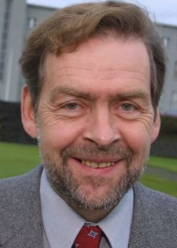
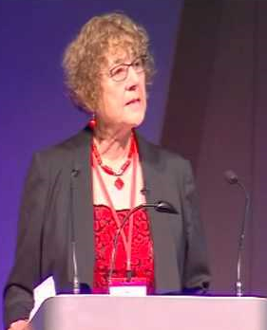
WHAT DO THEY SAY ABOUT ECONOMICS?
Professor Páll Skúlason (University of Iceland)
“…Education is now ruled by Economics… These economists, they are like priests of a new religion…”
[Keynote, 8th Enhancement Themes Conference, Edinburgh, 2011]
Professor Sue Clegg (Leeds Met University)
“…the Government should stop using this economicistic approach to the management of education…”
[Intervention, SRHE 50th Anniversary Symposium, London 2015]

Slide 9
WHY DO THEY DISLIKE ECONOMISTS?
EDUCATION RESEARCH in the UK
Predominantly based on qualitative methodology
Cuts to Education by the current Government
Metrics-driven approach to funding associated to the ‘economicistic’ approach to Education management.
ECONOMICS RESEARCH and TEACHING
Predominantly based on quantitative methodology
Traditional tendency to isolate from other Social Sciences
Crisis in the aftermath of financial crisis and Great Recession → criticism raised to the way Economics it thought and taught.

Slide 10
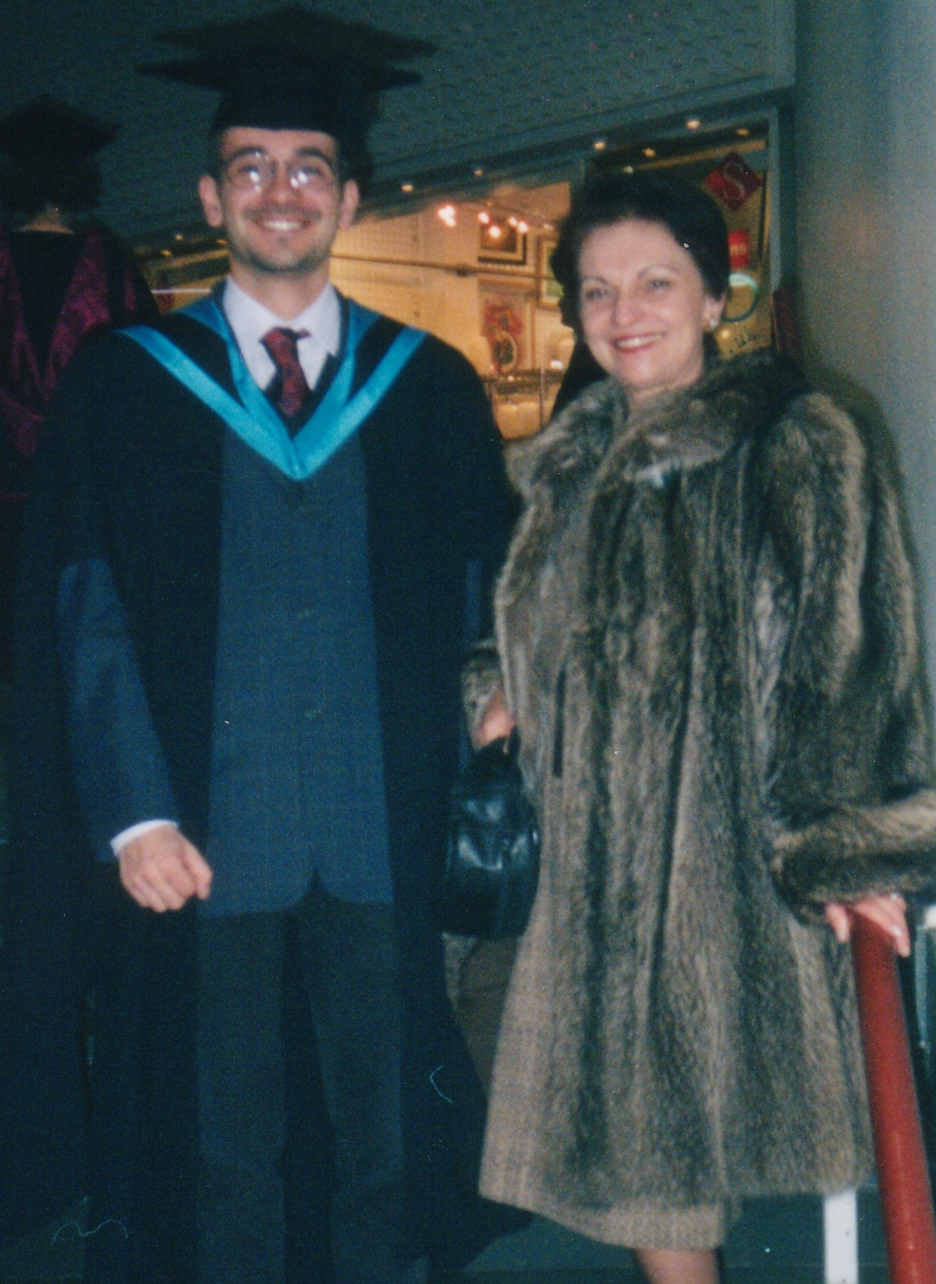
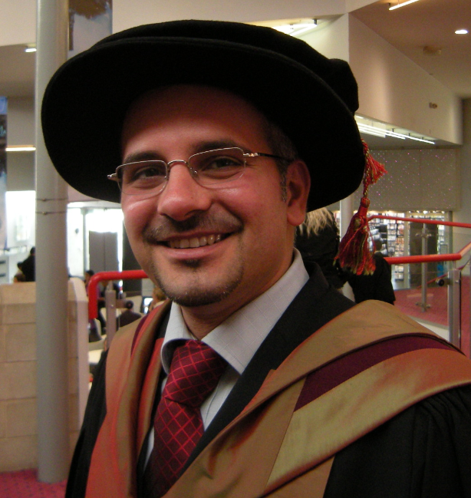
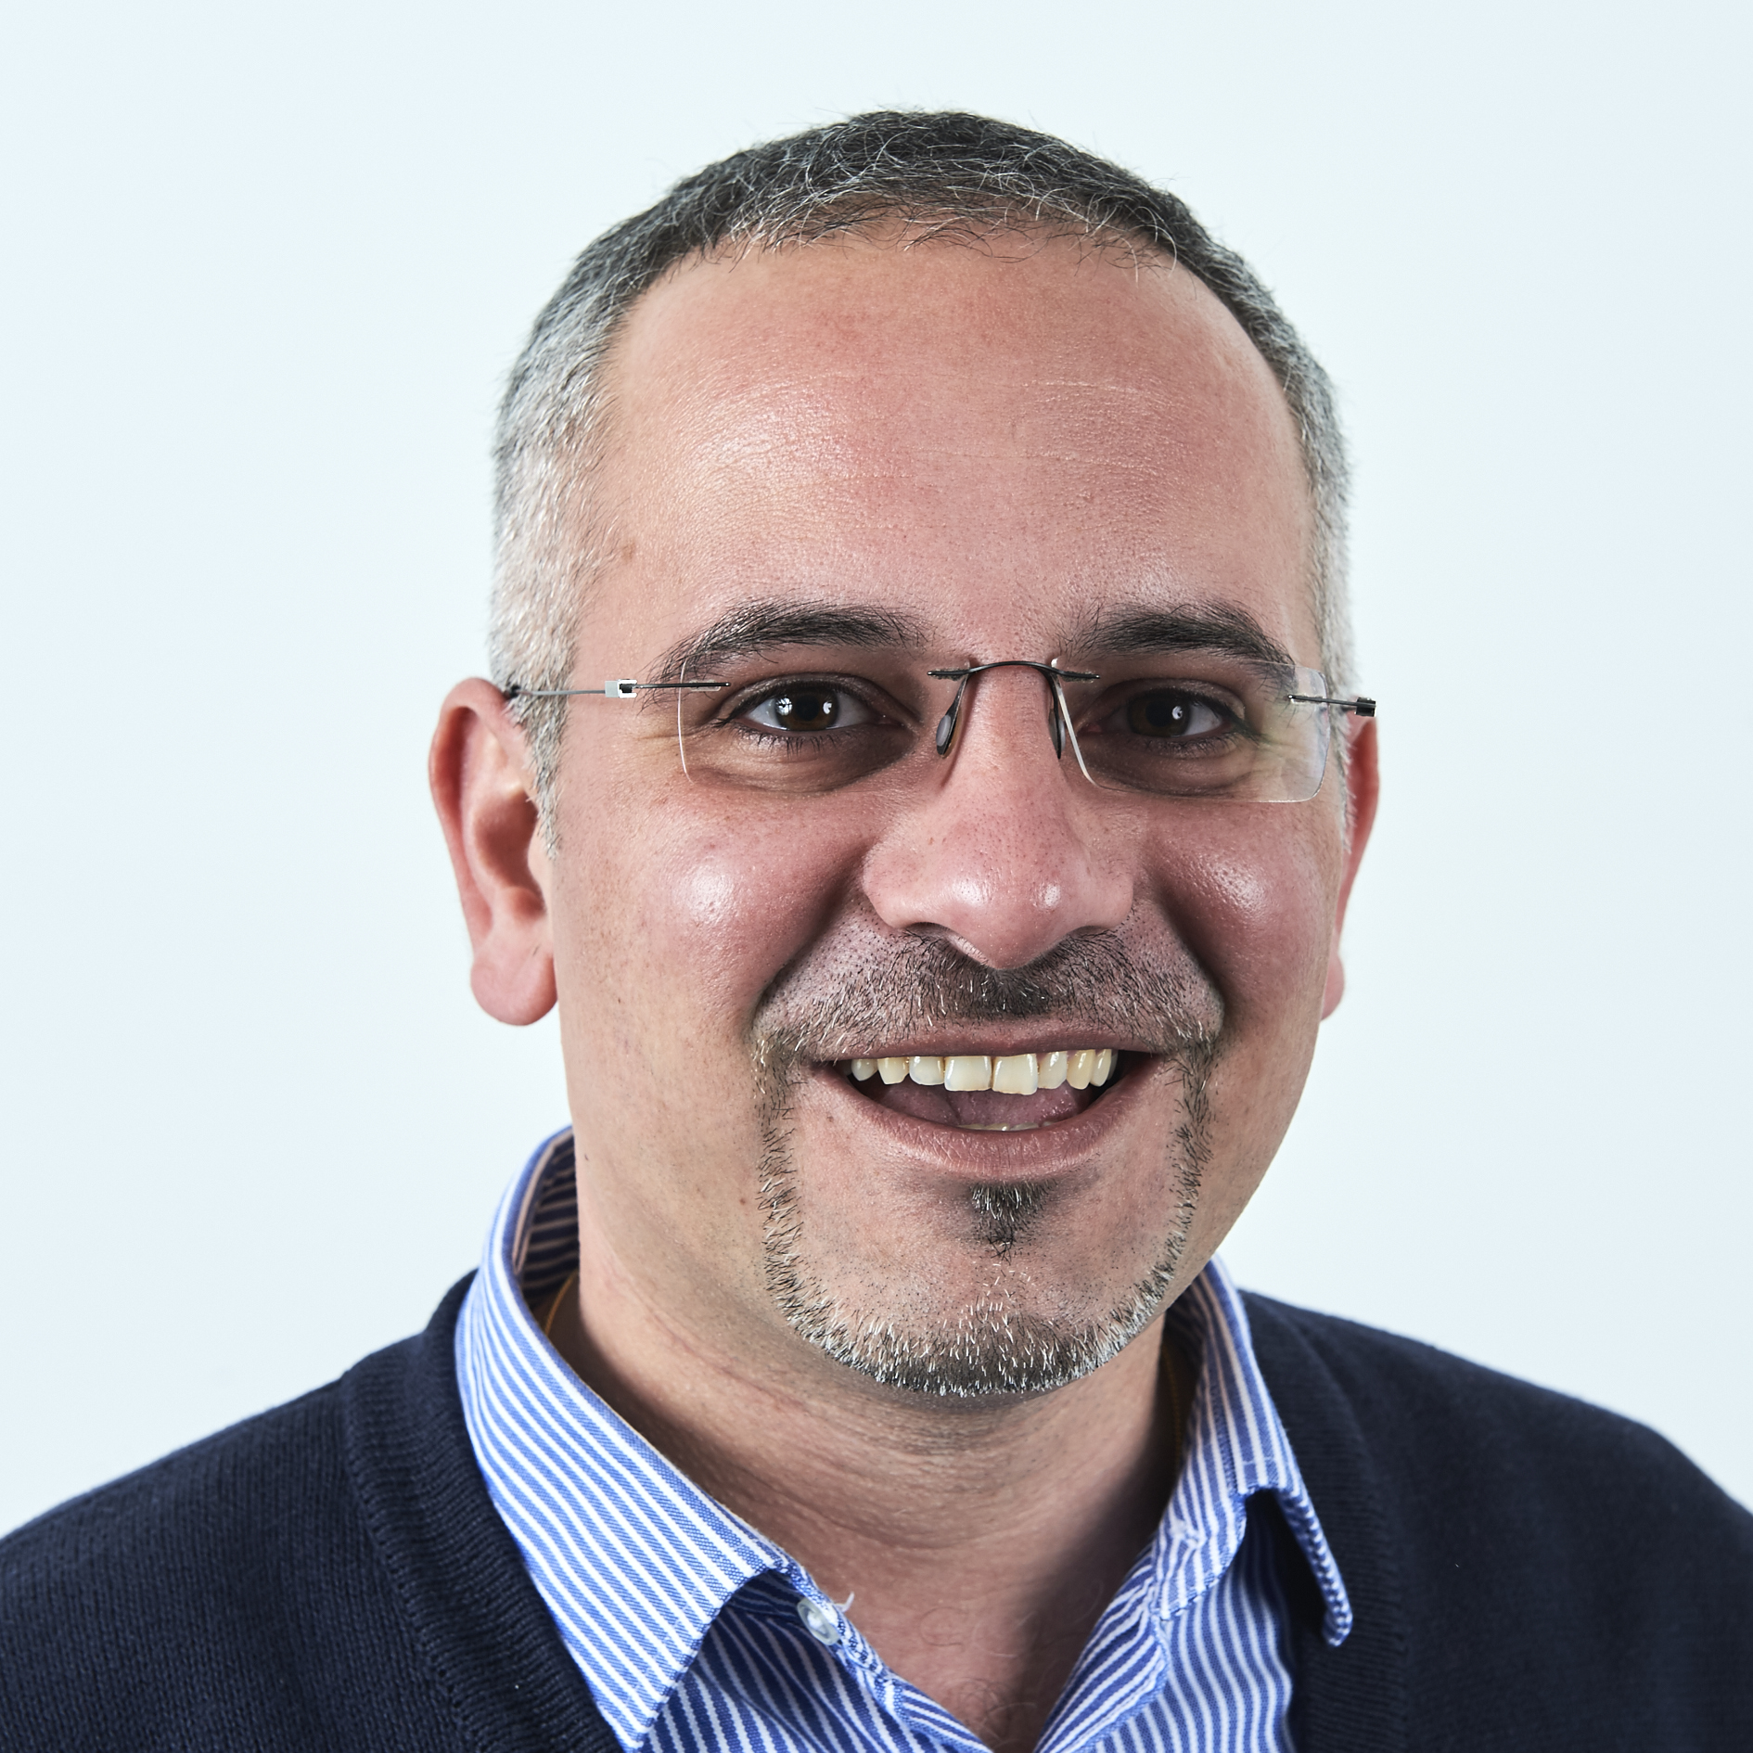
WHY NOBODY LOVES ME?
“A man who wants the truth becomes a scientist; a man who wants to give free play to his subjectivity may become a writer; but what should a man do who wants something in between?” ― R. Musil, The Man Without Qualities
“One does what one is; one becomes what one does.” ― Robert Musil

Slide 11
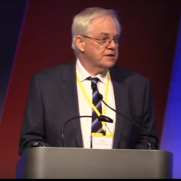
HUMAN CAPITAL THEORY UNDER ATTACK
Professor Simon Marginson (UCL Institute of Education)
“Rethinking education, work, and ‘employability’”
[Keynote, SRHE Annual Conference, Newport, Dec 2015]
Harsh (and at times unfair) criticism to HCT
Wake-up call for economists, but no economists were in the room (but me)
Sign of lack of dialogue across disciplines that is not productive, frustrating, and that needs addressing.
Statement: HCT claims universal truth
HCT fails the test of realism.

Slide 12
HUMAN CAPITAL THEORY UNDER ATTACK
1st Attack: HCT is only focussed on individual’s earning
rate of return on education as only thing that matters.
but education process is contextual to each individual.
1st Response: HCT evolved and extended since the 1960s
Developments in Growth Theory in 1990s
Romer (1986), Lucas (1988), Mankiw Romer Weil (1992)
→ positive externalities from education
Development in Economics of Education (past 25 years)
→ disentangling the effect of ability
→ myopic discount rates in HC investment

Slide 13
HUMAN CAPITAL THEORY UNDER ATTACK
2nd Attack: HCT is just one-lens approach through which we see phenomena
Social Science seen as a closed-system
Mathematical model correct only if assumptions are.
2nd Response: Recall pledge to Economics being isolated (mea culpa)
Theoretically:
→ isn’t this criticism applicable to every model?
Pragmatically:
→ we need to decide how much to invest in education
→ animal spirits: urge to action rather than inaction (Keynes)

Slide 14
HUMAN CAPITAL THEORY UNDER ATTACK
3rd Attack: Empirical multivariate analysis relies on independence of explanatory variables, which does not exist in reality. The world is complex, but statistics claims it can isolate causal relationships between factors.
3rd Response: Statistics is mainly about association, not causation.
Statistical inference is based on probability. We attempt
to control for the mistakes we can make in our predictions.
Pragmatically:
→ there is a debate in the way we use statistics/econometrics
→ we need economists do defend ourselves by other economists
→ thankfully, economists love to disagree. Celebrate that!

Slide 15
HUMAN CAPITAL THEORY UNDER ATTACK
4th Attack: Agents do not behave according to rational motives Research in sociology shows status-seeking behaviour matters,
as well as a range of other non-rational determinants.
4th Response: Economics is taking care of that too, but very few people know. Think about the development in Behavioural Economics.
Our (economists) fault is that we talk to each other, but do not
engage with a much wider debate in the social sciences.
Both theoretically and empirically, Economics of Education addresses these issues. (Example to follow)

Slide 16
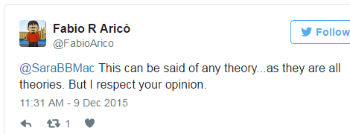
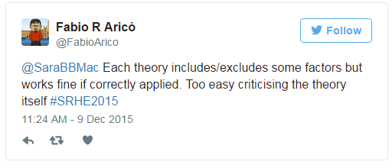
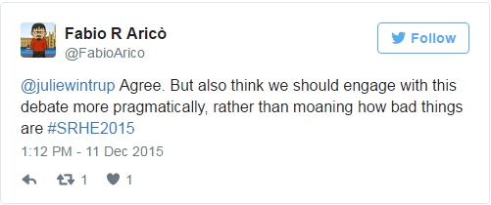
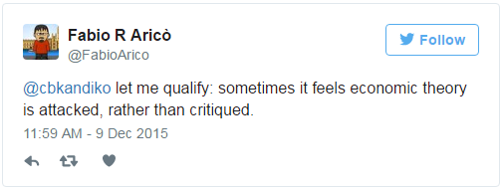
HUMAN CAPITAL THEORY UNDER ATTACK
ARGH!

Slide 17
HUMAN CAPITAL THEORY UNDER ATTACK
Resolution Focualt (1979) – dyads (different attributes) in social sciences
dyad linked by a strategic logic
(homogeneity)
HCT
education
work
dyad linked by a dialectical logic
(encompassing differences)
education
work
synthesis

Slide 18
HUMAN CAPITAL THEORY UNDER ATTACK
Response Is this sufficient to claim that HCT (and economists) must die?
Is this sufficient to create a new theory? Is the claim impartial?
What are we going to do in the meantime?
How is the government going to take decisions?
Who is going to pay for education? How? How much?
Francis Bacon, Novum Organum, 1620
pars destruens → review and criticise old body of knowledge
remove prejudice and errors
pars costruens → build the new body of knowledge
find the new truth.

Slide 19
CAPITAL IN EDUCATION & ECONOMICS
cultural
capital
social
capital
economic
capital
The debate develops around the notions of capital
→ Bourdieu (1986), “The Forms of Capital”
→ Coleman (1988), “Social Capital in the Creation of Human Capital”

Slide 20
ECONOMICS of EDUCATION CAN DO IT!
Jack Whybrow, UEA PhD Candidate in Economics
“An investigation into the Cultural and Social Capital influences on rates of UK HE participation. An analysis using two cohorts born in 1958 and 1970”
engages with the different notions of capital
engages with the sociological literature
enriches previous models of participation in HE
a great example of how Economics of Education can up its game!

Slide 21
CULTURAL/SOCIAL CAPITAL and HE
Econometric model
P (HE) = f ( background, ability, cultural capital, social capital)
household income
parental education combination of very detailed
social class set of survey answers
sibilings
key stage ability tests
(reading, maths, etc.)

Slide 22
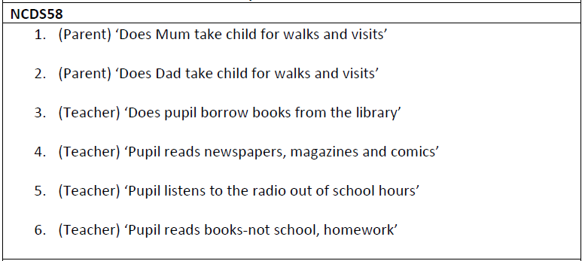
CULTURAL/SOCIAL CAPITAL and HE
Operationalisation of Cultural Capital

Slide 23
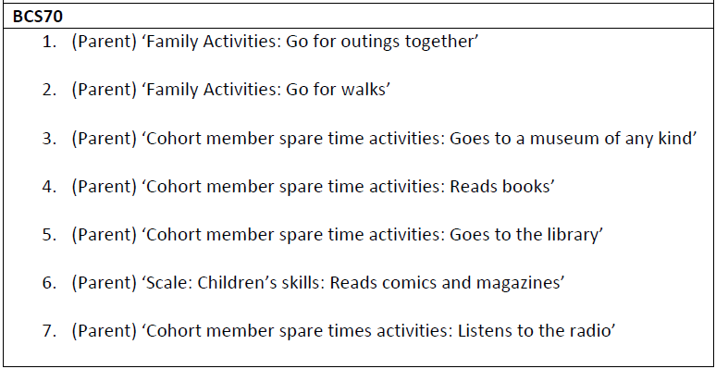
CULTURAL/SOCIAL CAPITAL and HE
Operationalisation of Cultural Capital

Slide 24
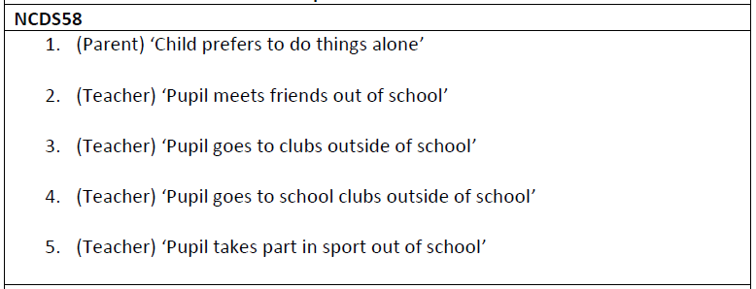
CULTURAL/SOCIAL CAPITAL and HE
Operationalisation of Social Capital

Slide 25
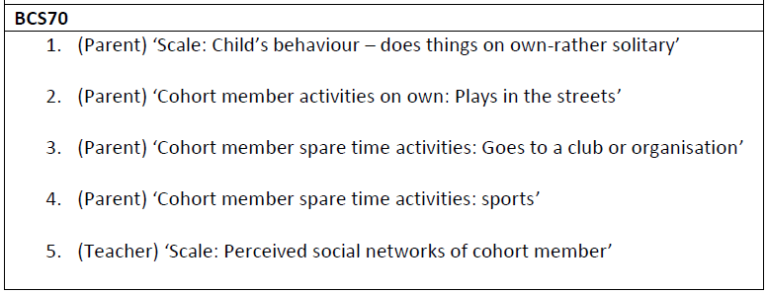
CULTURAL/SOCIAL CAPITAL and HE
Operationalisation of Social Capital

Slide 26
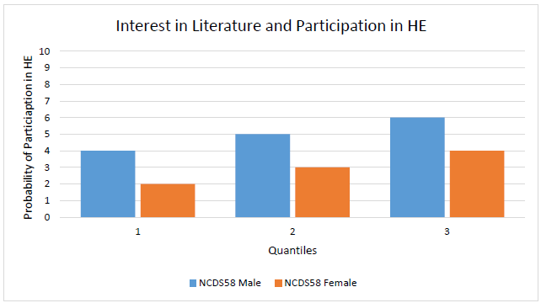
CULTURAL/SOCIAL CAPITAL and HE
Participation in HE as a function of Cultural/Social Capital

Slide 27
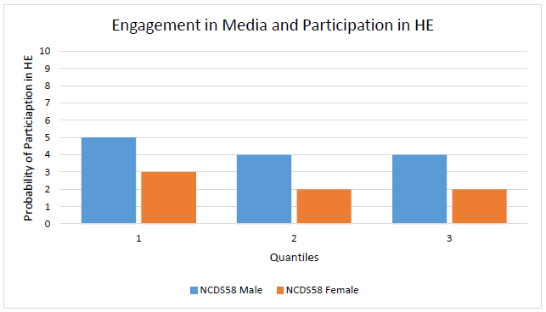
CULTURAL/SOCIAL CAPITAL and HE
Participation in HE as a function of Cultural/Social Capital

Slide 28
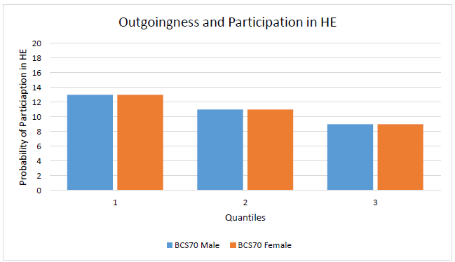
CULTURAL/SOCIAL CAPITAL and HE
Participation in HE as a function of Cultural/Social Capital

Slide 29
CULTURAL/SOCIAL CAPITAL and HE
In summary
A beautiful example of how econometric modelling is simultaneously informed by sociological and economic theories
A better understanding of the factors that are associated to participation in HE, and that could determine variation of earnings (not this paper)
A wider range of options for the policy-maker, who can engage with the socio-cultural dimensions of education-choice, and aim to use education as a vector for social mobility.

Slide 30
WHAT DO I THINK? WHAT DO I DO? (WHAT AM I?)
I embrace education research with the tools of an economist
I embrace the principles of accountability and measurability (pragmatically)
In the quest for metrics, but metrics that matter know the limitations know we cannot be without
UEA-HEFCE ‘Piloting Measures of Learning Gain’
Strand of Self-Efficacy (student confidence at performing academic tasks).
philosophy of education
theory-informed evidence-based
research
learning analytics

Slide 31
A PLURALIST EPILOGUE
There is a crisis of confidence in Economics and in the Social Sciences
we have models but we continuously challenge their validity
without confidence no model can ever be fit to purpose (Keynes)
in a complex world confidence can only be restored by open dialogue.
Economists
should come out from their own discipline and bring the debate out in the open
be ethical, resist the temptation of the hegemony of policy-making (vested int.)
Education Researchers
should invite economists to their table, as equal partners
should engage more with the political debate, in a constructive way, acknowledge a pragmatic urge to change and co-operate towards it.

