Slide 1
Economic Evaluation in Health Care
William Whittaker
William.whittaker@manchester.ac.uk
4.304 Jean McFarlane
Zweifel (Ch.2)
Morris et al. (Ch.1, Ch8-10)
Elgar Companion (Ch.33-Ch.50)

Slide 2
Overview
What is an economic evaluation?
Why is an economic evaluation needed?
Incremental Cost-Effectiveness Ratio
Measuring benefits
Measuring costs

Slide 3
What is an Economic Evaluation?
Economic evaluation is a tool to analyse whether an intervention is cost-effective
compares the benefits of a health intervention to its cost (Cost Benefit Analysis)
Helps decision makers choose between alternatives (Cost Effectiveness Analysis)
Require information on the costs and benefits of the service
Costs typically monetary
Costs are essentially opportunity costs – benefits that could have been obtained alternatively
Benefits measured as:
Natural units
Cardinal utility function mapping several dimensions to an index
Monetary units

Slide 4
Black box of production
Can think of economic evaluation in terms of production function
inputs outputs
If inputs and outputs have the same physical units = technical efficiency (how to get the most with what you have)
If inputs are valued and outputs physical units = production allocative efficiency (how to get the most with the budget you have) - CEA
If both inputs and outputs are valued = overall allocative efficiency - CBA

Slide 5
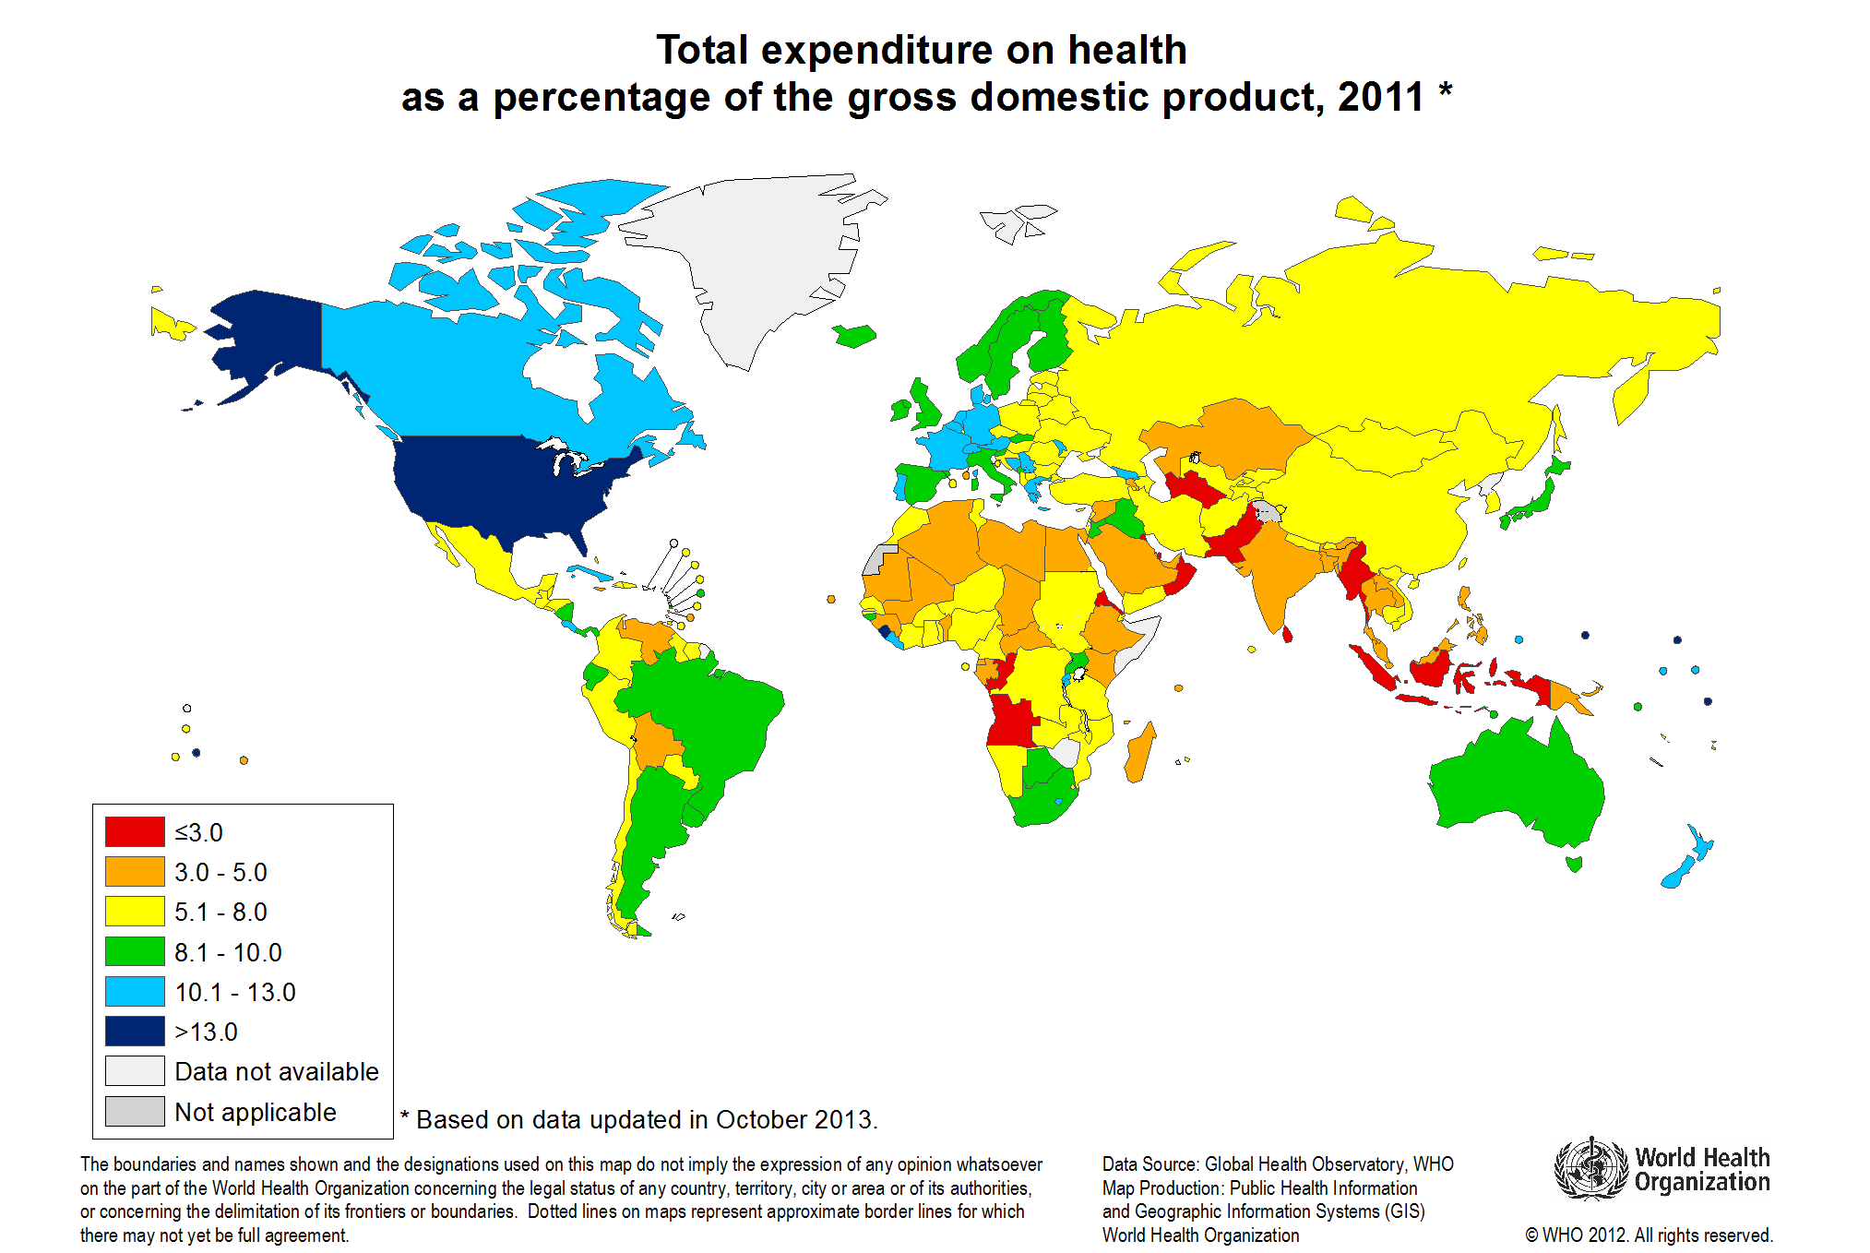
Why is an EE needed in health care?
Health care is expensive

Slide 6
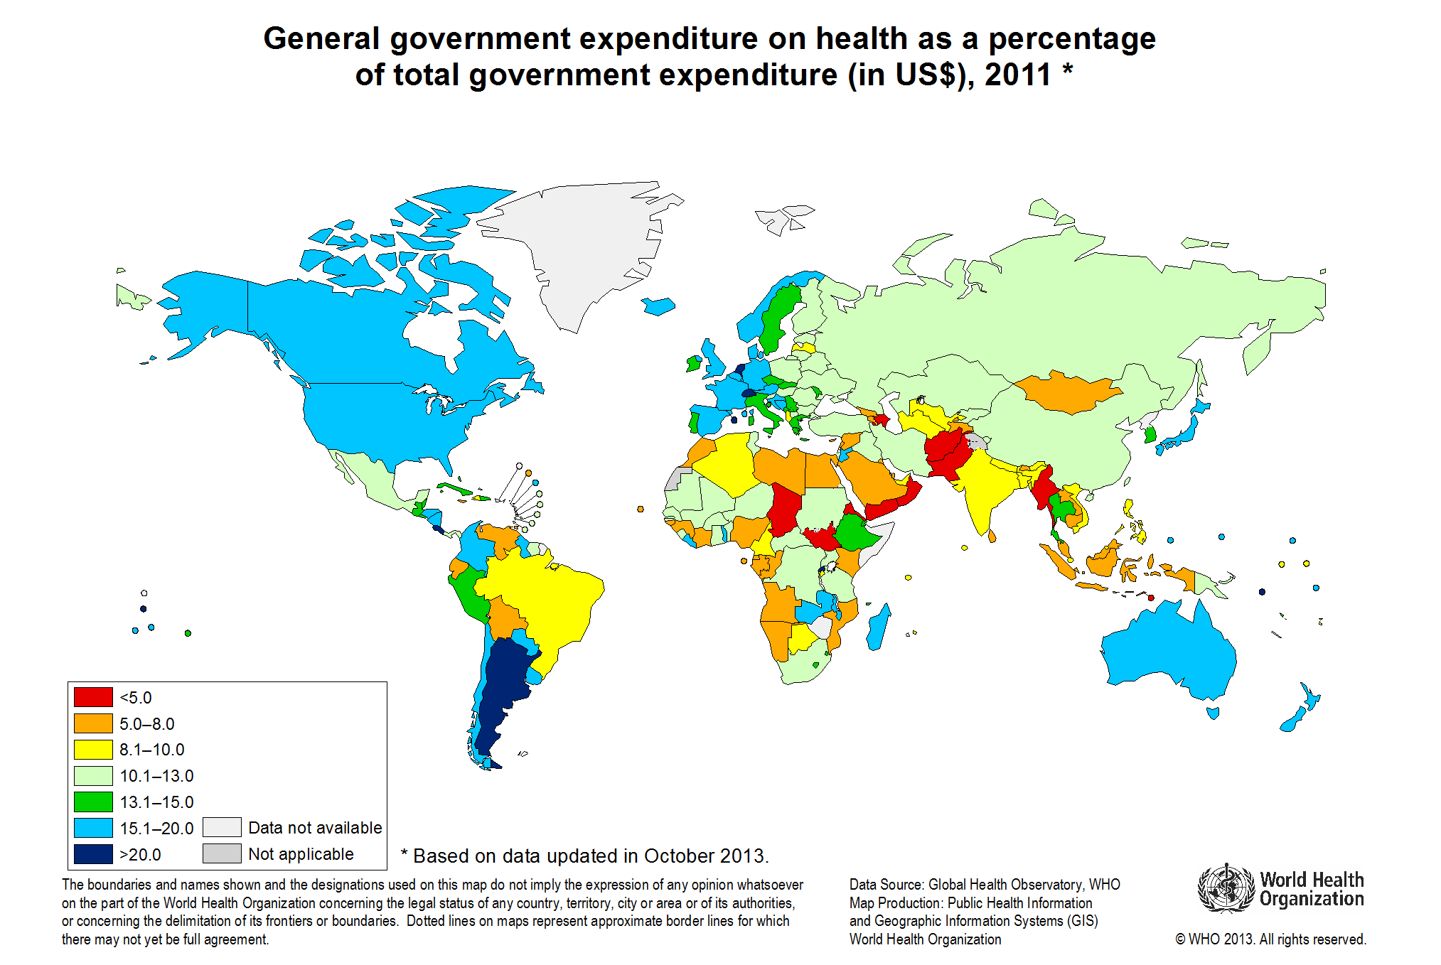
Why is an EE needed in health care?
Health care is expensive

Slide 7
Why is an EE needed in health care?
Decisions need to be made about the scope and type of services the health care system will cover
Health care is an economic good
Demand for services exceed supply
Resources are scarce
Has an opportunity cost
Benefits foregone from spending elsewhere
Most efficient mix maximise benefits
May not be most equitable

Slide 8
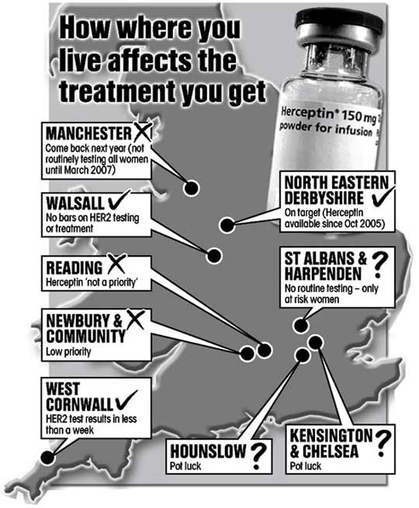
Who makes the decisions?
World Health Organisation
(WHO)
Private insurers
Government
Central authority (NICE)
At a local level, providers
of health care may make
decisions (postcode lottery)

Slide 9
The perspective (Morris et al (Ch.9))
The benefits (and hence costs) of the intervention may be constructed on the basis of normative judgements
What is of benefit?
What are the costs? Opportunity costs?
Normative economics
Welfarism – individual’s value of utility, Pareto principle (measuring and ranking individual preferences to make decisions on social welfare maximisation)
Non-welfarism – social welfare not only determined by utility from consumption, health enters into the social welfare function alongside utility – extra welfarism in EE focussed on measuring health only
Notes:
Pareto principle does not allow trade offs pg.216, but compensation could help (could be costly)

Slide 10
Welfarism
Social welfare function is the sum of individual utility
Individuals maximise their own utility so their valuation of a service is what matters
Valuations by health care professionals and others are irrelevant
Consequentialist
Concerned with only consequences (outcomes) of consumption on utility not how it is delivered
Consistent ranking of all states in terms of utility obtained
Decisions based on the Pareto principle
Weak pareto improvement
Strong pareto improvement
Pareto optimal
Notes:
Pareto principle does not allow trade offs pg.216, but compensation could help (could be costly)

Slide 11
Welfarism – Pareto principle
Pareto principle
Weak Pareto improvement (both improved)
Strong Pareto improvement (one improved, other same)
Pareto optimal (none can be improved without sacrificing another)
Equity
Not concerned with equity (who gets the improvement?)
Potential improvements
Cannot rank non-optimal points
Notes:
Pareto principle does not allow trade offs pg.216, but compensation could help (could be costly)

Slide 12
Welfarism – Pareto principle
Utility possibilities frontier gives the Pareto optimal points
U_{B}
U_{A}

Slide 13
Welfarism – social welfare functions
How do we decide which Pareto optimal choice to undertake?
W_{(x)}=f(U_{A(x)},U_{B(x)},…,U_{n(x)})
Alternative views
Utilitarian: W_{(x)}=(U_{A(x)}+U_{B(x)}+…+U_{n(x)})
maximise the sum of utilities
a 1:1 relationship between increases and decreases in utility for social welfare to be unchanged. Slope=-1
.
U_{B}
W_{U}
U_{A}
Notes:
Pareto principle does not allow trade offs pg.216, but compensation could help (could be costly)

Slide 14
Welfarism – social welfare functions
How do we decide which Pareto optimal choice to undertake?
W_{(x)}=f(U_{A(x)},U_{B(x)},…,U_{n(x)})
Alternative views
Bernoulli-Nash: W_{(x)}=((U_{A(x)})(U_{B(x)})…(U_{n(x)}))
equal utility is preferred to unequal distribution
utility is weighted (usually smaller for individual’s with higher utility)
Convex curve
.
U_{B}
W_{BN}
W_{U}
U_{A}
Notes:
Pareto principle does not allow trade offs pg.216, but compensation could help (could be costly)

Slide 15
Welfarism – social welfare functions
How do we decide which Pareto optimal choice to undertake?
W_{(x)}=f(U_{A(x)},U_{B(x)},…,U_{n(x)})
Alternative views
Maximin: W_{(x)}=min(U_{A(x)},U_{B(x)},…,U_{n(x)})
Rawlsian SWF
minimum utility is maximised
L-shaped curve – only increases in both will increase welfare
.
U_{B}
W_{R}
W_{BN}
W_{U}
U_{A}
Notes:
Pareto principle does not allow trade offs pg.216, but compensation could help (could be costly)

Slide 16
Welfarism – social welfare functions
Based on ethical beliefs about what is socially optimal
Rely on being able to measure and compare utility
Ordinal measurements may not be comparable between people
Dictatorship solves this
Arrow’s impossibility theorem shows how rankings can be inconsistent
Alternatively, a different perspective is needed…
Notes:
Pareto principle does not allow trade offs pg.216, but compensation could help (could be costly)

Slide 17
Non-welfarism
Two key concerns with welfarism
individuals assumed to make rational, utility maximising choices
conflict between preferences and trade-offs between individuals in society
Non-welfarism is any other normative framework that rejects welfarism
Key arguments against welfarism
Not applicable to health care due to market failure (imperfect information/externalities/supplier inducement/moral hazard)
Utility may be measured differently by individuals
Health is an important construct in determining people’s assessment of well-being
In some instances health has even substituted for utility

Slide 18
Economic evaluation
The perspective has important implications on the approach taken for economic evaluation
Recall an economic evaluation uses information on the benefits and costs of competing treatments this requires
A common measurement of benefit
Who’s perspective of health? Individual or practitioner? Subjective or objective? Specific or general?
A boundary for cost considerations
Who’s costs? Individual or health care provider? What about labour costs? Familial care?
As such all economic evaluations are normative

Slide 19
Economic evaluation
Key components:
Average Cost Effectiveness Ratio (ACER)
ACER=(costs of intervention)/(benefit of intervention)
Gives cost per unit, lower the better
If benefits are monetary then this is CBA
Incremental Cost Effectiveness Ratio (ICER)
Compare two mutually exclusive interventions
Additional costs (benefits) than the next most effective
ICER=(additional cost of alternative)/(additional benefit of alternative)
Related to ACER when the next most effect intervention is doing nothing
Can more benefit be produced at a lower cost?

Slide 20
Economic evaluation
Cost effectiveness plane summarises these
ΔC
Activity dominated
ΔB
Activity dominates

Slide 21
Economic evaluation
With multiple alternatives we need to rule out dominated interventions
More costly and less effective (dominance)
ICER larger than ICER of more expensive intervention (extended dominance)

Slide 22
Example with multiple alternatives
Zweifel (pg.20)
ICER (1)
Rank by cost
A: next most effective is do nothing (ACER=ICER)
300/30=£10 per life year gained
B: next most effective is A
(500-300)/(40-30)=200/10=£20 per life year gained
C: next most effective is B
(600-500)/(50-40)=100/10=£10 per life year gained
Intervention | Cost (£) | Life years gained | ICER (1)
A | 300 | 30 | 10
B | 500 | 40 | 20
C | 600 | 50 | 10

Slide 23
Example with multiple alternatives
Zweifel (pg.20)
ICER (2)
Rank by cost
B is ruled out by extended dominance (has a higher ICER than C which is more expensive)
A: next most effective is still do nothing
300/30=£10 per life year gained
C: next most effective is A
(600-300)/(50-30)=300/20=£15 per life year gained
Intervention | Cost (£) | Life years gained | ICER (1) | ICER (2)
A | 300 | 30 | 10 | 10
B | 500 | 40 | 20 | -
C | 600 | 50 | 10 | 15

Slide 24
Cost effectiveness threshold
How do we make decisions when we are in the North-East or South-west quadrant?
Cost effectiveness threshold – ceiling (ratio of cost to benefit, Rc) that an intervention must meet to be seen as cost effective

Slide 25
Cost effectiveness threshold
Cost effectiveness threshold
ΔC Rc
Activity unacceptable
ΔB
Activity acceptable

Slide 26
Cost effectiveness threshold
Threshold values have been employed to identify whether an intervention should be taken
National Institute for health and Clinical Excellence (NICE) in the UK
Intervention adopted if ICUR<£20,000 per QALY
Further evidence needed if £20,000≤ICUR≤£30,000
Further stronger evidence needed if ICR>£30,000
New guidelines have special thresholds applicable to certain areas of health
End of life – less than 2 years life expectancy and the treatment extends life by 3 months or more

Slide 27
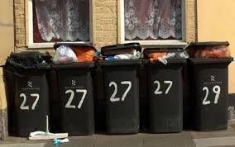
Cost effectiveness threshold
Thresholds do not guarantee budgets maximise benefits
Marginal opportunity cost of the resources should be assessed, this requires all current and potential interventions to be taken into account and all reassessed when budgets and interventions change
The scope is important, are we maximising utility from the health sector or entire State budget?
Consider the utility gained from more regular refuse collections…

Slide 28
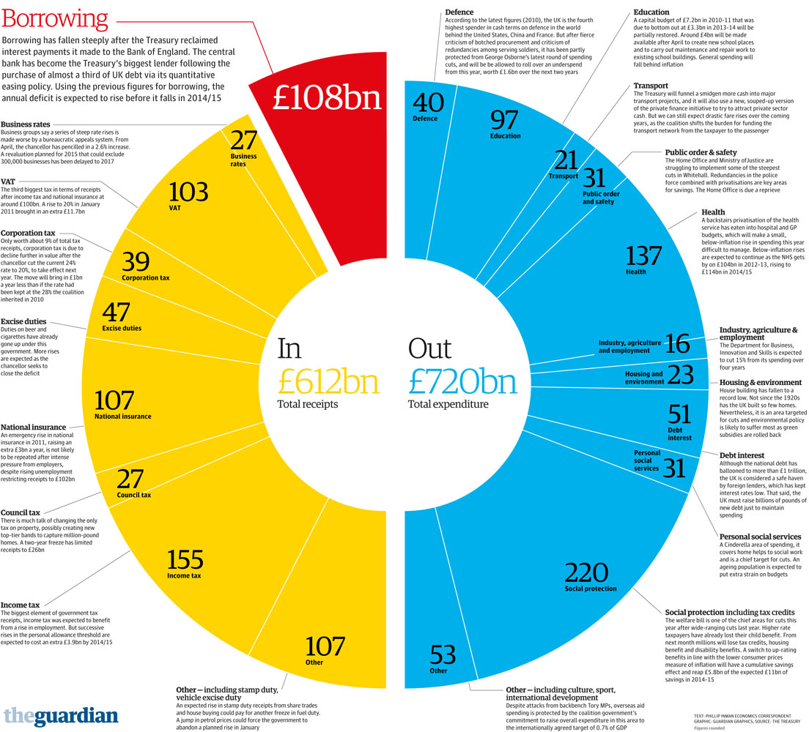
Total State budget

Slide 29
Cost effectiveness threshold
Thresholds do not factor in equity concerns
Not concerned with who gets the benefit or cost saving, nor is it concerned with reallocations of resources
What if both interventions are inefficient?

