Slide 1
Measuring benefits
Morris et al (2012) Ch.11-12

Slide 2
Measuring benefits
To perform an economic evaluation, we need to have information of the benefits and costs of an intervention
Who’s perspective should we take?
Clinical measure by a test or practitioner?
Patient reported measures?
How wide ranging do we want to be?
Include all stakeholders?
Include patient costs?
These are important questions that could potentially result in different conclusions and policy recommendations

Slide 3
Market based pricing
One approach to measuring the value of output could be to take the market price
In health care there is no market price
You can’t ‘buy’ health
In publically funded healthcare or private insurance the individual may under- or over-value the benefit of healthcare
Even if we value the over the counter price this may not be rational
Imperfect information on treatment value
Success of treatment
Side-effects
Infer prices or omit them altogether

Slide 4
Monetary valuations of benefits
One approach could be to simply ask individuals their valuations
Revealed preferences
Inferred from real choices
Assumes people make rational choices (weigh up all benefits and costs)
Combined with group preferences we get the demand curve
Example: imagine you were selling ibuprofen – how would you reveal your customers valuations of that drug?
Example 2: how does this change (or does it?) if we are now selling hip replacements?
Concerns with the value of health generated – how can we measure this?

Slide 5
Monetary valuations of benefits
Stated preferences
Instead of actual behavioural responses to price changes, we could ask individuals how much they would be willing to pay in surveys
Lacks economic reasoning provided by real choices
Contingent valuation method (CVM) is most popular
Asks individuals for valuations contingent upon a hypothetical scenario
Must be realistic and clear (financing, how obtained, probability they may need it, treatment probability of success etc)
May be
closed-ended (discrete or binary choice) yes no to a given price
open-ended (no value or reference)
payment scale (range of choices)
iterative-bidding (yes no yes) price increases and decreases until indifferent
Issues on strategic answers if individuals expect to pay later for treatment (undervalue) or to have this publically provided (overvalue)

Slide 6
Monetary valuations of benefits
Example: let’s set up a CVM for a new drug to combat stomach ulcers
Discrete choice experiments
Goods and services are bundles of attributes
Individual’s valuations of those attributes form the valuation of the good or service
Regression analysis can translate choices into the valuation of those attributes

Slide 7
Arguments against monetary valuations
Revealed preference data is rare
Stated preference has issues with respect to reliability
Health is a special good, rejection of placing valuation onto life
Dilutes practicality of choice making compared to cost-effectiveness
Monetary valuations make decision making more abstract from key stakeholders in health care

Slide 8
Benefits: Natural units
So far assessed evaluations where the benefits measured are of a common unit
E.g. Clinical measure (blood count) or length of life (years)
Differ in only one aspect
No side-effects (treatment only affects measure chosen)
Valuations are for the same clinical outcome measurement
In reality we may wish to compare treatments with no common clinical outcome
Indeed, from a social maximisation position, we would prefer all outcomes to be of a common scale

Slide 9
Benefits: Quality of Life
Quality of Life (QOL) enables a common measure of health
Permits evaluations of completely different clinical areas
Includes all potential effects of the treatment or intervention
Sound familiar?
Economists are used to working with utility
Health Related Quality of Life (HRQOL)
Typically used in evaluations as a more accurate/relevant measure of an intervention
The value assigned to duration of life as modified by the impairments, functional status, perceptions and social opportunities that are influenced by disease, injury, treatment or policy
(Patrick and Erickson, 1993)
A step away from welfarism?

Slide 10
Benefits: Quality of Life
Like CEA, except now ‘utility’ replace effectiveness
Cost-Utility Analysis (CUA)
Independent interventions (costs and benefits independent of other interventions)
Average Cost-Utility Ratio (ACUR)
Gives cost per utility unit
Incremental Cost-Utility Ratio (ICUR)
Mutually exclusive interventions
Benefits now measured in utils

Slide 11
Benefits: Quality of Life
CUA more widely applicable than CEA as it can capture several effects in one
Otherwise identical and names are used interchangeably
CUA has useful policy implications
Enables ranking of interventions enabling a payer to identify how many QOL units can be produced within budget and different ways this can be done
However CUA
Doesn’t state how QOL should be distributed
Whose utility function are we concerned with?
Doesn’t say whether the intervention is cost-effective without some marker of utility threshold

Slide 12
Properties of QOL indicators
HRQOL may use instruments – questionnaires/surveys completed by respondents
We want an unambiguous measure of benefit (to identify a causal relationship), that is comparable, and can be valued
Based on psychometric properties
Reliability – does the instrument generate consistent results (test-retest)?
Validity – does the instrument
Correlate with known valid measures (criterion validity)?
React in ways suggested by theory (construct validity)?
Appear to measure what it is supposed to measure (face validity)?
Responsiveness – does the instrument respond to changes in health?
Feasibility – is the instrument able to use?

Slide 13
EQ-5D
Derived by EuroQol
5 dimensions to HRQOL with 3 levels for each
Mobility
Self-care
Usual activity
Pain and discomfort
Anxiety and depression

Slide 14
EQ-5D
Derived by EuroQol
5 dimensions to HRQOL with 3 levels for each
Mobility
No problems in walking about
Some problems in walking about
Confined to bed
Self-care
Usual activity
Pain and discomfort
Anxiety and depression

Slide 15
EQ-5D
Derived by EuroQol
5 dimensions to HRQOL with 3 levels for each
Mobility
Self-care
No problems with self-care
Some problems washing and dressing
Unable to wash or dress self
Usual activity
Pain and discomfort
Anxiety and depression

Slide 16
EQ-5D
Derived by EuroQol
5 dimensions to HRQOL with 3 levels for each
Mobility
Self-care
Usual activity
No problems with performing usual activities (eg work, study, house work)
Some problems with performing usual activities
Unable to perform usual activities
Pain and discomfort
Anxiety and depression

Slide 17
EQ-5D
Derived by EuroQol
5 dimensions to HRQOL with 3 levels for each
Mobility
Self-care
Usual activity
Pain and discomfort
No pain or discomfort
Moderate pain or discomfort
Extreme pain or discomfort
Anxiety and depression

Slide 18
EQ-5D
Derived by EuroQol
5 dimensions to HRQOL with 3 levels for each
Mobility
Self-care
Usual activity
Pain and discomfort
Anxiety and depression
Not anxious or depressed
Moderately anxious or depressed
Extremely anxious or depressed

Slide 19
EQ-5D
Derived by EuroQol
5 dimensions to HRQOL with 3 levels for each
Mobility
Self-care
Usual activity
Pain and discomfort
Anxiety and depression
Generates a profile of an individual’s health state
243 possible outcomes (3⁵)
Example: 32211
Confined to bed, some problems washing or dressing, some problems with performing usual activities, no pain or discomfort, and not anxious or depressed

Slide 20
Ranking the EQ-5D
Can say 32211 is better than 32212
Cannot say 32211 is better than 23211
Need an index of weights to identify whether mobility is more important than self-care (in this example)
York MVH project surveyed 2,997 individuals on 43 EQ-5D health states
Regression using dummies for each dimension and a level 3 dummy (=1 if any dimension had 3) with a constant for perfect health
Estimates:
U=0.97+(-0.066M2)+(-0.271M3)+(-0.029S2)+(-0.097S3)+(-0.127U2)+(-0.224U3)+(-0.144P2)+(-0.376P3)+(-0.114A2)+(-0.259A3)+(-0.305ANY3)

Slide 21
Ranking the EQ-5D
Is 32211 better than 23211?
Populate the estimates:
32211
U=0.97+(-0.271M3)+(-0.029S2)+(-0.127U2) +(-0.305ANY3)
=0.97-0.271-0.029-0.127-0.305
=0.238
23211
U=0.97+(-0.066M2)+(-0.097S3)+(-0.127U2)+(-0.305ANY3)
=0.97-0.066-0.097-0.127-0.305
=0.375
Can say 32211 is not better than 23211 (utility lower)

Slide 22
Health gains and the EQ-5D
Since we are interested in the effect of an intervention, we wish to assess the gain in health borne from that intervention
Likely to occur over time
Example: 32211 (0.238), 22211(0.748), 12211(0.814), 11211 (0.843)

Slide 23
Health gains and the EQ-5D
Area under the curve gives the total amount of health experienced
Incremental effect of the intervention is the gap between what would have happened without intervention and what did with the intervention (the gain in health)

Slide 24
Benefits: Quality of Life
Quality Adjusted Life Years (QALYs) are the most used utility index:
Klarman et al. (1968)
All health states placed within interval [0,1]
Death 0, perfect health 1
Adjusts years gained by morbidity
Health states assigned a morbidity weight
Weights updated by surveys
QALY is sum of years of state multiplied by morbidity weight
X defined by:
Survive one year in health state with utility index of x
Survive fraction x of a year in perfect health
All states can be measured this way, giving a ‘gain in QALYs’ benefit

Slide 25
QALYs
Enables comparisons of changes in quality of life with changes in length of life
Example 1
Increase in length of life (x years) but at health state H₁
Utility :
(utility of state H₁=v(H₁))x(x years)
Respective years in perfect health:
(utility of perfect health(v(H*)=1))x(y years)
y obtained by algebraic manipulation:
v(H₁)x(x)=v(H*)x(y)=y
and y<x

Slide 26
QALYs
Example 2
Change in health state (H₂ to H₃) for x years
Comparisons of two health state is possible
Same technique as Example 1 - Convert each health state into years of perfect health
Difference between the y’s give gains in years of perfect health = change in utility of going from H₂ to H₃ for x years

Slide 27
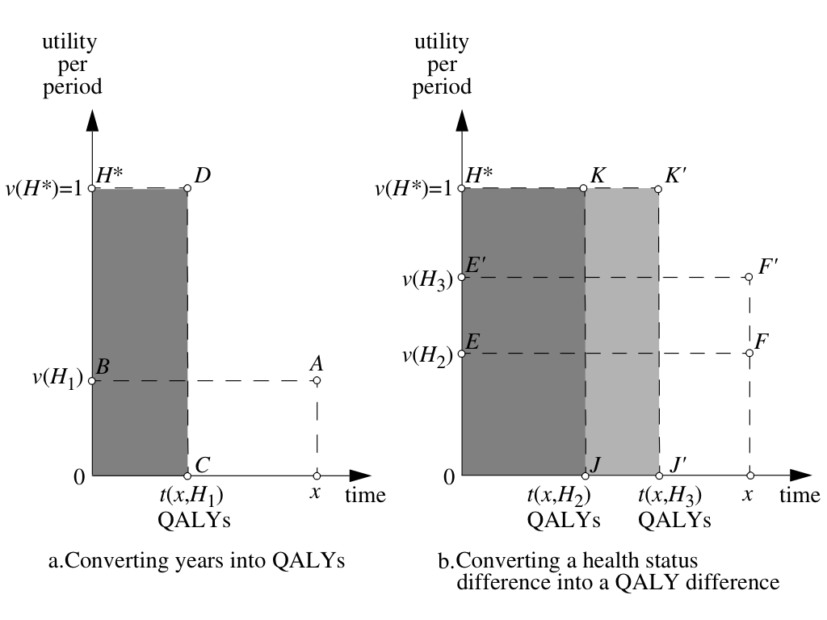

Slide 28
QALYs and the EQ-5D
Area under the curve (assumes linear progression)
Year 1= (U0+U1)/2= (0.238+0.748)/2=0.493 QALYs
Year 2= (U1+U2)/2= (0.748+0.814)/2=0.781 QALYs
Year 3= (U2+U3)/2= (0.814+0.843)/2=0.8285 QALYs
Sum=2.1025 QALYs (note this is smaller than 3 years)

Slide 29
QALYs and the EQ-5D
Area under the curve
Year 1= (U0+U1)/2= (0.238+0.748)/2=0.493 QALYs
Year 2= (U1+U2)/2= (0.748+0.814)/2=0.781 QALYs
Year 3= (U2+U3)/2= (0.814+0.843)/2=0.8285 QALYs
Sum=2.1025 QALYs (note this is smaller than 3 years)

Slide 30
Alternative utility weights
Rating scales
Visual Analogue Scales
Standard Gamble
Time Trade-Off

Slide 31
Alternative utility weights
Rating scales
Scale in which individuals assign a rating for a health state
Visual Analogue Scales
Single line with descriptions
Standard Gamble
Time Trade-Off

Slide 32
Alternative utility weights
Rating scales
Visual Analogue Scales
Standard Gamble
Probabilities assigned to health states
“Imagine you had a disease leaving you in health state H_{h} without treatment. The only treatment is free but would cure you with probability π or lead to death with probability (1- π)”
π varies until individual is indifferent between treatment and no treatment
Time Trade-Off

Slide 33
Alternative utility weights
Rating scales
Visual Analogue Scales
Standard Gamble
Value H_{h} at T= v(H_{h})T
With treatment:
(1- π*)xv(death)xt(death) +
π*xv(perfect health)xt(perfect health)
= π*xT
v_{sg}(H_{h})=(π*xT)/T= π*
Utility weight of H_{h} is π*
Also routed in expected utility
Compatible with risk attitudes (the T cancels)
Time Trade-Off

Slide 34
Alternative utility weights
Rating scales
Visual Analogue Scales
Standard Gamble
Time Trade-Off
Iterative procedure to determine indifference in health states
Individuals asked whether they would have treatment or not in hypothetical situations:
“Imagine you have a condition that results in health state H_{h} for T years if untreated. A treatment is available for free that cures you but shortens your life to t years”
Once individual is indifferent we obtain t
Trade off of quality of life for length of life

Slide 35
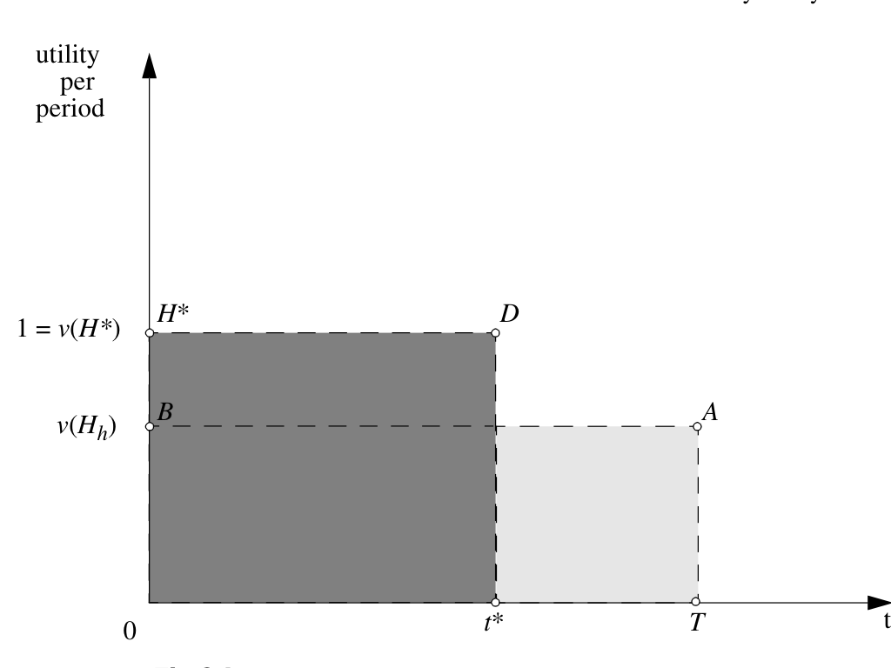

Slide 36
Alternative utility weights
Rating scales
Visual Analogue Scales
Standard Gamble
Time Trade-Off
Utility weight for health state H_{h} is: v_{tto}(H_{h})=t*(T,H_{h})/T
Uses expected valuations of life and hence expected utility theory
Unbiased if individuals are risk-neutral to remaining life
If risk-averse, then the trade-off would be a downward biased estimator of the true utility weight

Slide 37
Viewpoints

Slide 38
Viewpoints
The viewpoint is an extremely important factor in determining what benefits and costs to measure
Taking an NHS perspective, for example, may lead to shifting costs elsewhere (unemployment benefit? Pensions?)
From a welfare perspective it can be argued that the societal perspective should be taken. In CEA and CUA however, we may get different viewpoints for the numerator and denominator

Slide 39
Measuring costs
Drummond et al (2005) advocate a societal perspective since this is the broadest viewpoint and is always relevant
Gerard and Mooney (1993) however, argue that if we are maximising budgets, only costs relevant to the budget should be noted
Whilst a societal perspective is welfare maximising, it may not maximise NHS budgets
But does this mean therefore that we should not evaluate future costs because they form future budget levels?

Slide 40
Measuring benefits
Although costs tend to be taken at the provider level benefits are typically at a societal level
Weights used to transform QOL indicators into QALYs are usually taken from social values rather than those of patients
Why might they differ?
Individual in treatment v general public may value health states differently and have alternative preferences
Individual may not incorporate spill-over effects in their valuations
Bodies such as NICE have guidelines on the perspective to take

Slide 41
Estimating costs
The perspective is important when determining costs
Societal costs of an intervention will differ from a health care sectors costs
Need to
Identify changes in resource use
Quantify those changes
Value them
Rely on several constraints, most notably, data
Average costs may only be available (assumes providers are efficient and changes in quantity do not affect price!)
Shadow pricing may be imperfect (values on leisure time, caring)
Transparency and sensitivity analysis is key!

Slide 42
Discounting
Some times benefits and costs are far in the future
Discounting accounts for time preferences
Gives less weight for future events
Provides a present value (PV) of the intervention
PV=FV(1/(1+r)^{t})
Current HM Treasury (2003) rate for r is 3.5%
Positive time preferences are standard, people prefer now to the future
For comparison with private investments, we need to make sure alternatives are comparable else we overstate returns in public investment

Slide 43
Discounting
What about benefits?
Not discounting benefits overstates the effectiveness of an intervention and favours interventions with longer running benefit streams
NICE recommend discounting benefits at 3.5% (previously 1.5%)
Contentious on the grounds of health being a tradable good, individuals cannot trade health now for later like they can do money

Slide 44
Equity revisited
Recall the social maximisation issue – what viewpoint do we take?
CUA is essentially a welfarist approach, adopting individual level valuations of health interventions (note the importance of where the utility weights come from here)
Maximisation of QALYs has no factor for equity – who gets what?
Treating like for like may result in a less socially optimal outcome if society values equity (see welfarism slides)

Slide 45
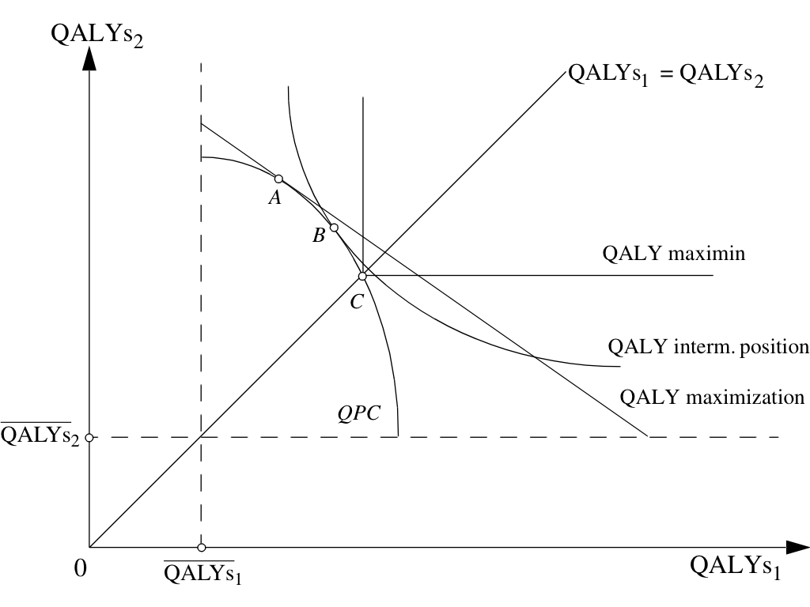

Slide 46
Which to use?
Neither CBA, CEA or CUA consider distribution concerns
Particular concern for policy makers concerned with equity
CUA/CEA can ONLY identify if an intervention should go ahead if there is a pre-determined threshold
How is the threshold chosen?
CEA is an extra-welfarist approach – only health related utility is captured, while CBA (and CUA) relies on wider (subjective) utility (welfarist)
CBA relies on assigning a monetary value to utility

Slide 47
Summary
There are three broad approaches to determining what should be provided with health care budgets (CEA, CUA, CBA)
Each have respective benefits and drawbacks
Each require information from individuals which may be open to bias
Each require normative judgements on the decision of what should be valued
Viewpoint is crucial for estimation of costs and benefits
Equity concerns are a key problem with evaluations

Slide 48
Housekeeping
Exam contains 5 questions
2 Eleonora’s
2 from Mario/Silviya’s
1 from Will’s
Answer 3, each weighed same (33 marks)
Econ 60432 semester 2 covers:
Topic 1 Equity in health and health care (WW)
Topic 2 Incentives and multitasking in health care (MP)
Topic 3 Methods for policy evaluation (SN)
Guest lecture: Microeconometric evaluations of incentive systems and reforms in the UK (MS)
Topic 4 Economics of health behaviours (EF)
Guest Lecture: Empirical studies of health at older ages (JB)

Slide 49
Good luck!!
We hope the course has been cost-effective
Unit assessments on Blackboard now ☺

